Slide 1
Disaster-related Child and Adolescent Mental Health (CAMH) Surveillance
Tabletop Exercise (TTX) Introductory Overview
Slides developed May 2026
Notes:
Call participants to order
Confirm the topic of exercise: Discussion-based Disaster CAMH Surveillance TTX

Slide 2
Agenda
Introductions
Project overview
  Background
  Objectives
  Scope
Discussion

Slide 3
Child and Adolescent Mental Health (CAMH) background

Slide 4
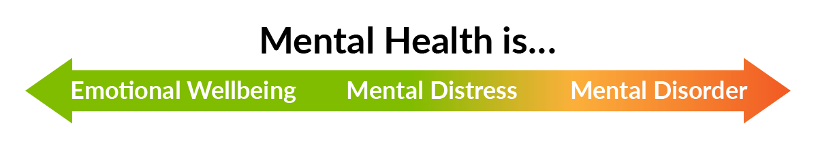
What is Child and Adolescent Mental Health?
All children and adolescents have mental health—and their mental health can be built, nurtured, promoted, and protected.
  Being mentally healthy during childhood means reaching developmental and emotional milestones, acquiring healthy social skills, and learning how to cope when there are problems.
  Mentally healthy children and adolescents have a positive quality of life and can function well at home, in school, and in their communities.

Slide 5

Child and Adolescent Mental Health (CAMH) resources
CDC and PHII collaboratively developed resources to build public health capacity to support CAMH surveillance. Community partners vetted the following resources through meetings and workshops:
  Using Data to Improve CAMH: The Opening Playbook
  CAMH User Stories
  Summary of laws and legal considerations related to CAMH data sharing
  CEU-accredited course on using data to improve CAMH surveillance
Notes:
CDC and PHII collaboratively developed a number of resources to build public health capacity to support CAMH vetted by community partners through meetings and workshops. These resources include:
Playbook
User Stories
Summary of laws and legal considerations related to data sharing
CEU accredited training
Visit their website to learn more.

Slide 6



Using Data to Improve CAMH: The Indicators
The CAMH Playbook highlights three indicators that are available and could potentially be shared with public health partners.
School Attendance
School Disciplinary Action
School Readiness
Notes:
In particular, the Playbook highlights three possible indicators of mental well-being for school-aged children that schools generally have available and could potentially be made available to public health partners.
school attendance,
disciplinary actions, and
school readiness
take a moment for the group to discuss these findings and the viability of these indicators

Slide 7
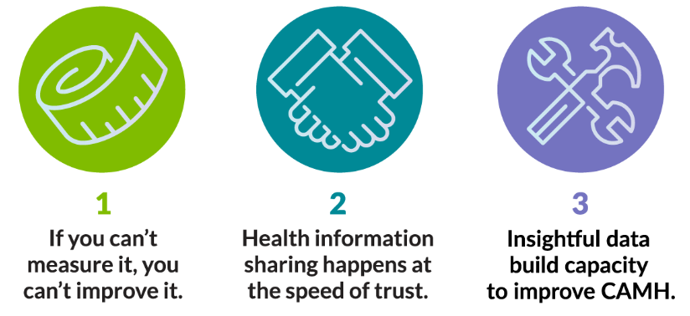
Three Key Truths
Notes:
The playbook also emphasizes three key truths: the importance of data and the acknowledgement that data flows at the speed of trust and the recognition that the use of data to make informed decisions can lead to improved outcomes for CAMH. We hope that today’s activity can help to increase understanding around the value of data and the importance of trust among partners.

Slide 8
Why Disaster-related CAMH Surveillance?
The mental health of children and adolescents can vary over time, in different conditions, and at different ages.
Natural disasters can lead to significant psychological distress, interrupt access to mental health services, and exacerbate existing conditions
Surveillance of CAMH is critical to inform targeted interventions and effectively allocate resources
Establishing plans and partnerships in advance aids in execution of CAMH surveillance activities
Notes:
Review the bullets on the slide:
The mental well-being of school age children from 5 to 17 years of age is a growing critical public health issue
Natural disasters can lead to significant psychological distress, interrupt access to mental health services, and exacerbate existing conditions
Surveillance of CAMH is critical to inform targeted, effective interventions

Slide 9
Conducting a Disaster-related CAMH Surveillance Tabletop Exercise (TTX)
Notes:
We are now going to start with inject #1, which will focus on the period of time about 7 to 10 days prior to a natural disaster.

Slide 10
Disaster-related CAMH Surveillance Framework and Situation Manual overview
In 2025, PHII in collaboration with CDC, developed 2 additional resources in support of disaster-related CAMH Surveillance that were pilot tested with local health departments:
A CAMH Disaster-related Surveillance Framework (aka, Framework) with information on key indicators, relevant datasets, situational awareness, and resource allocation.
A CAMH Disaster-related Surveillance Situation Manual (aka, SITMAN) with 3 tabletop exercise (TTX) injects focused on CAMH surveillance before, during, and after a natural disaster at the community level.
Notes:
The Public Health Informatics Institute (PHII) in collaboration with the Centers for Disease Control and Prevention (CDC) developed two resources to support state, tribal, local, and territorial (STLT) public health agencies in collecting, leveraging, and strategically using surveillance data to identify and monitor CAMH before, during, and after disasters and inform public health decision-making, preparedness efforts, and response strategies.
The two resources are: 1) the CAMH Disaster Surveillance Framework, which we will refer to as simply “the Framework”; and 2) the CAMH Disaster Surveillance Situation Manual – also known as the SITMAN.

Slide 11
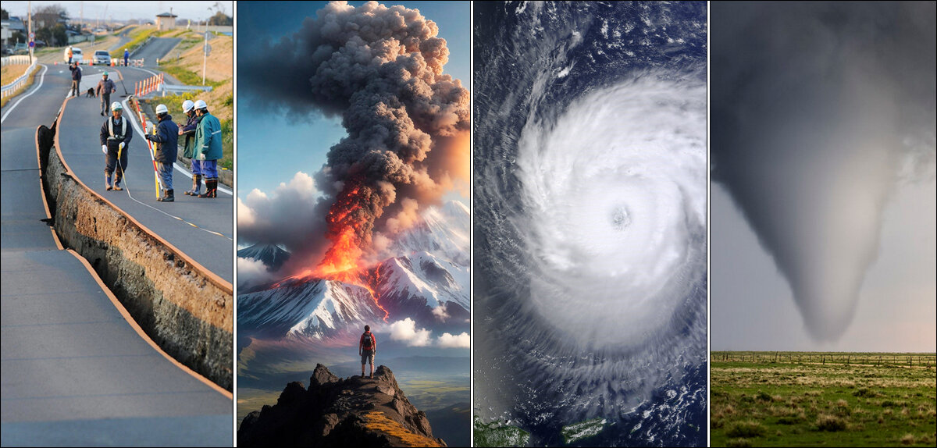
How do we define a natural disaster?

Slide 12
Objectives aligned with core capabilities
01
Gain experiential learning in using discussion-based exercises to explore disaster-related CAMH surveillance
Community Preparedness
Community Recovery
02
Assess how jurisdictions coordinate CAMH disaster surveillance with internal and external partners
Emergency Operations Coordination
03
Public Health Surveillance and Epidemiological Investigation
Identify gaps and issues in STLT (state, tribal, local, and territorial) CAMH surveillance plans
04
Discuss the ability to deliver coordinated, reliable, and actionable CAMH information to communities
Information Sharing
Notes:
On this slide, you can see the alignment. For example, objective 1 is aligned with the capabilities of community preparedness and emergency operations…… (and so forth)
* include comment about PHEP discussions related to requirements

Slide 13
Tabletop Exercise aligned with Response Readiness Framework outlined by PHEP
Partnerships
Addressing disproportionately affected populations (i.e., children)
Risk communication
Data modernization
Recovery–including behavioral health needs for the community
Using the SITMAN to execute a tabletop exercise (TTX) can help jurisdictions meet the 2024-2028 PHEP requirements.
Notes:
also wanted to share that the child and adolescent disaster mental health surveillance tabletop exercises align with the 5 central Response Readiness Framework (RRF) program priorities outlined by Public Health Emergency Preparedness (PHEP) for inclusion in a natural disaster discussion-based exercise:
Partnerships
Addressing disproportionately affected populations (i.e., children)
Risk communication
Data modernization
Recovery – including behavioral health needs for the community
Participating as a pilot site can help jurisdictions meet the 2024-2028 PHEP requirements for a natural disaster exercise.

Slide 14
Exercise structure
1. Before
7-10 days prior to a natural disaster
Discussion-based, facilitated exercise
Three injects that can be used together or inserted into a larger scale TTX
  Each inject has two main activities:
  (1) scenario overview and (2) facilitated discussion based on a set of questions
  Each inject is approximately 45 to 60 minutes long
3. After
2. During
90 days after disaster
96 hours after disaster
Notes:
The TTX is a discussion-based, facilitated exercise incorporating a scenario with three phases to examine the operational response of [insert organizations] to a natural disaster in your area.
We will consider and discuss CAMH surveillance issues related to the period of time before, during and after a natural disaster.
Each phase will consist of two main activities: a scenario inject and a facilitated discussion session.
The scenario inject will include specific considerations related to CAMH disaster surveillance.
The discussion will occur among all players based on a set of questions posed by the facilitators.

Slide 15




Exercise roles
Players
Observers
Subject matter experts
Evaluator/Notetaker
Engage in discussion and ask questions based on their direct role in disaster response
Support the group by providing perspective from outside the direct line of response
Provide technical and scientific information, as needed
Document the discussion without interrupting the flow of the exercise
Notes:
During the TTX, everyone has a role. For example:
Players engage in discussion and ask questions based on their direct role in disaster response
Observers support the group by providing perspective from outside the direct line of response
Subject matter experts provide technical and scientific information, as needed
Evaluators or notetakers document the discussion without interrupting the flow of the exercise

Slide 16
Funding statement and additional resources
The resources for this exercise were developed by the Public Health Informatics Institute (PHII), through funding from the Centers for Disease Control and Prevention (CDC) of the U.S. Department of Health and Human Services (HHS) under grant number 5 NU38PW000002.
Additional resources related to this work can be found at
phii.org/camh-resources/
Notes:
The resources for this exercise were developed by the Public Health Informatics Institute, through funding from the Centers for Disease Control and Prevention (CDC) of the U.S. Department of Health and Human Services (HHS) under grant number 5 NU38PW000002. Any information, content and expressed conclusions are those of the author and should not be construed as the official position or policy of, nor should any endorsements be inferred by CDC, HHS or the U.S. Government.

Slide 17

Questions and Answers

