Slide 1


Implementing Automated Audiology Concept Extraction Application to Support Public Health Reporting
Project Champion Talking Points
2026

Slide 2


Acknowledgements
The proposed solution was made possible through coordination by the Public Health Informatics Institute (PHII) and supported by cooperative agreement number NU38PW000002, funded by the Centers for Disease Control and Prevention (CDC). PHII undertook this work under the guidance of the CDC’s Early Hearing Detection and Intervention (EHDI) program. Some of the slides in this presentation were created using generative artificial intelligence. Human in-the-loop verification was used to ensure accuracy.
The project engaged technical experts and clinical healthcare professionals who generously contributed their time and expertise through meetings, phone calls, testing sessions, and development. Contributors to this project include:
Amazon Web Services (AWS)
Association of Public Health Laboratories (APHL)
Boston Children’s Hospital (BCH)
California Polytechnic Institute Digital Transformation Hub (CalPoly)
Centers for Disease Control and Prevention (CDC)
Mass Eye and Ear (MEE)
Massachusetts Universal Newborn Hearing Screening Program
Public Health Informatics Institute (PHII)
Notes:
The proposed solution was made possible through the support of multiple organizations. The Public Health Informatics Institute coordinated efforts in partnership with the CDC through a cooperative agreement. PHII undertook this work under the guidance of the CDC’s Early Hearing Detection and Intervention (EHDI) program. The solution development and testing phases engaged partners from Amazon Web Services, Boston Children’s Hospital, California Polytechnic Institute Cloud Innovation Center, Mass Eye and Ear, and the Massachusetts Universal newborn hearing screening program.

Slide 3
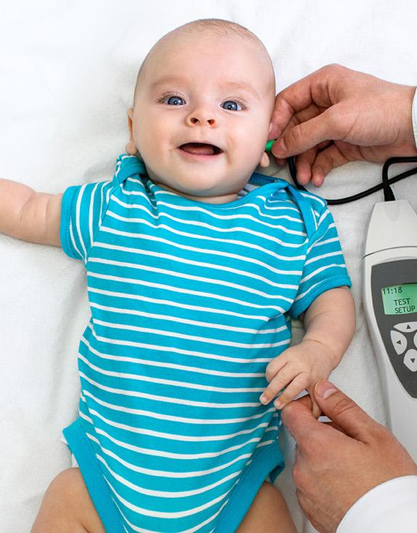
Agenda
Introduction
Background
Value proposition
Automated Audiology Concept Extraction (AACE) solution
Summary
Next steps

Slide 4
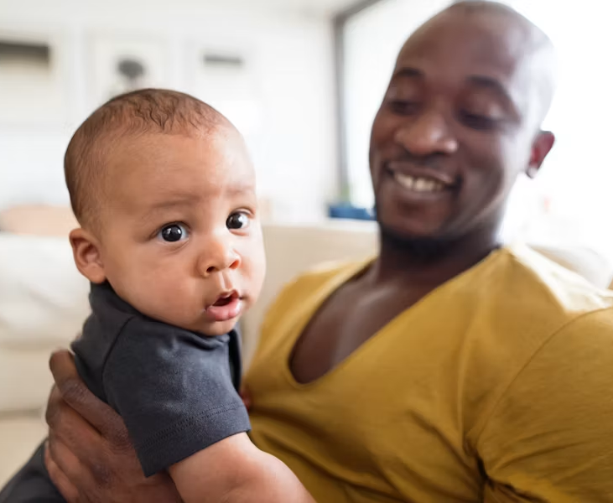
Introduction
<<Update this slide>> Project Champion Name
Why this project is important to me
How does it align with broader goals within the organization
Notes:
Use this time to introduce yourself and provide an overview of why this project is important to you. This could be clinical reasons or to benefit the hospital (see later slides)

Slide 5
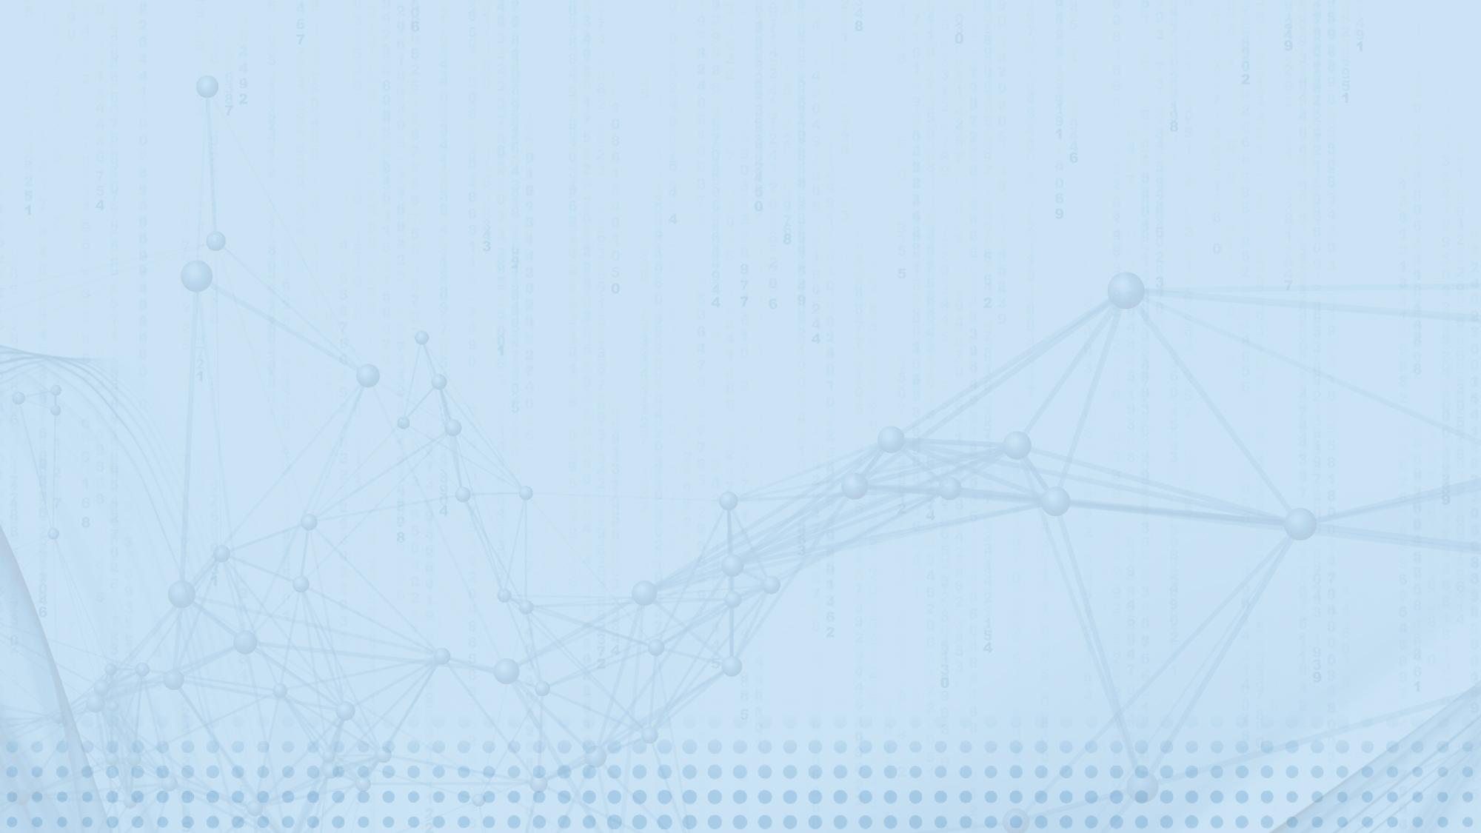
Background

Slide 6
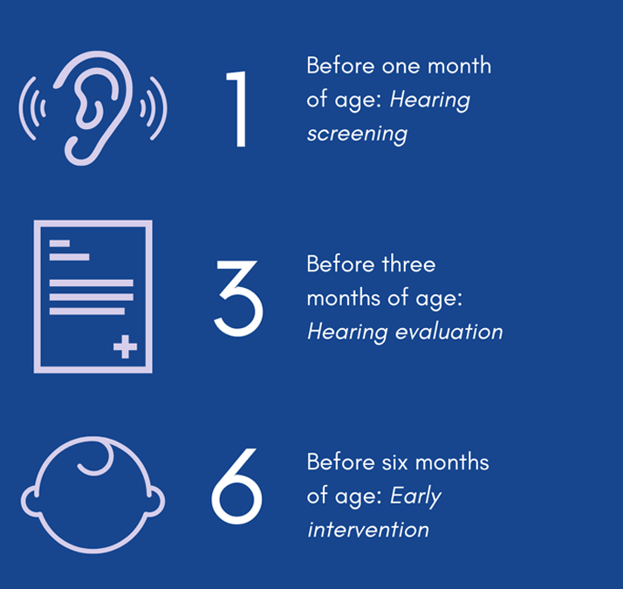
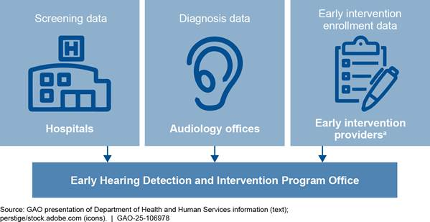
Early Hearing Detection and Intervention (EHDI)
Notes:
To provide some background on the topic at hand, EHDI stands for Early Hearing Detection and Intervention. It is a national program with the goal of identifying infants with hearing loss as early as possible to provide appropriate intervention services.
Hearing loss can affect a child’s ability to develop speech, language, and social skills. Early identification and intervention increases likelihood of reaching their full potential.
Recommended Early Hearing Detection and Intervention (EHDI) benchmarks include screening for hearing loss before 1 month of age, diagnostic evaluation before 3 months of age, and enrollment in early intervention before 6 months of age, These are known as the 1-3-6 benchmarks. The data from these steps are shared with state EHDI program offices. State EHDI programs rely on hospitals and audiology providers to report data to achieve these benchmarks.
The proposed solution was developed to support audiology providers in reporting diagnostic data.

Slide 7
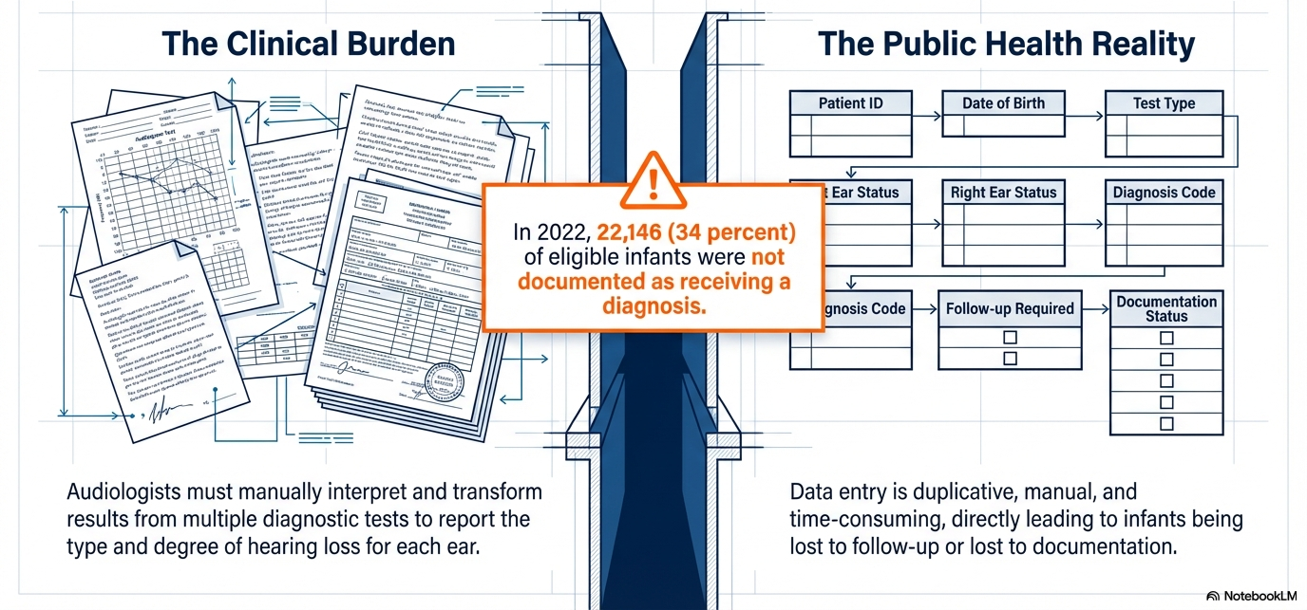
Reporting challenge for EHDI Programs
Notes:
Early Hearing Detection and Intervention (EHDI) programs rely on reporting from audiology providers to track and ensure that infants who are deaf or hard-of-hearing are identified and connected to early intervention services. However, in many jurisdictions, there is often under-reporting of diagnostic audiology reports due in part to manual interpretation and time-consuming data entry requirements. Audiologists have to translate information from multiple visits, tests and narrative reports into specific categorical values required for public health reporting. These values traditionally do not exist in the audiologist’s electronic health record systems.
In 2022, 34% (22,146) of infants who did not pass their hearing screen were either lost to follow-up (meaning they did not receive services) or lost-to documentation (meaning they received services but public health reporting did not occur).

Slide 8

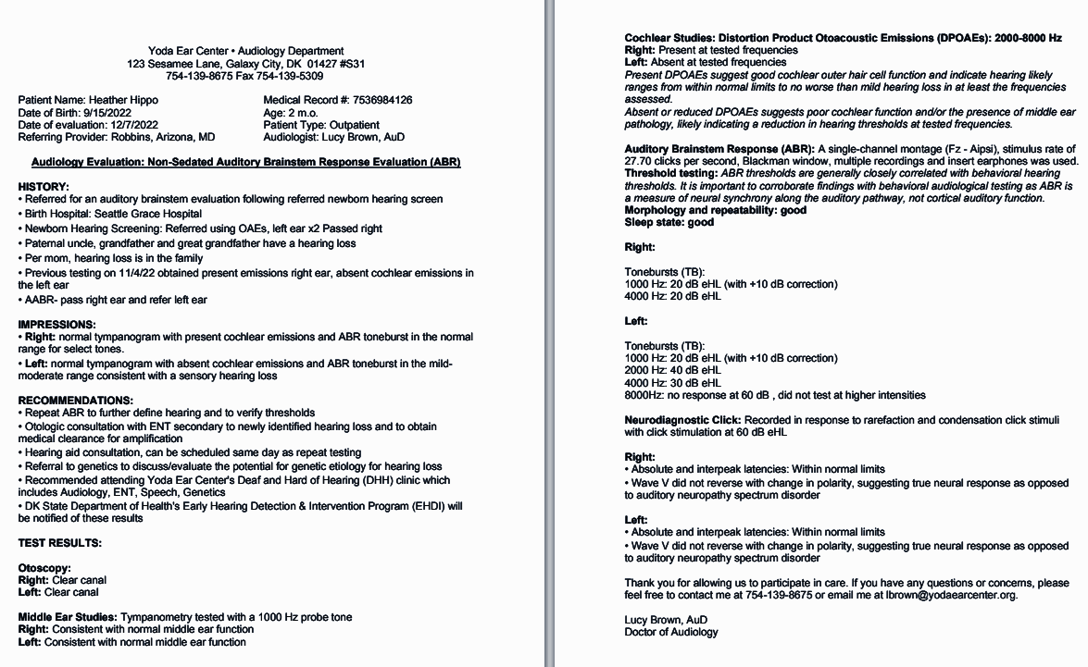
Discussion: current workflow of reporting
In your hospital, what is the
current workflow for public health reporting on diagnostic exams for infants who did not pass the newborn hearing screen?
Notes:
Open forum to discuss what the current state of reporting looks like for your specific area.

Slide 9
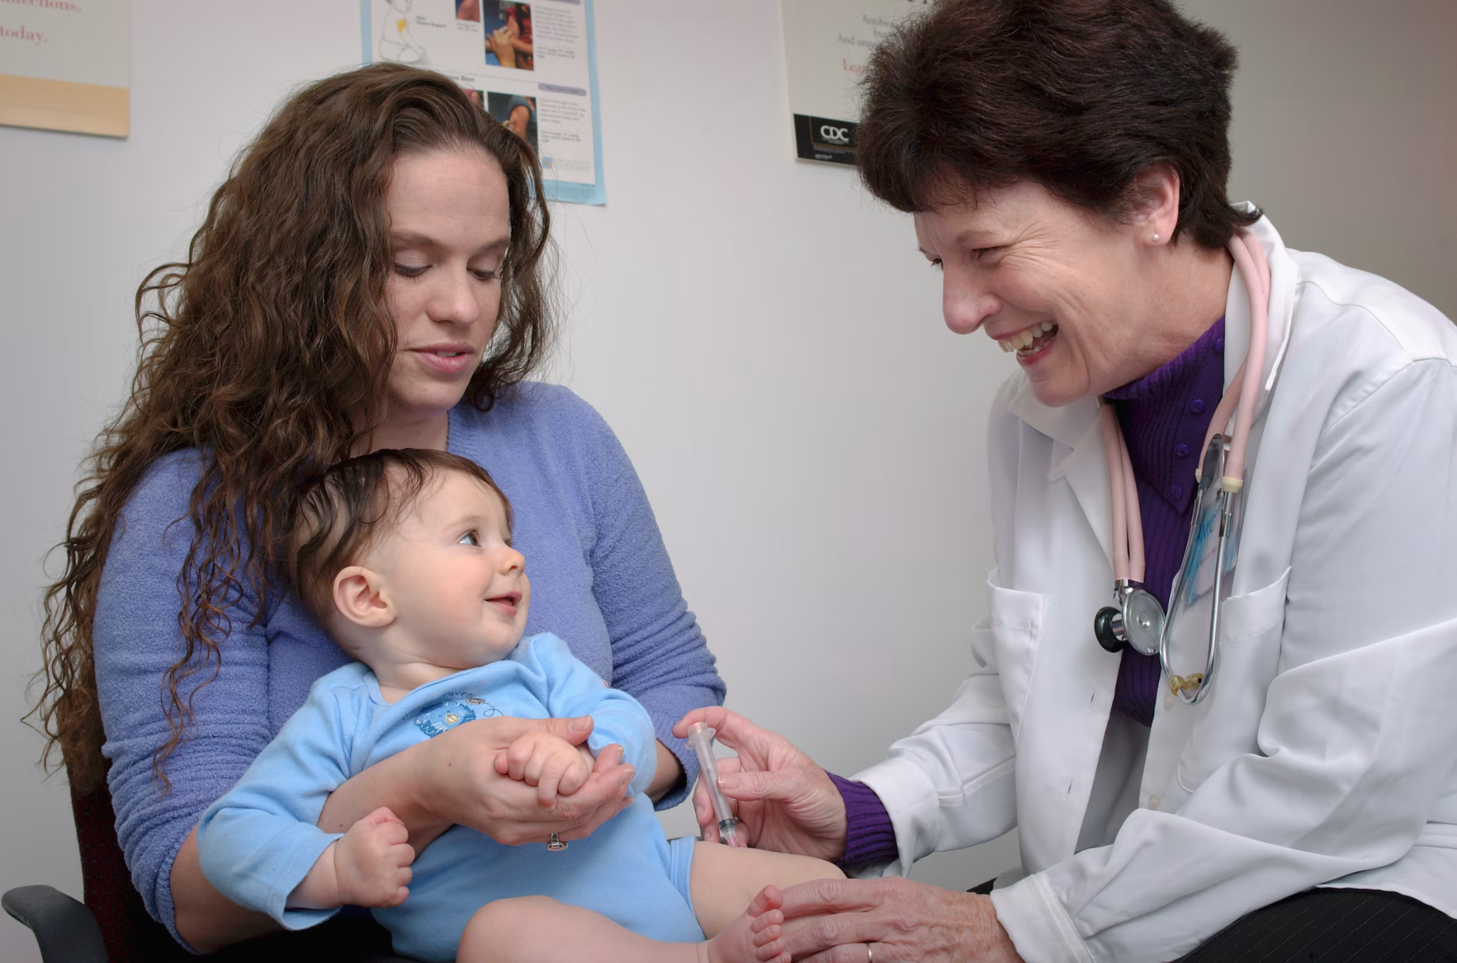
Automated Audiology Concept Extraction solution goal
Reduce rates of lost to follow-up (LFU) and lost to documentation (LTD)
Reduce burden of reporting for audiologists
Aligns with strategic priorities around data quality and digital transformation
Shift focus to patient-centered care, rather than data entry
Notes:
The goal of the AACE solution is to
Reduce rates of lost to follow-up, where newborns are not receiving recommended follow-up services and lost to documentation, where a newborn does in fact receive the recommended services but the required reporting is not getting to public health
Reduce burden of reporting for audiologists
Aligns with strategic priorities around data quality and digital transformation
Align with the clinical priorities of giving providers back time to focus on clinical care, rather than do data entry

Slide 10

Why use generative artificial intelligence (GenAI) for audiology reporting?
Reduce manual efforts and processes
Automate data collection and streamline data entry
Take clinical notes and translate them into the data elements needed for public health reporting
Ensure standardized reporting from clinical records to public health
Notes:
The primary objective is to ease the reporting burden on audiologists and reduce the LTF and LTD rates for infants and children who are DHH. This is achieved using generative AI, a trained LLM, to interpret clinical audiology notes and test results from the electronic health record, generating the categorical values needed for reporting to jurisdictional EHDI programs. The verified results are formatted to meet the state-specific reporting requirements and sent to the EHDI information system. This saves the audiologist from duplicative data entry processes that are currently in place in most jurisdictions

Slide 11
Automated Audiology Concept Extraction (AACE) solution

Slide 12
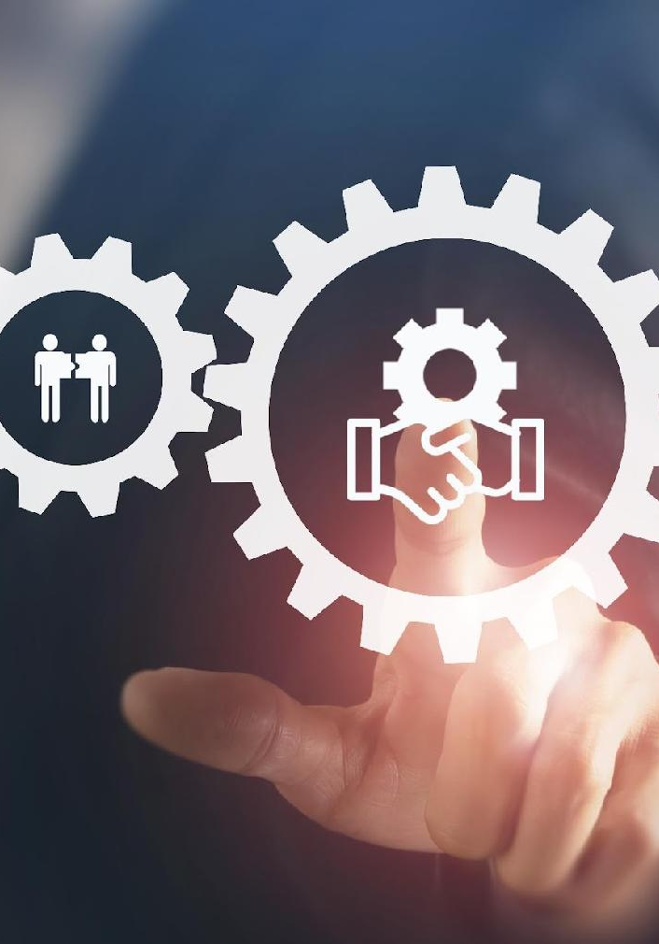
AACE solution approach
Project partners developed and tested
an open-source solution leveraging GenAI—paired with reasoning logic
and human-in-the-loop validation, to streamline workflows while maintaining the scientific rigor required for audiology reporting
Notes:
The project partners developed and tested an open-source solution leveraging generative AI, paired with reasoning logic and human-in-the-loop validation, to streamline workflows while maintaining the scientific rigor required for audiology reporting

Slide 13
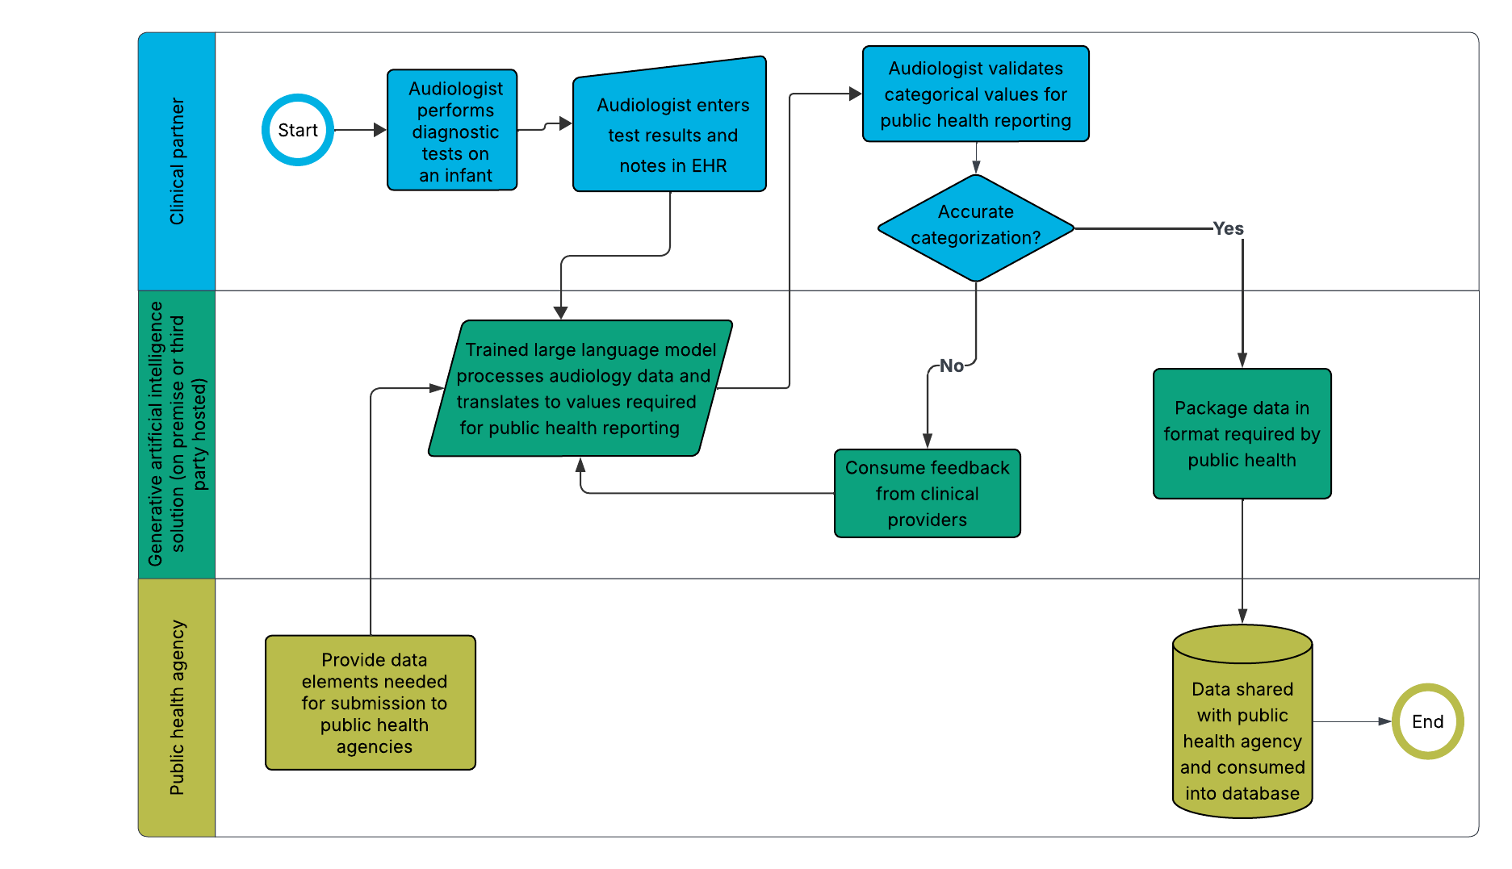
How does the GenAI solution work?
Notes:
The solution takes audiology data in the EHR and runs it through a configurable logic engine in a trained LLM to generate an outputs that reflect clinical rules and public health requirements specific to the jurisdiction. The solution provides documented reasoning for validation of solution outputs. Once validated, the solution delivers the results to public health.
The logic engine would be need to be configured and the overall solution tested for each specific implementation, given the differences in clinical data and public health reporting requirements.

Slide 14
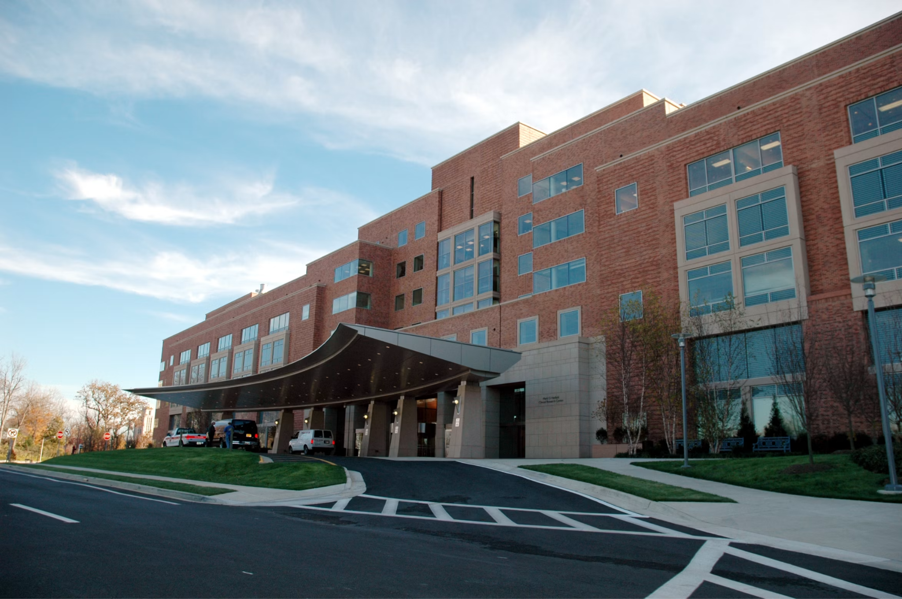
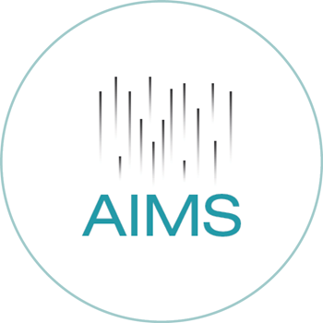
Scalability option—on premise or externally hosted
Host in our internal Amazon Web Services (AWS) environment
Connect with trusted third party instance, AIMS currently used by eHealthExchange for electronic case reporting (eCR) to public health
AIMS - Association for Public Health Laboratories (APHL) Informatics Messaging Service
Notes:
This project requires coordination across partners. The Public Health Informatics Institute provides documented resources to support this project. Your jurisdictions EHDI program will provide the public health reporting requirements to configure the solution. The clinical partner provides the raw audiological data and the expertise for output validation.
There are two options for implementation of the solution. The solution is open-source and the code is publicly available via the California Polytechnic State University’s GitHub page. To offer a scalable option for the solution, the Association of Public Health Laboratories is exploring the possibility of hostingthe solution on a shared service called the APHL Informatics Messaging Services (AIMS) platform. This platform has established connections to healthcare and public health through its existing work with electronic case reporting and electronic lab reporting. Hosting the solution on the AIMS platform would eliminate the need for each clinical partner to install the solution and allow implementation time to be spent validating the clinically specific data inputs and confirming alignment with public health reporting requirements.

Slide 15
Project steps for the Audiology Reporting project
Milestone | On premise | Third party (APHL) hosted
Execute data sharing agreement |  | Clinical partner/APHL
Install, configure, and maintain solution | Clinical partner | APHL
Connect to third party |  | Clinical partner/APHL
Package EHR data | Clinical partner | Clinical partner
Validate and test solution | Clinical partner | Clinical partner
Refine large language model (LLM) configuration | Clinical partner | Clinical partner/APHL
Package results | Clinical partner | APHL
Connect to public health | Clinical partner | APHL
Notes:
What are the roles and responsibilities for the technical implementation when a third party hosts the solution?
A a.
Clinical partner: Provides subject matter expertise on audiologist reporting workflows and key sources of data input. Verifies connectivity with the trusted third party. Generates test data and validates the solution accuracy. Receives necessary approvals to input data into the solution.
Public health partner: Provides subject matter expertise on state EHDI program reporting workflows and required data elements. Verifies connectivity with the trusted third party. Participates in testing to review extract data files and provide feedback on implementation plausibility. Works to consume the solution outputs electronically into the EHDI information system.
Trusted third party: Hosts the open-source solution on a common platform. Verifies connectivity with clinical and public health partners. Conducts testing and validation.
Leadership, IT, and legal at all partner sites: Secures approval to dedicate staff time, implement the solution, and share data.
Q b. What are the roles and responsibilities for the technical implementation when the clinical partner hosts the solution?
Clinical partner: Provides subject matter expertise on audiologist reporting workflows and key sources of data input. Hosts the open-source solution on a common platform. Verifies connectivity with the public health partner. Generates test data and validates the solution accuracy. Receives necessary approvals to input data into the solution.
Public health partner: Provides subject matter expertise on state EHDI program reporting workflows and required data elements. Verifies connectivity with the trusted third party. Participates in testing to review extract data files and provide feedback on implementation plausibility. Works to consume the solution outputs electronically into the EHDI information system.
Leadership, IT, and legal at all partner sites: Secures approval to dedicate staff time, implement the solution, and share data.

Slide 16
Why should we do this project?

Slide 17
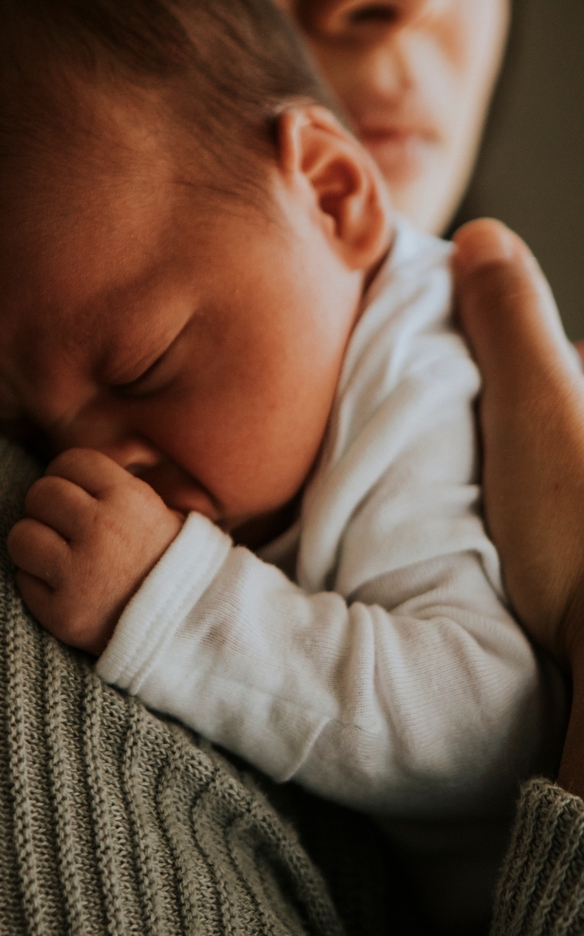
Public health impact
The use of GenAI and trained LLMs has the potential to:
improve timeliness of reporting to EHDI programs
support newborns who are deaf or hard of hearing (DHH) to achieve speech and language milestones
Notes:
Close out the presentation bringing people back to the why behind this work. The use of generative AI and trained large language models has the potential to:
reduce documentation burden for audiologists
improve timeliness of reporting to EHDI programs
support newborns who are deaf and hard of hearing to achieve speech and language milestones

Slide 18
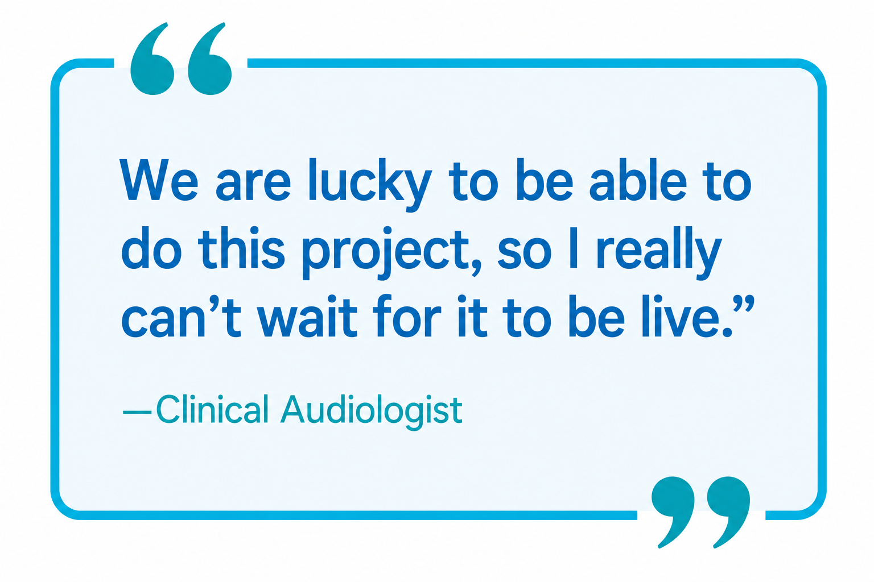
Hospital impact
Accelerates progress towards hospital priorities including:
  quality improvement
  patient-centered care
  digital transformation goals
Reduces clinical documentation burden
Supports clinician well-being, which leads to improved staff retention and reduced burnout
Notes:
Close out the presentation bringing people back

Slide 19

Build the case
Determine if this solution is right for you
by doing the following:
  Clarify the problem you are trying to solve (e.g., duplicative data entry, reduced rate of lost to documentation)
  Document the current workflow to
  enter diagnostic test results into the electronic health record
  Document the workflow for reporting
  to public health
Notes:
If you haven’t done so already, a good next step is to build a business case for this work by conducting a current state review of your workflows and needs assessment to better understand the program you are trying to solve.
There are additional resources to support this project

Slide 20
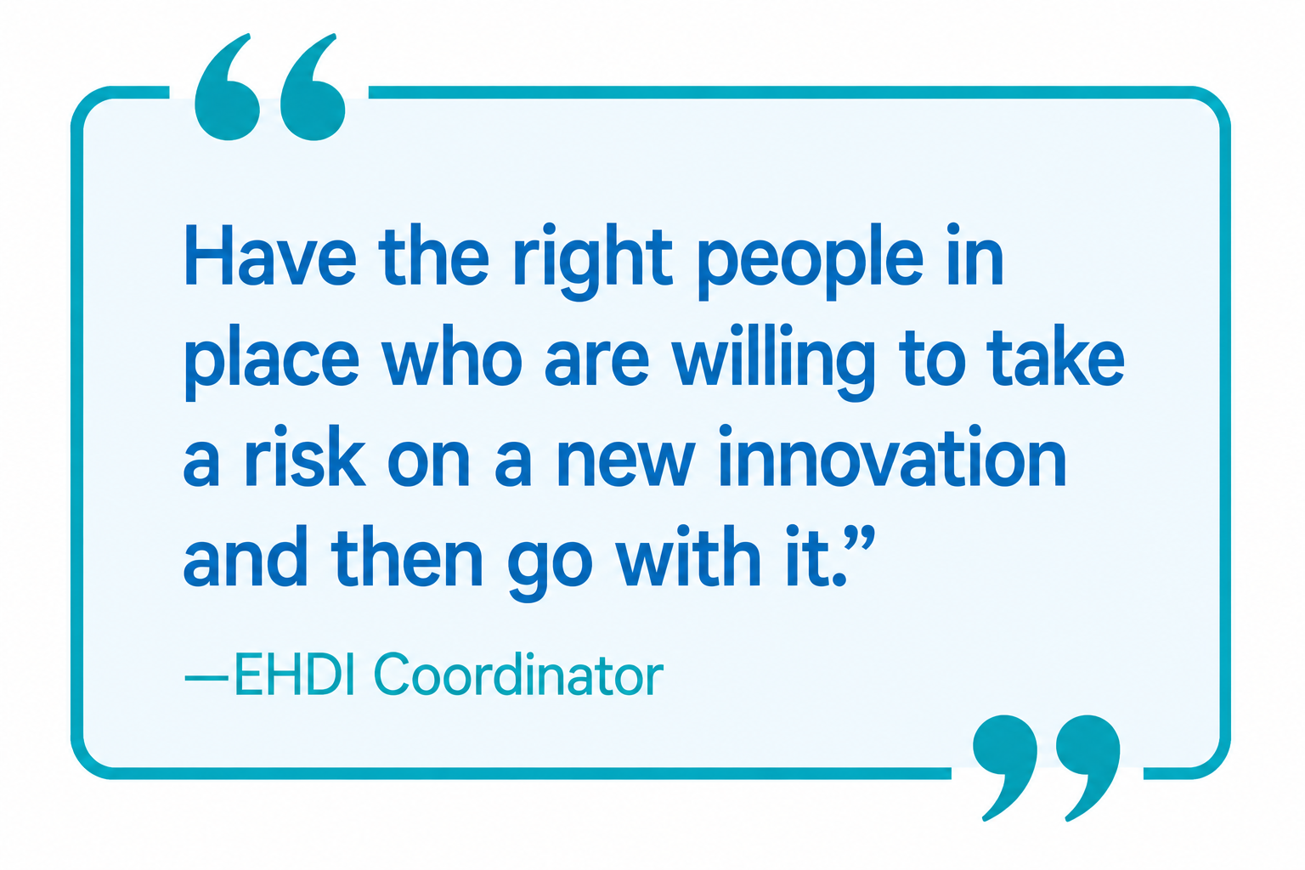
Who should you involve in this process?
Key team members include
  Leadership
  Audiology
  IT groups (EHR, Cloud, Clinical
  informatics, Data Science)
  Cybersecurity
  Legal
  Public Health
Notes:
It is important to get decision makers involved early. A good next step is to discuss this internally with these suggested teams.

Slide 21

Next steps
Establish a project team
Decide on internal or external hosting
Visit the GitHub site
Establish a project kickoff date and prepare for that!
Contact PHII with any questions
  info@phii.org
Notes:
If you haven’t done so already, a good next step is to build a business case for this work by conducting a current state review of your workflows and needs assessment to better understand the program you are trying to solve.
There are additional resources to support this project

Slide 22



Questions

Slide 23
Learn more about this project
Technical Overview
Watch the Technical Overview video (MP4)
Audiology Classification Overview
Watch the Audiology Classification Overview video (MP4)
PHII resources
Visit the PHII EHDI resources page
GitHub Resource of the Cal Poly DxHub Audiology API
View the GitHub repository

