Slide 1

Strategic Sustainability and IIS Budget
Public Health Informatics Institute (PHII) IIS Leadership Workshop
Jennifer Ratliff
Public Health Analyst (PHA)I
Informatics and Data Analytics Branch (IDAB)
Immunization Services Division (ISD)
National Center for Immunization and Respiratory Diseases (NCIRD)
Centers for Disease Control and Prevention (CDC)
June 9, 2026

Slide 2
Strategic Sustainability and IIS Budget Objectives
objectives
At the end of this segment, you will be able to:
  Define strategic sustainability
  Understand possible funding opportunities
  Explore ways to diversify funding
  Consider cost-sharing and cost-lowering approaches
  Identify how to best make decisions in the context of long-term sustainability
  Understand the components of an IIS budget

Slide 3

Sustainability Starts with the Value of the IIS
Strategic Sustainability and IIS Budget

Slide 4




IISs are Essential to Immunization Programs and Others
The value of iis
ELEVATE
JURISDICTION HEALTH DEPARTMENTS
ENABLE
CDC AND US GOVERNMENT
Manage the Vaccines for Children program—ordering, inventory management, provider assessment, clinical decision support
Monitor vaccine uptake, vaccination patterns, and areas of low coverage at local and regional levels
Develop approaches to improve and sustain equitable vaccination coverage
Create a strong foundation to respond quickly to public health emergencies
Monitor vaccine uptake, vaccination patterns, and areas of low coverage at national level using timely data
Develop approaches to improve and sustain equitable vaccination coverage
Link immunization data to other record-level data to assess trends and make informed decisions
EQUIP
HEALTH CARE PROVIDERS
EMPOWER
INDIVIDUALS
Coordinate patient care across multiple providers and give recommendations for safe and effective care
Administer the Vaccines for Children (VFC) program including enrolling VFC participants, ordering and managing vaccine inventory, monitoring vaccine administration, and conducting patient outreach
Securely access complete, electronic records to understand vaccination needs and to provide proof of vaccination

Slide 5












IISs are Central to a Complex Immunization Data Ecosystem
The value of iis
Providers collect immunization data using standards-based electronic health systems
IIS collect, consolidate, analyze, and report data using best practices, standards, and tools
Stakeholders use IIS data to make decisions and drive action
Hospitals, Clinics, & Doctor’s Offices*
CDC and US Government*
Emergency response coverage (RVR, COVID reports)
Routine coverage assessments
Identifying communities needing intervention
Pharmacies
64 Jurisdiction Immunization Information Systems
IZ Gateway
IZ Gateway
Health Care Providers*
Patient assessment
Vaccination reminders
Proof of vaccination
Workplaces*
Public Health Departments
Jurisdiction Health Departments*
Population health assessments
Targeting interventions
VFC participation (orders, inventory mgmt., quality improvement, provider assessment)
Federal Agencies*
Individuals*
Consolidated vaccination records
Reminders
Proof of vaccination
*CDC’s IZ Gateway enables some data flow

Slide 6

Strategic sustainability is having a long-range view and plan so that you have clear priorities in place when funding opportunities arise and needs or priorities shift.

Slide 7
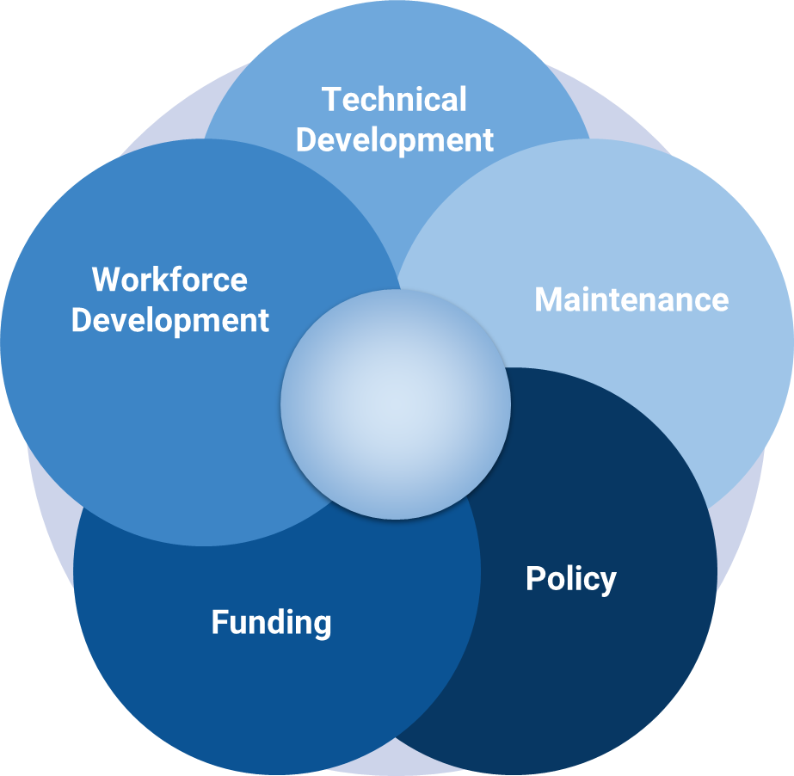
Strategic Sustainability Considerations
The value of iis
Technical Development – Modernization and enhancements
Workforce Development – Existing and future staffing
Maintenance – Technical infrastructure of the IIS, provider management and data quality monitoring
Policy – Data management and data sharing
Funding – Identification of existing and prospective sources

Slide 8

Strategic Sustainability is Critically Important
THE VALUE OF IIS
Jurisdictions rely heavily on federal cooperative agreement (CoAg) funds for their IIS, rather than a mix of diverse funding sources
Funding cycles boom and bust, making long-term planning challenging
COVID-19 set unprecedented expectations for IIS functionality and data
  Funding has decreased post COVID-19, but stakeholder expectations remain high
Strategic IT development takes long-term planning and sustainable funding

Slide 9

Discussion Questions
ACTIVITY
What impacts have recent federal and state budget cuts had on your jurisdiction, and how have you managed those impacts?
What IIS strategic sustainability topics are you interested in learning more about?​
What kind of assistance would help you find what you need?

Slide 10

IIS Funding
Strategic Sustainability and IIS Budget

Slide 11

CDC Supported IIS Funding
Iis funding
Strengthening Vaccine Preventable Disease Prevention and Response Immunization CoAg
IIS supports all aspects of the immunization program, most fund types (Discretionary (e.g., PPHF & 317), VFC, and Pan-Flu can be used for IIS)
Competitive component awards vary, current components are Outbreak Response and Larger Response
Other CDC opportunities: Public Health Infrastructure Grant (PHIG), preparedness response, surveillance, etc.

Slide 12
Data Modernization Funding Timeline and Progression
Iis funding
FY2020
FY2021
FY2023
FY2024
Initial DMI funding to 64 STLTs through ELC
Advancing Data Modernization in Jurisdictions through ELC
Public Health Infrastructure Grant (PHIG)
PHIG A3 Modernizing IIS Supplement
C1 – Health Information Systems
Funded annually, non-Data Modernization Initiative (DMI) funds
C2 – Data Modernization
$200M for 36 months across 3 funding tiers​
C2 – Data Modernization​
Electronic Case Reporting Expansion
National Vital Statistics System Modernization​
Project extended for additional 36 months as part of DMI Acceleration in May 2023 (Data Modernization 2 Supplemental Award)
Data Modernization funded under Strategy A3​ - Core, LDX, and DMI Acceleration (May 2023)
Additional Supplemental funding – December 2023
IIS Data Modernization funded under Strategy A3​ - September 2024
End date November 2027

Slide 13
Public Health Infrastructure Grant (PHIG) Context
Iis funding
PHIG funding previously allowed IIS related modernization efforts while also focusing on other modernization needs.
PHIG A3 Modernizing IIS (MIIS) is solely focused on IIS modernization efforts.
PHIG jurisdictional leadership operates at the state level and has been established since the inception of PHIG.
The degree of collaboration between Immunization Programs and state PHIG programs has varied.
Successful IIS modernization efforts will require close collaboration, strong communication, and coordination.

Slide 14
PHIG Data Modernization –
General and A3 IIS Modernization
Iis funding
Maintain, improve and modernize the approach to acquire, manage, share and use data for public health action to more effectively detect, respond, prevent and control diseases and conditions to protect public health and safety through five strategies:
Modernize IIS Technology
Data Quality and Management and Linkage
Workforce Development
Data Exchange and Interoperability
IIS Data Quality and Technical Certification

Slide 15
PHIG –
IIS Component A Supplemental By the Numbers
Iis funding
Supplemental funding is intended to accelerate and extend, but not duplicate DMI activities fully funded through other mechanisms.​
37
63
$188.55
MILLION
FOR IIS MODERNIZATION
MONTHS TO COMPLETE WORK
End: Nov. 30, 2027
APPLICATIONS

Slide 16
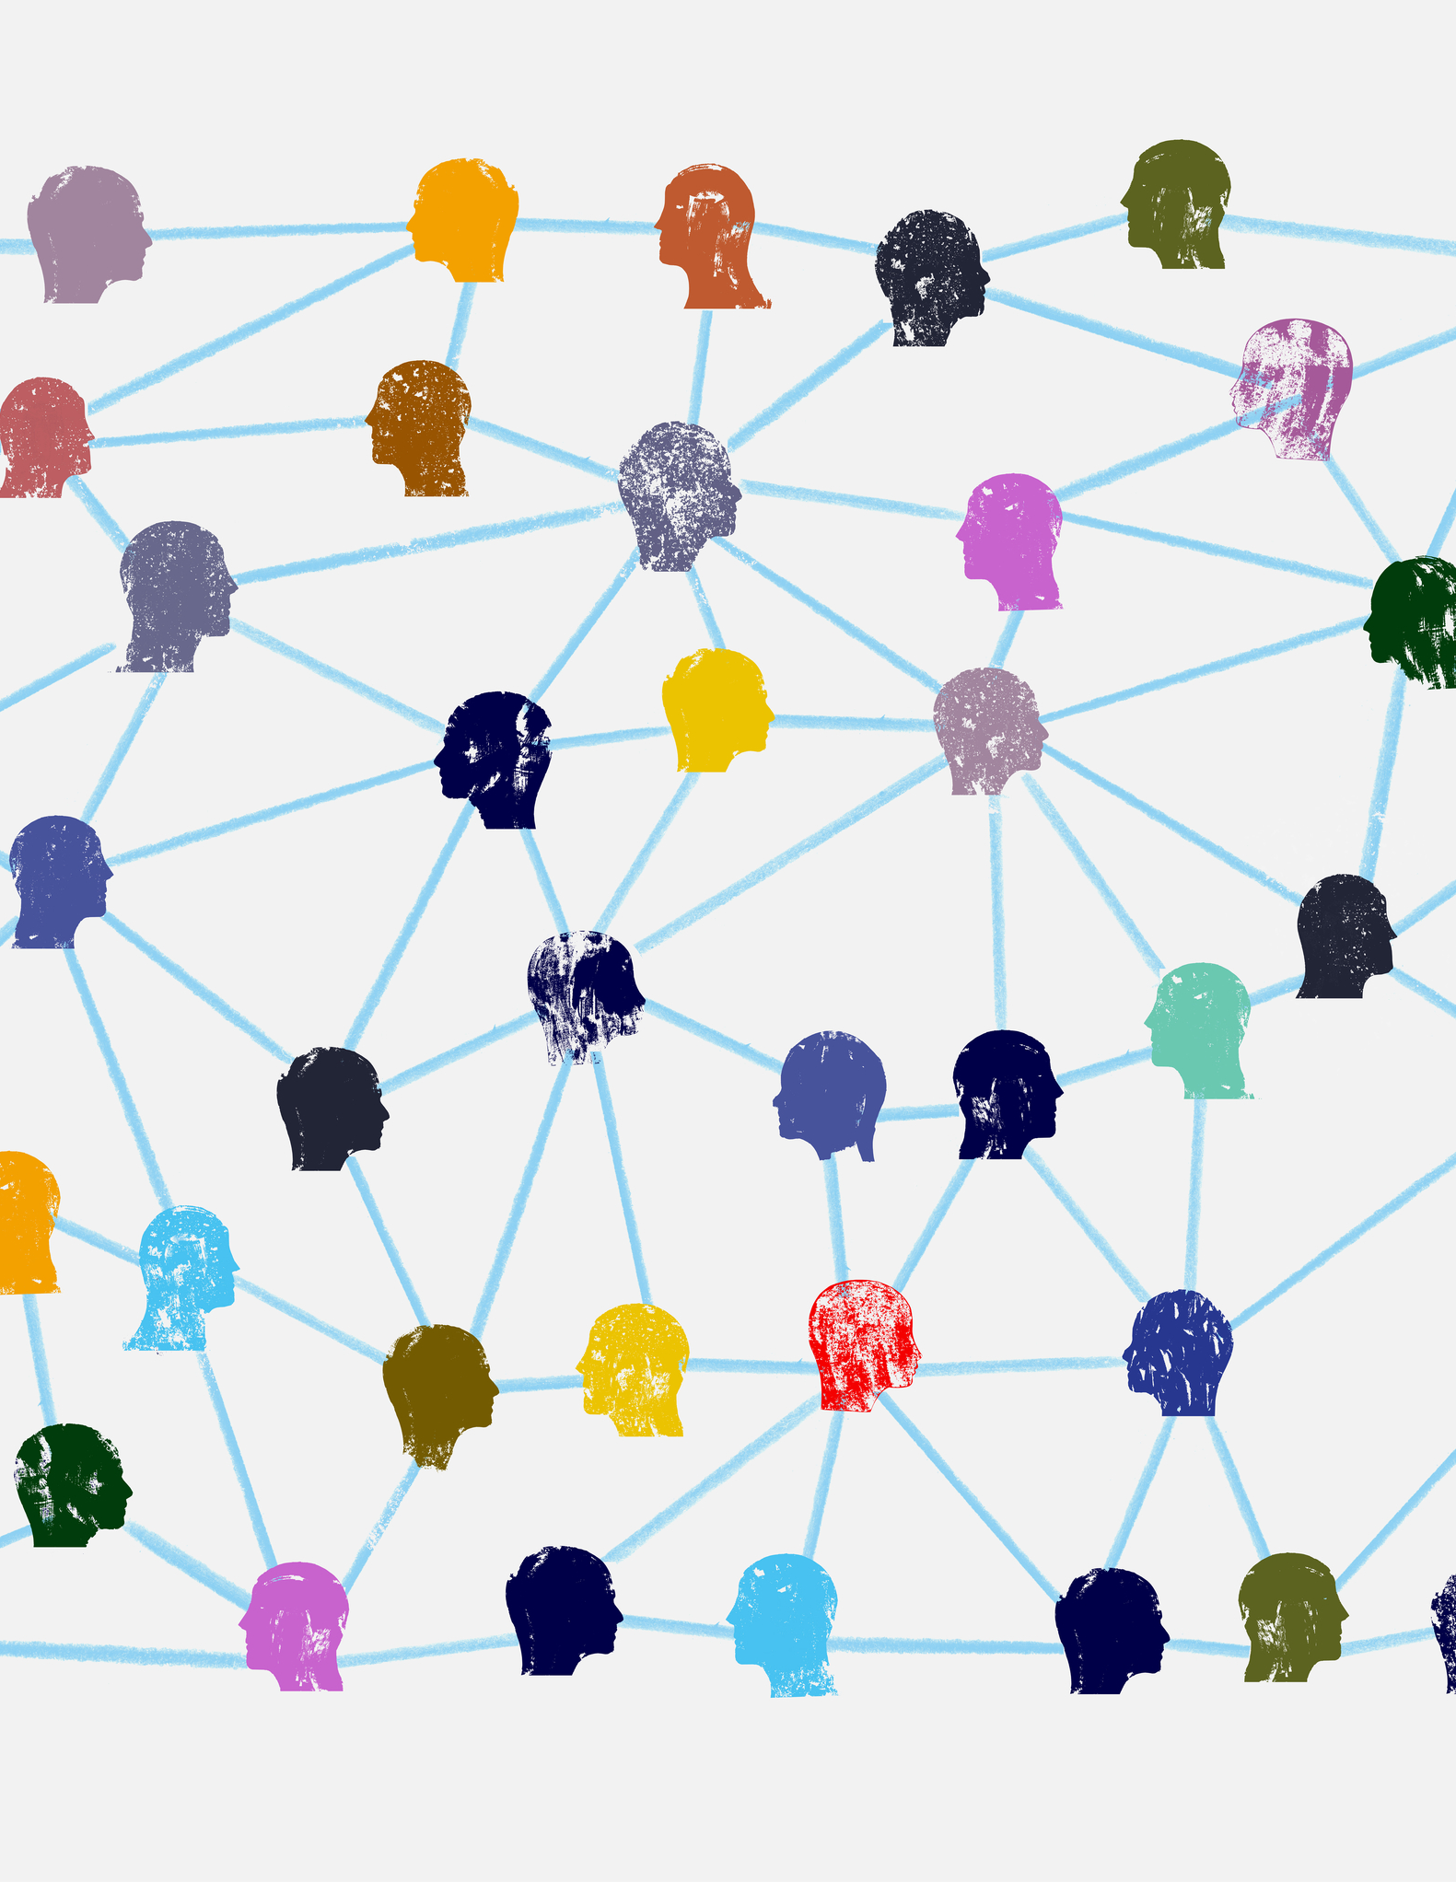
CDC Managed Funding Support
Iis funding
CDC Direct Vendor Contracts (DVC) that support national IIS objectives
  Data Exchange - IZ Gateway use cases
  Data Submission to CDC
  Privacy Preserving Record Linkage (PPRL)
  Vaccine Tracking System (VTrckS)- Application Programming Interface (API) Adoption
Future CDC-DVC efforts
  Improving Data Quality
  Improving the Interoperability Capabilities

Slide 17

Potential Private Partners for Support
Iis funding
Health plans, payers
  Support and charge for Healthcare Effectiveness Data and Information Set (HEDIS) performance measurement
In-kind support
  Offer no-cost assistance and/or guidance to promote the IIS
Local philanthropies
  Support program initiatives aligned with the philanthropy’s goals and objectives
  Promote public relations image for them
Contributions from local health systems
  Cultivating relationships takes time/requires credibility
  Engage leadership and partners
Note: Determine how data management and sharing policies support these activities

Slide 18

Potential Additional Sources of Funding
Iis funding
State general funds
  State-required population health performance measures
  Outbreak and emergency response
  Delivery of the VFC and state childhood vaccine programs
Other state agencies
  Department of Education
  Childcare and school entry requirements and assessments
  Medicaid
  Medicaid match programs

Slide 19
Iis funding
“States may receive 90% federal financial participation (FFP) for design, development, or installation, and 75% FFP for operation of state mechanized claims processing and information retrieval systems approved by the secretary”
Medicaid Federal Financial Participation (FFP)
Medicaid Management Information System (MMIS) Match
  90/10
  75/25
Administrative match
  50/50
  Medicaid.gov – Medicaid Management Information System

Slide 20

Medicaid Match Formal Application Process
Iis funding
Implementation Advanced Planning Document (IAPD)
  Annual application
  Updates can be done throughout the year
Process takes time – start early
  Applications can include multiple years
Updates are possible throughout the year (IAPD-U)
Reimbursement model
Non-federal funds needed for match
Medicaid fair share
  Medicaid pays for costs proportional to the size of the Medicaid population (aka: Medicaid Fair Share)

Slide 21

Partnering with Other Programs
Iis funding
Support other public health or state programs:
  Early hearing loss prevention programs
  Lead programs
  Women Infants and Children (WIC)
  Emergency preparedness and response programs
  VFC and state childhood vaccine programs
Notes:
  Carefully consider shared goals vs. goals of the immunization program
  Assure maintenance and long-term support are built into the plan

Slide 22

Potential Ways to Lower Costs
Strategic Sustainability and IIS Budget

Slide 23
Automate and Streamline
Potential ways to lower costs
Leverage shared services
CDC Direct Vendor Contracts | Commercial Off-the-Shelf (COTS) IIS Platform Consortia
CDC Vaccine Administration Management System (VAMS) IZ Gateway | Smarty
AIRA’s Onboarding Shared Services | AIRA’s EPI Community of Practice
Automate manual business processes for providers and IIS program (data quality, password resets, etc.)
  Save staff time, reduce material costs, reduce program costs overall
  Automate data management and submission to the degree data management and sharing policies allow

Slide 24
Automate and Streamline
Potential ways to lower costs
Document current procedures in SOPs to ensure they are “lean” and repeatable
Limit hand-offs, simplify processes, eliminate waiting periods
Take advantage of an existing product to reduce your enhancement and maintenance costs
  Minimize local customization
  Leverage open source/commercial options

Slide 25
Automate and Streamline
Potential ways to lower costs
Leverage open source/commercial options
Open Source
HLN’s Immunization Calculation Engine (ICE)
A Syntropi onboarding and customer management module
Commercial
* Atlantic Management Center, Incorporated (AMCI)

Slide 26
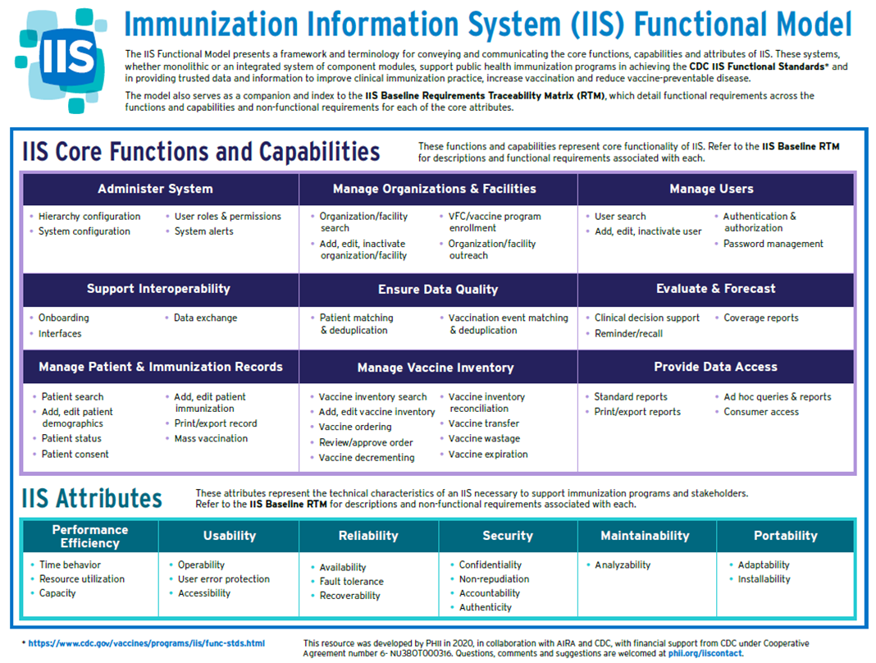
Standardize Where Possible
Potential ways to lower costs
IIS Functional Model
Requirements Traceability Matrix (RTM)
CDC IIS Functional Standards v5 and Operational Guidance Statements
AIRA Guidance Documents
AIRA Measurement and Improvement (M&I) Initiative

Slide 27
Engage with the IIS Vendor and Consortium
Potential ways to lower costs
Enhancement requests for a shared IIS platform can be prioritized and coordinated within each of the consortia groups, and costs may be shared
WIR
STC
Envision
Awardee Developed
27

Slide 28

Managing the Budget You Have
Strategic Sustainability and IIS Budget

Slide 29
Know and Understand IIS Costs and Budget
Managing the budget you have
Review your program budget costs for:
  Staffing - all sources
  Contracts
Identify your fund sources and the amount of your budget covered by each source
Document the contributions your IIS makes to other programs, departments, agencies and stakeholders
Determine what collaboration is available with your colleagues in other jurisdictions

Slide 30
Plan, Prioritize, Price, Pause, Pick, Proceed OR Pass
MANAGING THE BUDGET YOU HAVE
Plan: Document IIS functionality, gaps and dependencies
  Map IIS functionality against requirements traceability matrix (this is a CoAg activity and supports PHIG efforts)
  Document what works and what doesn’t work
Prioritize: Review the list with key stakeholders, adjust and collaboratively prioritize the list
Price the prioritized functionality (or fixes)
Pause: Look for opportunities for funding
Pick
Proceed OR Pass

Slide 31
Workforce Considerations
Managing the budget you have
Finding and keeping skilled team members isn’t easy
Consider:
  Keeping job descriptions updated – roles with tasks that are current and modern may be more attractive and accurate
  Developing and updating a workforce model that will support your IIS vision and strategic direction
  Leveraging different funding opportunities to fill staffing gaps

Slide 32
Augmenting Your Workforce
Managing the budget you have
Leveraging staff from within your agency to support activities
  Central IT resources
  Surveillance/research/epidemiology teams or staff to provide or support analytic needs
Programs outside of Immunizations or the Department of Health (DOH)
  Expertise to improve processes
  Minnesota DOH’s Center for Public Health Practice
Internships
CDC Public Health Advisor Program (PHAP) fellows
CDC Foundation
  Workforce Acceleration Initiative (WAI)

Slide 33
Contracting Considerations
Managing the budget you have
Looking for lower costs for some services (like cloud hosting)
Leveraging the General Services Administration contracting services, or pricing when negotiating with your vendor
Evaluating the cost of your current IIS and the cost to change platforms. (Talk with your procurement office first!)
Worth repeating:
  Are there options to leverage open-source software, and manage maintenance costs to lower costs?
  Are there options for shared services, or cost sharing?

Slide 34
Instructions
ACTIVITY | IIS SUSTAINABILITY SWOT
IIS Strengths | IIS Weaknesses
IIS Opportunities | IIS Threats
Identify 1-2 Strengths
Identify 1-2 Opportunities
Identify 1-2 Weaknesses
Identify 1-2 Threats

Slide 35

Understanding IIS Costs
Strategic Sustainability and IIS Budget

Slide 36
Understanding the Costs of IIS
UNDERSTANDING IIS COSTS
Costs of IIS vary across the IIS community
CDC needs more IIS cost detail to educate and promote the need for IIS funding
CDC no longer requires jurisdictions to complete a separate workbook to confirm IIS costs
The budget data submitted with your CoAg application in VFC CAMP is used to identify IIS costs
  Assure that staff, contracts and other costs associated with the IIS are well documented in VFC CAMP
  Include the percentage of the costs associated with
    Operations and maintenance
    Modernization and enhancements
    Provider management
    Data quality and monitoring
Working closely with your budget staff and program manager to document IIS costs accurately in your CoAg application assures that CDC has the most accurate information about IIS costs

Slide 37
COST CATEGORIES AND Examples
Operations and Maintenance
Servers and Hosting
Cloud Hosting
Routine Database Maintenance
Database Upgrades
System Capacity Monitoring
Testing and continued monitoring of CDC-funded solutions (e.g., PPRL)
Operations and Maintenance Documentation
Defect Identification and Remediation
Routine Security Scans
Domain Costs
Licensing Costs
Training Materials and Delivery
Other Services
Modernization and Enhancements
Functionality Upgrades
New Modules/Capabilities
Architecture Upgrades
Interface Upgrades
Enhancement Documentation
Training Materials and Delivery
Data Quality and Monitoring
Address Checking
Vaccine Code Maintenance
Geocoding
RunMatch (Deduplication)
Data Exchange Monitoring and Issue Remediation
Forecasting (Scheduling, Adding New Vaccines)
Training Materials and Delivery
Provider Management
Recruitment
Provider Onboarding
Data Usage Agreement Maintenance
Data Exchange Coordination
HL7 Onboarding
Training Materials and Delivery
Help Desk and User Support
Other
Anything not accounted for above

Slide 38
Overview of IIS Budgets & Sustainability
There are no easy answers to the questions of strategic sustainability.
However, it is critical that all of us continue to work toward providing stable, cost-effective, long-term services.
Diversifying funds, reducing costs, and developing wisely can help stabilize and sustain your IIS.
Defining and refining your budget for CDC gives them better information for future funding considerations.
Understanding iis costs

Slide 39

Discussion Questions
ACTIVITY | ASSESS YOUR WORKFORCE
What role has artificial intelligence (AI) played in your jurisdiction towards cost savings?
Are there any additional cost saving strategies that your jurisdiction has successfully employed?

Slide 40

Questions and Discussion
Strategic sustainability and iis budget

Slide 41
Thank you.

