Slide 1


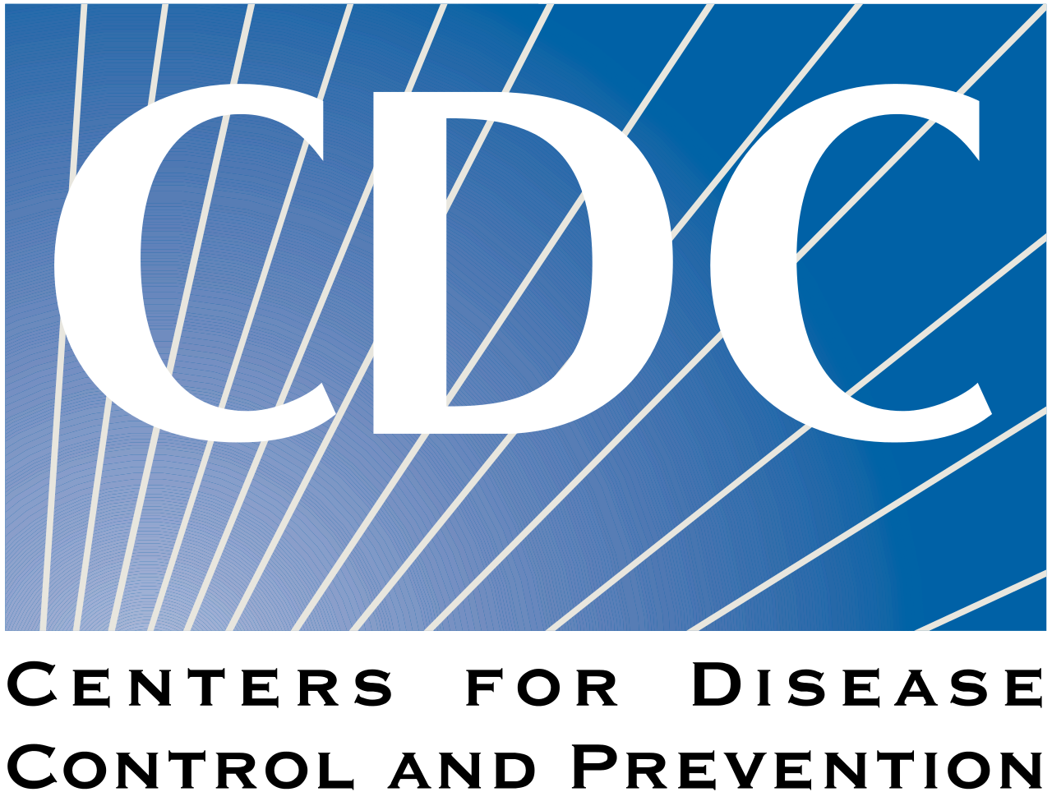

Laws, Policies and Procedures
Supporting Your IIS Operations
Beth Cox
Mary Beth Kurilo

Slide 2
Learning Objectives
Increase understanding about how your jurisdiction’s laws, policies, and procedures can impact IIS and Immunization Program goals
Explore important benefits and risks of modifying laws, policies, and procedures
Discuss how federal initiatives and related policy requirements affect state and local IIS implementation, operations and IIS data
Expand understanding for how Standard Operating Procedures (SOPs) can ensure your team aligns with policy and law
Notes:
MBK

Slide 3
Overview of this Session
Discuss the difference between law, policy, and other regulations
Discuss the landscape of jurisdictional IIS laws and policies
Discuss the impact of law and policy on technical and operational program components, and considerations for modifying them
Explore policy impacts to the following national initiatives:
  Inter-jurisdictional data sharing
  Sharing immunization data with federal partners
  Making data available via data dashboards
Prioritize essential SOPs
Notes:
MBK
We’ll briefly review the landscape of laws and policies in the U.S, touching on why laws vary so much but in what areas there are a lot of similarity.
We’ll spend a fair bit in discussing as a group 2 very recent policy areas related to sharing IIS data: how they are playing out for you and what you are learning about your laws and policies that either enable or inhibit these new use cases for data sharing.
Please feel free to ask questions as they arise.

Slide 4

Disclaimer
This is a very complicated time…
Notes:
Address possible discord between local, state, federal policies

Slide 5
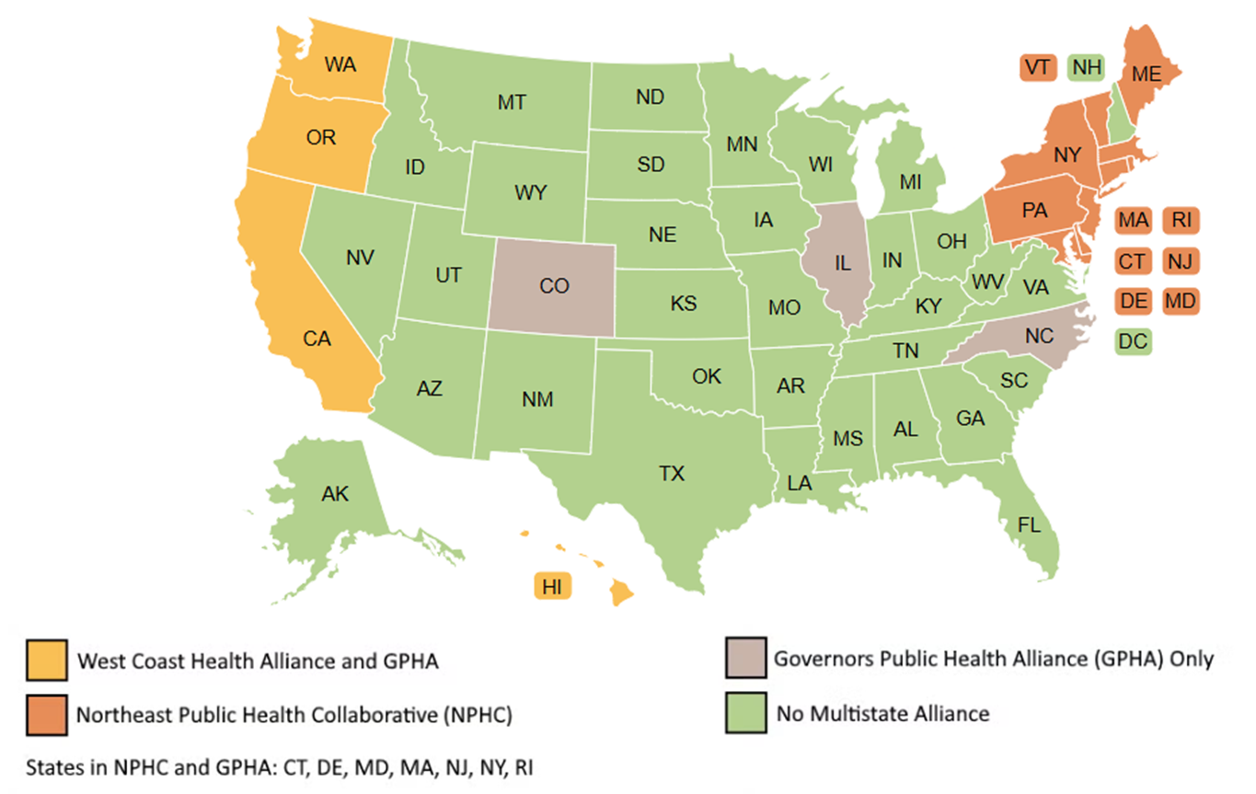
What’s In The News
Lawsuit and judicial ruling in AAP v. HHS
Multiple immunization Recommending Bodies
States forming new alliances
West Coast Health Alliance
Northeast Public Health Collaborative
Governors Public Health Alliance
Others?
https://www.immunize.org/official-guidance/state-policies/state-vaccine-recommendations/
Notes:
Two key messages -
The science hasn’t changed
There is broad public support for vaccines

Slide 6
Differences Between Laws, Policies, and More
Notes:
MBK

Slide 7
Definitions
Laws
Laws describe the principles and regulations established in a community by some authority and applicable to its people, whether in the form of legislation (statutory law) or of custom and policies recognized and enforced by judicial decision (case law).
Administrative Rules
Administrative rules (sometimes called regulations) are officially promulgated agency regulations that have the force and effect of law. Generally these rules elaborate the requirements of a statute.
Policies
Policies are detailed guiding principles to put laws and rules into practice.
Procedures
Procedures are detailed steps for compliance with policies.
Notes:
MBK
Laws (often painfully) enacted by elected officials. State laws cannot violate federal constitution and laws, and county and city ordinance cannot violate state constitution and laws.
When a law is passed, the legislative body often includes in the new law that the executive branch -- usually a state agency -- needs to developed rules/regulations for how to impo,kment and enforce the law. Administrative rules described. Published for public comment and have to respond touch comments. Administrative Law Judge.
Programs within the state agency then write policies specific to the finalized rules. Can have policies on a wide range of other issues.
Procedures then provide the detailed, specific, repeatable processes for ensuring the policy and the rule are adhered to.
Procedures are to policies what rules are to laws: the administrative and operational details -- how things get implemented day to day.

Slide 8
The Legal and Policy Ecosystem
Standard Operating Procedures
Jurisdictional Policies
Jurisdictional Laws/Statutes
Standard Operating Procedures
Jurisdictional Policies
Federal Laws/Regulations (HIPAA, FERPA, etc.)
Standard Operating Procedures
Administrative Rules
Program Policies
Standard Operating Procedures
Program Policies
Standard Operating Procedures
Notes:
MBK
There is a hierarchy in the world of law and policies. It begins with the U.S. Constitution and laws at the federal level, from which flowed the separate state constitutions and from those, state laws, which couldn’t contradict either the U.S. or state constitutions
The administrative rules/regulations then provide the details of how the law is implemented and enforced.
From there, more granular policies and and procedures are developed, none of which can contradict the laws or the constitutions.
Procedures are to policies what rules are to laws.
Discuss whether this aligns with jurisdiction’s views of their own systems.

Slide 9
Adding To the Complexity…
“The United States Constitution does not mention the word “health” and does not explicitly grant the federal government authority over health…
The states bear the majority of statutory responsibility for health…and other activities related to the health and well-being of their populations.”
Public Health Informatics and Information Systems, 2nd Edition, J.A. Magnuson and Paul C. Fu, 2014
Notes:
MBK
Spend a minute talking about the balance between Federal and State authority around health.

Slide 10
Our Current Environment
Given changing federal perspectives, it is essential to establish strong state-level leadership and policy structure:
Establish/strengthen your relationship with your State Health Officer/Health Commissioner, legal contacts (Attorney General/Assistant AG), Immunization Coalitions, IIS Advisory Bodies
How much do they know/understand about your program and the broad value it brings?
How can you deepen these relationships, directly or indirectly?

Slide 11




Federal Level Policies/Laws
Notes:
MBK

Slide 12
Federal Laws Especially Relevant to IIS
Health Insurance Portability and Accountability Act (HIPAA)
Are you a covered entity? A hybrid?
Family Educational Rights and Privacy Act (FERPA)
Protects the privacy of student education records but indirectly affects data exchange between schools/IIS
21st Century Cures Act
Health information reform, includes provisions around TEFCA (Trusted Exchange Framework and Common Agreement)
One Big Beautiful Bill Act (OBBB)
Modifying Medicaid eligibility
Notes:
MBK
Congress has over the years established “floors” in a number of area that impact public health and immunization data sharing. As IPMs and IIS managers, you need to understand what these laws do and don’t allow so you know whether your policies and procedures are meeting these floors.
We won’t spend time on these today but if you are unfamiliar with these three federal laws and the rules associated with them, check in with your privacy officer and they can provide more specific information for your health department, such as whether you are a covered entity or hybrid under HIPAA.

Slide 13
The National Picture
Since public health law largely and constitutionally originates at the state level, statutes and policies vary across the U.S., and there are few national policy frameworks
In 2020, the COVID-19 pandemic tested our country’s ability to balance federal authority, state and local autonomy, and individual rights in responding to the threats of the pandemic
  We continue to see an increase in law and policy changes as we debate the role of public health in disease control and prevention
Notes:
MBK
Quirky and inefficient reality
Debating the role of PH -
Increased consent rules
Rolling back school mandates
Modifying data shared with federal partenrs
Question for group: What does it mean to you? As a manager and leader, in the middle between goal of standardization and uniformity and the political realities of states’ rights.

Slide 14
The National Picture, Continued
Actions from the Executive Branch have affected how IIS are using federal funds
Changes to diversity, equity and inclusion (DEI) language and practices
Changes to federal advisory boards
Changes to vaccine schedules
Changes to vaccine funding?

Slide 15
State Level Policies/Laws
Notes:
Beth

Slide 16
Jurisdictional Laws Relevant to IIS
IIS enabling legislation (or your statute may be silent)
Reporting mandates
Individual Consent Mandates
  Mandatory Inclusion
  Implicit Consent, or “opt-out”
  Explicit Consent, or “opt-in”
Immunization data sharing
  (with whom, what purposes, what conditions)
Interjurisdictional exchange
Federal partner-IIS exchange of data
Sharing data with CDC
Data In
Data Out
Notes:
Beth
Jurisdictional-level laws or ordinances are, of course, much more specific to immunizations and IIS.
Data sharing: Consent required? Share for research purposes? With Medicaid? Media?
Not only the board strokes but the nuances -- overarching government data practices law.
Not every IIS has specific enabling legislation that authorized the health department to create an IIS. Not necessary but can certainly be useful to have the most relevant provisions n one law.
Who has enabling legislation for their IIS? Appropriations?
Opt in/out and childhood or lifespan are two other very common areas.
To tell us more, I’ll hand the floor over to Beth Cox with CDC, and she’ll walk us through what the current landscape looks like.

Slide 17
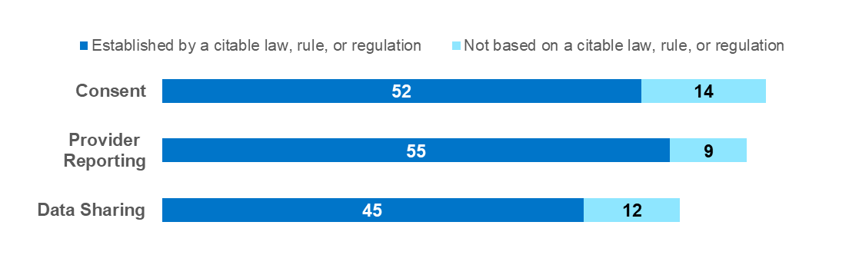
The Current Policy Landscape
Notes:
Beth

Slide 18
Consent Policies
Consent is whether or not an individual has the right to decide if their demographic and immunization data is included in the IIS
Types:
Mandatory inclusion, meaning that an individual is included in the IIS with no possibility to opt out
Implicit consent, meaning that an individual is included in the IIS unless they choose to opt out
Explicit consent, meaning that an individual must give consent, or opt in, to be included in the IIS
Notes:
Beth

Slide 19

Reporting Policies
Note: Jurisdictions may have a combination of reporting policy types
Requirements for vaccination providers to report immunizations to the jurisdiction's IIS
Types:
All providers are mandated to report to the IIS
Specific providers are mandated to report to the IIS
Mandatory with age requirements
Specific vaccines are mandated to report to the IIS
No mandatory reporting to the IIS
Notes:
Beth

Slide 20
Data Sharing Policies/Data Governance
Requirements and/or restrictions for sharing immunization data from the jurisdiction’s IIS with other public health entities, such as CDC and other IISs
Types:
Requiring a data use agreement (DUA) or memorandum of understanding (MOU)
Requiring that the data are only used for public health or other specific purposes (e.g., disease surveillance, IIS management)
Protecting the data's confidentiality
Data sharing upon request or with approval or authorization
Allowing only deidentified data or nonidentifying summary statistics to be shared
Notes:
Beth

Slide 21
Policy Shifts
COVID brought some changes to consent and reporting polices
Jurisdictions added mandatory inclusion consent statutes
Many jurisdictions added some type of mandatory reporting requirement
Data Sharing rules are regularly being reviewed and shifting at the jurisdictional level to ensure privacy and security of data
Notes:
Beth

Slide 22
Policy Documents in 2026
Data Sharing Policy Documents
CDC Data Use Agreement Addendum (DUA) for submission of vaccination data to federal level
  All Routine and Respiratory (to include flu, COVID, and RSV) Immunizations
  Implementation of PPRL Service License Agreement
Immunization (IZ) Gateway Legal Documents
Association of Public Health Laboratories (APHL) DUA
  Share Task Order, Appendix A of APHL DUA
  IIS-CDC Task Order, Appendix B of APHL DUA (see above)
CDC Jurisdictional Provider Agreement for national provider organization data exchange with jurisdictions
Interjurisdictional Memorandum of Understanding (MOU)
Notes:
Beth
Inter-jurisdictional exchange is called out as an IIS Functional Standard (#22)
Sharing across state lines exposes quirks in current patchwork of immunization data sharing laws
IZ Gateway: Goals of facilitating multi-state data partner submissions and inter-jurisdictional exchange
Good example of how the legal and policy issues can be as complex as the technical ones!

Slide 23



Laws can be changed, but there is risk…
Bill passes, you get what you want
Bill fails, you get nothing/no changes
Legislature changes bill, and it may include conditions you don’t want
Notes:
Beth
3 possible outcomes, two not great.
You may get what you want: Good for you! A sign you did the prep work of lining up supporters, etc.
The bill may fail and you get nothing: Better to have the author pull the bill than suffer defeat on the florr.
The legislature may change what you propose so you only get some or none of what you want, and you may have to live with conditions you don’t want (e.g., an opt-in requirement)
The worst case. Again better to pull the bill
That being said, there may be very good reasons you want to change your law, or at least begin exploring the landscape
Privacy is the Achilles heel of IIS! Never, ever, underestimate

Slide 24

Activity: Discussion
Are there areas of your current legislation that your program or others within your jurisdiction would like to consider changing in the future? Are there outside groups advocating for legislative changes? If so, what are they? Who are likely to be allies/supporters and opponents of the change?
Consider:
  Jurisdiction trends focused on privacy
  Impact on what a jurisdiction shares and what it receives
  Managing expectations and gatekeeping on data needs
Notes:
Beth
Discuss at tables and share thoughts in large group

Slide 25
You Are Not Alone! Areas of Policy Support
CDC, AIRA, and AIM (the Association of Immunization Managers) all try to amplify the IIS/Immunization Program voice in policy/law to ensure laws and policies continue to support our work through:
Representation on the Adult Vaccines Access Coalition (AVAC)
Collaboration with HIMSS Government Relations
Support for state laws/policies through testimony
Comments on emerging federal laws/policies
Notes:
Beth
Consider asking for a contribution from the AIRA perspective here, and asking if an AIM representative wants to share from the AIM perspective as well.
Then hand off to Mary Beth

Slide 26
IIS Program Level Policies and Procedures
Notes:
Mary Beth
So now we are going to talk about the impact of IIS related policies from a technical and programmatic perspective.

Slide 27
Example IIS Policies
*Can be associated with state law/policy
Jurisdictional-level examples:
Requirements for reporting of VFC vaccine/by VFC providers at the POLICY (not state law) level
  Adding a requirement in the VFC Provider Agreement for providers to submit data to the IIS
  Linking VFC vaccine distribution to IIS reporting
Requirements to inform public on personal data handling
Security policies
Vital records information
Data uses: summary data/reports, research, evaluation
Record retention
Consent requirements*
Notes:
Mary Beth
Policies can be grounded in rules/regulations/laws or independent of them but they cannot be in conflict with law or rule.
Ideally, every policy at the program level should have a procedure attached to it: this promotes consistent, uniform implementation. You would want it to be clear enough that someone new could pick up and complete the related tasks.
This is the area you control, are responsible for, and accountable for.

Slide 28
What About AI?
Many states and programs are developing policies around use of AI in the workplace
Topics an AI policy might cover:
  What kind of AI are we talking about? (e.g., conversational AI, generative AI, assistive AI, multimodal AI, etc.)
  Privacy and security
  Citing and verifying AI-generated content
  Ethical use
Does your state or program have an AI policy?
Notes:
ChatGPT is a form of Conversational AI powered by large language models and transformer-based deep learning. In capability terms, it is considered Narrow (or Weak) AI, designed to perform specific tasks rather than general human-level reasoning.
What’s the difference between Generative AI and Predictive AI?
Generative AI creates new content such as text, images, audio, video, and code.
Predictive AI analyzes historical data to forecast future outcomes, trends, or behaviors.
What is multimodal AI?
Multimodal AI refers to models that can understand and generate multiple types of data simultaneously, including text, images, audio, and video. These systems can combine inputs across formats to produce more contextual and accurate outputs.
What type of AI is best for workplace automation?
For workflow automation, organizations typically use a combination of Assistive AI and emerging Agentic AI. Assistive AI supports tasks such as routing, summarizing, and recommending, while agentic systems can plan and execute multi-step activities with limited human input.

Slide 29
Spotlight: Procurement Policies
Procurement policies are generally determined within each state/jurisdiction
They vary widely in approach, involvement, timeline, process, etc.
Approaches to consider:
  Using NASPO (National Association of State Procurement Officials) may be a faster route, but can be costly
  Explore leveraging other jurisdictions’ resources (RFP?)
  Build solid relationships with procurement office, understand their needs, plan ahead - remember that you are all on the same team!

Slide 30
Clinical Decision Support at the State Level
There is currently a preliminary injunction in the AAP v. HHS lawsuit that addresses the HHS childhood immunization schedule:
•Changes to the schedule are put on hold
•Reconstitution of ACIP found to violate FACA (Federal Advisory Committee Act), and new appointments were put on hold
•All votes cast by these ACIP appointees were put on hold
Operationally, this reverts formal recommendations to an earlier ACIP schedule (June 2025), but this creates issues with flu, etc.
Additionally, on April 6, a new ACIP charter was posted on the Federal Register
Notes:
•Operationally, this reverts formal recommendations to an earlier ACIP schedule (June 2025), but this creates issues with flu, etc.
•It is still unclear whether the Administration will appeal – they likely have up to 60 days to declare the decision
•Meanwhile, immunization schedules are now available from at least seven other recommending bodies (AAP, ACOG, etc.)

Slide 31
Procedures
Documented and updated regularly, procedures are as critical as the policies themselves
IIS procedures help ensure compliance with policies
The most common kind of procedure document used across the IIS community is the SOP
  Documents how things get done operationally and by whom
Notes:
Mary Beth

Slide 32
Why Maintain SOPs?
Consistency, ensuring a procedure is done accurately each time
Accountability, so that you and your team can demonstrate how your program complies with applicable laws
Turnover, since staff will inevitably change over time
Onboarding of new staff, so that you have documents to orient and train them with
Support cross-training among current staff
Notes:
Mary Beth
It is critical to maintain documentation, tracking, and updating, of SOPs for a variety of reasons
Have group brainstorm on reasons

Slide 33
SOP Topics
The topics that need to be covered will be specific to your jurisdiction, but consider starting with the most common procedures:
Common Help Desk issue responses
Requests for data
Onboarding tasks
Data exchange tasks – importing or extracting
Data quality tasks
Notes:
Mary Beth

Slide 34
SOP Tracking
Consider developing an index that can help you track policies in need of development, as well as the cycle of review
  As a general rule, SOPs and policies should be reviewed at least annually
  They don’t need to be updated each time, but they should be reviewed and dated to ensure they are still current
Leveraging an SOP template and tracking index can streamline drafting and review
Notes:
Mary Beth

Slide 35
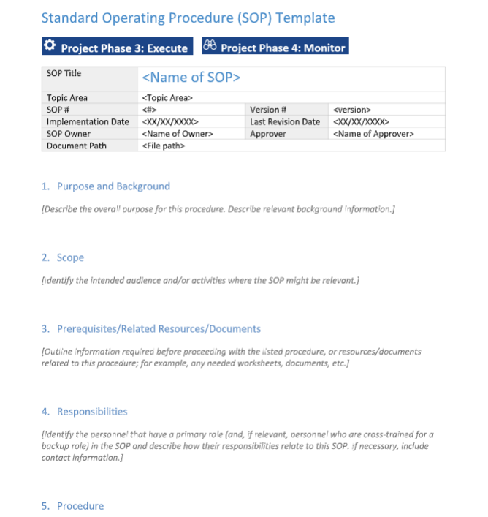
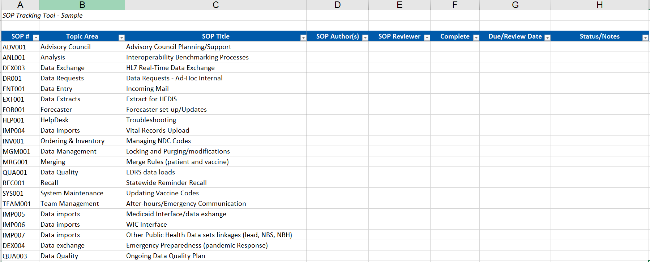
SOP Tracking Tool and Template
Notes:
Mary Beth
Both of these are available on the PHII website, and can easily be downloaded and personalized for your jurisdiction.
Having the tracking tool lets you share the responsibility for updating.
Hand back to Beth…

Slide 36
Consider Level of Effort to Change
High
Expected Effort To Change
Low
SOP Policy Administrative Rule Law/Statute Federal Regulation
Notes:
Mary Beth
Review for the group: What are you responsible for and what can you influence?

Slide 37


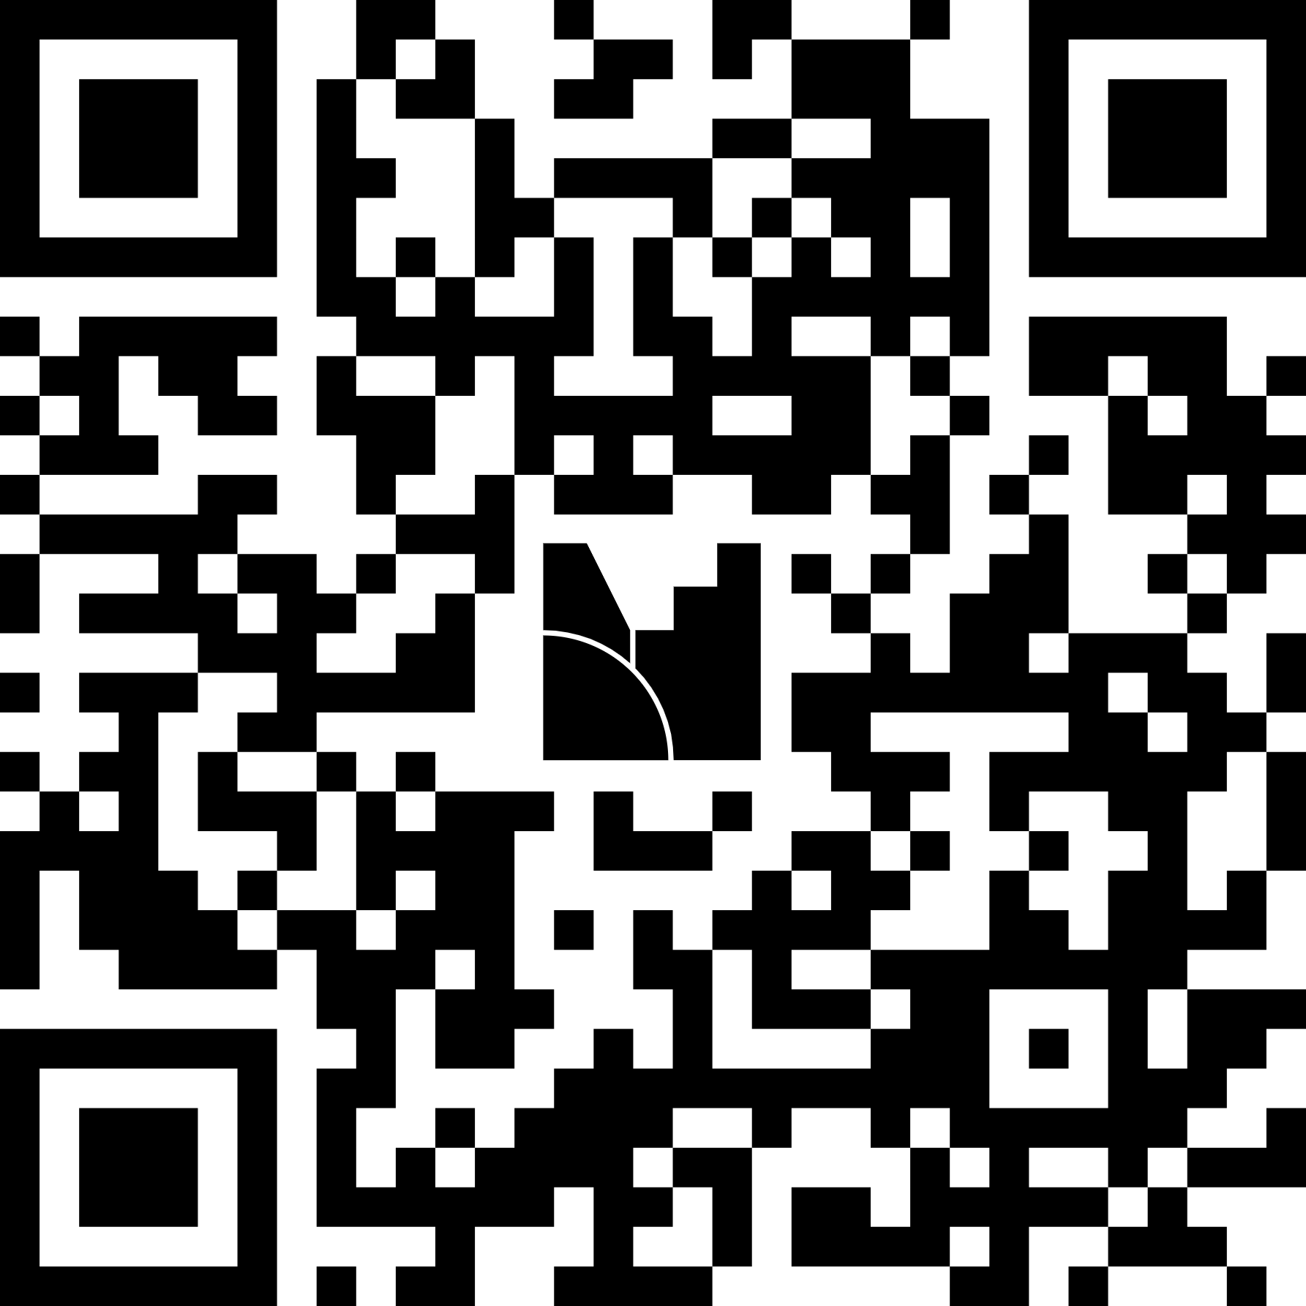
Activity: Discussion Questions
On a scale of 1-5, where would you place your jurisdiction in timely, complete documentation of needed standard operating procedures?
  1 = no procedures documented
  3 = some procedures documented, but not necessarily complete or current
  5 = all procedures are fully documented and updated
What are your most high-priority SOPs to document in the next three months?

Slide 38



Summary and Wrap Up
Policy is a complex area that affects IIS work at multiple levels (federal, state, local, law, procedures, etc.)
As an immunization Leader, you are in control of some of these levels, able to influence others, and simply responsible for implementing others
However, it is critical you understand and can speak to the impacts and intersections at all levels
Notes:
Mary Beth
If not well versed in L&P, get to know your laws and get a mentor

Slide 39
Laws, Policies, and Procedures Resources
Awardee Sharepoint Site Policy Document Folder
APHL DUA (Association of PH Labs Data Use Agreement)
Interjurisdictional MOU (Memorandum of Understanding)
Share Task Order, Appendix A of APHL DUA
IIS-CDC Task Order, Appendix B of APHL DUA (see above)
IZ Gateway Multi-Jurisdiction Vaccine Provider Jurisdiction Data Exchange Agreement (PJA)
CDC DUA Addendum
Business Associate Agreement (BAA)
AIRA Repository, PHII Site, and AIM Website
AIRA Confidentiality and Privacy Considerations for IIS - assists IIS as they develop policies and procedures to meet legal requirements for protecting the privacy of individuals and the confidentiality of information in IIS
Public Health Inter-jurisdictional IIS MOU Template - provides a fillable form for a MOU for secure, electronic exchange of immunization information among governmental entities that operate a population-based IIS
Clinical Decision Support One Sheet - This resource provides a high-level overview of the role of Clinical Decision Support (CDS) in immunizations.
Immunization Program Policy Toolkit - designed to equip members of the Association of Immunization Managers (AIM) and their staff with the tools and information
SOP Tracking Tool and Template - PHII tools to support documentation on business processes
Notes:
Mary Beth
Cover resources, note that confidentiality guidance will be replaced by newly developed security guidance (expected summer 2026)

