Slide 1




Effective IIS Data Use
Using IIS Data to Promote Immunization and Protect the Health of the Public
Amy Metroka, PHII Consultant
Notes:
I would like to invite Amy Metroka to the stage for our Effective IIS Data Use session.

Slide 2
Learning Objectives
Understand the connection between data quality and data use
Apply the SIPOC framework to identify the key
        Suppliers, Inputs, Processes, Outputs and Consumers of IIS data
Identify the internal and external partners who can use IIS data to increase up-to-date immunization of individuals and populations
Recognize the potential impact of data visualization on increasing IIS data access, use, and awareness by the public and partners

Slide 3
IIS Core Competency Model Definition
Data Use
Data use is the translation of IIS data into actionable information to support clinical practice, immunization program operations and other purposes that protect and promote the health of individuals and communities.
Notes:
The definition of IIS Data Use per the 2021 IIS Core Competency Model is the translation of IIS data into actionable information to support user needs.
We saw this translation of IIS data in many ways throughput the pandemic in various data visualization and presentation methods that enabled the data to be translated for action.

Slide 4
Why is IIS Data Use Important?
The purpose of the IIS is to collect, consolidate and share data to increase immunization coverage rates and promote public health
Sustainability and credibility of the IIS depends on data use
Data use improves data quality
  Users find the problems and help you fix them
Data quality promotes data use
Notes:
Use of the IIS data fosters sustainability and credibility of the IIS as a key information system.
And data use helps identify discrepancies in the data to be resolved.

Slide 5
Your Role as an IIS Leader
Continuously work to achieve high-quality IIS data
  Strengthen data quality processes and personnel
  Use CDC, AIRA, and PHII resources
Promote and enable authorized use of high-quality IIS data by internal and external partners
Especially:
  Immunization program, including VFC
  Immunization providers

Slide 6

How can you achieve effective IIS data use?

Slide 7
SIPOC Framework for Effective IIS Data Use
Suppliers
Inputs
Processes
Outputs
Consumers (Users)
Providers
Other IIS
Federal agencies
Patient demographics
Vaccination events
Onboarding for reporting and access
Matching, merging and de-duplicating records
Clinical Decision Support (forecasting)
Vaccination records
Immunization Forecasts
Vaccination coverage and line list reports
Reporting to CDC, jurisdiction
Dashboards
Providers
Immunization Program
Other Public Health Programs
Other IISs
Public
Schools, Colleges
Child Care
CDC
Medicaid, Health Plans
Researchers
Recruit and connect all suppliers
Motivate providers to report high quality data
Capture full range of IIS data inputs
Ensure integrity of data processes
Continuously improve data quality processes
Promote authorized access
Share high quality IIS data outputs to protect the health of the public
Enable authorized IIS access to meet public health needs
Highlight data use champions
Role of
IIS Leader
Notes:
Here is a framework for us think about important ingredients for effective IIS data use.

Slide 8
Recruit and Connect all IIS Data Suppliers
SIPOC
Onboard data suppliers for interoperability with the IIS
Set up accounts for suppliers to access the IIS user interface
Data Suppliers are Critical Partners for Shared Success!
  Clinics - Hospital, Public Health
  Private Provider Offices
  Federally Qualified Health Centers (FQHCs)
  Pharmacies – Chains and Independents
  School-Based Health Centers (SBHCs)
  Points of Dispensing (PODs)
  Urgent Care Clinics
  IISs in other jurisdictions, federal agencies – via IZ Gateway
Notes:
Stress partnerships with suppliers

Slide 9
Capture Full Range of IIS Data Inputs
SIPOC
Collect all CDC Core Data Elements - and then some
Patient demographics
    Name (first, last, middle), current address, phone number, email
Vaccination events
      Vaccination date, vaccine code, presentation, manufacturer, lot number, etc.
      Provider, Facility

Slide 10
Motivate Providers to Input Quality Data
SIPOC
Providers must input quality data to get useful data out of the IIS
To promote quality data:
Facilitate standards-based interoperability for reporting all vaccines
        Leverage Promoting Interoperability incentives for providers
        Leverage certified EHRs
Ensure confidentiality and security of IIS data
Leverage VFC and public purchase vaccine programs for adults (317, state) to get quality data in
  Obtaining publicly-purchased vaccines motivates providers to report quality data

Slide 11

Activity: Small Group Discussion
Discuss the questions below with the people at your table, and designate one person to report out for your group.
  What data quality or data use challenges are you facing now?
    What are the factors contributing to the challenges?
  What partnerships and skills can you use to address the challenges?
After 10 minutes, each group will report out and everyone will engage in a large group discussion.
Notes:
Before we continue with our SIPOC framework analysis, let’s take 15 minutes to think and talk about the IIS data quality and data use challenges you currently face and how you might address them.

Slide 12
Ensure Integrity of IIS Data Processes
SIPOC
Adhere to HL7 standards for both IIS reporting and access
Collaborate with your technology partners to improve record matching, merging and deduplication
Update IIS Clinical Decision Support (CDS) engine (forecaster) - align with evidence-based recommendations
Document and implement standard operating procedures (SOPs) for key processes (e.g., onboarding, manual deduplication)
Notes:
Coming back to our SIPOC framework, let’s consider processes.

Slide 13
Continuously Improve Data Quality Processes
SIPOC
Designate a Data Quality Analyst – point person to lead a team
Ensure active review and correction of incoming data and data at rest
Work with providers to correct data quality problems
Engage with EHR vendors and providers to improve reporting of all CDC Core Data Elements
Providers need to enter detailed demographic information in their EHR for the IIS to receive the data

Slide 14
Promote Authorized Access
SIPOC
Support HL7 query/response (bidirectional data exchange) for providers, health plans, schools
    Delivers quick, easy access to patient records and forecasts
Facilitate IIS capacity to handle large volume data requests
    Support access to a replicated IIS database (e.g., data lake)
    Ensure sufficient processing capacity, bandwidth, storage and redundancies
Expand public access by supporting consumer access

Slide 15
Share High Quality IIS Data Outputs, I
SIPOC
Have a strong data governance structure
Data goverance defined: the people, policies, procedures and technologies that support how data are used and protected
People: individuals internal and external to IIS who are responsible for establishing and maintaining governance
Policies & Procedures: written guidelines for sharing data
  Align with IIS authorizing legislation, confidentiality policiies
Technologies: framework detailing technologies used to hold, catalog, display, share and protect data
Notes:
Source: PHII course: Data Governance for Public Health. See resources for course link. More on data governance in a later module.

Slide 16
Share High Quality IIS Data Outputs, II
SIPOC
Strengthen your communication skills to promote data use by different partners
Create or support dashboards
  Promote effective data visualization to inform and guide action for population health at local, national levels

Slide 17
Share High Quality IIS Data Outputs, III
SIPOC
Provide vaccination records, forecasts, coverage reports and line lists to providers, immunization program, schools, payers (e.g., Medicaid), other public health programs and partners
Share data via the IZ Gateway
  Connect to other IISs to supply and capture out-of-jurisdiction immunizations
Share aggregate and patient record-level, de-identified data with CDC
Use Privacy Preserving Record Linkage (PPRL)
Notes:
More on data governance later

Slide 18
Share High Quality IIS Data Outputs: CDC
SIPOC
Has your jurisdiction signed the Data Use Agreement (DUA) Addendum for sharing data with CDC?
CDC SMEs are here and available for questions
Why sign the DUA Addendum and share data with CDC?
Consolidate individual records across jurisdictions
Support national emergency response
Monitor national vaccine coverage and safety
Meet VFC CoAg requirement
Notes:
I raise this topic to emphasize the importance of signing the DUA Addendum. I expect that if your jurisdiction has not signed it as yet, getting it signed is on your radar and your immunization program is moving the approval process forward. If you have questions about the DUA Addendum, there will be an opportunity in the next few days to raise them with your CDC SME (if present, or a different CDC SME).

Slide 19
Meet Consumer (User) Needs with IIS Functionality
SIPOC
Immunization Providers: Enable vaccine ordering, receiving, managing, and accounting for VFC, adult, other public vaccines
Immunization Program, other Public Health Programs, Medicaid, Other Health Plans:
Enable access to and use of IIS data and functionality to support all components of the immunization program - IIS is key to program decision-making
Enable access by other public health programs, Medicaid, other health plans for the protection of public health
Public: Offer a consumer access application to enable the public to obtain their immunization records, including digital proof of vaccination)
Notes:
Broad definition of consumers

Slide 20
Highlight Data Use Champions
SIPOC
Recognize providers using the IIS to achieve high immunization coverage
Collaborate with AAP and other professional associations (e.g., nurses)
  Recognize providers at meetings
  Post Honor Roll on websites (AAP, health department)
  Collaborate on quality improvement initiatives
Encourage champions to share their work with peers

Slide 21
Examples of IIS Data Use

Slide 22
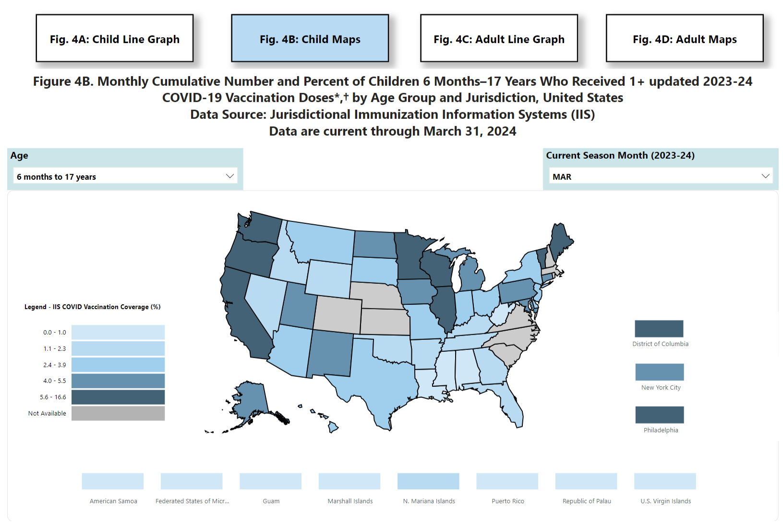
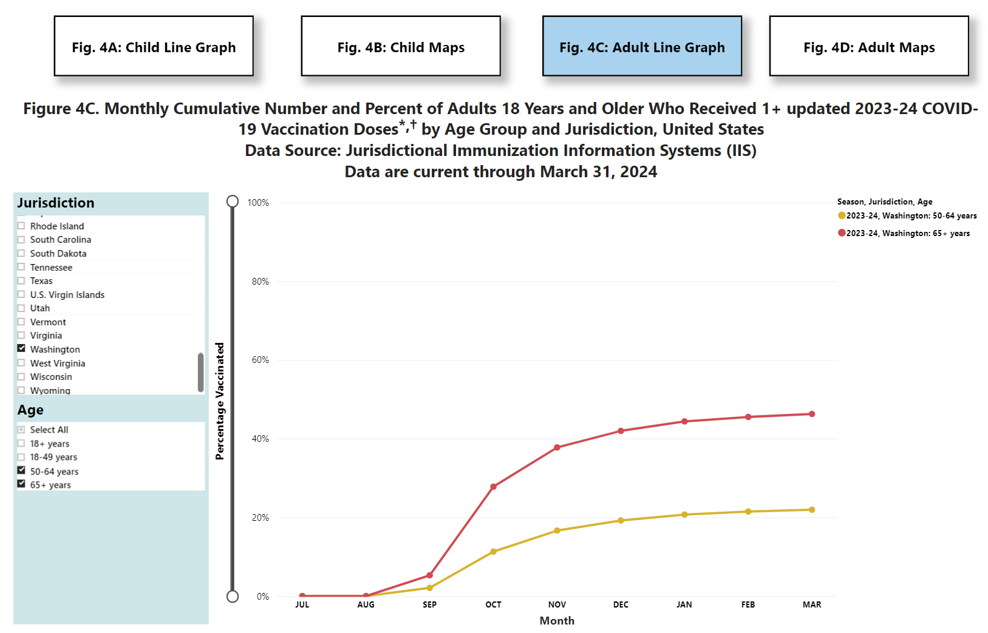
CDC Use of IIS Data
Vaccine Administration and Coverage by Jurisdiction (IIS), United States
Vaccine Administration and Coverage by Jurisdiction (IIS), United States | CDC
Vaccine Administration and Coverage by Jurisdiction (IIS), United States | CDC

Slide 23
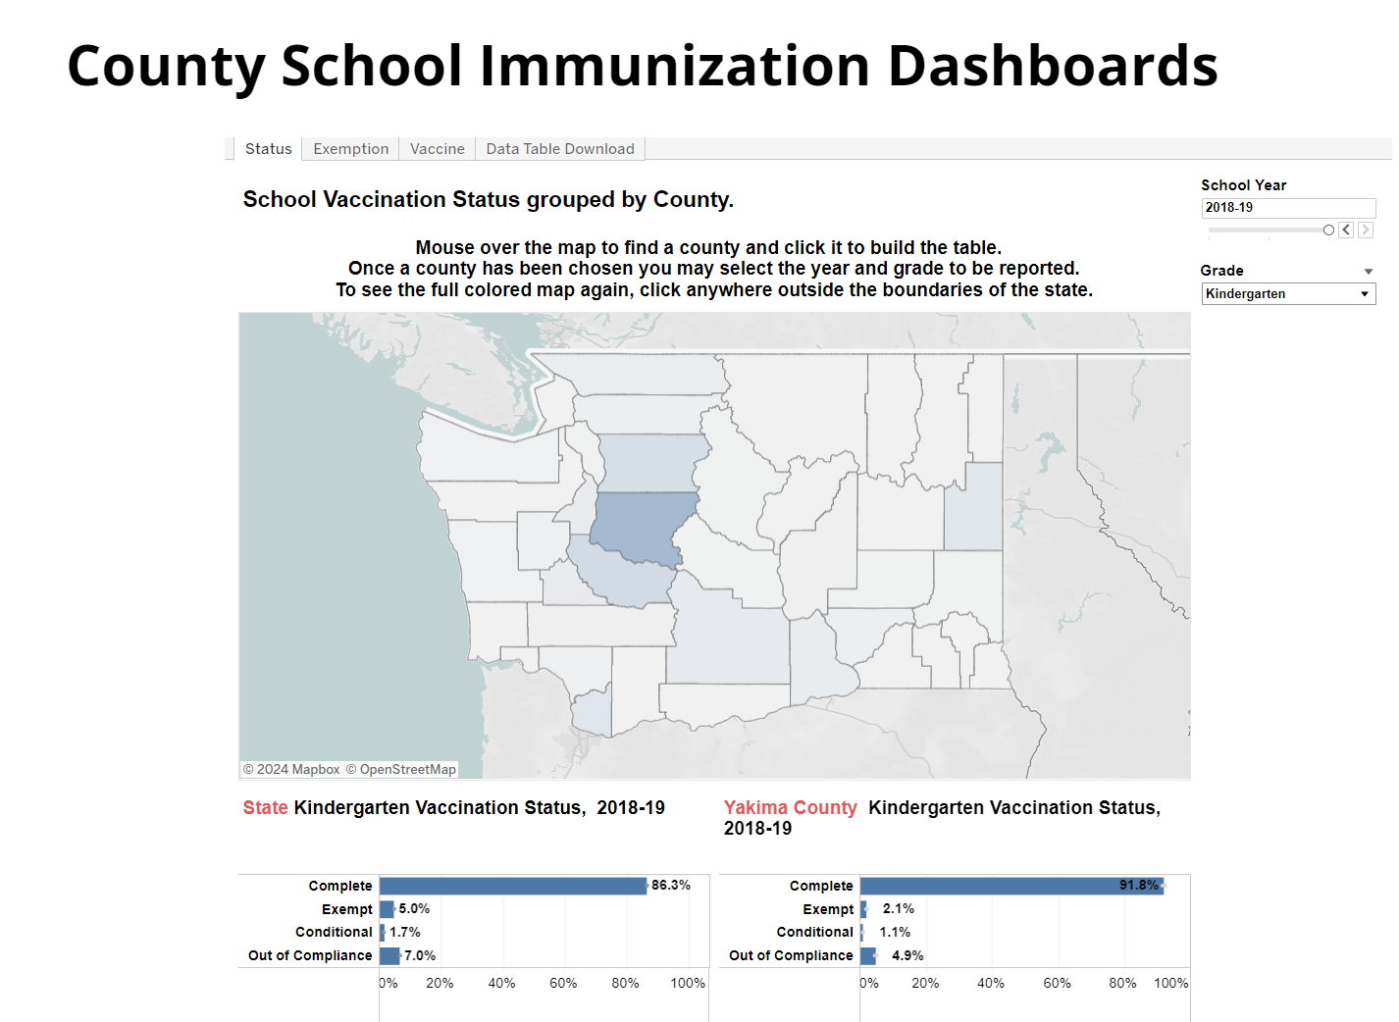
Jurisdiction Use of IIS Data
County School Immunization Dashboards | Washington State Department of Health

Slide 24
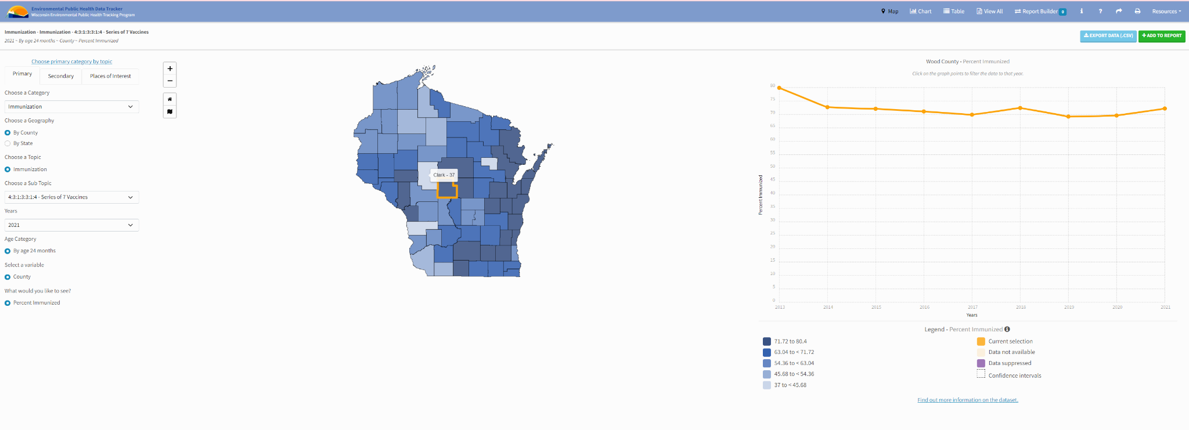
Jurisdiction Use of IIS Data
Wisconsin EPH Tracker

Slide 25
Activity: Large Group Discussion
What are some examples of effective data use in your jurisdiction?
Notes:
~10 minute discussion, time permitting. May use prompts - use of IIS data by partners, e.g., providers, child care, schools, colleges, Medicaid. May want to ask about use of dashboards

Slide 26
Data Use Key Resources
CDC Core Data Elements for IIS Functional Standards- list of CDC-endorsed data elements
CDC IIS HL7 Version 2.5.1 Implementation Guide (IG) and Addendum - guide for EHR vendors, immunization providers, and other partners to implement standards-based data exchange with an IIS
AIRA Onboarding Guidance and Shared Services - supports awardee jurisdictions with onboarding providers to their local IIS
Data Governance for Public Health - PHII course providing considerations on data governance from the lens of data modernization and public health

Slide 27

Questions, Comments, Discussion

