Slide 1
CDC and the IIS Community
LaTreace Harris, MPH
Senior Scientist/Programmatic Deputy Chief
Informatics and Data Analytics Branch (IDAB)
Immunization Services Division (ISD)
National Center for Immunization and Respiratory Diseases (NCIRD)
Centers for Disease Control and Prevention (CDC)
June 9, 2026
IIS Leadership Workshop

Slide 2
Learning Objectives
Understand the purpose of an Immunization Information System (IIS)
Understand how the IIS supports the Immunization Program through 317/Vaccines for Children (VFC) Cooperative Agreement (CoAg) activities
Understand the importance of IIS data quality
Understand the CDC’s Immunization Services Division (ISD) structure
Understand the Informatics and Data Analytics Branch (IDAB) four areas of focus
Understand how the CDC’s ISD communicates and engages with jurisdictions

Slide 3
Immunization Information Systems (IIS)
CDC and the IIS Community

Slide 4
IIS Overview
Confidential, population-based, computerized databases that record all immunization doses administered by participating providers
  Points of Clinical Care
    Provides consolidated immunization histories for use by a vaccination provider in determining appropriate client vaccinations
  Population Level
    Provides aggregate data on vaccinations for use in surveillance and program operations and in guiding public health action, with the goals of improving vaccination rates and reducing vaccine-preventable disease
Notes:
CDC’s Definition
Immunization information systems (IIS) are confidential, population-based, computerized databases that record all immunization doses administered by participating providers to persons residing within a given geopolitical area
At the point of clinical care, an IIS can provide consolidated immunization histories for use by a vaccination provider in determining appropriate client vaccinations
At the population level, an IIS provides aggregate data on vaccinations for use in surveillance and program operations, and in guiding public health action with the goals of improving vaccination rates and reducing vaccine-preventable disease

Slide 5
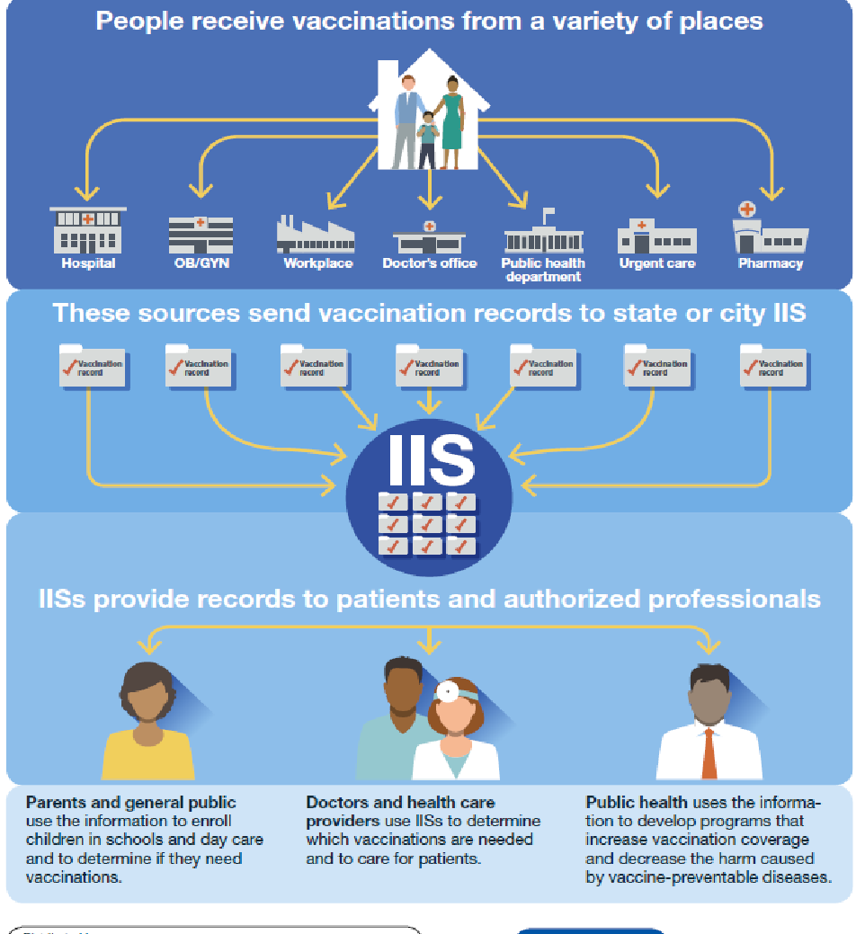
IIS Overview
IIS data enables public health workers to:
  Identify populations at risk for vaccine-preventable diseases
  Analyze vaccination coverage and work to address gaps
  Respond to public health emergencies
Infographic with blue background provides example of places people can receive vaccinations. Examples include hospitals, public health departments, and pharmacies. The infographic also outlines how places people receive vaccinations send vaccination records to Immunization Information Systems (IIS) so the public and healthcare providers have access.
Notes:
Discuss the different inputs noted on the visual.

Slide 6
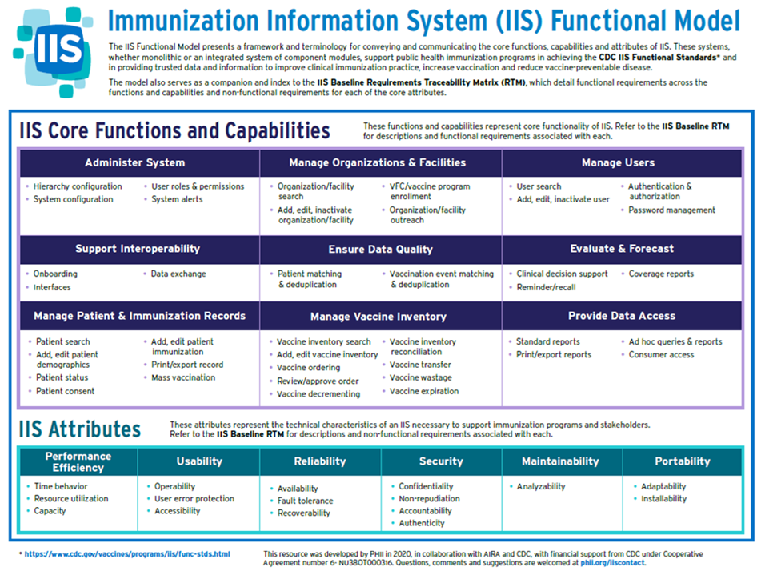
Notes:
Core functions, capabilities and attributes of an IIS

Slide 7
Key IIS Functions
Key IIS functions support routine operations and expand/scale up to support emergencies.
  Consolidated Immunization Records: Create a comprehensive, lifetime record of vaccinations for individuals, which helps avoid over- or under-immunization.
  Clinical Decision Support: Offer accurate, up-to-date vaccine forecasting to help providers determine which vaccines a patient needs based on age or health risk factors.
  Reminder and Recall Systems: Generate alerts to notify patients when they are due for a vaccine (reminder) or overdue for a vaccine (recall).

Slide 8
Key IIS Functions (con't)
Vaccine Management and Accountability: Assist with tracking, ordering, and managing vaccine inventory, including storage equipment temperature monitoring.​
Public Health Surveillance and Coverage Analysis: Allows monitoring of vaccination rates, identification of coverage gaps, and targeting of interventions to reduce vaccine-preventable diseases.​
Interoperability and Data Exchange: About 85% to 90% of all immunization data is exchanged electronically between Electronic Health Records (EHRs), pharmacies, and state/regional systems.​ IIS functionality and staff routinely support seamless data sharing between these systems through onboarding best practices, monitoring data exchange connections, and through ongoing outreach and education to provider offices.

Slide 9




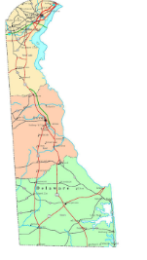
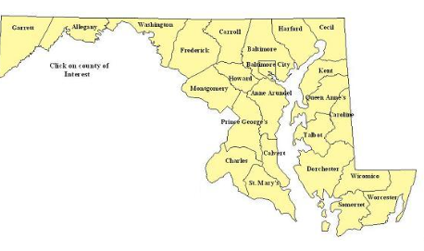
Primary IIS Data Sources
Vital statistics
Patient vaccination data via EHR*
Data from other jurisdictions and federal entities via the IZ Gateway
*There are some isolated instances in which data are not in EHRs and are submitted in batch processes.

Slide 10
What Has Changed in 10 Years?
Technological advances
  Most patient and vaccination data arrive to the IIS via electronic data exchange
  The IIS community has access to helpful tools such as Smarty and Privacy Preserving Record Linkage
  IZ Gateway facilitates data sharing between IISs, government agencies, and patient portals
  Measurement and Improvement (M&I) assesses IIS conformance to standards
Focus on data quality
  High quality IIS data increase confidence in the answers to immunization program and public health questions
  High quality IIS data help clinicians make clinical vaccination recommendations
Notes:
Many of these efforts were in place 10 years ago but have been gaining momentum since then.
Though there are still challenges in operating and maintaining the technology, Immunization Program Staff can turn their focus more towards ensuring a high level of IIS data quality.

Slide 11
IIS Focus in the Immunization VFC/317 Cooperative Agreement (CoAg)
CDC and the IIS Community

Slide 12
National Immunization Program Infrastructure Support
Section 317
Public Health Service Act
Helps meet the costs of prevention health services
Priorities include preserving immunization infrastructure, maintaining vaccine supply, etc.
Vaccines for Children Programs
(VFC)
Provides vaccines to children whose parents/guardians may not be able to afford them
Supports opportunities for all children to get their recommended vaccinations on schedule
Notes:
CDC’s Immunization Services Division (ISD) Notice of Funding Opportunity (NOFO) continues and builds upon the ongoing work of the Section 317 and Vaccines for Children (VFC) Programs. These programs remain central to the U.S. immunization program infrastructure to achieve high vaccination coverage, low incidence of vaccine-preventable disease (VPD) and maintain or improve response to vaccine-preventable public health threats.
The VFC Program provides vaccines to children whose parents or guardians may not be able to afford them. Serving as an important contributor to health equity, the program helps support fair and just opportunities for all children to get their recommended vaccinations on schedule and achieve their highest level of health. Section 317 of the Public Health Service Act helps meet the costs of prevention health services, and 317 priorities include preserving immunization infrastructure, maintaining vaccine supply as a safety net for uninsured adults, and responding to VPD outbreaks.

Slide 13
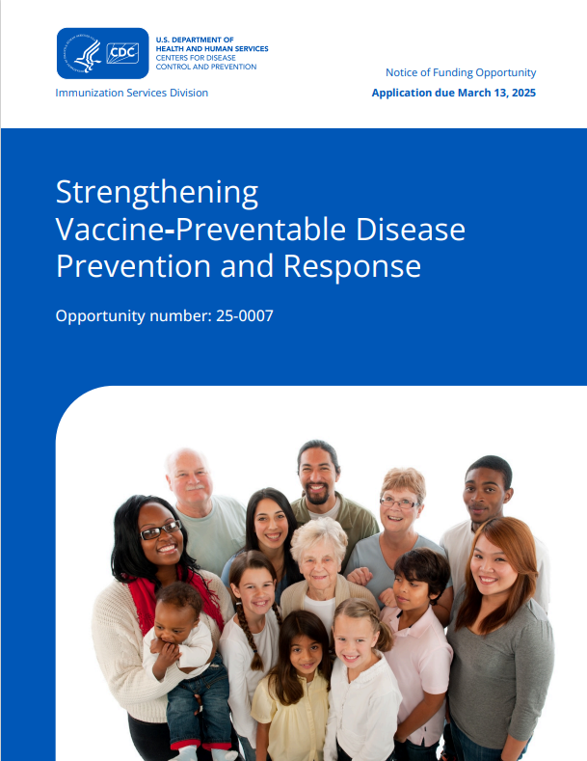
Immunization VFC/317 CoAg Strategies
Strengthen program infrastructure and management
Increase vaccine access
Improve vaccination equity
Promote vaccine confidence and demand
Enhance data and evaluation
Strengthen program support for partners
Enhance vaccination response readiness
Notes:
The purpose of this funding opportunity is to protect all people from vaccine preventable diseases using seven strategies. The seven strategies will reduce morbidity and mortality from vaccine preventable diseases.
Depends on the Awardee. As my co-workers can attest to it jurisdictions also have IIS tied to Perinatal Hep B, Adolescent, School Coverage
IIS SMEs sent their awardees an IIS Functional Model and a corresponding IIS Baseline Requirements Traceability Matrix (RTM) developed in collaboration with CDC, AIRA, and jurisdictions. The RTM provides an extensive list of essential and optional functionality across a set of core IIS functions. We hope awardees will use this information to inform their jurisdiction’s COVID-19 Vaccination Supplemental Funding plans, which are due March 1, 2021. In addition to the technical system functionality enhancements in the RTM documents, awardees should consider the following additions to the plan:
Add IIS support staff at the state level, in local health departments, or to work across groups of providers to:
Onboard providers, including COVID-19 and pharmacy providers
Improve data quality and support analytics and reporting activities
Support help desk activities
Train internal staff and providers either onboarding or already using the IIS
Develop marketing and training materials to increase IIS awareness and use within the jurisdiction
Develop IIS marketing materials targeted at submitting providers and other provider sites
Develop and/or enhance on-demand training materials (e.g., for responsibilities related to data quality)
Improve immunization program processes
Automate current manual IIS and program business processes
Procure a customer management system
Enhance the IIS provider enrollment system (e.g., with the ability to incorporate enhancements rapidly if needed in the future)
Contract with an organization to develop a strategic plan in areas such as change management, operating procedures documentation, position description development, business process improvement, and use of IIS data to support immunization program goals
Improve data exchange and access to immunization data
Adopt the Privacy Preserving Record Linkage (PPRL)
Onboard to the IZ Gateway
Implement a consumer access system
Develop and support dashboards to inform the public

Slide 14
Immunization VFC/317 Cooperative Agreement Strategies Related to IIS
Strategy 1- Strengthen program infrastructure and management
Distributing resources needed to maintain and strengthen the nation’s immunization infrastructure.
Strategy 5- Enhance data and evaluation
Enhancing existing data systems and creating new tools to improve the quality of data and of program outcomes.
Strategy 6- Strengthen program support for partners
Enabling and building partner capacity in immunization across the country.
Notes:
Most CoAg strategies relate in some way to IIS activities. Most IIS activities, however, relate to the strategies listed here.
IIS Activities are found in the following Strategy Areas of the NOFO and the VFC Camp Workplan:
Strategy 1: Strengthen program infrastructure and management: Invest in the critical people and the equitable distribution of resources needed to maintain and strengthen the nation’s immunization infrastructure.
Strategy 5: Enhance data and evaluation: Invest in enhancing existing data systems and creating new tools to improve the quality of data and of program outcomes.
Strategy 6: Strengthen program support for partners: Invest in enabling and building partner capacity in immunization across the country. This opportunity builds and leverages strong networks of partners and increases collaboration opportunities to help advance vaccine confidence, equity, and demand activities.
Since you are relatively new in your role as Immunization Program Managers, you may or may not have seen previous years’ IPOM requirements. Chapter D includes most of the IIS requirements in the IPOM. Since the IIS supports all aspects of the immunization program, however, you will also find IIS requirements in other IPOM chapters.
This slide highlights the top level IIS strategies and some of the priority activities. Data Quality, Advance IIS Capabilities, Incorporate Technology Best Practices.
You can see that onboarding to the IZ Gateway and implementing PPRL are highlighted. These additions promote data exchange among IIS and with multi-jurisdictional vaccine providers and improving data quality by linking vaccination records administered by multiple providers.

Slide 15
Using IIS to Support CoAg Strategies
Strategy 1 – Strengthen Program Infrastructure and Management
  Immunization Quality Improvement for Providers (IQIP)
  Vaccine Management
  Clinical Decision Support (CDSi)
  Coverage Assessments
Strategy 2 – Increase Vaccine Access
Strategy 3 – Improve Vaccine Equity
  Identification of Target Populations
Strategy 4 – Promote Vaccine Confidence and Demand

Slide 16
Using IIS to Support CoAg Strategies (con't)
Strategy 5 – Enhance Data and Evaluation
  CDC National Surveillance
  National Immunization Survey (NIS)
  School Vaccination Assessment
  Reminder/Recall
Strategy 6 – Strengthen Program Support for Partners
  Consumer Access
Strategy 7 – Enhance Vaccination Response Readiness
  Mass immunization Module

Slide 17
CDC Reports and Tools
CDC and the IIS Community

Slide 18
CDC Tools to Improve IIS and Data Quality
CDC Functional Standards v5
IIS Data Quality Blueprint
IIS Routine Vaccination Submission Data Quality Report*
PPRL Data Quality Feedback Report
Immunization Information Systems Semi-Annual Report (IISSAR)
*This report is not yet available.
Notes:
Later speakers will cover some of these ideas more in depth.

Slide 19
Functional Standards
The IIS Functional Standards describe the operations, functionality, data quality, and technology needed by IISs to support immunization programs, vaccination providers, and other immunization stakeholders
The IIS Functional Standards and Operational Guidance Statements (OGS) help assure that all IISs attain a level of uniformity and consistency in supporting common clinical, programmatic, and public health immunization goals for both public and private stakeholders
Notes:
Key Resource:
IIS Functional Standards v5

Slide 20
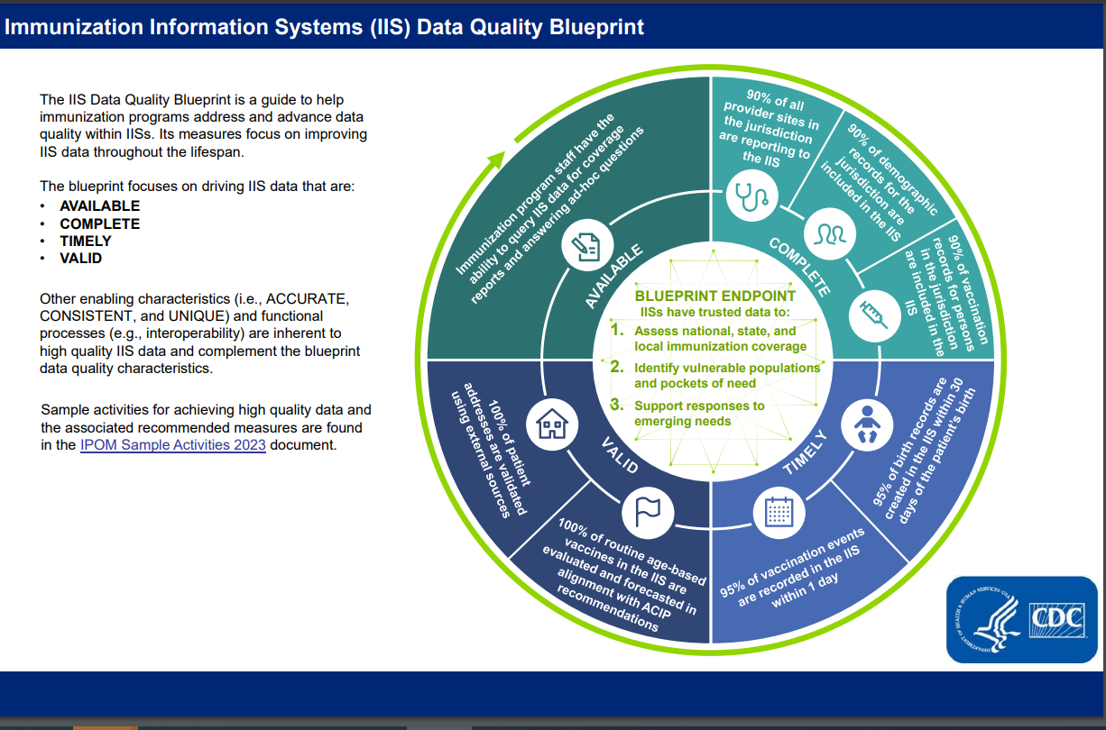
IIS Data Quality
Blueprint

Slide 21
Immunization Services Division (ISD) & Informatics and Data Analytics Branch (IDAB) Organizations
CDC and the IIS Community

Slide 22
Support: Immunization Services Division
Division Director
Georgina Peacock, MD, MPH
Associate Director for Medical Affairs
Deputy Director for Management, Operations, Policy, and Communication
CAPT Janell Routh, MD, MHS
Deputy Director for Implementation
Kathy Gallagher, BS
Shannon Stokely, DrPH
Associate Director for Communication
Associate Director for Science
Sara Dodge Ramey, MEd
Nicole Dowling, PhD
Applied Research, Implementation Science, and Evaluation Branch
Surveillance and Epidemiology Branch
Associate Director for Policy
Associate Director for Readiness and Response
Vacant
Rebecca Miller, MPH
Vacant
Informatics and Data Analytics Branch
Associate Director for Program Management
Vacant
Vacant
Pamela Nonnemacher, MS
Immunization Operations and Services Branch
Vaccine Supply and Assurance Branch
Field Services Branch
Health Education and Communication Branch
Jeanne Santoli, MD, MPH
CDR Jamie Mells, PhD, MS
Michelle Banks, MHSA, MBA, BSN
Rosa Herrera
Revised August 17, 2025
Notes:
What you can emphasize here is the adult program and the branches. IDAB works closely with our sister branches.

Slide 23
Support: Informatics and Data Analytics Branch (IDAB)
IDAB works to maximize protection against vaccine-preventable diseases by funding and supporting IISs across the country.
(Acting) Branch Chief
Stuart Myerburg
Deputy Branch Chief & Acquisition Project Management Team Lead
Kimberly Clark
Deputy Branch Chief for Program/Senior Scientist
LaTreace Harris
Vickie Garrett
Karla Harrison
Lee Kennedy
Virginia O’Garro
Susan Cleveland
Amanda Kellerman
Kafayat Adeniyi-Inniss
Nkenge Jones Jack
Outreach and Assistance Team
Lead: Jan Hicks-Thomson
Outreach and Assistance Team
Lead: Beth Cox
Informatics and Standards Team
Lead: Vacant
Application Support Team
Lead: Susan Pierce-Richards
Detailed
Kim Nguyen (ARISE)
Heba Athar (ARISE)
Ellen Boundy (SEB)
Hannah Fast (SEB)
Ashley Treharne (SEB)
Trenetria Manglona
Natalie Johns
Jennifer Ratliff
Chantel Hartman
Marley Vazquez
Crystal Edwards
Tristi Bond
Amee Demartino
Janet Fath
Chrissy Miner
David Lyalin
Faisal Reza
Terence Ng
Abdulhakeem Olorukooba - PHIF Fellow
Fikru Mekonnen - PHIF Fellow
Michael Mekbib - PHIF Fellow
Melody Parker
Shani Doss
Jackie Reyes
Lauren Shaw
Revised August 17, 2025

Slide 24
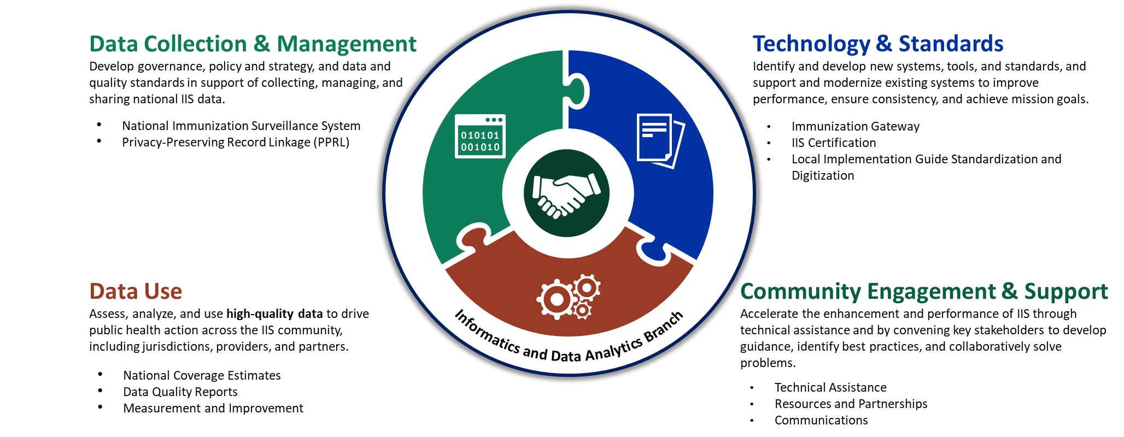
Focus Areas and Initiatives to Achieve IDAB Vision
IDAB identified, scoped, and refined these four focus areas through a series of leadership and full branch workshops during summer 2022.

Slide 25
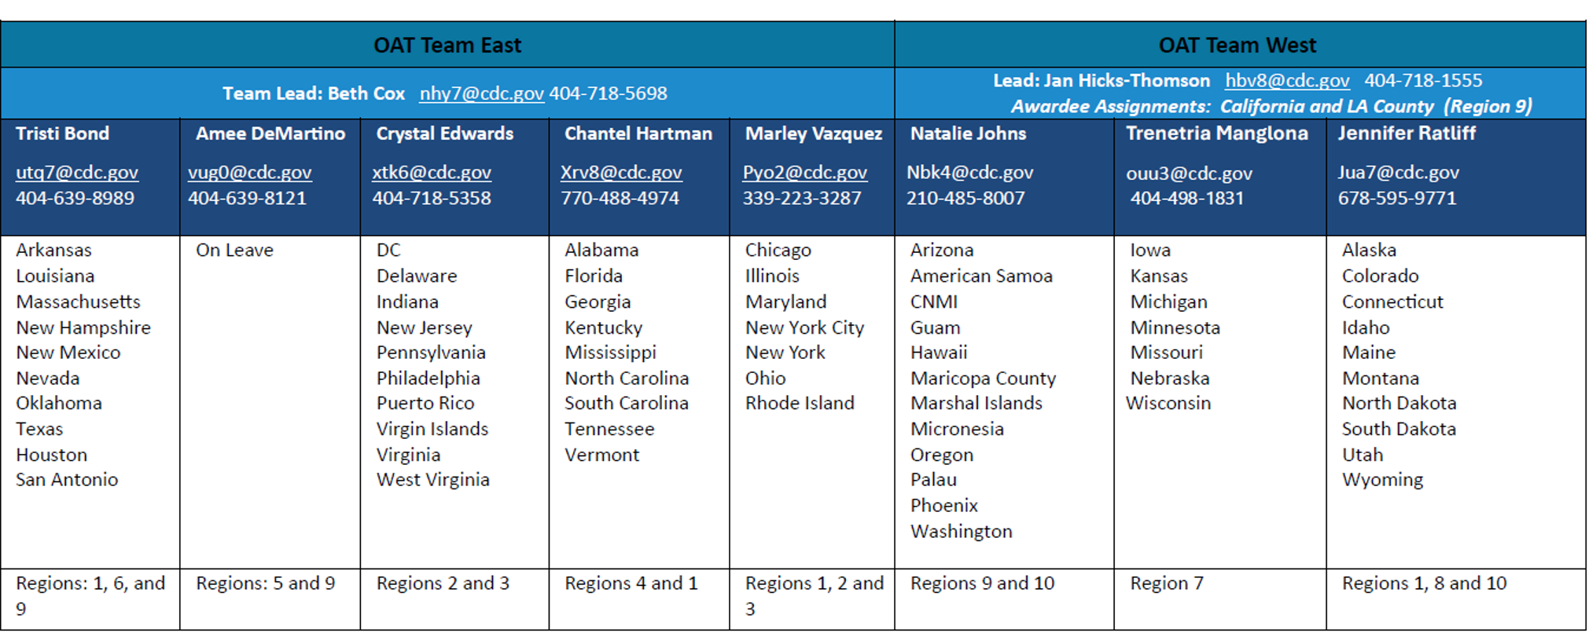
Support: Outreach and Assistance Team SMEs
IIS subject matter experts (SMEs) provide direct support to awardees. Beth Cox and Jan Hicks-Thomson lead the teams.

Slide 26
CDC and Communications
CDC and the IIS Community

Slide 27
CDC Engagement Opportunities
Support
IIS User Community Touch Base & Office Hours
Site Visits
Awardee
Reverse
National Meetings
American Immunization Registry Association National (AIRA) Conference
National Immunization Conference
On-site
Virtual
IIS All-Awardee Forums
Notes:
Communication as you heard key aspect of an IIS leader’s role…
Question: How many of you receive the All-Awardee message, IIS Branch Brief? Communicate how to subscribe
Question: How many of you have access to the ISD SharePoint? Obtain information from those that don’t to assist in obtaining access.
Many of these are opportunities to come as travel opens back up both at the jurisdiction and for CDC.
Support note-IDAB or IOSB, American Immunization Managers Association (AIM) for program managers benefit
AIRA(annual)
NIC (every other year)

Slide 28
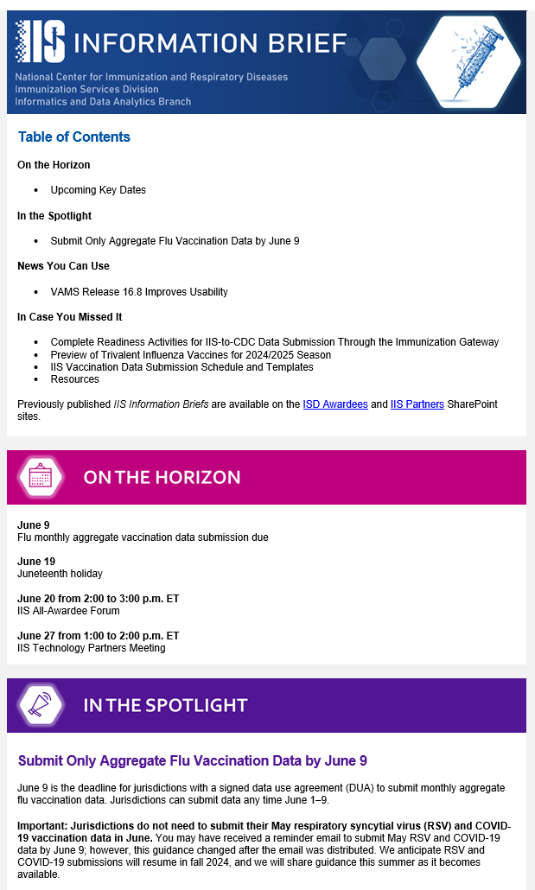
IIS-Specific Communication Channels
Resource | Audiences | Notes
IIS Information Brief Biweekly email | Jurisdictions, technology partners, and national partners | Provides updates and announcements for the IIS community
IIS All-Awardee Forum Monthly call | IIS Managers, Program Managers, select national partners | Offers opportunity for in-depth look at priority activities and hear from jurisdictional partners
IIS User Community Call Monthly Call | IIS Managers, national partners, technology partners | Provides updates focused on IZ Gateway and the opportunity for troubleshooting
VFC Cooperative Agreement Management Platform (CAMP) Document repository | Jurisdictions | Allows jurisdictions to have access to documentation pertaining to the VFC CoAg
ISD Award Recipient SharePoint Site Document repository | Jurisdictions, technology partners, and national partners | Enables CDC to manage and provide partners access to useful documents
Notes:
Resource
Format
Audiences
Notes
IIS Information Brief is Weekly email for Jurisdiction, Technology, and National Partners
That Provides updates and announcements for the IIS community
IIS All-Awardee Forum, Monthly call with IISS Managers, Program Managers, and Awardee IIS team members
Offers opportunity for in-depth look at priority activities and hear from jurisdictional partners
IIS Technology Partners Monthly call to engage IIS technology partners/IIS vendors in discussion about priorities and key technical updates
SharePoint Sites
Document Portal
Jurisdiction, Technology, and National Partners
Various SharePoint spaces allow CDC to manage and provide partners access to useful documents.
REQUEST – We want All Awardee Forums to be useful to you. Help us by suggesting topics for upcoming forums in the comments section.

Slide 29
Questions?
CDC and the IIS Community

Slide 30
Thank You!

