Slide 1
AIRA Overview
Resources to Help You Grow Your Skills
Wednesday, June 10, 2026
Mary Beth Kurilo, AIRA

Slide 2

Learning Objectives
Grow your understanding of AIRA as a member support organization
Expand your knowledge of AIRA resources to support technical, operational and policy program areas
Discuss and determine where key program staff can engage with workgroups, committees, user groups, and peers to further develop skills

Slide 3
Introduction and Highlights
What Is AIRA?

Slide 4
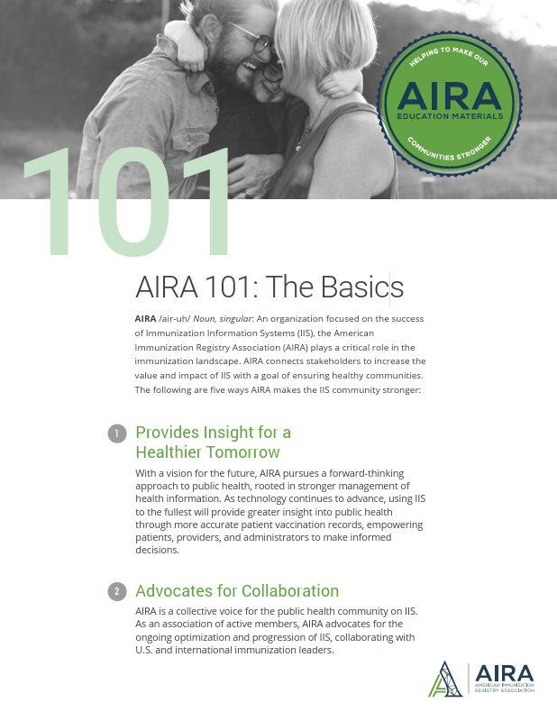
Who we are
AIRA /air-uh/ Noun, singular: An organization focused on the success of Immunization Information Systems (IIS)
Established in 1999 as a convening body for immunization registry programs
Our Mission promote and support the use of immunization information to ensure healthy communities.
AIRA: https://repository.immregistries.org/files/resources/5caf7b197bf77/aira_101.pdf
Notes:
MBK
AIRA’s work is all about empowering our community to share and use immunization information effectively.
Collaboration is the heartbeat of AIRA.
Vision: To facilitate the sharing and use of immunization information by all partners and ensure that immunization information systems are fully supported and represented.
From original slide:
1999 – Organized as an entity
2009 – Became a 501(c)3 non-profit
Members from IIS programs across the country are the cornerstone of AIRA
Governed by a Board of Directors
Staff support the work of the organization, but AIRA belongs to its members

Slide 5
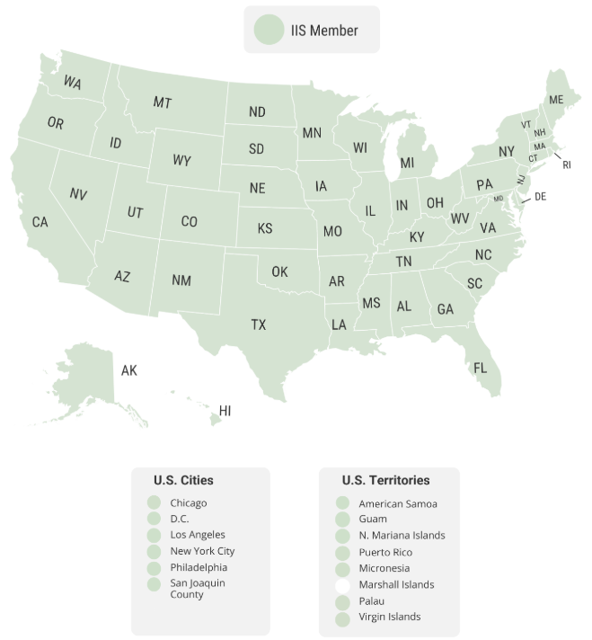
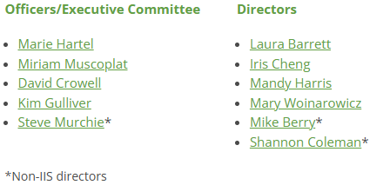
Members Are Central To Our Work
Notes:
MBK
Emphasize criticality of our IIS members, and AIRA’s role in speaking with a collective voice through comments, convening, etc.

Slide 6












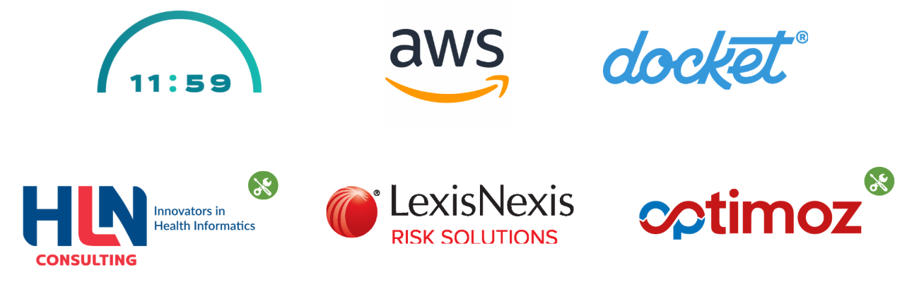








AIRA’s Partners include
Notes:
MBK - call out JPHIT as a reconstituted set of partners

Slide 7
We support our Members and Partners Through
Advocacy
Developing Standards
Technical Assistance
A collective voice for the IIS community with policy makers and partners
Leads and collaborates on the development of standards and best practices
Supports the community in advancing programmatic, policy, and technical goals
Convening
Bring the community together for trainings, informational sessions, meetings, and peer-to-peer sharing
Measuring Standards Alignment
Measures the adoption and alignment with standards
7
Notes:
AIRA is a collective voice for the IIS community with policy makers and industry partners, consolidating and amplifying key perspectives.
AIRA leads and collaborates on the development of standards and consensus-based best practices.
Our technical assistance supports the broader community in furthering their programmatic, policy, and technical goals.
We bring the community together for trainings, informational sessions, meetings, and invaluable peer-to-peer sharing helps the entire membership to be stronger.
AIRA measures the community on adoption and alignment, providing valuable feedback for change

Slide 8
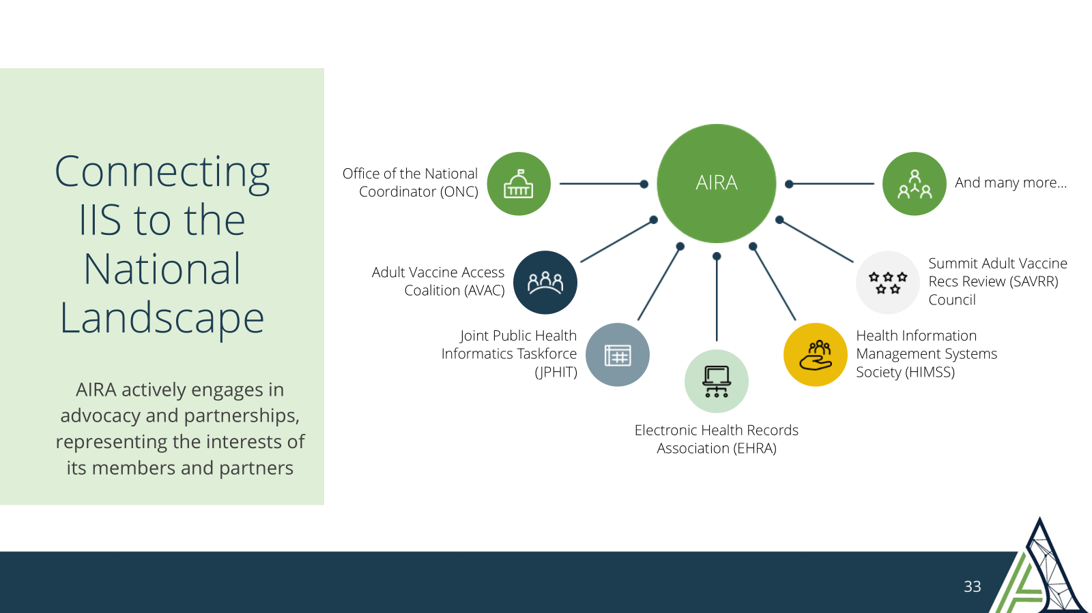
How Does AIRA Support Our Members and Partners?
Advocacy
Developing Standards
AIRA provides a collective voice for the IIS community with our state and federal policy makers and industry partners, consolidating and amplifying key perspectives
AIRA leads and collaborates on the development of standards and consensus-based best practices
Technical Assistance
Our technical assistance supports the broader community in furthering their programmatic, policy, and technical goals
Convening The
Community
Bringing the community together for trainings, informational sessions, meetings, and invaluable peer-to-peer sharing helps the entire membership to be stronger
Measuring for Alignment with Standards
AIRA measures the community on adoption and alignment, providing valuable feedback for change

Slide 9
How AIRA Strengthens IIS
Notes:
MBK

Slide 10
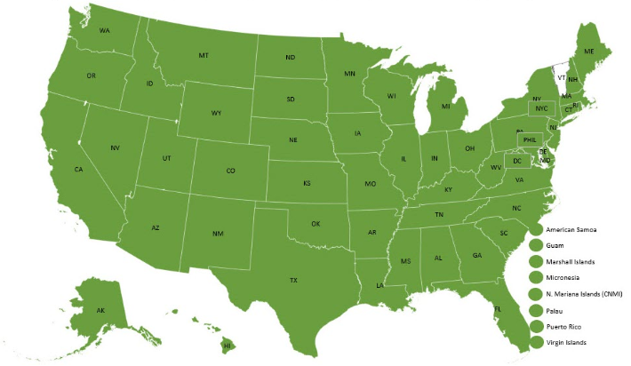
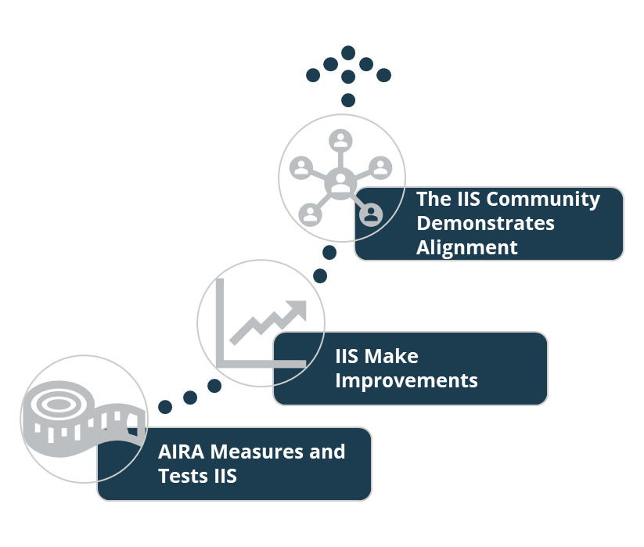
Measurement & Improvement
The IIS Measurement and Improvement (M&I) Initiative, funded by CDC, began in 2015 as an effort to:
  Test IIS alignment with standards
  Provide IIS with info and assistance to improve
All testing is conducted by AIRA through:
  Connecting with pre-production systems
  Analyzing de-identified data
  Sharing results via the Aggregate Analysis Reporting Tool (AART)
https://www.immregistries.org/measurement-improvement
Notes:
Emphasize great participation (97% of the community connected and tested in the last year).
Tie in with AART - TBD later

Slide 11




Value of Standards to IIS Programs
Improves Data Quality
Onboarding
Simplified
Supports
Interoperability
Builds Trust
in Data
Accurate, complete, and reliable immunization records
Clear expectations for providers, vendors, and partners
Enables standardized data exchange with EHRs, pharmacies, and public health
Confidence for clinical care, reporting, and decisions
Notes:
MBK
Standards are what gives us confidence in IIS systems reliable and make them usable across the board.
They ensure that the data coming into the system is accurate, complete, and consistent, which is critical for both clinical care and public health decision-making.
They also make onboarding much easier.
When providers, vendors, and partners know exactly what’s expected, integration becomes more efficient and less error-prone.
Another key piece is interoperability.
Standards allow IIS to exchange data seamlessly with EHRs, pharmacies, and other systems, reducing manual work and improving timeliness.
All of this ultimately builds trust in the data.
When programs and providers trust the data, they can confidently use it for forecasting, reporting, and responding to public health needs.
Behind the scenes, standards are what enable things like clinical decision support, population-level surveillance, vaccine management, and secure data exchange.

Slide 12


AIRA's Training & Technical Assistance
Expert Guidance
  Direct assistance for
  technical challenges connections with experts
Peer Learning
  Access to a community that has faced similar issues
Practical Resources
  Tools and information
Problem Solving
  Building long-term
  knowledge and confidence
Capacity Building
  Strengthening individual
  expertise
Personalized Support
  Support for specific and unique needs
Meeting you where you are, from beginner to expert
12
Notes:
AIRA’s training & technical assistance is designed to meet you where you are, whether you are new to IIS or have years of experience.
Combines expert guidance, peer learning, and practical resources
If you encounter a technical challenge, you can submit a request and AIRA will provide direct assistance or connect you with the right expert or peer who has likely faced a similar issue.
What makes this especially valuable is that it is not just about solving one problem. It helps you build knowledge and confidence so you can apply what you learn moving forward.
Over time, this can help to strengthens both individual capacity and overall IIS program performance.
Other questions as they arise equates to other duties as assigned. We will try to help with anything we can.
Much of our TA happens in collaboration with CDC, and often with PHII.

Slide 13

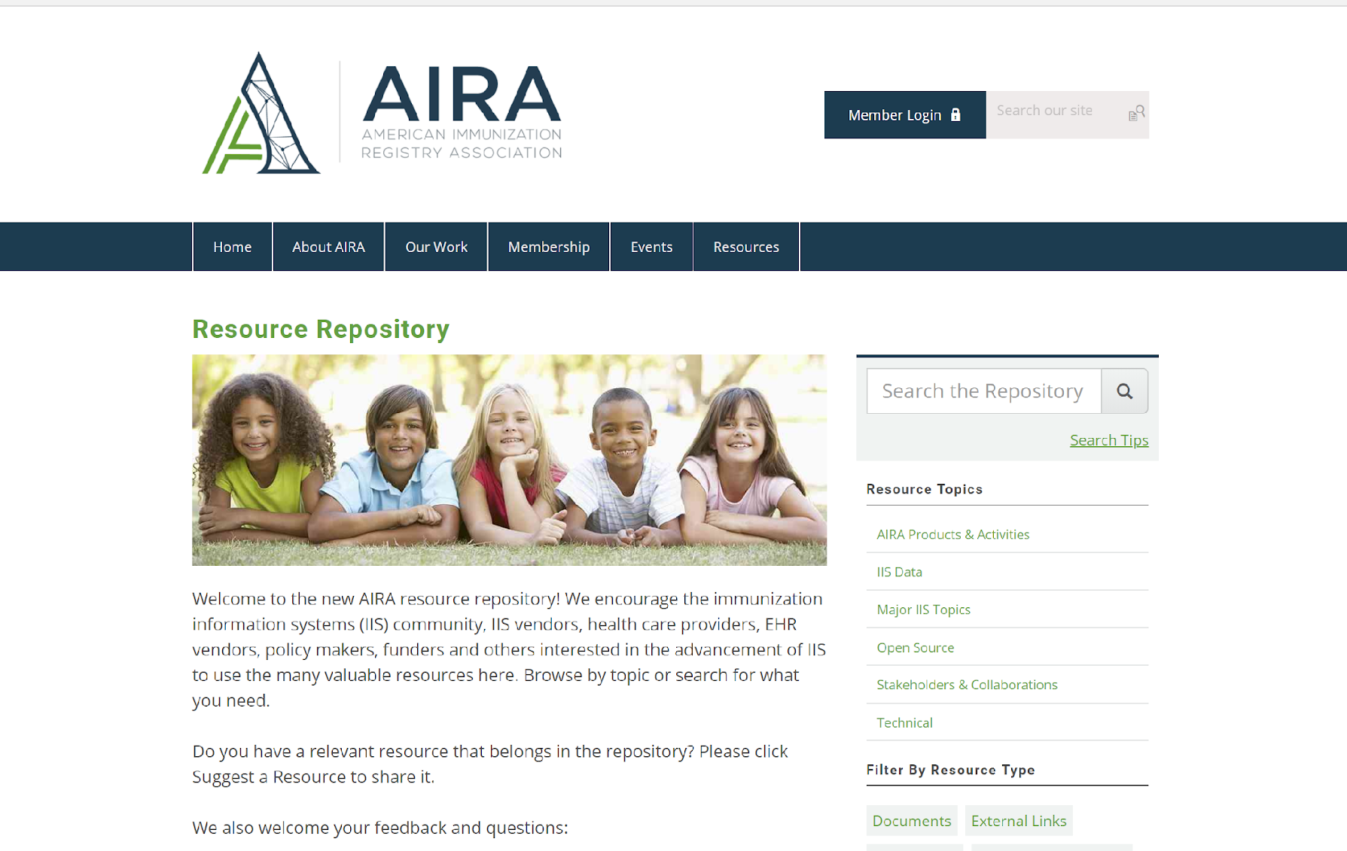
AIRA Repository
Standards and Guidance Documents
Regional and National Meeting Presentations
Webinar recordings and slides
Newsletters, Monthly Updates
Information Requests
On demand trainings
And so much more…
Notes:
Everything we’re talking about today can be found on AIRA’s repository - we hope you’ll use this as a resource to support this work.
Password protected section

Slide 14
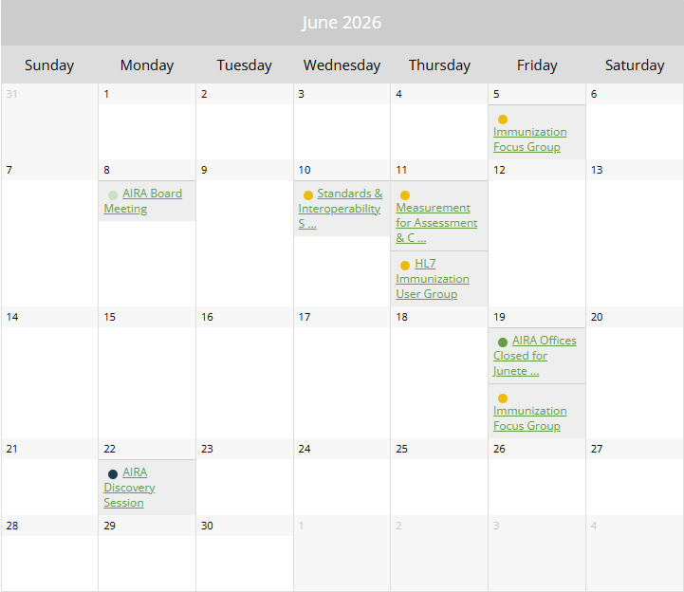
User Groups & Webinars
Smarty Address Cleansing
HL7 Workgroup
IIS Data Analyst Collaborative/Forum
Discovery Sessions
IIS Managers Meetings
https://aira.memberclicks.net/calendar
Notes:
https://aira.memberclicks.net/calendar

Slide 15

Two Key Meetings
AIRA Members and Partners Call
  Meets quarterly, 3rd Mondays at 2pm ET
  The next call is July 20th, 2026
  Hear from key partners (CDC, ASTP/ONC, PHII, ASTHO, and more!)
Standards & Interoperability Steering Committee (SISC)
  Meets monthly, 2nd Wednesdays at 1pm ET
  The next call is July 8th, 2026
  Covers a broad range of technical and operational topics

Slide 16
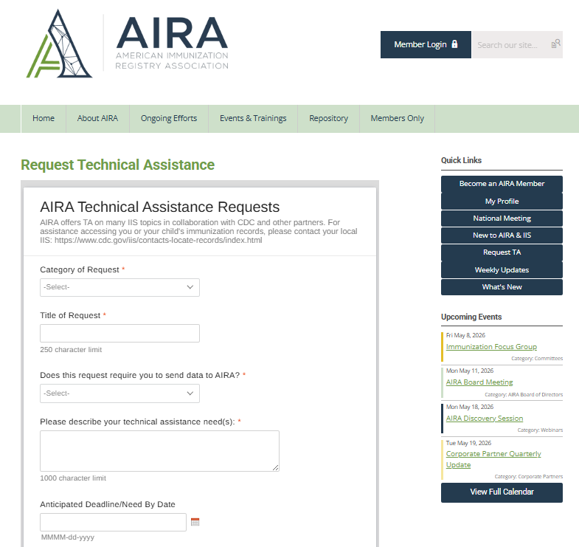

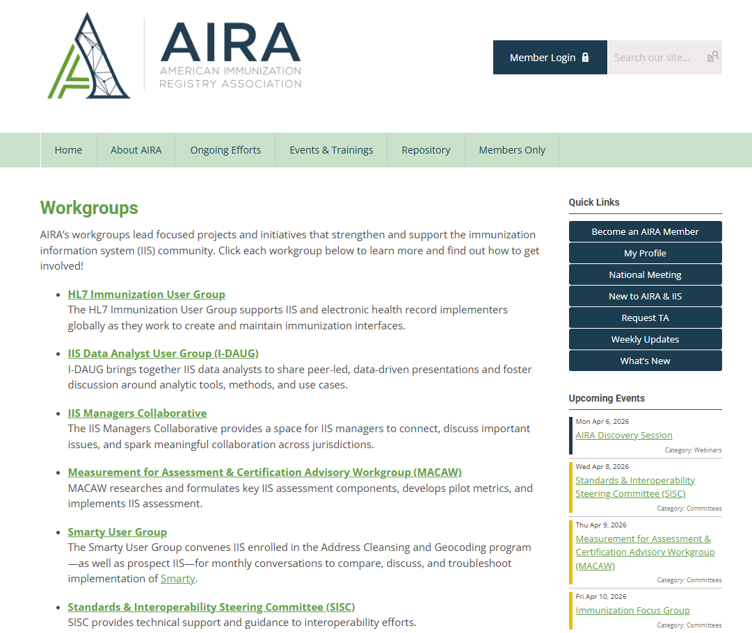
Get involved:
  Participate in workgroups and user groups
  Support each other across the IIS community
  Engage with AIRA
IIS are essential to modern healthcare and public health
Continued collaboration is critical to success
16
Notes:
RC

Slide 17
Emerging Topics (and Acronyms!)
USCDI
TEFCA
Data Modernization
SAVRR Council
Notes:
TEFCA - Trusted Exchange Framework and Common Agreement
USCDI - United States Core Data for Interoperability
CMS IPPS - Centers for Medicare and Medicaid Services Inpatient Prospective Payment System (IPPS) - the rules that govern incentive payments for providers

Slide 18
Emerging Topics
The Trusted Exchange Framework and Common Agreement (TEFCA) gaining momentum as a “nationwide network of networks”
  IIS don’t have a substantial role yet
  Learn more here: https://rce.sequoiaproject.org/tefca/
United States Core Data for Interoperability (USCDI) expanding standardization of data elements for exchange across the health care ecosystem
  Learn more here: https://isp.healthit.gov/united-states-core-data-interoperability-uscdi#draft-uscdi-v7
Notes:
rolling out Version 7 this year

Slide 19
Emerging Topics
The Summit Adult Vaccination Recommendations Review Council (SAVRR):
  Provide stakeholder input on vaccination recommendations
  Support effective clinical implementation of evidence-based vaccine recommendations
Data Modernization Initiative (DMI), Modernization for IIS (MIIS)
  The work continues!
  Modernization is funded by Public Health Infrastructure Grant (PHIG) funds and other sources

Slide 20
Emerging Topics
Clinical Decision Support – varying recommendations
  Seven independent organizations issuing recommendations
  The Summit Adult Vaccination Recommendations Review Council (SAVRR):
    Provide stakeholder input on vaccination recommendations
    Support effective clinical implementation

Slide 21
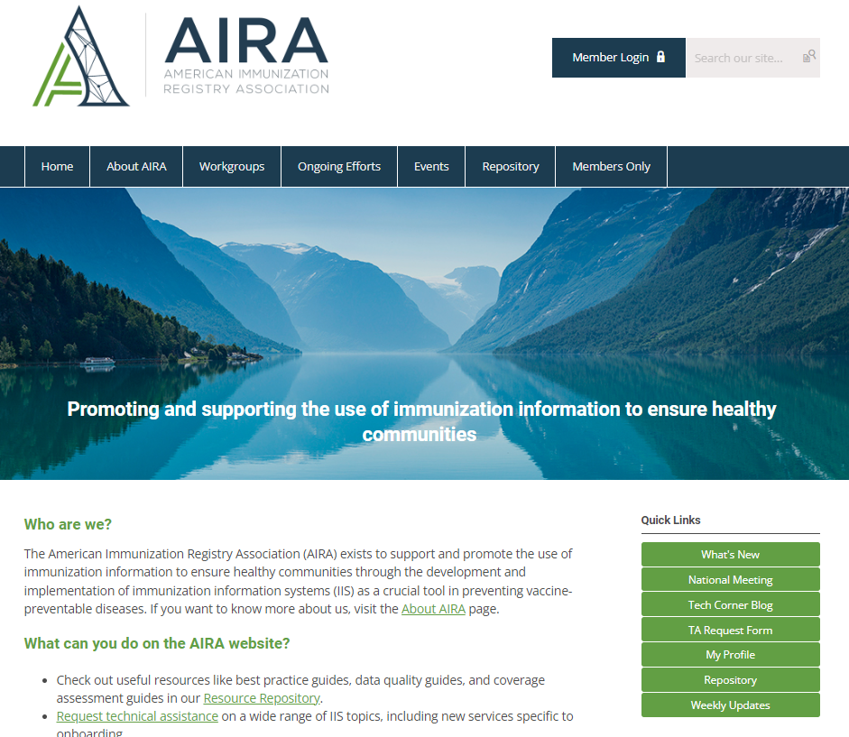
Send Us Your Questions!
TA Request
Form Link
www.immregistries.org

Slide 22

Did You Attend? How Was It?
Notes:
Asking if anyone attended?
Rationale for virtual:
NIC in August
Ongoing COVID pandemic barriers to travel

Slide 23
Bringing It All Together
How can AIRA help you as a leader

Slide 24

Bringing It All Together
Members
  The focus of all AIRA's efforts
Convening
  Brings the community
  together
Standards
  Ensure data consistency,
  usability, and alignment across jurisdictions
Measurement
  Measuring progress and
  identifying areas for
  enhancement
Training & TA
  Essential training and
  assistance to members
Partnerships & Advocacy
  Connecting partners to
  advance work & creating stronger advocates
24
Notes:
RC
Members are at the center of everything AIRA does…
IIS → The infrastructure that powers immunization data
Standards → The foundation that ensures consistency and quality
Measurement → The accountability that drives improvement
AIRA → The connector and catalyst across the community
This is where everything comes together.
We’ve talked about each of these pieces individually, but they only really work when they’re connected.
IIS is the infrastructure. It’s the system that holds and moves the data.
Standards are the foundation. They make sure that data is consistent, usable, and aligned across jurisdictions.
Measurement adds accountability. It helps us understand where we are today and where we need to improve.
And then AIRA plays a unique role. It connects all of us, brings the community together, and helps move this work forward.
None of these pieces stand alone. When they work together, that’s when we see stronger systems, better data, and ultimately better public health outcomes.”

Slide 25
Where Can AIRA Help You Hone Your Leadership Skills?
Communication
Management
Subject Matter
Expertise
Connecting with peers, Building relationships, Engaging stakeholders, Fine-tuning writing skills, Providing dynamic presentations…
Considering staffing, evaluating policies, Discussing work plans and evaluations, Developing procedures (SOPs)...
Developing knowledge of standards, Identifying best practices, Informing about the national landscape…
Notes:
[thread] communication heard/discussed in other modules
Modify wording… don’t go too far beyond

Slide 26

Activity: Opportunities to Engage
Where to plug in (for you and your staff)

Slide 27


Get Involved
Run for a board position
Provide comments
Consider a leadership role
Share your feedback
Join a workgroup/user group
Review Products
Help test and validate new tools or systems
Collaborate with peers on areas of interest
Ask Questions
Engage with Partner Projects
Seek clarification and deepen your understanding
Contribute to & learn from collaborative efforts

Slide 28

Activity: AIRA Opportunities for You and Your Staff
Review AIRA Opportunities Worksheet
Find one or two usergroups, workgroups, etc., that might be especially useful for you and/or your teammates to be engaged in
Capture your thoughts in the worksheet within the pocket of your workbook, discuss with others at your table
Share your key ideas/thoughts in a large group discussion

Slide 29
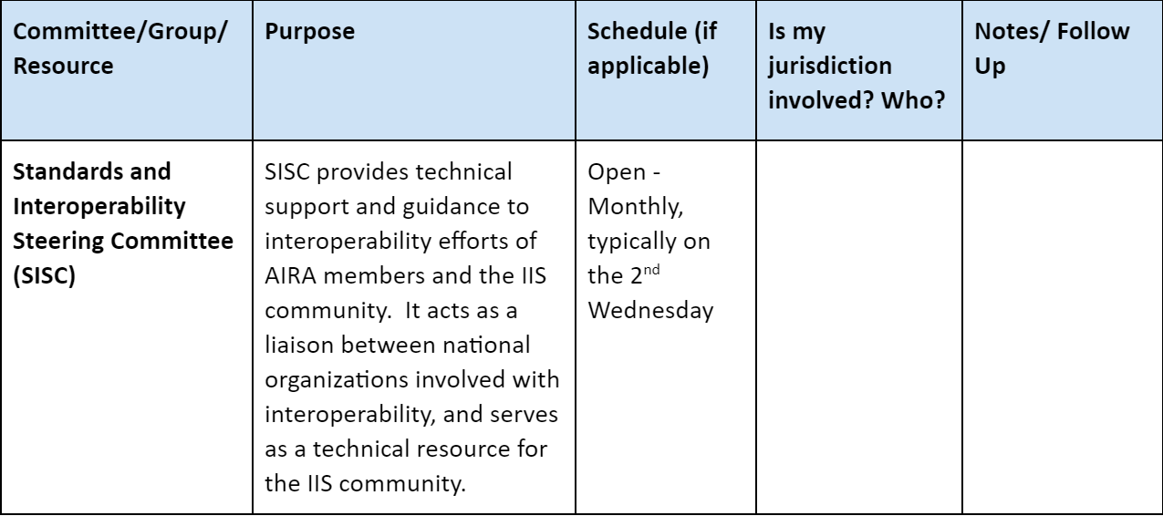
Activity: AIRA Opportunities for You and Your Staff
Review the worksheet and discuss with your peers. How might you prioritize involvement for you and your staff?

Slide 30

Activity: AIRA Opportunities for You and Your Staff
Share your group’s collective input with the larger group
Notes:
As time allows…

Slide 31


Activity: Interest Cards
While you’re at it…fill out an interest card
AIRA will follow up with you or your team members
Sign Me Up!

Slide 32
AIRA Resources
AIRA Repository - section of the AIRA website where resources (previous webinar slides, meeting presentations, articles) can be found
AIRA Events Calendar - online calendar detailing upcoming events and activities across the IIS community
AIRA Aggregate Analysis Reporting Tool (AART) - an application specifically developed to visualize and compile results and information on community-driven measures and tests related to IIS Functional Standards
TA Request Form - an online form for submitting requests for technical assistance for any IIS-related topics

Slide 33

Questions?

Slide 34
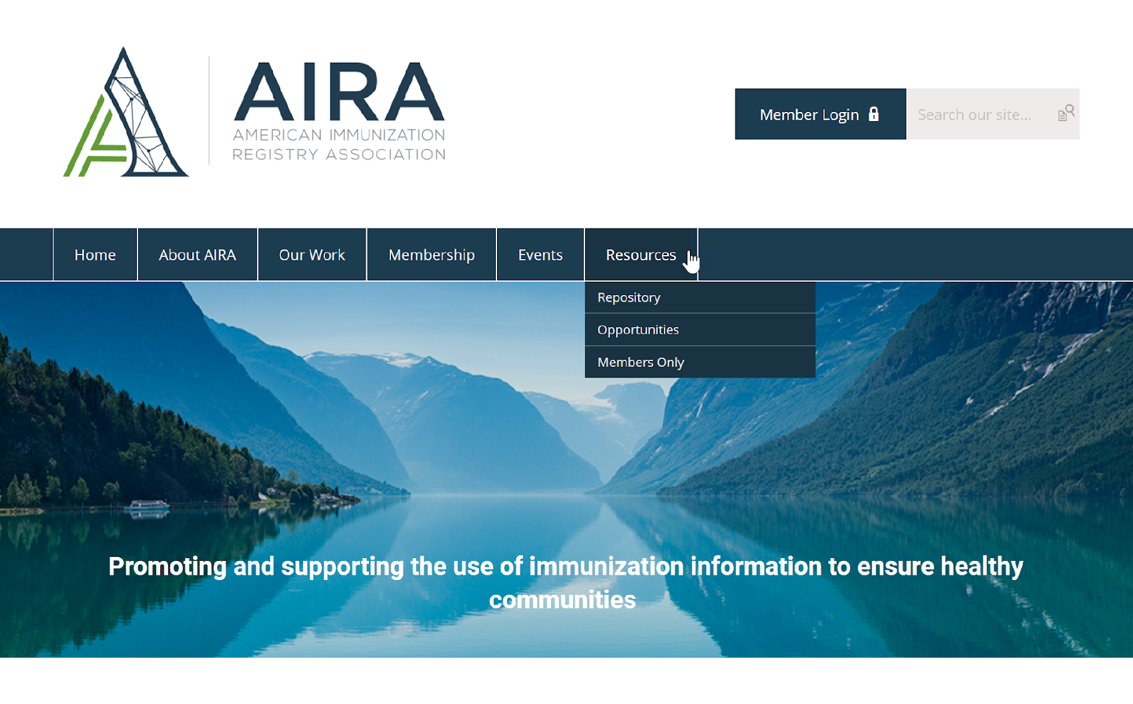

Thank You!
www.immregistries.org

