Slide 1




IIS Procurement:
An Interactive Webinar
Procurement Process Overview, Considerations and Discussion
Amee deMartino, CDC
Marcey Propp, PHII consultant
2026

Slide 2


Funding disclosure:
This presentation is supported by cooperative agreement number 6 NH23IP922664-02, funded by the Centers for Disease Control and Prevention (CDC). Its contents are solely the responsibility of the authors and do not necessarily represent the official views of the Centers for Disease Control and Prevention or the Department of Health and Human Services (HHS).

Slide 3
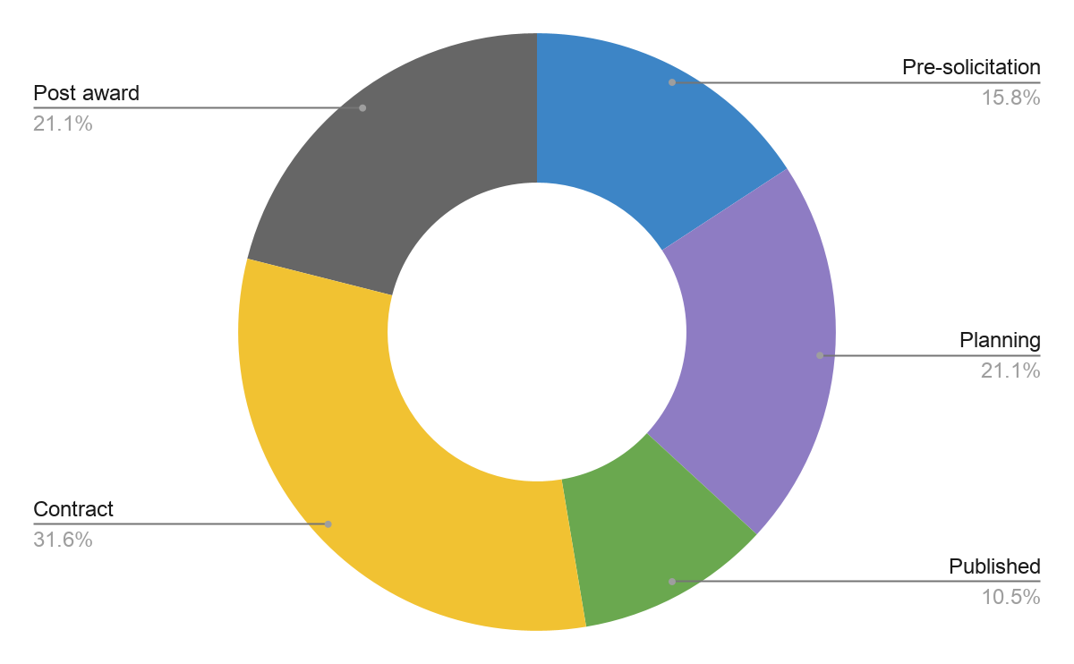
Registration profiles
Where are you in your procurement process?
What barriers have you/do you expect to encounter in your procurement process?
Uncertain funding and Medicaid changes hinder planning and timelines.
State procurement is the main bottleneck due to lengthy processes, multiple approvals, slow amendments, and loss of solicitation waivers.
Limited guidance (NASPO, other states’ experience) increases learning curve and effort.
Procurement delays drive inefficient use of staff time and resources.
Internal approval processes further slow progress.
Vendor management is effective post‑contract, but accountability is harder for lower‑funded projects.

Slide 4
Procurement webinar series: learning objectives
Discuss policies, resources and relationships to support the procurement phases and activities
Discuss ways to document service needs and expectations to improve results and collaboration with vendors throughout the contracting process and period of performance, and improve post-award management
Identify lessons learned for effective procurement practice based on peer/previous experience

Slide 5



Procurement phases overview
Acquisition planning
Solicitation
Pre-award/award
Conduct market research
Assemble acquisition team
Collect requirements
Develop project budget
Document SOW/PWS
Evaluate responses
Negotiate contract
Develop solicitation document
Award contract
Develop evaluation criteria
Publish solicitation/Q&A

Slide 6
Acquisition planning: highlights
Clarify the need - create business case
Understand all steps in the process
Know who has approval authority at what steps
Know the people; build trust
Identify procurement options
Become familiar with the templates
Obtain samples from which to learn
Recommendation
Draft a Gantt chart or a similar tool of all activities/tasks to determine appropriate lead times/timeline.

Slide 7
Acquisition planning: considerations
Market Research: If you aren’t sure you understand the IIS marketplace well, consider a Request for Information (RFI).
Budget is crucial as you cannot procure what you can’t afford.
Governance is an integral component:
How decisions are made
Who plays a role in decision making
Processes used
Who has approval authority
Assemble the ‘right’ team early on
Recommendation
Reassess team/roles as the procurement process evolves.

Slide 8
Collect requirements: highlights
Describe what is needed and not how
Commercial Off-The-Shelf (COTS) market:
Overly specific/detailed requirements can build unachievable expectations
Overly detailed Request for Proposals (RFPs) can be hard to respond to and meet without extensive customization
Customization of a commercial software product versus configuration that’s enabled by the product!
Balance between essential/non-essential requirements
Align requirements to available funding - DO WE NEED IT??!
Acquisition plan phase
Recommendation
If your requirements (and needs) are clear, every subsequent step within the process will be easier - from publication, to addressing questions, to negotiation and living with the contract.

Slide 9
Document SOW/PWS: highlights
The centerpiece of a solicitation document
Defines the criteria for acceptance
Defines your responsibilities and those of your contractor
Documenting requirements is your primary responsibility!
Requires significant attention, thought and time
The key to good documentation is precision and completeness
Whichever format is used (Statement of Work (SOW), Performance Work Statement (PWS), Statement of Objectives (SOO)), it is the single biggest determinant of a successful procurement
Acquisition plan phase

Slide 10
Solicitation document: highlights
Solicitation document written by whoever in the jurisdiction has procurement authority; generally, the contracting office.
Should be written keeping both the jurisdiction and the offerors in mind.
Need to be crystal clear about the outcomes you want to achieve.
“Good fences make good neighbors.”
Solicitation phase
Recommendation
The clearer and more complete you are in the solicitation document, the fewer issues you are likely to experience as the process unfolds.

Slide 11
Solicitation methods/types
Public
Request for proposal (RFP)
Request for quotation (RFQ)
Types
Competitive bid
Selective bid
Single (sole) source

Slide 12
Service level agreements (SLAs)
Tool
IT services worksheet
Considerations
A key document that should be required in the solicitation
Defines the level of service and terms with your vendor, central IT and/or program
Can impact pricing depending on the level of service and terms required
Included as part of the contract at time of award
Recommendation
Apply the same principles of precision, clarity and understanding of what’s reasonable/affordable and realistic.

Slide 13
Develop evaluation criteria: highlights
Need to determine evaluation criteria and identify evaluation panel.
The most effective evaluation panel includes those with sufficient technical knowledge to evaluate the technical responses and evaluate the associated pricing.
The process is designed to be fair and objective.
Solicitation phase

Slide 14
Publish the solicitation document: highlights
Jurisdiction’s rules governing the publication of the solicitation may include:
Where it is posted and by whom.
Whether you can directly notify prospective offerors, etc.
How questions are vetted and responded to.
Solicitation phase

Slide 15
Respond to questions: highlights
Pre-proposal conference
Establish a clear process for documenting, formally responding and promptly publishing or sending responses to the questions asked verbally.
Schedule early enough in the process to be helpful.
Establish a clear process for receiving, documenting drafting/reviewing/approving responses to and promptly publishing or sending responses to written questions.
Different requirements for oral vs. written comments?
Deadline for submission and a schedule for responding clearly stated?

Slide 16
Solicitation document: key takeaways
Some common mistakes made in procurements include:
Assuming the selected offeror will perform tasks not specified in the solicitation document.
Assuming the program will have direct access to the data for data cleansing or other purposes.
Over-specification of either tasks or timelines by a program.
Recommendation
Structure the solicitation document in outline format so the various components can be clearly referenced. (“In section III.C.1 you say…”)

Slide 17
Pre-award/award phase: highlights
Pre-award/award is the final phase of procurement, consisting of:
Evaluation of solicitation responses
Negotiation
Award of contract
A contract is:
Negotiated, awarded and then administered.
Mostly drafted prior to being solicited.
Finalized after negotiations are completed.
The key to a well-written contract is well-defined documented requirements.
Pre-award/award phase
Recommendation
Do not develop a contract from scratch. Leverage prior planning and documentation to finalize the contract.

Slide 18
Evaluate responses: highlights
Responses are scored/ranked based on the evaluation criteria documented within the solicitation.
Who scores?
Contracting office often sets the evaluation panel.
Most effective Evaluation Panels include:
Those with sufficient technical knowledge to evaluate the technical responses and associated pricing.
Evaluation process is designed to be fair and objective!
Pre-award/award phase

Slide 19
Negotiating the contract
Allow enough time!
Can take months.
Take the opportunity to refine terms used in the solicitation document.
Be clear about roles and responsibilities, and about system performance and service level expectations.
Pre-award/award phase
Recommendation
Don’t make assumptions about what will be provided and by whom.

Slide 20
Contract pricing
Firm-fixed price - low risk to agency; contract generally includes a milestone payment schedule that aligns payment to completion of identified segments of work
Cost reimbursable - high risk to agency; usually priced with a not-to-exceed ceiling
Time & Materials (T&M) - moderate risk; paid per hour, though requires heavy oversight to prevent "scope creep"
Indefinite Delivery/Indefinite Quantity (IDIQ) - flexible; locks in a vendor and price, but only orders when the need arises

Slide 21
Contract types: Intergovernmental and federal
General Services Administration (GSA) Multiple Award Schedule (MAS)
State Term Contracts (Statewide): Most states have "master agreements"
Piggybacking/Cooperative Purchasing

Slide 22
A word about penalties…
Are penalties for non-performance clear as to:
The circumstances under which the penalties are invoked?
The type(s) of penalties (financial or other) and, if more than one type, which apply to which circumstance(s)?
The role of program staff in providing supporting documentation related to penalties?
Be incremental in your penalties; avoid “all or nothing” clauses that don’t allow you or your vendor any wiggle room.

Slide 23
Pre award/award: key takeaways*
Know your team, rules and templates.
Terms and conditions can potentially limit the number of responses.
Inconsistencies with required approach (agile development) and pricing (fixed cost).
Vague objective(s) can lead to misinterpretation or non-response.
Unclear or unrealistic delivery requirements can lead to issues post-award.
*Based on real scenarios.

Slide 24
Post-award management
Does your procurement office send you invoices/do you approve them?
What options do you have withholding payment if you’re not getting services (tied to SLA, type of final contract)?
Regular engagement needed in procurement office in the contract period – this will be a struggle if you don’t have a relationship.
Understanding options for possible modifications – what is the lead time on modification if you need an extra module or functionality. This can be brought up at the beginning of each funding period
The ongoing relationship with procurement is required for the most successful contract

Slide 25


What’s on your mind related to procurement?

Slide 26
Group discussion
Holding vendors accountable to contracts post award
Importance of SLAs and contract negotiation process
Developing mutually beneficial service level agreements
How to resolve when the vendor does not comply with a requirement or does not comply in a timely manner?
Holding vendors accountable when project funding is minor compared to others

Slide 27
Group discussion
Best practices for project management and change management
detailed state versus vendor project plans (not just template); samples from other jurisdictions?
Change management, particularly moving outside users to a new platform
Rising costs

Slide 28
Group discussion
How to best utilize subject matter experts during the various steps of the procurement process
Key best practices in managing communications
How do you hold a vendor accountable when they have a MAS?
Is it possible to add a clause that caps the amount a vendor can increase prices after a year or x amount of time?
Do all jurisdictions have to provide their funding amount to the vendor in the procurement process?

Slide 29

Summary of procurement phases and major activities
Acquisition planning phase
Major activities
Key recommendations
Conduct market research
Develop project budget
Assemble acquisition team
Collect requirements
Document SOW/PWS
Layout all procurement activities to ensure appropriate lead times/timeline.
Reassess the team members and roles as the procurement process evolves.
Requirements can be collected in advance of issuing a solicitation.
Include people within and outside your organization who understand the need and can think strategically.
Identify requirements relevant to your jurisdiction using the IIS Baseline RTM as a starting point.
Be as specific and clear as possible regarding your requirements and service expectation.
Be realistic of what your budget will allow.
Solicitation phase
Major activities
Develop solicitation document
Develop evaluation criteria
Publish solicitation/Q&A
Key recommendations
Be as clear and complete as possible within the solicitation document.
Structure the solicitation document in outline format for reference.
Comply with jurisdictional policy regarding the evaluation, publication and notification of the solicitation document.
Pre-award/award phase
Major activities Key recommendations
Evaluate responses
Negotiate contract
Award contract
Do not develop a contract from scratch; leverage prior planning and documentation.
Be incremental in your penalties; avoid all or nothing clauses.

Slide 30
Requirements resources
Tools*
IIS Functional Standards
Core Data Elements
IIS Functional Model
IIS Baseline Requirements Traceability Matrix (RTM)
IIS Functional Model Assessment
IT Services Worksheet (service expectations)
*Additional tools can be found in the PHII IIS Procurement Toolkit located at: phii.org/procurement-toolkit

Slide 31


Thank you!
Send your questions/comments to iis@phii.org.

