Slide 1




Role of the IIS Leader
Leading the Way to Success
Amy Metroka
Notes:
For the first session of our day, I would like to invite Amy Metroka to the podium.

Slide 2
Learning Objectives
Understand the key responsibilities and skills of an IIS leader, including strengthening partnerships to promote the IIS and public health broadly
Recognize the IIS leader’s critical responsibility for building a strong and effective team
  Identify staff roles needed to successfully operate an IIS
  Learn about IIS resources to assess staffing and fill gaps

Slide 3

What does leadership mean to you?
Notes:
Identify some words or terms that describe what leadership means to you.
Add them to sticky notes and put your sticky notes on the butcher paper in the back of the room.

Slide 4
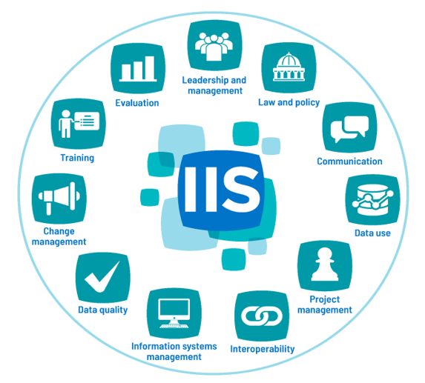
Introduction to the IIS Core Competency Model
Defines 11 competencies that are integral to the IIS team
Includes knowledge, skills and abilities for each competency
Provides links to associated reference materials
Notes:
Provides a roadmap for the IIS leader to build an effective team. We will be discussing the competencies throughout the next few days.

Slide 5
Leadership and Management Competency: Definition
The application of strategic thinking and operational skills to fully leverage the IIS in support of immunization and other public health goals.
2021 IIS Core Competency Model

Slide 6
Leadership and Management Competency: Skills
Includes 16 knowledge, skills, and abilities statements
Examples:
Create and maintain strong collaborative relationships by communicating with IIS stakeholders….
Establish strategic priorities…..
Assess organizational and staffing capacity….
Develop IIS workforce….
Negotiate and advocate for human, financial, technical and other resources…
Notes:
Here is where we all strive to be

Slide 7
IIS Leadership Framework
- informed by the Core Competency Model
Create the
Strategy to
Achieve the IIS Vision
Build a Strong
IIS Team
Engage and Motivate People
Promote IIS Data Quality and Use
Notes:
Use this as an organizing principle for the action plan/leadership plan/growth plan

Slide 8

Create the Strategy to Achieve the IIS Vision

Slide 9
Common Vision for IIS
The IIS includes a complete and accurate immunization record for every individual in the jurisdiction
IIS information is used to increase immunization rates and prevent and control vaccine-preventable diseases
Notes:
Here is where we all strive to be

Slide 10
Collaborate to Create the Strategy
Engage your immunization program manager and staff, IIS team, immunization providers, schools, technology partners (vendor, jurisdiction IT)
  Plan for the “here and now” and long-term
Get involved in CDC and AIRA activities to learn from your peers and stay abreast of new developments, challenges and solutions
Participate in your IIS technology partner consortium (if applicable)
Be flexible and adapt to change
Notes:
Foreshadow partners in addition to technology partners

Slide 11
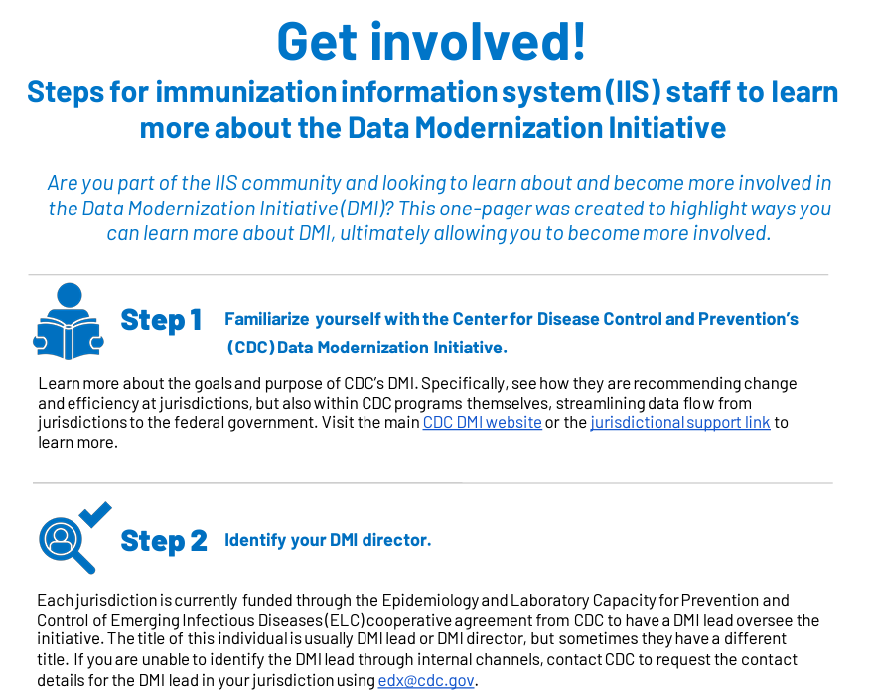
PHII One-Pager on DMI and IIS
Notes:
PHII recently published a IIS-DMI one pager for the IIS community. A step-by-step guide to ensure that IIS are connected to efforts to modernize the public health system, and offers supplementary resources to learn more about how the Data Modernization Initiative intersects with the work of IIS.

Slide 12

Build a Strong IIS Team

Slide 13
Assess Staffing
What are the staff roles needed to successfully operate the IIS?
  Do you have the necessary roles covered?
  Identify gaps
Develop and implement a plan to fill gaps through training and coaching current staff or bringing on new staff
  Consider sharing staff with other units, bureaus, divisions
Use CDC, AIRA, and PHII resources to help recruit and train staff
Notes:
Key Resources:
IIS Core Competency Model - defines 11 core competencies for the IIS team
Sample IIS Staffing Model - helps visualize coverage for key IIS staffing roles and gaps
IIS Workforce Classifications/Role Descriptions - guides identification of staffing needs and helps with recruitment
Staff Allocation Matrix - helps assess current and planned staff allocation and capacity
IIS Staff Roles Matrix - helps identify staffing responsibilities for key IIS roles

Slide 14
Ensure Key Roles are Covered
Data Quality Analyst
Assesses and improves the quality of incoming data and data at rest
Interoperability Analyst
Onboards and monitors providers and partners for reporting and/or query based on standards
Epidemiologist/Data Analyst
Analyzes data to inform program activities to increase immunization rates; ensures the IIS meets reporting requirements for CDC and jurisdiction
Outreach and Training Coordinator
Conducts outreach to increase provider participation; supports and
trains IIS users
Notes:
Emphasize that staff can come from outside the IIS, e.g., from the immunization program, IT.
Describe difference between data analyst - the epi analyzes data to inform immunization program activities, e.g., identifies low immunization coverage areas for interventions to raise coverage rates; the data analyst typically extracts, formats, and sends data to authorized users and partners, e.g., supplies health plans with immunization data on enrollees

Slide 15
Be a Role Model for Your Team
Set high standards for yourself, a high-performing team, and IIS
Foster a focus on results - make your IIS work for your partners
Collaborate to deliver a useful IIS that works to protect the health of the public
Pursue your own growth and development - encourage staff to do the same
Participate in learning opportunities locally and nationally
Join CDC, AIRA, and PHII discussion forums, workgroups, other activities
Present at CDC and AIRA national meetings - you and your staff
Connect with your technology partner consortium (if applicable)
Collaborate on writing papers for publication
Notes:
National community - regional-based and consortiums

Slide 16
Delegate
Achieving success through others is what effective management is about
Document standard operating procedures (SOPs) for staff to support execution of important tasks and improve training
Foster communication and collaboration among staff and partners
Convene staff and partners regularly
Avoid micromanaging
Challenge and empower staff to perform their roles, solve problems
Guide, support and mentor staff

Slide 17
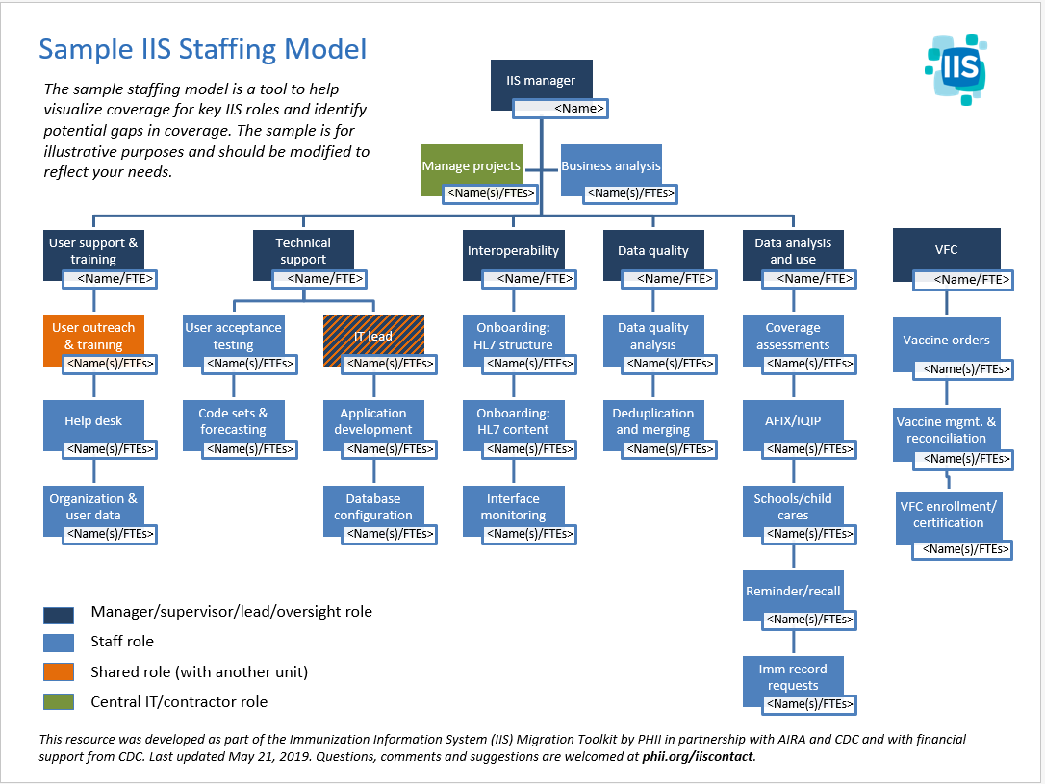
Notes:
Emphasize that we acknowledge that staff varies in size, however, these areas need to be covered. That doesn’t necessarily mean there is a staff person per area; this is not an org chart!

Slide 18
Activity Instructions
Read the IIS Staffing Model at your desk and think about how your current IIS team (including shared staff) compares to the model - 5 minutes
Go to the IIS Staffing Model posted on the back wall and attach dots indicating which roles are covered (green), partially covered (yellow) and not covered (red) among your current IIS team - 5 minutes
Return to your table to participate in a group discussion about your findings and how to fill staffing gaps - 5 minutes

Slide 19

Engage and Motivate People

Slide 20
Create and Maintain Internal Partnerships
Strengthen your partnership with your immunization program manager
  Manage up – collaborate and keep manager informed
  Advocate for the IIS - jointly develop and manage the budget to ensure sustainability
  Align IIS activities with program’s strategic vision and goals
  Ensure each staff member is engaged and understands their role
Goal: the right person in the right role doing the right things the right way

Slide 21
Create and Maintain Internal Partnerships
Work the system in your agency
Partner with colleagues to get things done, e.g., hiring, purchases, contracts
Partner with jurisdiction IT, legal counsel and other public health programs
Facilitate compliance with laws, policies for authorized IIS access and use
Get involved in DMI
Support work of Communicable Disease Prevention, School Health, Childcare

Slide 22
Create and Maintain External Partnerships
Build strong partnerships
Immunization providers
IIS technology partners
CDC, AIRA, PHII, IIS leaders in other jurisdictions
Other key external partners in your jurisdiction, e.g., schools, childcare, the public
Collaborate with your CDC IIS SME to help you meet CDC Cooperative Agreement (CoAg) requirements
Communicate early and often – critical to building support and strengthening partnerships

Slide 23
Promote IIS Advancement and Use
Advocate for the financial, human, and technical resources needed to advance the IIS
Adapt to growing expectations and evolving changes to ensure strategic sustainability and maximize IIS usefulness
  Maintain flexibility in setting priorities
  Develop and use change management knowledge and skills
Participate in CDC’s Data Modernization Initiative (DMI)

Slide 24

Promote IIS Data Quality and Use

Slide 25
Achieve High Quality Data in the IIS
What is high quality IIS data? How is it achieved?
Starts with high quality data submissions from immunization providers, other partners!
Collaborate with providers, other partners to address/resolve issues with reporting high quality data
Continually assess and resolve data quality issues
Promote data exchange with other IISs and federal partners via IZ Gateway
High quality data in high quality data out
Notes:
What is high quality data? Tools available to define it: Blueprint, IIS Dashboard, CDC DQ reports
Don’t strive for perfection, but make it a continuous process
Will be discussed in depth in a later module

Slide 26
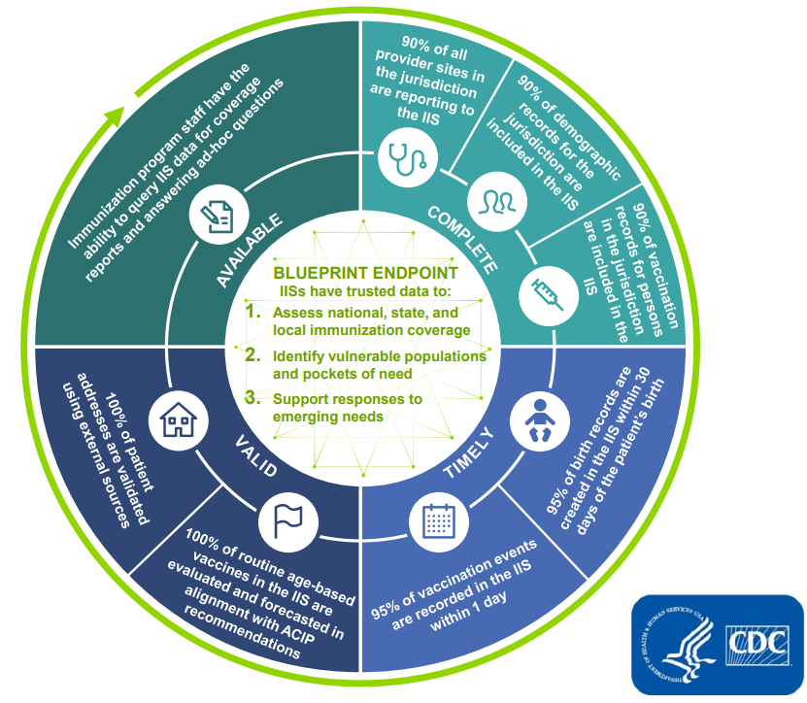
CDC IIS Data Quality Blueprint
Defines data quality, activities to achieve it, and endpoint data use
Notes:
The CDC Blueprint is foundational for determining data quality priorities. Will be discussed in depth in upcoming modules….
Note: Beth will talk about this later

Slide 27
Continuously Collaborate with Providers
Focus on what’s in it for them!
Demonstrate IIS value and facilitate high quality data submissions
Leverage publicly-funded vaccine programs (VFC, 317, adult) to incentivize complete and accurate reporting of all immunizations
Require IIS reporting of publicly-funded vaccine doses through VFC, 317 and adult vaccine provider agreements
Link vaccine ordering to reporting

Slide 28
Facilitate Provider IIS Access and Reporting
Support standards-based, bidirectional data exchange between your IIS and provider EHRs, pharmacy systems
  Enables providers to remain in their workflow when reporting immunizations - encourages more complete data submissions
  Enables providers to receive patient immunization records and forecasting at point of care during the visit
    Helps assure the patient receives recommended immunizations and avoids extra immunizations

Slide 29
Support IIS Core Functionality
Streamline major tasks of immunization program, providers, schools, CDC, other public health programs, the public
  Assess immunization coverage by provider and geographical area
  Identify vulnerable populations and pockets of need
  Respond to outbreaks
  Enable ordering and management of VFC, 317-funded vaccines
  Facilitate compliance with school, childcare vaccine requirements
  Offer the public consumer access to their own and their children’s immunization records - official proof of vaccination

Slide 30
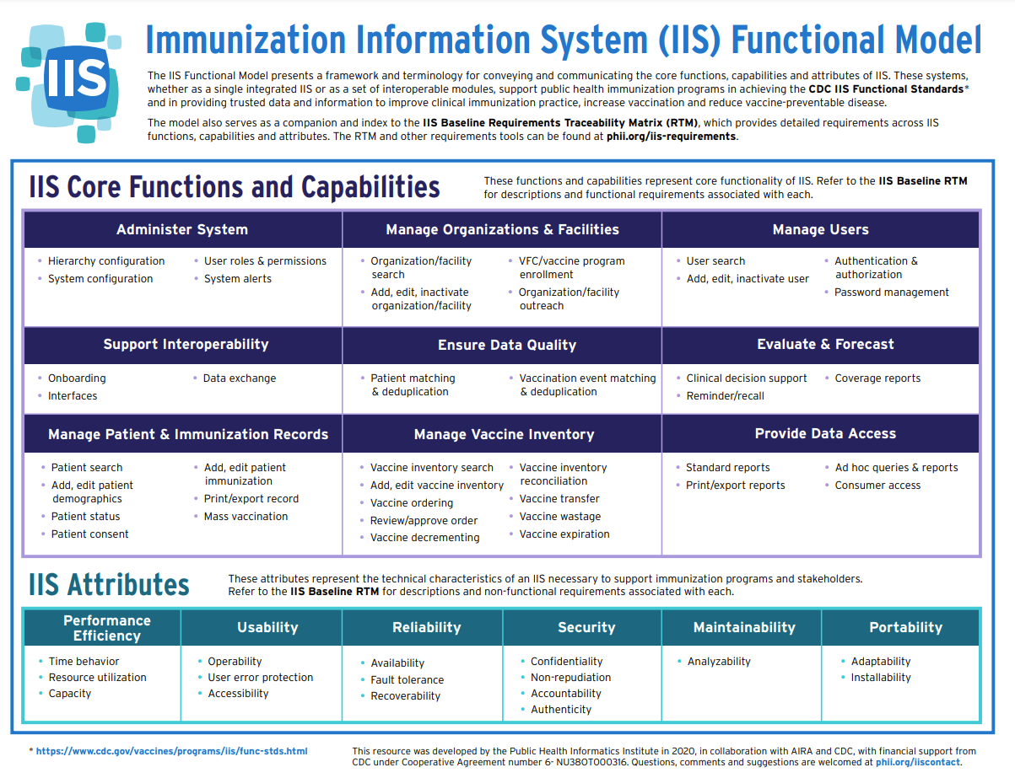
Notes:
Review format: Core functions, capabilities and attributes of an IIS

Slide 31
Ensure Authorized Use of IIS Data
It is why your IIS exists – data is its core value!
Using the data is critical to improving its quality
  Data users will help you find problems
Enable standards-based, real-time HL7 query/response
Support public dashboards with effective data visualization
Implement other data sharing methods to increase access and use to protect the health of the public
Notes:
Might want to call out the standard for IIS to allow HL7 Q/R - are they using it?

Slide 32


Necessary for Success
A skilled and knowledgeable IIS team
An IIS system with high quality data and functionality

Slide 33
Discussion Question
Where are you strongest as an IIS leader?
Where are you interested in growth?
Create a Strategy to Achieve the IIS Vision
Build a Strong IIS Team
Engage and Motivate People
Promote IIS Data Quality and Use
Notes:
Ask each participant both questions and should be built into their action plan!!

Slide 34


Questions, Comments, Discussion

Slide 35
IIS Leader Resources
IIS Core Competency Model - defines 11 core competencies for the IIS team
Sample IIS Staffing Model - helps visualize coverage for key IIS staff roles and gaps
IIS Workforce Classifications - guides identification of staffing needs and helps with recruitment
Staff Allocation Matrix - helps assess current and planned staff allocations and capacity
IIS Staff Roles Matrix - helps identify staffing responsibilities for key IIS roles
CDC IIS Data Quality Blueprint - guide to address and advance IIS data quality characteristics
CDC IIS Dashboard - identifies jurisdiction-specific data quality strengths and challenges
AIRA Aggregate Analysis Reporting Tool (AART) - provides information on IIS community-driven measures and tests
CDC Functional Standards and Operational Statements - describes operations, data quality and technology needed by IISs to support immunization programs and partners
DMI for IIS One-Pager Guide - steps for IIS staff to learn more about DMI
Immunization Program Operations Manual (IPOM) - lists requirements to meet CDC objectives (CDC Sharepoint site)
Notes:
IPOM - jurisdictions have access to the IPOM, which is behind the CDC firewall

