Slide 1




Effective IIS Data Use
Using IIS Data to Promote Immunization and Protect the Health of the Public
Amy Metroka

Slide 2
Learning Objectives
Understand the connection between data quality and data use
Apply the SIPOC framework to identify the key Suppliers, Inputs, Processes, Outputs and Consumers of IIS data
Identify the internal and external partners who can use IIS data to increase up-to-date immunization of individuals and populations
Recognize the potential impact of data visualization on increasing IIS data access, use, and awareness by the public and partners

Slide 3
IIS Data Use Competency: Definition
Data use is the translation of IIS data into actionable information to support clinical practice, immunization program operations and other purposes that protect and promote the health of individuals and communities.
2021 IIS Core Competency Model

Slide 4
Why is IIS Data Use Important?
The purpose of the IIS is to collect, consolidate and share data to increase immunization coverage rates and promote public health
Sustainability and credibility of the IIS depends on data use
Data use improves data quality
  Users find the problems and help you fix them

Slide 5
Your Role as an IIS Leader
Continuously work to achieve high-quality IIS data
  Strengthen data quality processes and personnel
  Use CDC, AIRA, and PHII resources
Promote and enable authorized use of high-quality IIS data by internal and external partners

Slide 6



How can you achieve effective IIS data use?

Slide 7
SIPOC Framework for Effective IIS Data Use
Suppliers
Inputs
Processes
Outputs
Consumers (Users)
Providers
Other IIS
Federal agencies
Patient demographics
Vaccination events
Onboarding for reporting and access
Matching, merging and de-duplicating records
Clinical Decision Support (forecasting)
Vaccination records
Immunization Forecasts
Vaccination coverage and line list reports
Reporting to CDC, jurisdiction
Dashboards
Providers
Immunization Program
Other Public Health Programs
Other IISs
Public
Schools, Colleges
Child Care
CDC
Medicaid, Health Plans
Researchers
Recruit and connect all suppliers
Motivate providers to report high quality data
Capture full range of IIS data inputs
Ensure integrity of data processes
Continuously improve data quality processes
Promote authorized access
Share high quality IIS data outputs to protect the health of the public
Enable authorized IIS access to meet public health needs
Highlight data use champions
Role of
IIS Leader

Slide 8
Recruit and Connect all IIS Data Suppliers
SIPOC
Onboard data suppliers for interoperability with the IIS
Set up accounts for suppliers to access the IIS user interface
Data Suppliers are Critical Partners for Shared Success!
  Clinics - Hospital, Public Health
  Private Provider Offices
  Federally Qualified Health Centers (FQHCs)
  Pharmacies – Chains and Independents
  School-Based Health Centers (SBHCs)
  Points of Dispensing (PODs)
  Urgent Care Clinics
  IISs in other jurisdictions and federal agencies – via IZ Gateway

Slide 9
Capture Full Range of IIS Data Inputs
SIPOC
Collect all CDC Core Data Elements - and then some
Patient demographics
  Name (first, last, middle), current address, phone number, email
Vaccination events
  Vaccination date, vaccine code, presentation, manufacturer, lot number, etc.
  Provider, Facility

Slide 10
Motivate Providers to Input Quality Data
SIPOC
Providers must input quality data to get useful data out of the IIS
To promote quality data:
Facilitate standards-based interoperability for reporting all vaccines
  Ease reporting burden
  Leverage Promoting Interoperability incentives
Ensure confidentiality and security of IIS data
  Leverage VFC and public purchase vaccine programs for adults (317, state) to get quality data in
    Obtaining publicly-purchased vaccines motivates providers

Slide 11
Ensure Integrity of Data Processes
SIPOC
Adhere to HL7 standards for both IIS reporting and access
Collaborate with your technology partners to improve record matching, merging and deduplication
Update IIS Clinical Decision Support (CDS) engine (forecaster) - align with Advisory Committee on Immunization Practices (ACIP) and CDS for immunization (CDSi) specifications
Document and implement standard operating procedures (SOPs) for key processes (e.g., onboarding, manual deduplication)

Slide 12
Continuously Improve Data Quality Processes
SIPOC
Designate a Data Quality Analyst – point person to lead a team
Ensure active review and correction of incoming data and data at rest
Work with providers to correct data quality problems
Engage with EHR vendors and providers to improve reporting of all CDC Core Data Elements
Providers need to enter detailed demographic information in their EHR for the IIS to receive the data

Slide 13
Promote Authorized Access
SIPOC
Support HL7 query/response (bidirectional data exchange) for providers, health plans, schools
  Delivers quick, easy access to patient records and forecasts
Facilitate IIS capacity to handle large volume of data requests
  Support access to a data warehouse/database replica/data lake
  Ensure sufficient processing capacity, bandwidth, storage and redundancies
Expand public access by supporting a consumer access application
  Assign sufficient staffing to support and train users

Slide 14
Share High Quality IIS Data Outputs
SIPOC
Strengthen your communication skills for different audiences to promote IIS data use
Provide vaccination records, forecasts, coverage reports and line lists to providers, immunization program, schools, payers (e.g., Medicaid), other public health partners
Share data via the IZ Gateway
  Connect to other IISs to supply and capture out-of-jurisdiction immunizations

Slide 15
Share High Quality IIS Data Outputs (cont.)
SIPOC
Send CDC aggregate and patient record-level, de-identified data regularly
  Use Privacy Preserving Record Linkage (PPRL)
  Complete the IIS Annual Report (IISAR)
Provide data to jurisdiction partners
Create or support dashboards
  Promote effective data visualization to inform and guide action for population health at local, national levels

Slide 16
Meet Consumer (User) Needs with IIS Functionality
SIPOC
Immunization Providers: Enable vaccine ordering, receiving, managing, and accounting for VFC, adult, other public vaccines
Immunization Program, other Public Health Programs, Medicaid, Other Health Plans:
Enable access to and use of IIS data and functionality to support all components of the immunization program - IIS is key to program decision-making
Enable access by other public health programs, Medicaid, other health plans for the protection of public health
Public: Offer a consumer access application to enable the public to obtain their immunization records, including digital proof of vaccination)

Slide 17
Highlight Data Use Champions
SIPOC
Recognize providers using the IIS to achieve high immunization coverage
Collaborate with AAP and other professional associations (e.g., nurses)
  Recognize providers at meetings
  Post Honor Roll on websites (AAP, health department)
  Collaborate on quality improvement initiatives
Encourage champions to share their work with peers

Slide 18
Examples of IIS Data Use

Slide 19
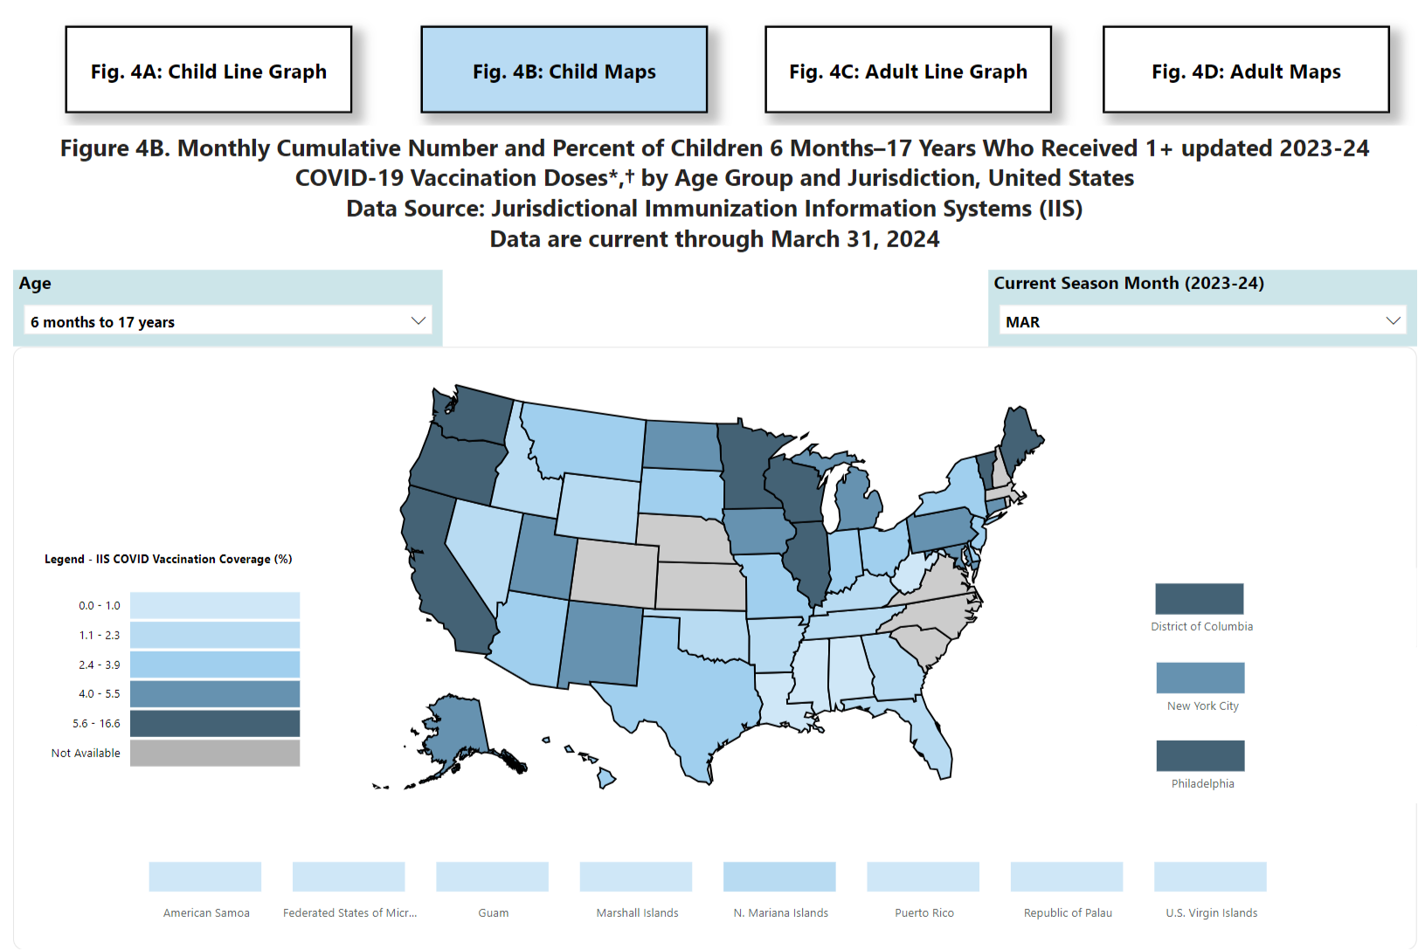
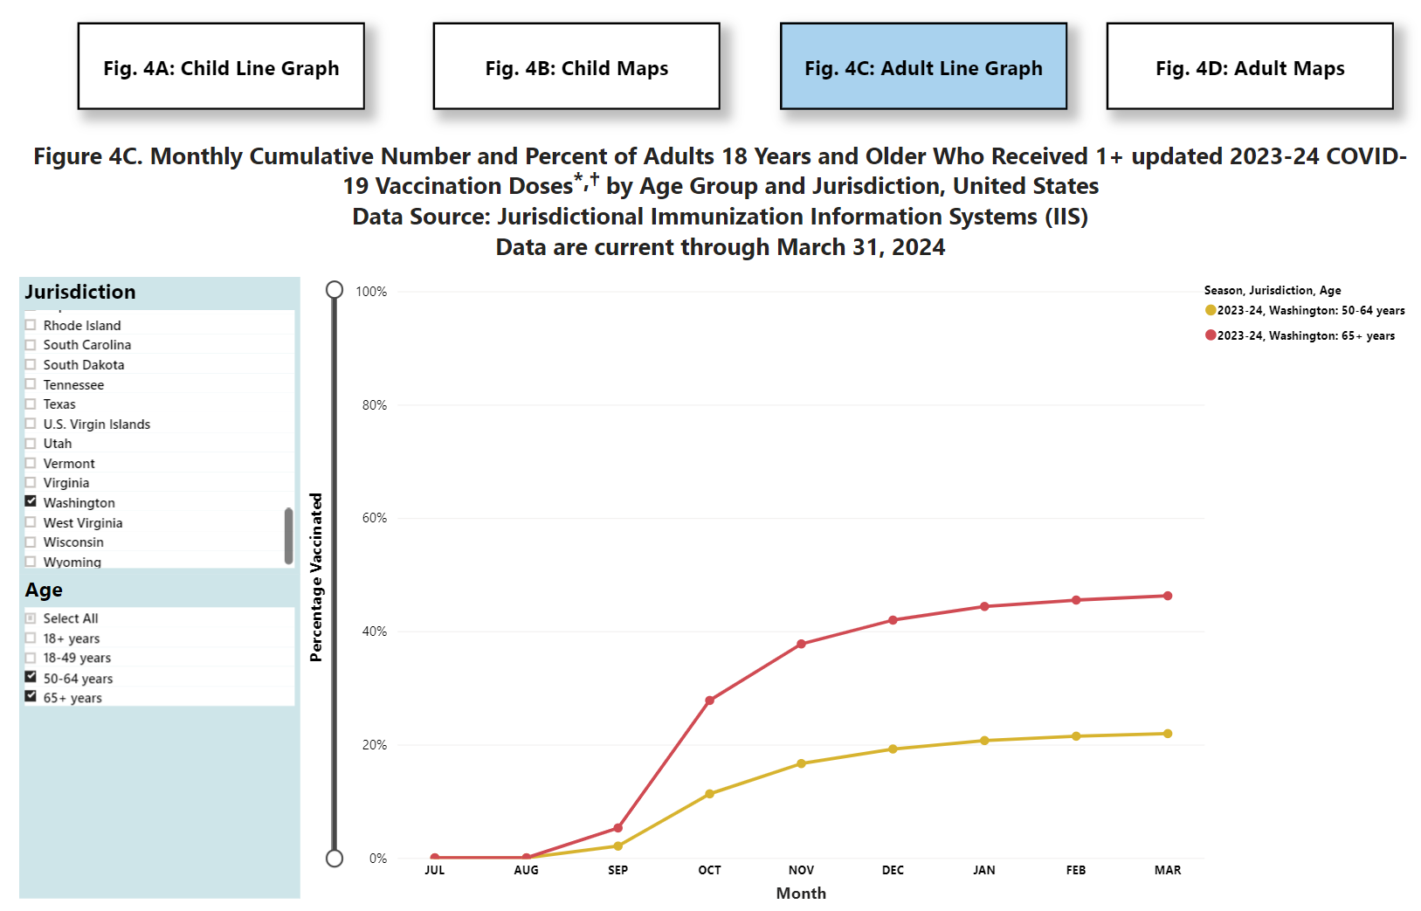
CDC Use of IIS Data
Vaccine Administration and Coverage by Jurisdiction (IIS), United States
Vaccine Administration and Coverage by Jurisdiction (IIS), United States | CDC
Vaccine Administration and Coverage by Jurisdiction (IIS), United States | CDC

Slide 20
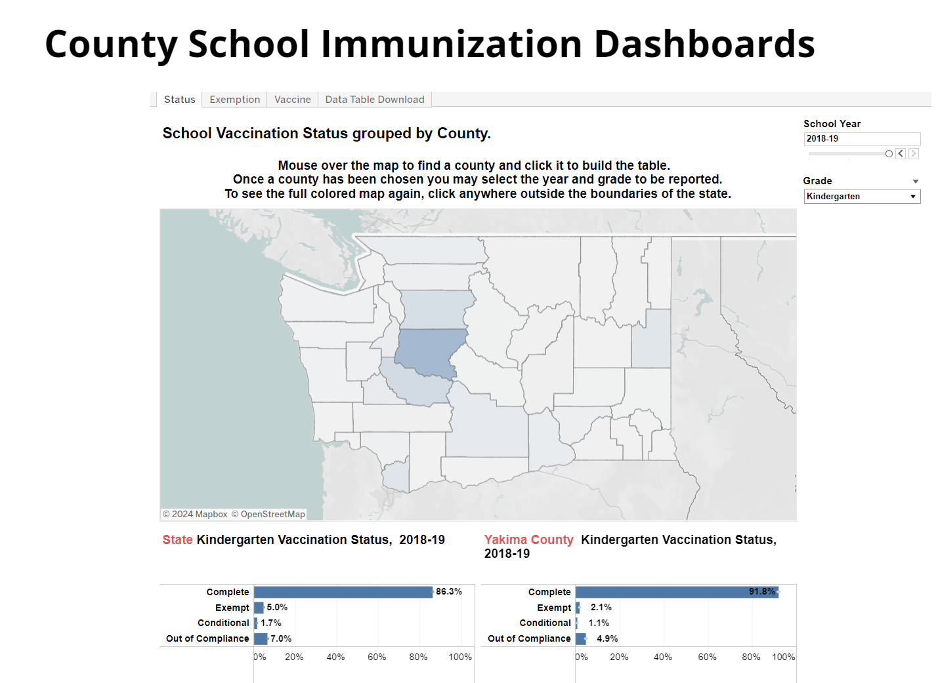
Jurisdiction Use of IIS Data
County School Immunization Dashboards | Washington State Department of Health

Slide 21
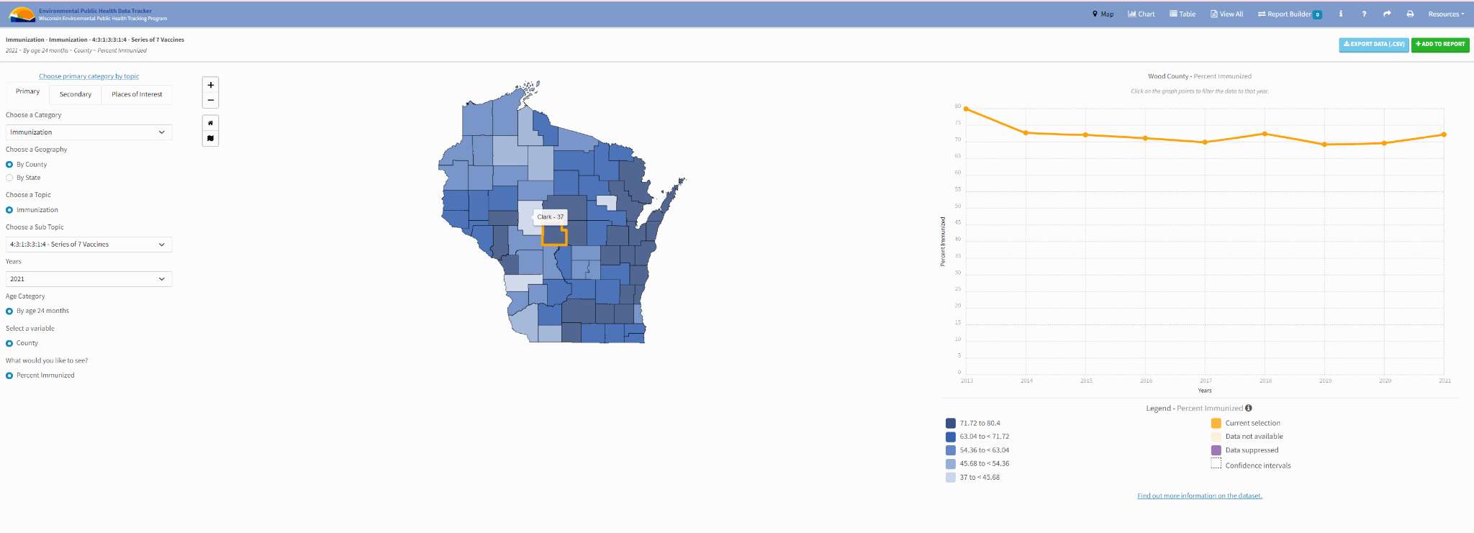
Jurisdiction Use of IIS Data
Wisconsin EPH Tracker

Slide 22

Activity: Small Group Discussion
Discuss the questions below with the people at your table, and designate one person to report out for your group.
  What data use challenges are you facing now?
  How can you work to overcome them?
  What partnerships and skills can you strengthen to increase effective data use?
After 10 minutes, each group will report out and everyone will engage in a large group discussion.

Slide 23

Questions/Comments/Discussion?

Slide 24
Data Use Key Resources
CDC Core Data Elements for IIS Functional Standards- list of CDC-endorsed data elements
CDC IIS HL7 Version 2.5.1 Implementation Guide (IG) and Addendum - guide for EHR vendors, immunization providers, and other partners to implement standards-based data exchange with an IIS
AIRA Onboarding Guidance and Shared Services - supports awardee jurisdictions with onboarding providers to their local IIS
AIRA Aggregate Analysis Reporting Tool (AART) - an application developed to visualize and compile results and information on community-driven measures and tests related to IIS Functional Standards

