Slide 1




Change Management, Project Management, and the Systems Development Life Cycle
The Convergence of People and Process to Successfully Deliver Technology
Marcey Propp, PHII Faculty

Slide 2


Learning Objectives
Understand how change management differs from project management
Recognize how they complement each other and why they are crucial to a successful systems transition/IT project
Leverage the PHII project management framework and tools as foundational resources in managing program systems initiatives

Slide 3

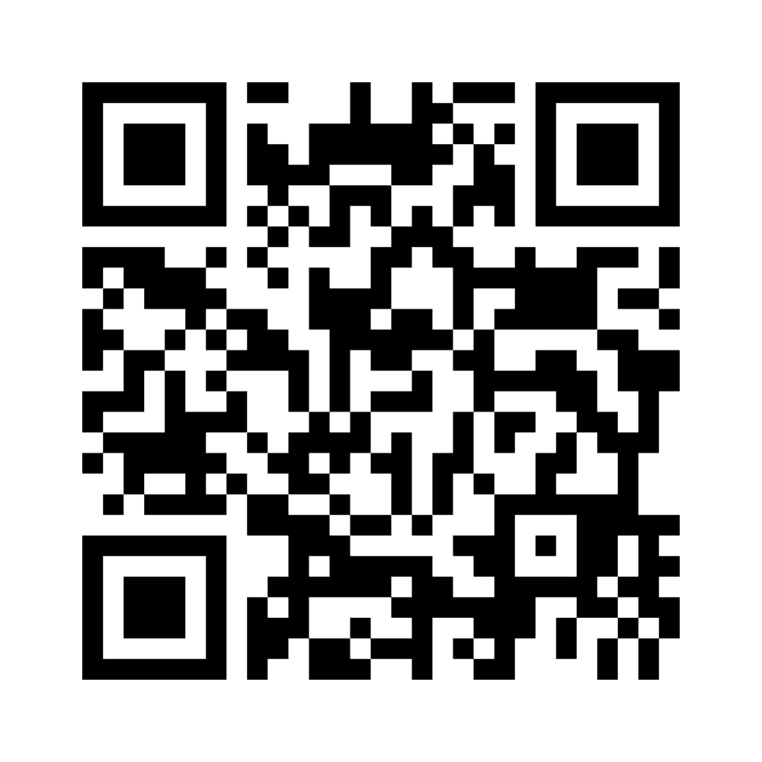
Activity: Word Cloud
How do you personally/professionally respond to change?
For example…
Embrace
Question
Fear
Loathe
Other

Slide 4
Information Systems Management Definition
Application and administration of technologies to securely and effectively meet IIS program and user needs.
2021 IIS Core Competency Model

Slide 5



Successful Change
Systems Development Life Cycle
Project Management
Conceptual model used in information system design and development that defines the stages in bringing a project from inception to completion.
Application of methods and tools to achieve defined objectives within the available time, human, technical and budgetary resources.
Change Management
Application of methods/tools to engage and support partners through changes in policies, processes and/or technologies.
2021 PHII IIS Core Competency Model

Slide 6

Project Managing the SDLC
Convergence of People, Process and Technology
Budget
Project Sponsorship
Staffing
Planning
Project Management
Change Management
Scope
Charter
Training
Risk Management
Communications
Change Control
Business Case
Documentation
Status
Reporting
Maintenance
Process Flows
Testing
Requirements
Implementation
Deployment
SDLC
Performance
Design
Capacity
Scalability

Slide 7
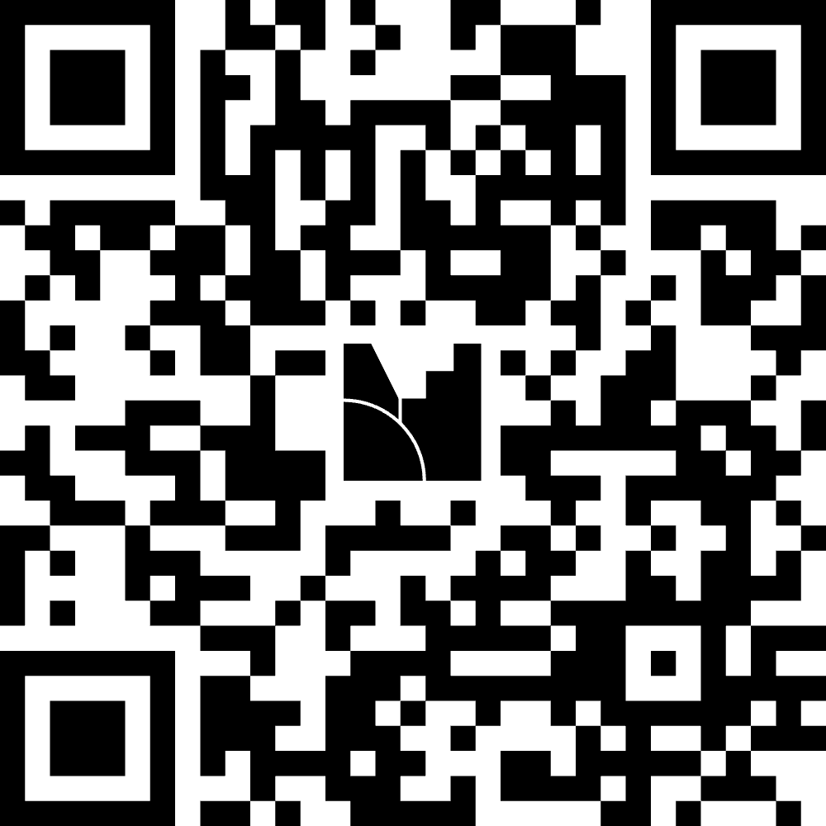
Activity: Organization Change Readiness Assessment
1. Thinking about your organization, click on the QR code to answer the following questions in Menti (Yes/No)
Most changes in my organization in the past have been implemented successfully
Leadership in my organization are visible and active change leaders and sponsors
My organization encourages and rewards staff who promote change and introduce new ideas
My management team is receptive to feedback and alternative ideas and encourages open communication
2. Discuss your responses with the larger group

Slide 8
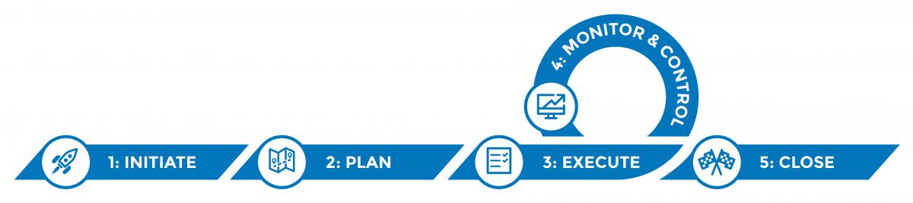
Project Management Framework
The five phases of the project management lifecycle:
Resource: https://phii.org/what-we-do/iis-hub/iis-operations/

Slide 9
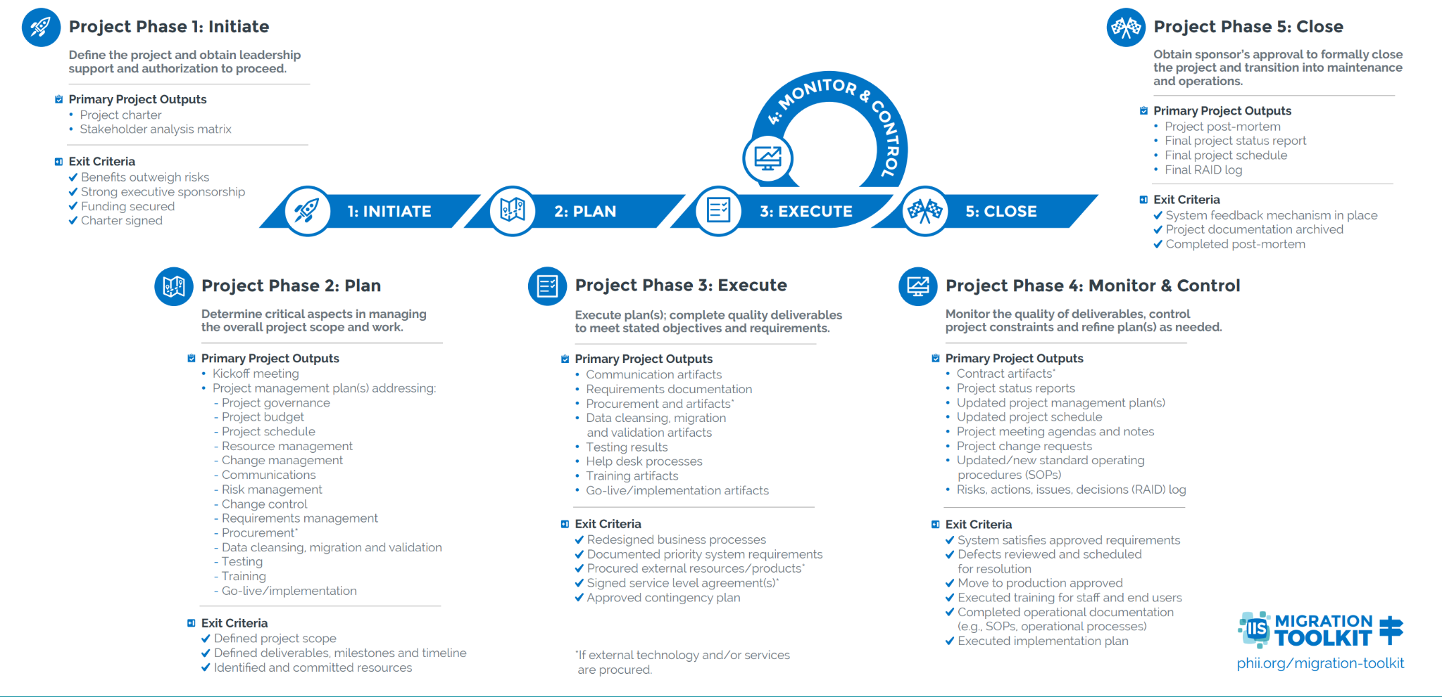

Slide 10
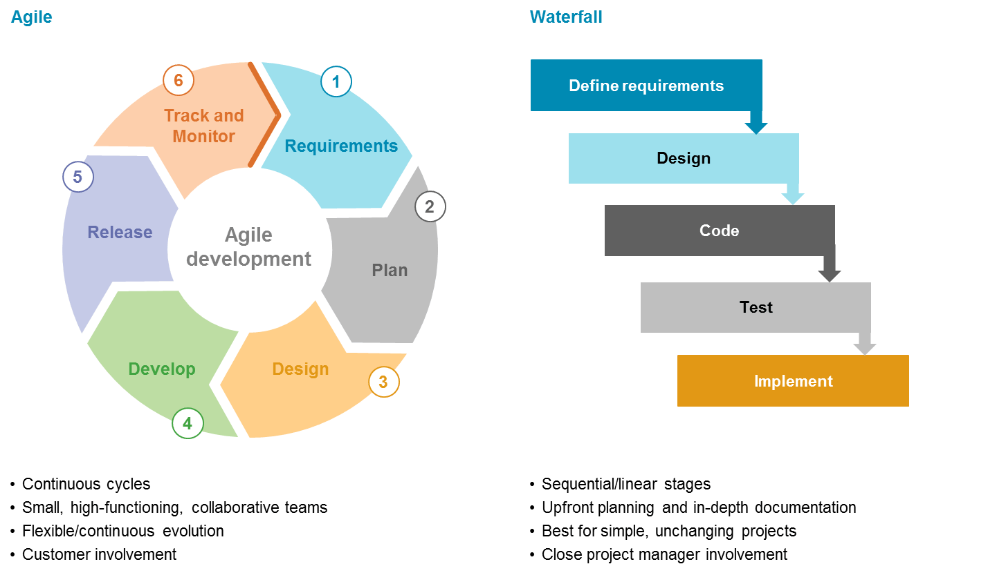
SDLC Delivery Approaches: Agile and Waterfall
Deployment
Resource: https://saigontechnology.com/blog/agile-vs-waterfall-in-software-development

Slide 11
Leveraging Agile for System Development
An Agile approach to system development, transition and maintenance can:
Help meet the demands of a rapidly changing, dynamic world
Enable thinking in terms of functions instead of systems to promote modularity and flexibility
Allow for a more flexible version to help deal with immediate, urgent needs
Provide additional functionality and choice in addressing emergent needs
Use modularity to be genuine and substitutable with components that are truly interoperable through application program interfaces (APIs)
Resource: DMI Recommendations Document

Slide 12
IIS Functional Model
Visual representation of the baseline functions, capabilities and attributes of a standard IIS
Identifies core functions that promote modularity and flexibility rather than promoting a single monolithic system
Represents a core system that can be supplemented by ancillary applications
Developed as a tool to assess your IIS in terms of:
Functionality
Alignment with Functional Standards/IPOM
Enhancements

Slide 13
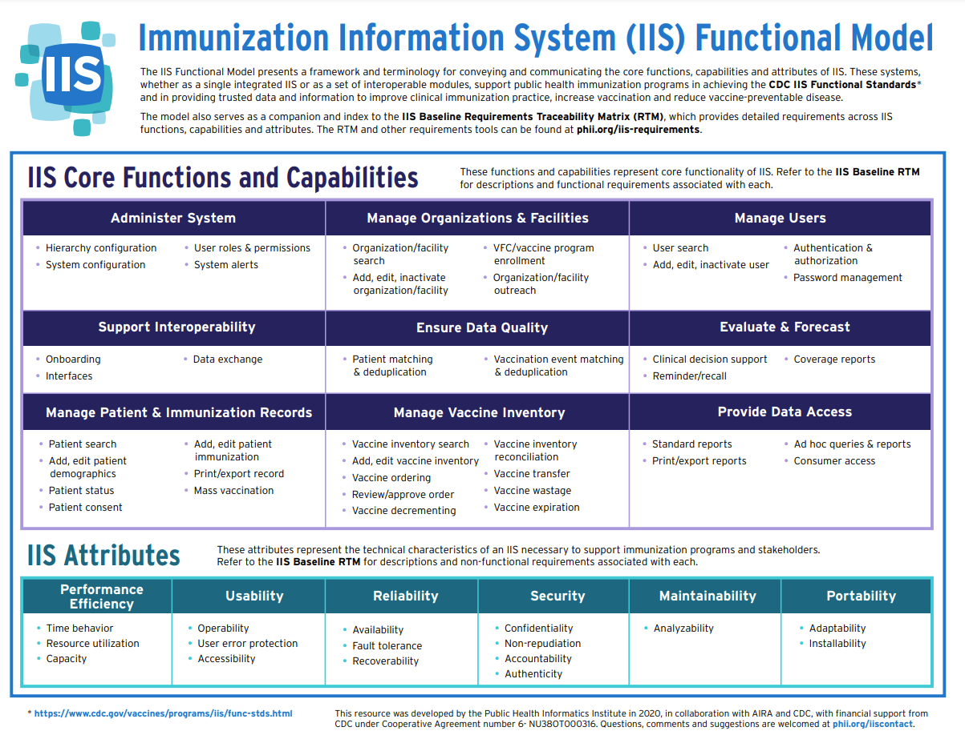

Slide 14
IIS Leader Considerations
Consider a balance between an IIS that meets your programmatic needs and one that allows for interoperability across modules, agencies and systems
Maintain awareness/understanding of emerging technologies, cognizant of the priority, need and cost to internal and external partners
Promote a culture of adaptation to present and evolving changes (e.g., DMI) to ensure strategic sustainability
Ensure you have the appropriate governance, staff and disciplines to successfully deploy and optimize new technologies
Align program efforts with other IT initiatives and agency’s overall strategic roadmap

Slide 15
Activity: Repurposing the IIS SWOT
In your team:
IIS Strengths
IIS Opportunities
Identify a spokesperson to read out your team’s responses to the broader group
IIS Strengths | IIS Weaknesses
IIS Opportunities | IIS Threats

Slide 16
Role of an IIS Leader
Foster productive internal and external partnerships
Establish and promote an environment of continuous improvement
Provide mechanisms for collecting, sharing ideas and fostering innovation
Apply SDLC, project management and change management disciplines to deliver technologies that meet agency, program and users’ needs
Delegate activities and tasks to leverage staff expertise and strengths in system deployments – don’t try to do everything yourself!

Slide 17

Questions, Comments, Discussion

Slide 18
Change Management, Project Management Resources*
Change Management Tools - guidance on change management activities that assist internal staff and external partners through transition
Project Management Framework - guidance to initiate, plan, execute, monitor and control, and close an IIS project
IIS Functional Model - a framework and terminology for conveying and communicating the core functions, capabilities and attributes of an IIS
IIS Baseline Requirements Traceability Matrix (RTM) - draft baseline functional and non-functional requirements for an IIS to clarify minimum expectations for what IIS technology must do and how it must operate to support IIS Functional Standards and programmatic and immunization stakeholder needs
RAID Log - a centralized source of Risks (R), Actions (A), Issues (I) and Decisions (D) identified and tracked throughout a project and a convenient means of distributing it to project team members and stakeholders; reviews and edits to the RAID log contents are commonly facilitated by the project manager during weekly project team meetings
DMI Toolkit - a guide to build leadership and partner buy-in for data modernization work and to assist health departments in developing plans that prioritize data modernization activities.
*Change Management and Project Management tools can be found in the PHII IIS Operations Toolkit located at: https://phii.org/what-we-do/iis-hub/iis-operations/

