Slide 1
CDC and the IIS Community
National Center for Immunization and Respiratory Diseases
Chantel Hartman, MPA, CPH
Informatics and Data Analytics Branch Immunization Services Division National Center for Immunization and Respiratory Diseases Centers for Disease Control and Prevention
June 10, 2025
IIS Leadership Workshop

Slide 2
Learning Objectives
Understand the purpose of an Immunization Information System (IIS)
Understand how the IIS supports the Immunization Program through 317/VFC CoAg activities
Touch on CDC tools to improve IIS data quality:
IIS Blueprint
Routine Vaccination Submission Data Quality Report
PPRL Data Quality Report
IIS Functional Standards
Understand the CDC’s Immunization Services Division (ISD) structure
Understand how the CDC’s ISD communicates and engages with jurisdictions

Slide 3
Immunization Information Systems (IIS)
CDC and the IIS Community

Slide 4
IIS Overview
Confidential, population-based, computerized databases that record all immunization doses administered by participating providers
Points of Clinical Care
Provides consolidated immunization histories for use by a vaccination provider in determining appropriate client vaccinations
Population Level
Provides aggregate data on vaccinations for use in surveillance and program operations, and in guiding public health action with the goals of improving vaccination rates and reducing vaccine-preventable disease

Slide 5
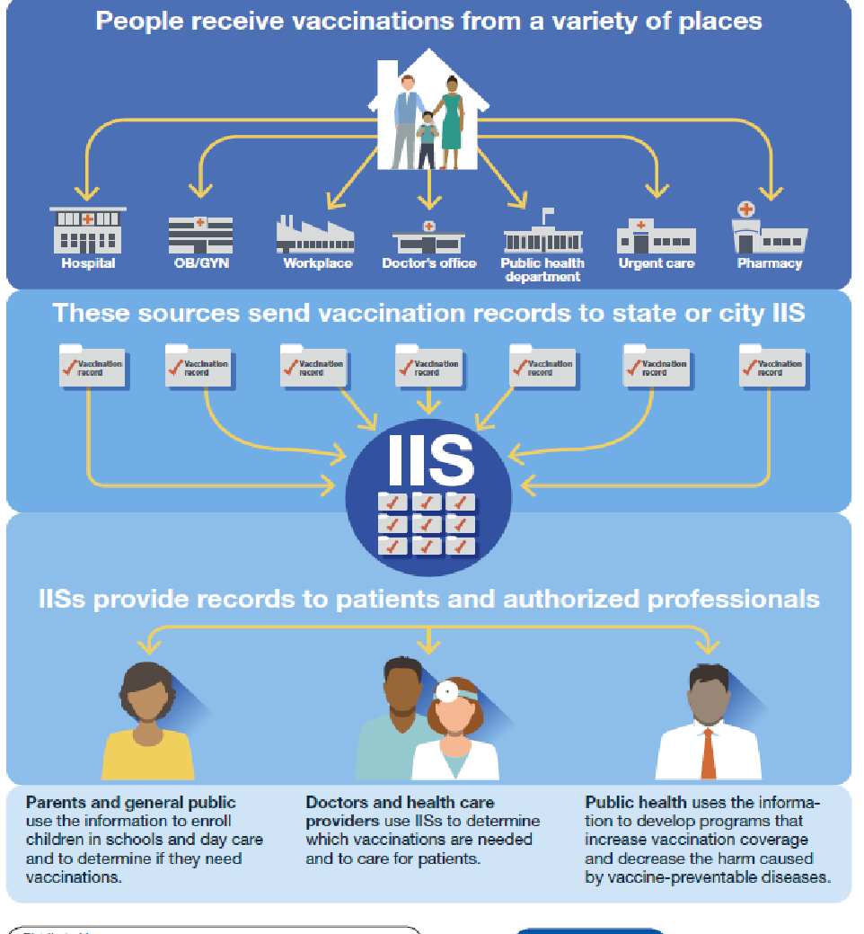
IIS Overview
IIS data enables public health to:
Identify populations at risk for vaccine-preventable diseases
Analyze vaccination coverage and work to address gaps
Respond to public health emergencies
Infographic with blue background provides example of places people can receive vaccinations. Examples include hospitals, public health departments, and pharmacies. The infographic also outlines how places people receive vaccinations send vaccination records to Immunization Information Systems (IIS) so the public and healthcare providers have access.

Slide 6
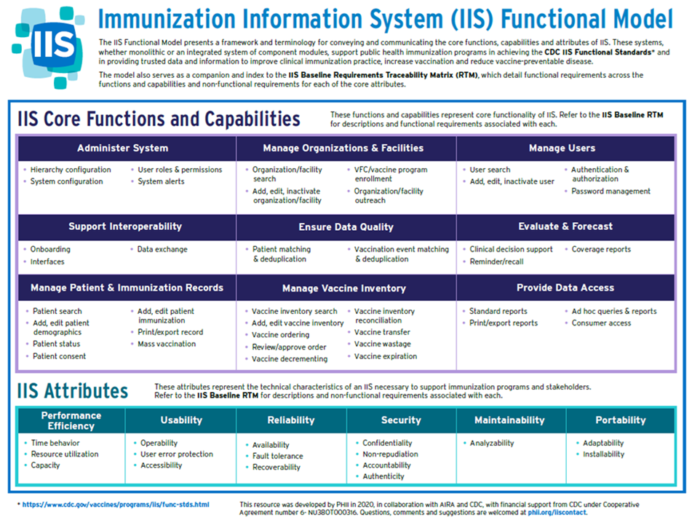
Chart Core outlines the functions, capabilities and attributes of an IIS.

Slide 7
IIS Functions and Capabilities
Monitors new vaccine uptake
Tracks and evaluates trends in coverage levels
Monitors outbreaks and disease levels
Automatically calculates vaccinations needed
Consolidates immunization-related information
Generates vaccination reminder/recall notices
Connects providers to complete vaccination records
Monitors Vaccines for Children (VFC) vaccine use and provider compliance

Slide 8
IIS Functions and Capabilities
Evaluating vaccine validity and forecasting next appropriate vaccination(s) due, specific to each patient
Supporting emergency preparedness and pandemic planning
Integrating with other electronic health information systems
Supporting vaccine management at the provider and immunization program levels

Slide 9




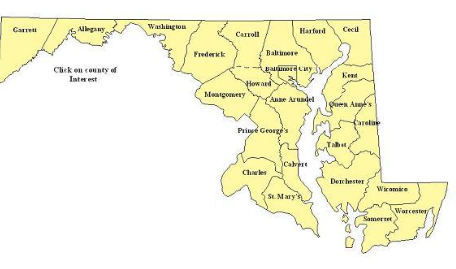
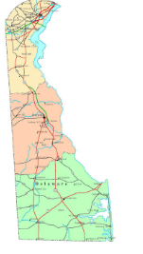
Primary IIS Data Sources
Vital statistics
Provider data via EHR
Clipart image on the left is a baby with their arms raised and the image on the right is a headstone.
Clipart image is a computer screen with a white background and blue symbols. Symbols on computer screen represent heartbeat health vitals, cross symbol, and patient photo.
Data from other jurisdictions and federal entities via the IZ Gateway

Slide 10
What Has Changed Over the Years?
Objective & Visibility
Originally the goal was to get data into the IIS and share it with providers
Manual documentation shifted to Interoperability and data exchange
Today, there is AIRA M&I that provides a focus of standards and how our community looks as a whole
IIS Dashboard summarizes the annual reporting responses with met and unmet metrics
Today, the focus is more on quality data and providing functionality that supports the Immunization Program

Slide 11
IIS Focus in the Immunization VFC/317 Cooperative Agreement
CDC and the IIS Community

Slide 12
National Immunization Program Infrastructure Support
Section 317 Public Health Service Act
Helps meet the costs of prevention health services
Priorities include preserving immunization infrastructure, maintaining vaccine supply, etc.
Vaccines for Children Programs (VFC)
Provides vaccines to children whose parents/guardians may not be able to afford them
Supports opportunities for all children to get their recommended vaccinations on schedule

Slide 13

Immunization VFC/317 Cooperative Agreement Strategies
Strengthen program infrastructure and management
Increase vaccine access
Improve vaccination equity
Promote vaccine confidence and demand
Enhance data and evaluation
Strengthen program support for partners
Enhance vaccination response readiness.

Slide 14
Immunization VFC/317 Cooperative Agreement Strategies
Strategy 1- Strengthen program infrastructure and management
Distributing resources needed to maintain and strengthen the nation’s immunization infrastructure.
Strategy 5- Enhance data and evaluation
Enhancing existing data systems and creating new tools to improve the quality of data and of program outcomes.
Strategy 6- Strengthen program support for partners
Enabling and building partner capacity in immunization across the country.

Slide 15
Practical Uses of IIS
Coverage Assessment reports for jurisdiction and providers
VFC Program Support
Managing vaccine orders
Managing vaccine inventory
Ensuring appropriate storage unit temperatures
IQIP Support
Provider Coverage reports by age, vaccine, etc.

Slide 16
Data Use
Understand pockets of need, populations and geographic areas that are not being immunized
Publish public dashboards at the federal and jurisdictional level to better understand coverage rates
Providing immunization records to the jurisdictional public

Slide 17
CDC Reports and Tools
CDC and the IIS Community

Slide 18
CDC Tools to Improve IIS and Data Quality
CDC Functional Standards v5
IIS Data Quality Blueprint
IIS Routine Vaccination Submission Data Quality Report*
PPRL Submission Data Quality Report
IISQR

Slide 19
Immunization Services Division (ISD) & Informatics and Data Analytics Branch (IDAB) Organizations
CDC and the IIS Community

Slide 20
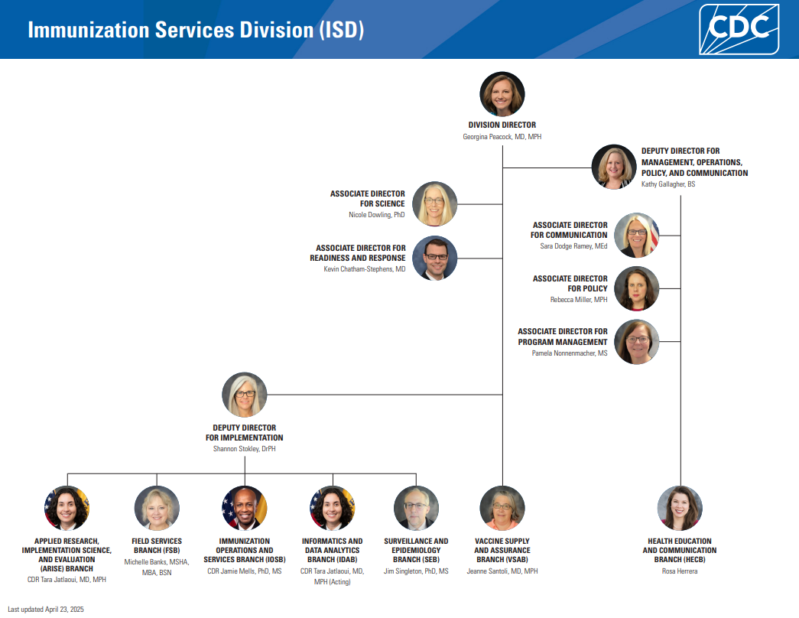

Slide 21
Support: Informatics and Data Analytics Branch (IDAB)
IDAB works to maximize protection against vaccine-preventable diseases by funding and supporting IISs across the country.
Branch Chief
Tara Jatlaoui
Deputy Branch Chief & Acquisition Project Management Team Lead
Kimberly Clark
Deputy Branch Chief for Program/Senior Scientist
LaTreace Harris
Vickie Garrett
Strategic and Special Projects Team
Lead: Kafayat Adeniyi-Inniss
Outreach and Assistance Team
Lead: Jan Hicks-Thomson
Outreach and Assistance Team
Lead: Beth Cox
Informatics and Standards Team
Lead: Stuart Myerburg
Evaluation and Applied Analytics Team
Acting Lead: Carla Black
Application Support Team
Lead: Susan Pierce-Richards
May 31, 2024

Slide 22
Support: Outreach and Assistance Team SMEs
IIS subject matter experts (SMEs) provide direct support to awardees. Beth Cox and Jan Hicks-Thomson lead the teams.
OAT Team East |  |  |  |  | OAT Team West
Team Lead: Beth Cox nhy7@cdc.gov 404-718-5698 |  |  |  |  | Lead: Jan Hicks-Thomson hbv8@cdc.gov 404-718-1555 Awardee Assignments: California and LA County
Tristi Bond utq7@cdc.gov 404-639-8989 | Amee DeMartino vug0@cdc.gov 404-639-8121 | Crystal Edwards xtk6@cdc.gov 404-718-5358 | Chantel Hartman Xrv8@cdc.gov 770-488-4974 | Marley Vazquez Pyo2@cdc.gov 339-223-3287 | Natalie Johns Nbk4@cdc.gov 210-485-8007 | Trenetria Manglona ouu3@cdc.gov 404-498-1831 | Jennifer Ratliff Jua7@cdc.gov 678-595-9771
Arkansas Louisiana New Mexico Nevada Oklahoma Texas Houston San Antonio Massachusetts New Hampshire | Arizona Indiana Ohio Phoenix Michigan Minnesota Wisconsin Illinois Chicago | Delaware DC New Jersey Puerto Rico Virginia Virgin Islands West Virginia Pennsylvania Philadelphia | Alabama Florida Georgia Kentucky Mississippi North Carolina South Carolina Tennessee Vermont | Maryland New York City New York Rhode Island | American Samoa Guam Hawaii Marshal Islands Micronesia CNMI Oregon Palau Washington | Iowa Kansas Missouri Nebraska | Alaska Colorado Montana Idaho North Dakota South Dakota Utah Wyoming Connecticut Maine
Chart with blue background outlines IIS subject matter experts (SMEs) that provide direct support to awardees. The chart is organized to illustrate state assignment by teams (east and west) and Team Leads Beth Cox and Jan Hicks-Thomson).

Slide 23
CDC and Communications
CDC and the IIS Community

Slide 24
CDC Engagement Opportunities
Support
All-Awardee Calls/Meetings
Site Visits
Awardee
Reverse
Convenings
American Immunization Registry Association National (AIRA) Conference
National Immunization Conference
On-site
Virtual

Slide 25
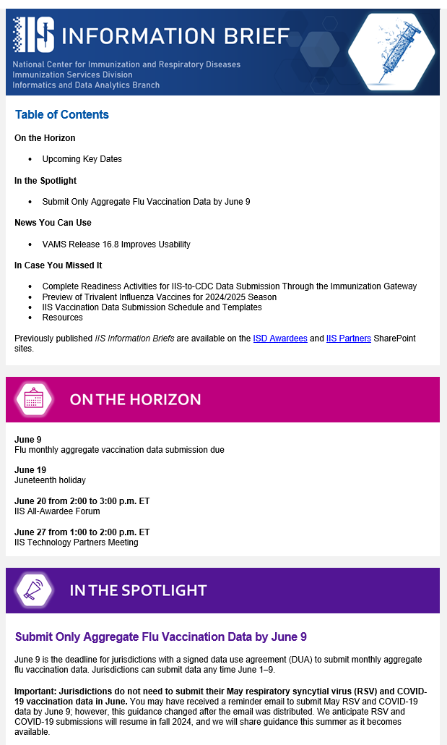
IIS-Specific Communication Channels
Resource | Audiences | Notes
IIS Information Brief weekly email | Jurisdiction, Technology, and National Partners | Provides updates and announcements for the IIS community
IIS All-Awardee Forum monthly call | IIS Managers and Program Managers | Offers opportunity for in-depth look at priority activities and hear from jurisdictional partners
IIS Technology Partners Calls monthly call | Technology Vendors and Partners | Engage IIS technology partners/IIS vendors in discussion about priorities and key technical updates
SharePoint Site document repository | Jurisdiction, Technology, and National Partners | Allows CDC to manage and provide partners access to useful documents
Chart with blue section borders that highlights IIS specific communication by resource type (ex. Monthly awardee call and weekly emails) and audience (ex. Technology vendor and juridicition).
Image has blue, pink, and purple section banners with IIS Information Brief content.

Slide 26
Questions?
CDC and the IIS Community

Slide 27
Resources
General Resources
Immunization Information Systems home page
IIS Functional Standards
IIS Functional Standards Guidance
PHII’s e-mail crash course for all things IIS
IIS Information Brief (IISInfo@cdc.gov)
General Resources
Explore Immunization Information Systems home page
Review the Functional Standards
Enroll in PHII’s e-mail crash course for all things IIS
Subscribe to IIS Information Brief (email IISInfo@cdc.gov)
IPOM Support Resources
Letter to Awardees (February 2, 2022)
Data Quality Report on the IIS Dashboard
IPOM Chapter D Sample Activities for Budget Year 2022

Slide 28
Thank You!

Slide 29
Immunization Information Systems
National Center for Immunization and Respiratory Disease
IIS Leadership Workshop
June 10, 2025
Tara Jatlaoui, MD, MPH, FACOG
Acting Chief, Informatics and Data Analytics Branch

Slide 30

Today, we will answer these questions:
What are CDC’s vision and priorities for IISs?
How does CDC support IISs?
2

Slide 31
What are CDC’s vision and priorities for IISs?

Slide 32


CDC’s Vision for IISs
IISs support the standardized capture and exchange of high-quality, individual-level immunization data for all doses of ACIP*-recommended vaccines.
These data are linked across jurisdictions, providers, and partners, and to other individual-level data sources to inform public health action.
* ACIP: Advisory Committee on Immunization Practices
4

Slide 33







Journey to Informed Public Health
CDC provides infrastructure, develops standards and guidance, and engages with the IIS community to support the journey from vaccine approval through the use of vaccine data for informed decision making.
Vaccine Approved & Available
A new vaccine is approved by FDA and can be administered
Data in IIS
IISs capture administration and other data (e.g., VFC)
Vaccine Administered
Clinicians provide vaccine to patients
Informed Public Health
Health officials and practitioners use data, reports, and dashboards to make decisions
Data Reported to CDC
IIS and specific providers send administration and other data to CDC
Data in EHR
EHRs capture administration and other data
START
Standards
Technology
Engagement

Slide 34

Immunization Data Informs Public Health Decisions
Valuable Insights from IIS Data
Vaccination coverage at the jurisdiction and national level
IISs play a key role in the dissemination and tracking of vaccines across the U.S., providing critical data during emergency responses and reporting immunization data to CDC.
Areas of low vaccination coverage
Populations at risk of vaccine-preventable disease
Characteristics of populations with high/low coverage
Quality of data (i.e., available, timely, complete, valid, accurate, consistent, unique)

Slide 35
Strategic Priorities for IISs
CDC’s data modernization efforts accelerate data into action supporting the vaccine journey from when vaccines are approved to when vaccine data are leveraged to inform public health decisions.
Technology Infrastructure |  | Data Quality |  | Data Exchange
Meet IIS Functional Standards to increase standardization of IIS functionality and data elements and support program and provider immunization processes. Test functionality to ensure standardization using AIRA's Measurement and Improvement Initiative. |  | Improve data quality through use of IIS Data Quality Blueprint to prioritize meaningful, quantifiable measures and IIS Data Quality Reports to identify actionable improvements. |  | Increase interoperability and data sharing between jurisdictions and providers via IZ Gateway. Use PPRL to allow cross-jurisdiction data matching.
Community Engagement

Slide 36

Technology and Standards
Functional Standards and Operational Guidance Statements (OGS)
HL7 v2.5.1 Implementation Guide for Immunization Messaging, Release 1.5
Measure Your IISs Adherence to Standards with Measurement and Improvement Initiative
These describe the underlying operations, data quality, and technology needed by IISs to support immunization programs, vaccination providers, and other immunization stakeholders and their immunization-related goals. They help assure that IISs attain a level of consistency in support of common clinical, programmatic, and public health immunization goals.
Guidance to help IIS comply with national standards, best practices, and the latest Health Level Seven (HL7) conformance methodology.
Measurement and Improvement (M&I) Initiative supports system testing to help guide individual IIS in aligning with identified standards.
7
Link: IIS Functional Standards | Immunization Information Systems (IIS) | CDC

Slide 37


Data Quality:
Immunization Data Reporting at the National Level
The COVID response showed the importance of IIS data are for public health action
and that all jurisdictions can submit data in an emergency response.
Pre-COVID-19
COVID-19 Response
DUA Addendum
2025
DUAs and Data Reporting
Jurisdictions use IISs to manage the Vaccines for Children (VFC) program and understand their jurisdiction’s vaccine coverage. ​
15 jurisdictions signed Data Use Agreements (DUAs)
Routine data reported quarterly, and flu data reported monthly.
Data use was limited.
Federally provided vaccine, provider agreements, and a COVID-19-specific DUA superseded state reporting and data sharing laws to allow reporting to CDC.
New DUA allows reporting of routine vaccination data across the lifespan.
Submit all demographic and vaccination records quarterly. Where prohibited by law submit aggregate quarterly.
Report aggregate RSV, flu, COVID-19 data monthly.
Submit ad-hoc or special data requests from CDC leadership.
64 jurisdictions with DUAs.
COVID-19 data reported daily, then weekly.

Slide 38
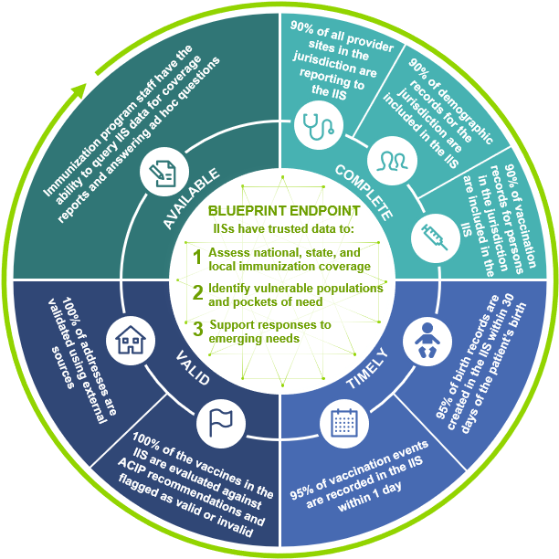
Data Quality: IIS Data Quality Blueprint
The blueprint guides awardee activities to improve data quality by prioritizing a small set of meaningful, quantifiable measures.
IIS Data Quality Endpoint
IISs will be the trusted source for reliable immunization data
IISs will produce data to support:
Immunization coverage assessments
Identification of pockets of need
Responses to emerging needs
7 Data Quality Characteristics
Available | Complete | Timely | Valid | Accurate | Consistent | Unique

Slide 39

Data Quality Support from CDC
Data Quality Improvement Reports
CDC aims to provide jurisdictions with timely feedback and technical assistance to support data quality improvement.
Who receives data quality improvement feedback?
Jurisdictions that send line level data to the CDC receive feedback.
How should I prioritize data quality improvement activities?
Your IIS SME will help you plan for data quality improvement based on results from all reports and available jurisdiction resources.
What support is available for aggregate reporters?
CDC is determining how to provide technical assistance to aggregate reporters.
Routine Vaccination DQ Report
Quality for priority data elements and analyses of trends over time and within population groups
Summary Report
Overview of jurisdiction’s quarterly data submission (e.g., valid records, coverage, timeliness)
PPRL DQ Feedback Report
Summary, list of potential duplicate patient IDs, and patient records with missing values for required data elements

Slide 40



Data Exchange: The Immunization (IZ) Gateway
Jurisdiction IISs
The IZ Gateway is a policy framework and cloud-based message routing system that facilitates data exchange among IISs, vaccine providers, direct-to-consumer applications, and data submission to CDC.
Consumer Access Applications
Message routing technology enables uniform application of data quality assurance, messaging, and security industry standards and best practices for all participants.
Multijurisdictional Vaccine Providers
VAMS
Policy framework ensures compliance with each jurisdiction’s data sharing laws and policies.
CDC via
IZ Data Lakehouse Platform

Slide 41
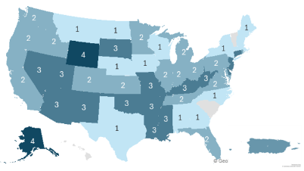
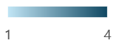
Data Exchange: IZ Gateway Data Exchange Metrics
Jurisdictions Participating in the IZ Gateway
Use Case | Metrics | Impact
IIS-to-IIS Data Exchange | 44 jurisdictions with 369 active exchanges | These IISs have more complete records for citizens vaccinated outside their jurisdiction
IIS and Multijurisdictional Provider Data Exchange | 8 providers* with 7,163 facilities in 52 jurisdictions | 52 jurisdictions have data on citizens vaccinated at large, multijurisdictional provider organizations
Consumer Access System Exchange with IIS | 1 platform exchanges with 6 jurisdictions | 6 jurisdictions streamlined their citizens’ access to their consolidated vaccination records
IIS-to-CDC Data Submission | 27 jurisdictions submit vaccination data to CDC | CDC offers jurisdictions the option to automatically send their vaccination data to CDC rather than using a manual submission process
Active Use Cases
Onboarded (Not Pictured)
Chicago | Houston | NYC | Pacific Islands | Philadelphia | San Antonio | Washington D.C.
63 jurisdictions have completed baseline onboarding and are prepared to implement use cases
*Multijurisdictional Providers: Veterans Administration (VA) VistA, VAMS, DocStation, AZOVA, VA Oracle Health, Fond du Lac, Department of Defense, EDN
Updated 5/12/25

Slide 42




Data Exchange: Privacy Preserving Record Linkage (PPRL)
Privacy-Preserving Record Linkage Defined
PPRL is a method to assign a unique identifier to all records associated with an individual without including Personally Identifiable Information (PII) in the submission of data.
PPRL in Jurisdictions
Jurisdictions retain PII within their IISs. They receive PPRL IDs (which are different from the ones CDC receives) and data quality feedback reports to use in their own data quality improvement efforts.
PPRL at CDC
CDC uses PPRL to deduplicate demographic records received from jurisdictions in their quarterly data submissions. No private or personal information is shared with CDC.
Learn More about PPRL
CDC and Public Health Informatics Institute (PHII) will host a webinar in July to share more about PPRL and the precautions that ensure PII in jurisdiction IISs remains secure and private.

Slide 43
Data Exchange: Local Implementation Guide Standardization and Digitization Project
Local implementation guides (IGs) are not standardized, which causes onboarding delays, IZ Gateway challenges, and data sharing issues. This project streamlines the local IG development process, increasing efficiency and effectiveness in healthcare data exchange.
May 2025
August 2024
Currently working with six jurisdictions and will soon engage with two more
Standardize
Digitize
Second Phase
Start entering two local IGs concurrently
October 2023
Pilot Phase
Start inputting local IG into IGAMT
Standardizing local IGs ensures each jurisdiction’s guide:
Follows national standards
Complies with the latest HL7 conformance methodology
Adheres to best practices
The National Institute of Standards and Technology's (NIST) HL7 Implementation Guide Authoring and Management Tool (IGAMT) is used to digitize each jurisdiction’s IG, making all IGs more accessible and usable (e.g., creating a jurisdiction-specific validation tool).
Pilot Phase
Start entering next local IG
February 2024
TBD
Third Phase
Train jurisdictions to manage local IGs in IGAMT
January 2025
Second Phase
Continue process for all local IGs

Slide 44
How does CDC engage the IIS Community?

Slide 45




CDC Supports and Engages the IIS Community
Providing funding and guidance to achieve priorities
Offering direct support to awardees through technical assistance, engagement, and communications
Engaging technical and national partners to strengthen the IIS community

Slide 46


Technology Providers and Partners
Updated May 2025
To support and sustain IISs, CDC funds technology partners to implement IISs and ensure capacity to advance prioritized IIS capabilities.
CDC also collaborates with technology partners, who are contracted by jurisdictions to support CDC’s vision and strategic priorities.
The most used IIS platforms are managed by Envision, STC Health, and Gainwell.
20
14
18
12
Arkansas
Colorado
Connecticut
Delaware
Kansas
Kentucky
Missouri
Nevada
New Hampshire
New Mexico
Oklahoma
Pennsylvania
Philadelphia
Pacific Islands (6)
South Carolina
Alaska
Arizona
District of Columbia
Indiana
Louisiana
Mississippi
Montana
Ohio
Puerto Rico
South Dakota
Tennessee
Washington
West Virginia
Wyoming*
California*
Georgia*
Hawaii*
Idaho*
Iowa*
Maine**
Maryland**
Minnesota**
Nebraska
New York State**
North Carolina*
Oregon*
Texas/Houston/San Antonio
U.S. Virgin Islands*
Virginia*
Wisconsin*
Alabama
Chicago/Illinois**
Florida
Massachusetts with SSG support
Michigan*
New Jersey
New York City with HLN support
North Dakota with BCBS-ND support
Rhode Island with HLN support
Utah
Vermont
Envision
STC Health
Gainwell/WIR
Awardee Developed
*Awardee is transitioning to a new IIS platform
** Awardee is transitioning to different platform and has issued a request for proposals

Slide 47
Support: Engagement with the IIS Community
CDC regularly engages with awardees and technology partners to support IIS activities. CDC also supports awardees and technology partners by providing funds and direction to the American Immunization Registry Association (AIRA) and the Public Health Informatics Institute (PHII) for developing guidance, identifying best practices, and collaboratively solving problems.
CDC
CDC communicates and engages with stakeholders to provide relevant, timely information, and guidance.
CDC Communication Resources
IIS Information Brief
SharePoint sites
Awardees
Technology Partners
Implement IISs and ensure capacity to advance prioritized IIS capabilities.
CDC Engagement
IIS-All Awardee Forum
Platform-based consortia sessions
Dedicated CDC SME
CDC- and partner-provided technical assistance
On behalf of awardees, implement IISs and ensure capacity to advance prioritized IIS capabilities.
CDC Engagement
IIS-All Awardee Forum, as needed
Direct vendor contracts
AIRA
PHII
Technical assistance
Workgroups
Technical trainings and educational activities
Technical assistance
Workforce trainings and educational activities
Competencies model

Slide 48
Thank you! Questions?
24

