Slide 1
Strategic Sustainability and IIS Budget
Working Hand-in-Hand for a Successful IIS
Jan Hicks-Thomson
June 6, 2024
Presenter name/date
Notes:
Emphasise IIS as more than system…
Jan Hicks-Thompson Bio

Slide 2
Strategic Sustainability and IIS Budget Objectives
At the end of this segment, you will be able to:
Define strategic sustainability
Learn about current funding opportunities
Explore ways to diversify funding
Consider cost-sharing and cost-lowering approaches
Identify how to best make decisions in the context of long-term sustainability
Understand the components of an Immunization Information Systems (IIS) budget
Consider your workforce and how to support and maintain the IIS core functions

Slide 3
Sustainability Starts with the Value of the IIS

Slide 4




IIS are Essential to Immunization Programs and Others
ELEVATES
JURISDICTION HEALTH DEPARTMENTS
ENABLES
CDC AND US GOVERNMENT
Manage the Vaccines for Children program—ordering, inventory management, provider assessment, clinical decision support
Monitor vaccine uptake, vaccination patterns, and areas of low coverage at local and regional levels
Develop approaches to improve and sustain equitable vaccination coverage
Create a strong foundation to respond quickly to public health emergencies
Monitor vaccine uptake, vaccination patterns, and areas of low coverage at national level using timely data
Develop approaches to improve and sustain equitable vaccination coverage
Link immunization data to other record-level data to assess trends and make informed decisions
EQUIPS
HEALTH CARE PROVIDERS
EMPOWERS
INDIVIDUALS
Coordinate patient care across multiple providers and give recommendations for safe and effective care
Administer the VFC program including enrolling VFC participants, ordering and managing vaccine inventory, monitoring vaccine administration, and conducting patient outreach
Securely access complete, electronic records to understand vaccination needs and to provide proof of vaccination

Slide 5












IIS are Central to a Complex Immunization Data Ecosystem
Providers collect immunization data using standards-based electronic health systems
IIS collect, consolidate, analyze, and report data using best practices, standards, and tools
Stakeholders use IIS data to make decisions and drive action
Hospitals, Clinics, & Doctor’s Offices*
CDC and US Government*
Emergency response coverage (RVR, COVID reports)
Routine coverage assessments
Identifying communities needing intervention
64 Jurisdiction Immunization Information Systems
Pharmacies
IZ Gateway
IZ Gateway
Health Care Providers*
Patient assessment
Vaccination reminders
Proof of vaccination
Workplaces*
Public Health Departments
Jurisdiction Health Departments*
Population health assessments
Targeting interventions
VFC participation (orders, inventory mgmt., quality improvement, provider assessment)
Federal Agencies*
Individuals*
Consolidated vaccination records
Reminders
Proof of vaccination
*CDC’s IZ Gateway enables some data flow

Slide 6
Strategic Sustainability
Strategic sustainability is having a long-range view and plan so that you have clear priorities in place when funding opportunities arise and needs or priorities shift.
Notes:
Beth

Slide 7
Strategic Sustainability
Technical Development
Technical Development – Modernization and enhancements
Workforce Development – Existing and future staffing
Maintenance – Technical infrastructure of the IIS, provider management and data quality monitoring
Policy – Data management and data sharing
Funding – Identification of existing and prospective sources
Workforce Development
Maintenance
Funding
Policy
Notes:
Beth

Slide 8
Strategic Sustainability is Critically Important
IIS funding lacks diversity
Funding cycles boom and bust making long-term planning challenging
COVID-19 set unprecedented expectations for IIS functionality and data
  Funding has decreased post COVID-19, but stakeholder expectations remain high
Strategic IT development takes long-term planning and sustainable funding!

Slide 9

Activity: Discussion Questions
What IIS strategic sustainability topics are you interested in learning more about?​
What kind of assistance would help you find what you need?
Notes:
Based on timing we would use these as platform for discussion or include as notes to the prior slide to just engage organically.

Slide 10
IIS Funding
Notes:
Beth

Slide 11
CDC Supported IIS Funding
CDC 317 and VFC Immunization Cooperative Agreement
IIS supports all aspects of the immunization program, most fund types (PPHF, 317, VFC, Pan-Flu can be used for IIS)
  Competitive component awards vary, currently VTrckS API
  Supplemental COVID funding may be used through 6/30/2025
Other CDC opportunities: Public Health Infrastructure Grant, preparedness response, surveillance, etc.

Slide 12

NCEZID Epidemiology and Laboratory Capacity (ELC) Cooperative Agreement – Background
Financial support and technical assistance to state, large local and US territory and affiliate health departments to detect, prevent and respond to emerging infectious diseases
64 recipients include states, large locals, and US territory and affiliate health departments
Disease-specific and cross-cutting project areas
  Cross-Cutting project areas includes:
    Health Information Systems Capacity
Distribution of both Core and Supplemental funding streams
Notes:
Beth

Slide 13





PHIG Public Health Infrastructure Grant Data Modernization – Activity Scope
Maintain, improve and modernize the approach to acquire, manage, share and use data for public health action to more effectively detect, respond, prevent and control diseases and conditions to protect public health and safety through five strategies:
Building the right foundation
Accelerating data into action
Developing a state-of-the-art workforce
Supporting and extending partnerships
Managing change and governance
Notes:
Beth

Slide 14
CDC Managed Funding Support
CDC Direct Vendor Contracts that support national IIS objectives
Data Exchange - IZ Gateway use cases
Data Submission to CDC
Privacy Preserving Record Linkage
Future CDC-DVC efforts
Improving Data Quality
Improving the Interoperability Capabilities
Other examples
Short-term staffing support
CDC Foundation

Slide 15
Potential Private Partners for Support
Health plans, payers
Support and charge for HEDIS performance measurement
In-kind support
Offer no-cost assistance and/or guidance to promote the IIS
Local philanthropies
Support program initiatives aligned with the philanthropy’s goals and objectives
Promote public relations image for them
Contributions from local health systems
Cultivating relationships takes time/requires credibility
Engage leadership and partners
Note: Determine how data management and sharing policies support these activities
Notes:
In-kind example: A health plan designed Minnesota’s promotional materials and patient notification materials

Slide 16
Potential Additional Sources of Funding
State general funds
State-required population health performance measures
Outbreak and emergency response
Delivery of the VFC and state childhood vaccine programs
Other state agencies
Department of Education
Childcare and school entry requirements and assessments
Medicaid
Medicaid match programs
Notes:
Share Oregon experience soliciting voluntary contributions

Slide 17
Medicaid Federal Financial Participation (FFP)
Medicaid Management Information System (MMIS) Match
90/10
75/25
Administrative match
50/50
Medicaid.gov – Medicaid Management Information System
“States may receive 90% federal financial participation (FFP) for design, development, or installation, and 75% FFP for operation of state mechanized claims processing and information retrieval systems approved by the secretary”
Notes:
§90/10 MMIS – for implementation
§75/25 Match for maintenance and operations
§50/50 Match for ongoing operations and Medicaid programmatic support (i.e., provider education etc.)
§Medicaid fair share
§Medicaid pays for costs proportional to the size of the Medicaid population (aka: Medicaid Fair Share)

Slide 18
Medicaid Match Formal Application Process
Implementation Advanced Planning Document (IAPD)
  Annual application
  Updates can be done throughout the year
Process takes time – start early
  Applications can include multiple years
Updates are possible throughout the year (IAPD-U)
Reimbursement model
Non-federal funds needed for match
Medicaid fair share
  Medicaid pays for costs proportional to the size of the Medicaid population (aka: Medicaid Fair Share)

Slide 19

Partnering with Other Programs
Support other public health or state programs:
Early hearing programs
Lead programs
WIC
Emergency preparedness and response programs
VFC and state childhood vaccine programs
Notes:
Carefully consider shared goals vs. goals of the immunization program
Assure maintenance and long-term support are built into the plan
Notes:
A lesson learned here, however, is that partnering with other programs for jurisdictions that use a vendor platform may need to leverage existing or planned functionality rather than creating new functionality. I'm not sure how to make that point but I'm thinking about Philadelphia and moving to the cloud.

Slide 20
Activity: Discussion Question
Name one new partnership that might help your program diversify and sustain funding in the future.
Notes:
[Day 1: Partner Analysis Matrix identified one new relationship for communications…now thinking of these partners through sustainability lens.]
Who was the partner that you thought of during the communication module?
What is in it for you to build this relationship?
Could one of your jurisdictions’ other public health systems be a partner? Could your systems provide benefit to each other? They give you funding? You supply valuable data?

Slide 21
Potential Ways to Lower Costs
Notes:
Beth
The planning for strategic sustainability…

Slide 22
Automate and Streamline
Leverage shared services
CDC Direct Vendor Contracts
COTS IIS Platform Consortia
Smarty
AIRA’s Onboarding Shared Services
AIRA’s EPI Community of Practice
Automate manual business processes for providers and IIS program (data quality, password resets, etc.)
Saves staff time, reduces material costs, reduces program costs overall
Automate data management and submission to the degree data management and sharing policies allow
Document current procedures in SOPs to ensure they are “lean” and repeatable
Limit hand-offs, simply processes, eliminate waiting periods
Notes:
Share Oregon experience soliciting voluntary contributions

Slide 23
Automate and Streamline
Take advantage of an existing product to reduce your enhancement and maintenance costs
Minimize local customization
Leverage open source/commercial options
Open Source
Immunization Calculation Engine (ICE)
AMCI’s Syntropi onboarding and customer management modules
Commercial

Slide 24
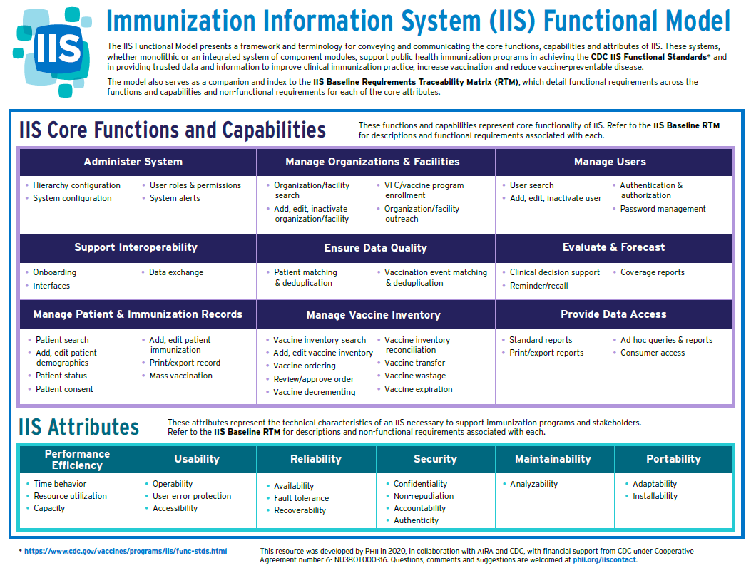
Standardize Where Possible
IIS Functional Model
IIS Baseline Requirements
CDC Functional Standards and Operational Guidance Statements
AIRA Guidance Documents
AIRA Measurement and Improvement (M&I) Initiative
Notes:
•Take advantage of a standard product to reduce your enhancement and maintenance costs
•Minimize local customizations
–The community can no longer afford to meet the same goal ten different ways

Slide 25
Engage with the IIS Vendor
Enhancement requests across IIS can be prioritized and coordinated within each of the consortia groups, and costs may be shared
WIR
STC
Envision
Awardee Developed

Slide 26
Managing the Budget You Have
Notes:
Beth
The planning for strategic sustainability…

Slide 27
Know and Understand IIS Costs and Budget
Review your program budget costs for:
  Staffing - all sources
  Contracts
Identify your fund sources and the amount of your budget covered by each source
Document the contributions your IIS makes to other programs, departments, agencies and stakeholders
Determine what collaboration is available with your colleagues in other jurisdictions

Slide 28

Plan, Prioritize, Price, Pause, Pick, Proceed OR Pass
Document IIS functionality, gaps and dependencies
  Consider mapping IIS functionality against requirements traceability matrix (this is a D3 activity)
  Document what works and what doesn’t work
Review the list with key stakeholders, adjust and collaboratively prioritize the list
Price the prioritized functionality (or fixes)
Pause: Look for opportunities for funding
Pick
Proceed or
Pass

Slide 29
Workforce Considerations
Finding and keeping skilled team members isn’t easy
Consider:
Keeping job descriptions updated – roles with tasks that are current and modern may be more attractive (and accurate)
Developing and updating a workforce model that will support your IIS vision and strategic direction
Leveraging different funding opportunities to fill staffing gaps
Notes:
Vijay discussed how a jurisdiction can level

Slide 30
Augmenting Your Workforce
Leveraging staff from within your agency to support activities
  Central IT resources
  Surveillance/research/epidemiology teams or staff to provide or support analytic needs
Programs outside of Immunizations or DOH
  Expertise to improve processes
  Minnesota DOH’s Center for Public Health Practice
Internships
CDC Public Health Advisor Program (PHAP) fellows

Slide 31
Contracting Considerations
Looking for lower costs for some services (like cloud hosting)
Leveraging the General Services Administration contracting services, or pricing when negotiating with your vendor
Evaluating the cost of your current IIS and the cost to change platforms. (talk with your procurement office first!)
Worth repeating:
  Are their options to leverage open source software, and maintenance costs in a way that lowers costs?
  Are their options for shared services, or cost sharing?
Notes:
Vijay discussed how a jurisdiction can level

Slide 32

Activity: SWOT-lite
A Partial SWOT: Consider the Opportunities and Threats for your IIS
  In small groups, discuss the Opportunities and Threats for your system at this time
  Share your group’s collective input with the larger group
  Consider the SWOT from the Change Management Module: What is a line item from it that you might add to your budget?
Notes:
Leverage Marcey’s SWOT template from Assessment, Prioritization and Planning. Focus on your sustainability when thinking about your IIS strengths and threats.

Slide 33
Understanding IIS Costs
Notes:
Beth
The planning for strategic sustainability…

Slide 34
Understanding the Cost of IIS
Costs of IIS vary across the IIS community
Although the primary funding source for IIS is the CDC 317-VFC Cooperative Agreement…
  Contracts don’t specify costs for maintenance vs. enhancements
  Contracts sometimes include language about IIS support but don’t specify a dollar amount (i.e., local health contracts)
  Staff positions associated with the IIS are not always readily identifiable from staff titles or descriptions
CDC needs more IIS cost detail to educate and promote the need for IIS funding

Slide 35
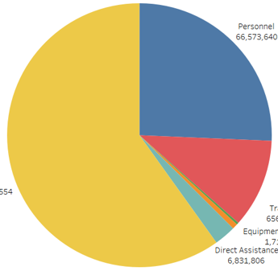
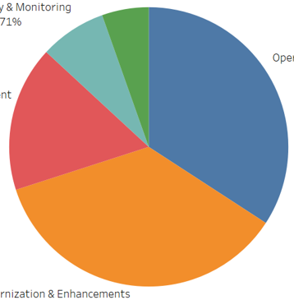
IIS Costs by Budget Category - Over All Awardees
Awardees allocate most of their IIS budget to contracts with their IIS platform vendor and personnel that operate the IIS. Most funding goes toward “keeping the lights on.” COVID funding allowed awardees to report data to CDC and invest in data modernization enhancements.
Budget Year 4 IIS Costs: General
$259,228,329
Budget Year 4 IIS Costs: Functions and Capabilities
$170,386,122
Other
5%
Operations & Maintenance
Modernization & Enhancements
Provider Management
Data Quality & Monitoring
Other
Data Quality & Monitoring
8%
Personnel
$66,573,640
(26%)
Provider Management
17%
Operations & Maintenance
34%
Other
$155,211,554
(60%)
Fringe
$28,239,689
(11%)
Personnel
Fringe
Travel
Equipment & Facilities
Direct Assistance
Other
Modernization & Enhancements
36%
Notes:
This information is from the BY4 budgets submitted by jurisdictions.

Slide 36

Overview of IIS Budget Collection
Purpose
Per the IPOM, jurisdictions will submit IIS budget information to help CDC understand how current funding is used and ways CDC can ensure that awardees have the resources they need. This data will help inform CDC’s planning for the future, including prioritizing future modernization efforts.
IPOM Language
Strategy D1 – Required Performance Measure: “Provide IIS budget summary in CDC-provided format when requested”
Desired Outcomes
      IIS budget data will provide clear insight into how jurisdictions use all funding for:
      Operations and Maintenance
      Modernization and Enhancements
      Provider Management
      Data Quality and Monitoring
      Other
      IIS budget data will help CDC to understand sources of IIS funding:
      CDC cooperative agreements funds
      COVID3
      COVID4
      State funds
      CMS funds
      Other
Notes:
Purpose
IPOM Language
Desired Outcomes
Value to Jurisdictions
Insight into norms and best practices across awardees
More informed and tailored TA to support CDC and awardee modernization priorities
Other Context
A similar IIS spending analysis was done with the WIR jurisdictions in 2019
We took feedback from this effort into consideration when we created the IIS Budget Template

Slide 37
IIS Budget Template Sections
Overview
Awardee contact information
High-level Budget Year 4 and Budget Year 5 funding information
Budget
Actual and obligated costs for Budget Year 6, including contracts
Contracts
Details of each IIS-related contract in place for Budget Year 6
Staff
List of all staff that partially or fully support the IIS for Budget Year 4
Appendix – Staff Title Reference (staff titles and descriptions)
Notes:
Hand participants template and walk through it with them.

Slide 38
Cost Categories and Examples
Operations and Maintenance
Servers and Hosting
Cloud Hosting
Routine Database Maintenance
Database Upgrades
System Capacity Monitoring
Testing and continued monitoring of CDC-funded solutions (e.g., PPRL)
Operations and Maintenance Documentation
Defect Identification and Remediation
Routine Security Scans
Domain Costs
Licensing Costs
Training Materials and Delivery
Other Services
Modernization and Enhancements
Functionality Upgrades
New Modules/Capabilities
Architecture Upgrades
Interface Upgrades
Enhancement Documentation
Training Materials and Delivery
Data Quality and Monitoring
Address Checking
Vaccine Code Maintenance
Geocoding
RunMatch (Deduplication)
Data Exchange Monitoring and Issue Remediation
Forecasting (Scheduling, Adding New Vaccines)
Training Materials and Delivery
Provider Management
Recruitment
Provider Onboarding
Data Usage Agreement Maintenance
Data Exchange Coordination
HL7 Onboarding
Training Materials and Delivery
Help Desk and User Support
Other
Anything not accounted for above

Slide 39
Activity: Assess Your Workforce
Scenario – Use the Year 4 submitted staff and compare the roles to the PHII Workforce Role Descriptions.
Questions:
How does your organization’s current staff map to the IIS Workforce Role Descriptions?
What roles, if any, don’t map to available role descriptions?
Notes:
Drafting, developing… discuss the accountability levels based on program and their role within it.

Slide 40
Overview of IIS Budget & Sustainability
There are no easy answers to the questions of strategic sustainability.
However, it is critical that all of us continue to work toward providing stable, cost-effective, long-term services.
Diversifying funds, reducing costs, and developing wisely can help stabilize and sustain your IIS.
Defining and Refining your budget for CDC gives them better information for future funding considerations.
Notes:
Purpose
IPOM Language
Desired Outcomes
Value to Jurisdictions
Insight into norms and best practices across awardees
More informed and tailored TA to support CDC and awardee modernization priorities
Other Context
A similar IIS spending analysis was done with the WIR jurisdictions in 2019
We took feedback from this effort into consideration when we created the IIS Budget Template

