Slide 1
Role of the IIS Leader
Leading the Way to Success
Amy Metroka
June 4, 2024
Presenter name/date
Notes:
For the first session of our day, I would like to invite Amy Metroka on stage.
Amy Metroka is a PHII Consultant and Former Director, Citywide Immunization Registry, NYC Dept of Health & Mental Hygiene
Amy Metroka has been in the IIS world since the early 1990s, when IIS were mostly in the planning stages. She is one of the pioneers of IIS development and played an important role in the formation of AIRA. Amy served as AIRA president twice, and was a long-time member of AIRA, serving on several Steering Committees during her tenure. She started her career as a social work administrator and moved into public health in the 1990s when the Robert Wood Johnson Foundation awarded a planning grant to NYC to explore the idea of developing an IIS. Amy has a masters degree and a PHD in Public Health. She retired from the NYC Department of Health & Mental Hygiene in January 2022 and we are fortunate to have her working as a part-time consultant for PHII.

Slide 2
Learning Objectives
Understand the key responsibilities of an IIS leader
Recognize the IIS leader’s critical responsibility for building a strong and effective team
Identify staff roles needed to successfully operate an IIS
Learn about IIS community resources to assess staffing and fill gaps

Slide 3

Activity
What does leadership mean to you?
Notes:
Identify some words or terms that describe what leadership means to you.

Slide 4
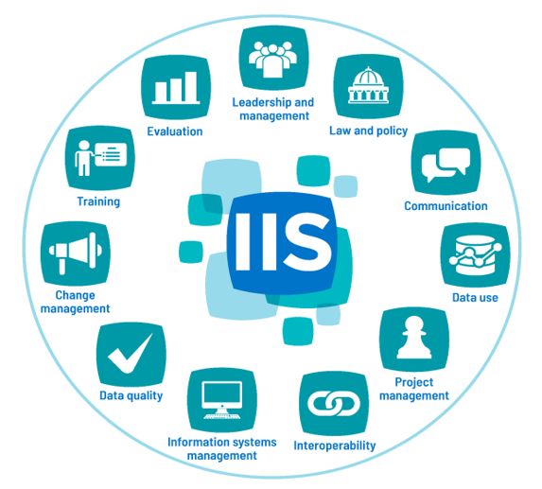
Introduction to the IIS Core Competency Model
Defines 11 competencies that are integral to the IIS team
Includes knowledge, skills and abilities for each competency
Provides links to associated reference materials
Notes:
Provides a roadmap for the IIS leader to build an effective team. We will be discussing the competencies in detail throughout the next few days.

Slide 5
Leadership and Management
The application of strategic thinking and operational skills to fully leverage the IIS in support of immunization and other public health goals.
2021 IIS Core Competency Model

Slide 6
Key Responsibilities of the IIS Leader and Manager
Create the Vision and Strategy
Build a Strong Team
Engage and Motivate People
Promote Data Quality and Use
Notes:
Use this as an organizing principle for the action plan/leadership plan/growth plan

Slide 7

Create the Vision and Strategy

Slide 8
IIS Vision
The IIS includes a complete and accurate immunization record for every individual in the jurisdiction
IIS information is used to increase immunization rates and prevent and control vaccine-preventable diseases
Notes:
Done through integration of operations and technology

Slide 9
Collaborate to Create the Vision and Strategy
Engage your immunization program manager, IIS team, and technology partners to create the strategy to achieve the vision
Advocate for the financial, human, and technical resources needed to advance the IIS
Participate in your IIS technology partner consortium (if applicable) and engage your jurisdiction IT
Join CDC and AIRA activities to stay abreast of new developments, challenges and solutions
Notes:
Foreshadow partners in addition to technology partners

Slide 10
Advocate for IIS Advancement and Use
Promote adaptation to evolving changes to ensure strategic sustainability
Maintain awareness of and get involved in CDC’s Data Modernization Initiative (DMI)
Promote use of IIS data and functions to increase immunization rates

Slide 11
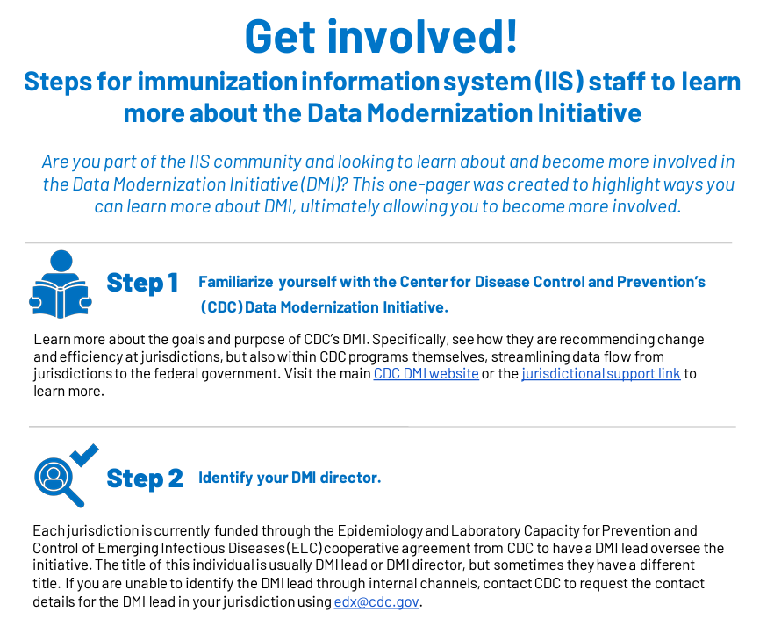
PHII One-Pager on DMI and IIS
Notes:
PHII recently published a IIS-DMI one pager for the IIS community. A step-by-step guide to ensure that IIS are connected to efforts to modernize the public health system, and offers supplementary resources to learn more about how the Data Modernization Initiative intersects with the work of IIS.

Slide 12

Build a Strong Team

Slide 13
Assess Staffing
What are the staff roles needed to successfully operate the IIS? Do you have the necessary roles covered?
Identify and fill gaps through training and coaching current staff or bringing on new staff
Notes:
Key Resources:
IIS Core Competency Model - defines 11 core competencies for the IIS team
Sample IIS Staffing Model - helps visualize coverage for key IIS staffing roles and gaps
IIS Workforce Classifications/Role Descriptions - guides identification of staffing needs and helps with recruitment
Staff Allocation Matrix - helps assess current and planned staff allocation and capacity
IIS Staff Roles Matrix - helps identify staffing responsibilities for key IIS roles

Slide 14
Ensure Key Roles are Covered
Data Quality Analyst
Assesses and improves the quality of incoming data and data at rest
Interoperability Analyst
Onboards providers and partners for reporting and/or query based on standards
Epidemiologist/Data Analyst
Analyzes data to inform program activities to increase immunization rates; ensures the IIS meets reporting requirements for CDC and jurisdiction
Outreach and Training Coordinator
Conducts outreach to increase provider participation; supports and trains users
Notes:
Emphasize that staff can come from outside the IIS, e.g., from the immunization program, IT.
Describe difference between data analyst - the epi analyzes data to inform immunization program activities, e.g., identifies low immunization coverage areas for interventions to raise coverage rates; the data analyst typically extracts, formats, and sends data to authorized users and partners, e.g., supplies health plans with immunization data on enrollees

Slide 15
Be a Role Model for Your Team
Set high standards for a high-performing team and IIS
Pursue your own growth and development
Encourage staff to do the same
Participate in learning opportunities locally and nationally
Keep yourself and staff engaged and motivated
Join AIRA committees/workgroups and give presentations at CDC and AIRA national meetings - you and your staff
Connect with your technology partner consortium (if applicable) and regional and national communities
Notes:
National community - regional-based and consortiums

Slide 16
Delegate
Achieving success through others is what effective management is all about
Document standard operating procedures (SOPs) for staff to support execution of important tasks and improve training
Avoid micromanaging
Challenge and empower staff to perform their roles and solve problem
Guide, support and mentor staff

Slide 17
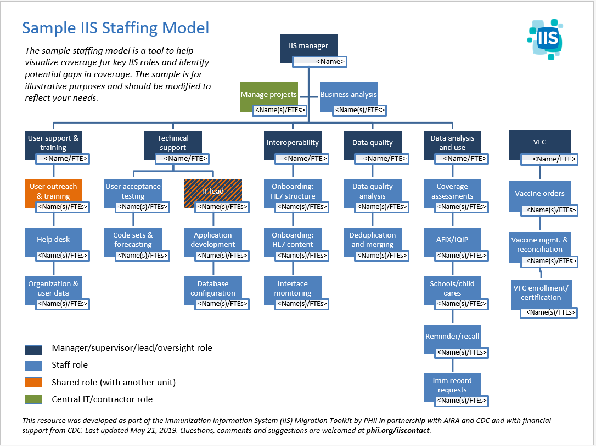

Slide 18
Activity: IIS Staffing Model
Read the IIS Staffing Model at your desk and think about how your current IIS team compares to the model - 5 minutes
Go to the IIS Staffing Model posted on the back wall and attach dots indicating which roles are covered (green), partially covered (yellow) and not covered (red) among your current IIS team - 5 minutes
Return to your table to participate in a group discussion about your findings and how to fill staffing gaps - 5 minutes

Slide 19

Engage and Motivate People

Slide 20
Create and Maintain Internal Relationships
Build a strong relationship with your immunization program manager
Manage up – keep manager informed
Advocate for resources – jointly develop and manage the IIS budget
Align IIS activities with program’s strategic vision – meet CDC and jurisdiction requirements
Ensure each staff member is engaged and understands their role
Goal: the right person in the right role doing the right things the right way
Notes:
S

Slide 21
Create and Maintain Internal Relationships (cont.)
Collaborate with jurisdiction IT, legal counsel and other public health programs
Facilitate compliance with laws, policies for authorized IIS access and use
Get involved in DMI
Support work of Communicable Disease, School Health, Childcare and Lead Poisoning Prevention
Work the system
Know your health department and how to get things done (e.g., hiring, purchases, contracts)
Notes:
S

Slide 22
Create and Maintain External Relationships
Build a strong relationship with:
Immunization providers
IIS technology partners
CDC
AIRA
Other key external partners (e.g., schools, the public)
Collaborate with your CDC IIS SME to help you meet CDC Cooperative Agreement (CoAg) requirements
Communicate early and often – critical to building support for IIS

Slide 23

Promote Data Quality and Use

Slide 24
Achieve High Quality Data in the IIS
What is high quality IIS data? How is it achieved?
Starts with high quality data submissions!
Collaborate with providers to address/resolve data issues
Continually assess and resolve data quality issues
Promote data exchange with IIS and federal partners via IZ Gateway
High quality data in high quality data out
Notes:
What is high quality data? Tools available to define it: Blueprint, IIS Dashboard, CDC DQ reports
Don’t strive for perfection, but make it a continuous process
Will be discussed in depth in a later module

Slide 25
Continuously Collaborate with Providers
Focus on what’s in it for them!
Demonstrate IIS value and facilitate high quality data submissions
Leverage publicly-funded vaccine programs (VFC, 317, adult) to incentivize complete and accurate reporting of all immunizations administered
Require IIS reporting of publicly-funded vaccine doses through VFC, 317 and adult vaccine provider agreements
Link vaccine ordering to reporting

Slide 26
Ease Provider IIS Access and Reporting
Support standards-based, bidirectional data exchange between your IIS and provider EHRs, pharmacy systems
Enables providers to remain in their workflow when reporting immunizations and receiving immunization data and forecasting

Slide 27
Support Core IIS Functionality
Streamline major tasks of immunization program, providers, schools, CDC, other public health programs, consumers
Assess immunization coverage
Identify vulnerable populations and pockets of need
Respond to outbreaks
Enable ordering, management, accountability for VFC, 317, other publicly-funded vaccines
Facilitate compliance with immunization requirements in schools, childcare
Offer consumer access to proof of vaccination

Slide 28
Ensure Authorized Use of IIS Data
It is why your IIS exists – data is its core value!
Using the data is critical to improving its quality
Data users will help you find problems
Enable standards-based HL7 query/response
Support public dashboards with effective data visualization
Implement other data sharing methods to increase access and use
Notes:
Might want to call out the standard for IIS to allow HL7 Q/R - are they using it?

Slide 29


Necessary for Success
A skilled and knowledgeable IIS team
An IIS system with high quality data and functionality
Notes:
We’ve just talked about building your team, let’s turn our attention now to your IIS. Integration of program and technology

Slide 30
Activity: Discussion Questions
Where are you strongest as an IIS leader?
Where do you have room to grow?
Create a Vision and Strategy
Build a Strong Team
Engage and Motivate People
Promote Data Quality and Use
Notes:
Ask each participant both questions and should be built into their action plan!!

Slide 31

Questions/Comments/Discussion?

Slide 32
IIS Leader Resources
IIS Core Competency Model - defines 11 core competencies for the IIS team
Sample IIS Staffing Model - helps visualize coverage for key IIS staff roles and gaps
IIS Workforce Classifications - guides identification of staffing needs and helps with recruitment
Staff Allocation Matrix - helps assess current and planned staff allocations and capacity
IIS Staff Roles Matrix - helps identify staffing responsibilities for key IIS roles
CDC IIS Data Quality Blueprint - guide to address and advance IIS data quality characteristics
CDC IIS Dashboard - identifies jurisdiction-specific data quality strengths and challenges
AIRA Aggregate Analysis Reporting Tool (AART) - provides information on IIS community-driven measures and tests
CDC Functional Standards and Operational Statements - describes operations, data quality and technology needed by IISs to support immunization programs and partners
DMI for IIS One-Pager Guide - steps for IIS staff to learn more about DMI
Immunization Program Operations Manual (IPOM) - lists requirements to meet CDC objectives (CDC Sharepoint site)
Notes:
IPOM - jurisdictions have access to the IPOM, which is behind the CDC firewall

