Slide 1
Effective IIS Data Use
Promoting Use of IIS Data to Protect Public Health
Amy Metroka
June 5, 2024
Presenter name/date
Notes:
I would like to invite Marcey Propp to the stage for our Effective IIS Data Use session.

Slide 2
Learning Objectives
Understand the connection between data quality and data use
Apply the SIPOC framework to identify the key Suppliers, Inputs, Processes, Outputs and Consumers of IIS data
Identify the internal and external partners who can use IIS data to increase up-to-date immunization of individuals and populations
Recognize the potential impact of data visualization on increasing IIS data access, use, and awareness by the public and partners

Slide 3
IIS Data Use
Data use is the translation of IIS data into actionable information to support clinical practice, immunization program operations and other purposes that protect and promote the health of individuals and communities.
2021 IIS Core Competency Model
Notes:
The definition of IIS Data Use per the 2021 IIS Core Competency Model is the translation of IIS data into actionable information to support user needs.
We saw this translation of IIS data in many ways throughput the pandemic in various data visualization and presentation methods that enabled the data to be translated for action.

Slide 4
Why is IIS Data Use Important?
The purpose of the IIS is to collect, consolidate and share data to increase immunization coverage rates and promote public health
Sustainability and credibility of the IIS depends on data use
Data use improves data quality
Users find the problems and help you fix them
Notes:
Why is IIS Data Use important? The IIS’s purpose is not only to collect/consolidate data for the health department but to share it with partners and enable actions that increase immunization coverage rates and promote public health.
Use of the IIS data fosters sustainability and credibility of the IIS as a key information system.
And data use helps identify discrepancies in the data to be resolved.

Slide 5
Your Role as an IIS Leader
Continuously work to achieve high-quality IIS data
Strengthen data quality processes and personnel
Use CDC, AIRA, and PHII resources
Promote and enable authorized use of high-quality IIS data by internal and external partners

Slide 6
How can you achieve effective IIS data use?

Slide 7
SIPOC Framework for Effective IIS Data Use
Suppliers
Inputs
Processes
Outputs
Consumers
Providers
Immunization Program
Other Health Department staff
Other IISs
Public
Schools
Child Care
CDC
Medicaid, Health Plans
Researchers
Providers
Other IIS
Federal agencies
Patient demographics
Vaccination events
Onboarding for reporting and access
Matching, merging and de-duplicating records
Clinical Decision Support (forecasting)
Vaccination records
Immunization Forecasts
Vaccination coverage and line list reports
Reporting to CDC, jurisdiction
Dashboards
Recruit and connect all suppliers
Motivate providers to report high quality data
Capture full range of IIS data inputs
Ensure integrity of data processes
Continuously improve data quality processes
Promote authorized access
Share high quality IIS data outputs
Meet consumer needs
Highlight data use champions
Role of IIS Leader

Slide 8
Recruit and Connect all IIS Data Suppliers
SIPOC
Onboard providers and partners for interoperability
Set up accounts for IIS user interface
Suppliers in this case include…
Hospital Clinics
Public Health Clinics
Private Provider Offices
Federally Qualified Health Centers (FQHCs)
Pharmacies – Chains and Independents
School-Based Health Centers (SBHCs)
Points of Dispensing (PODs)
IIS in other jurisdictions and federal agencies – leverage IZ Gateway

Slide 9
Capture Full Range of IIS Data Inputs
SIPOC
Collect all CDC Endorsed Data Elements
Patient demographics
Improve collection of race and ethnicity and, if possible, sex/sexual orientation and gender identity (SOGI) data and priority group to support equitable access to vaccines
Vaccination events
Vaccination date, presentation, manufacturer, lot number, etc.
Provider, Facility

Slide 10
Motivate Providers to Input Quality Data
SIPOC
Providers must input quality data to get useful data out of the IIS
To promote quality data:
Facilitate standards-based interoperability for reporting all vaccines
Ease reporting burden
Leverage Promoting Interoperability incentives
Ensure confidentiality and security of IIS data
Leverage VFC and public purchase vaccine programs for adults (317, state) to get quality data in
Obtaining publicly-purchased vaccines motivates providers

Slide 11
Ensure Integrity of Data Processes
SIPOC
Adhere to HL7 standards for both IIS reporting and access
Collaborate with your technology partners to improve record matching, merging and deduplication
Keep IIS Clinical Decision Support (CDS) engine (forecaster) updated and aligned with Advisory Committee on Immunization Practices (ACIP) and CDS for immunization (CDSi) specifications
Document and implement standard operating procedures (SOPs) for key processes (e.g., onboarding, manual deduplication)

Slide 12
Continuously Improve Data Quality Processes
SIPOC
Designate a Data Quality Analyst – point person to lead a team
Ensure active review and correction of incoming data and data at rest
Work with providers to correct data quality problems
Engage with EHR vendors and providers to improve reporting of all CDC endorsed data elements
Providers need to enter race, ethnicity, SOGI data in their EHR in order for the IIS to collect the data

Slide 13
Promote Authorized Access
SIPOC
Support HL7 query/response (bidirectional data exchange) for providers, health plans, schools
Delivers quick, easy access to patient records and forecasts
Facilitate IIS capacity to handle large volume of data requests
Support access to a data warehouse/database replica/data lake
Ensure sufficient processing capacity, bandwidth, storage and redundancies
Expand public access by supporting a consumer access application
Assign sufficient staffing to support and train users

Slide 14
Share High Quality IIS Data Outputs
SIPOC
Provide vaccination records, forecasts, coverage reports and line lists to providers, immunization program, schools, payers (Medicaid), other public health partners
Share data via the IZ Gateway
Capture out-of-jurisdiction immunizations in your IIS and supply it to other IISs

Slide 15
Share High Quality IIS Data Outputs (cont.)
SIPOC
Send CDC aggregate and patient record-level, de-identified data regularly
Use Privacy Preserving Record Linkage (PPRL)
Complete the IIS Annual Report (IISAR)
Provide data to jurisdiction partners
Create or support dashboards
Promote effective data visualization to inform and guide action for population health at local, national levels

Slide 16
Meet Consumer Needs with Useful IIS Functionality
Immunization Providers
Support vaccine ordering, receiving, managing, and accounting for VFC, adult, other public vaccine programs
Health Department
Promote use of IIS data and functionality to support all components of the immunization program
Enable internal access to colleagues for public health activities
Public
Offer a consumer access application for individuals and families
Promote access to digital proof of vaccination
Notes:
Broad definition of consumers

Slide 17
Highlight Data Use Champions
SIPOC
Recognize providers using the IIS to achieve high immunization coverage
Collaborate with AAP and other professional associations (e.g., nurses)
Recognize providers at meetings
Post Honor Roll on websites (AAP, health department)
Collaborate on quality improvement initiatives
Encourage champions to share their work with peers

Slide 18
Examples of IIS Data Use

Slide 19
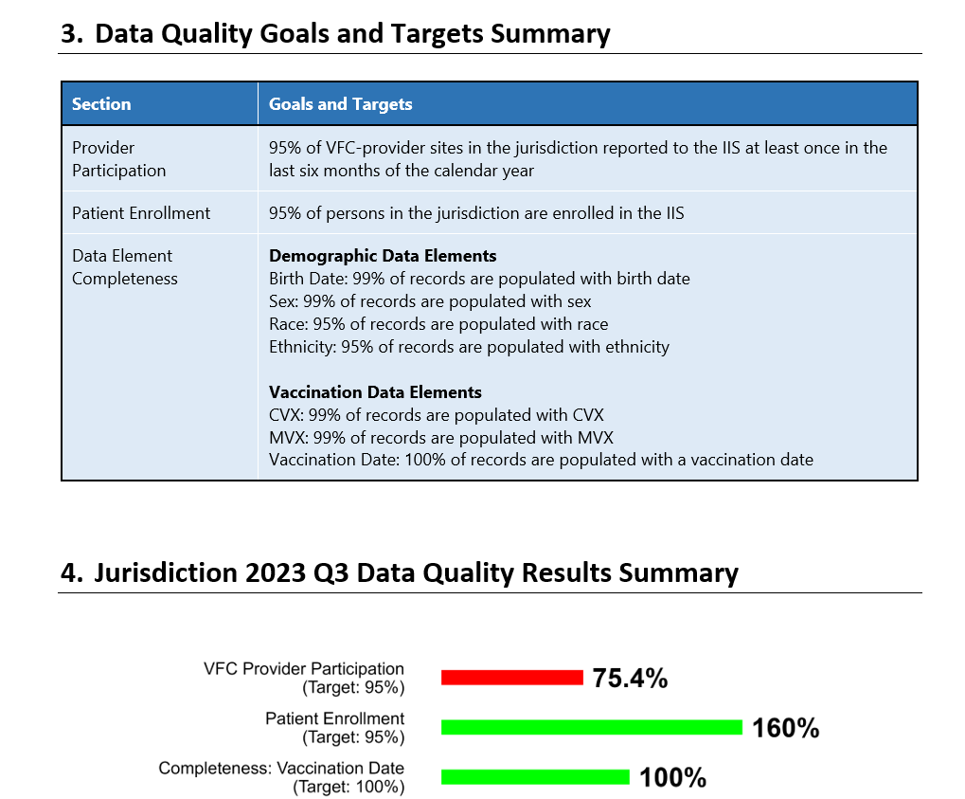
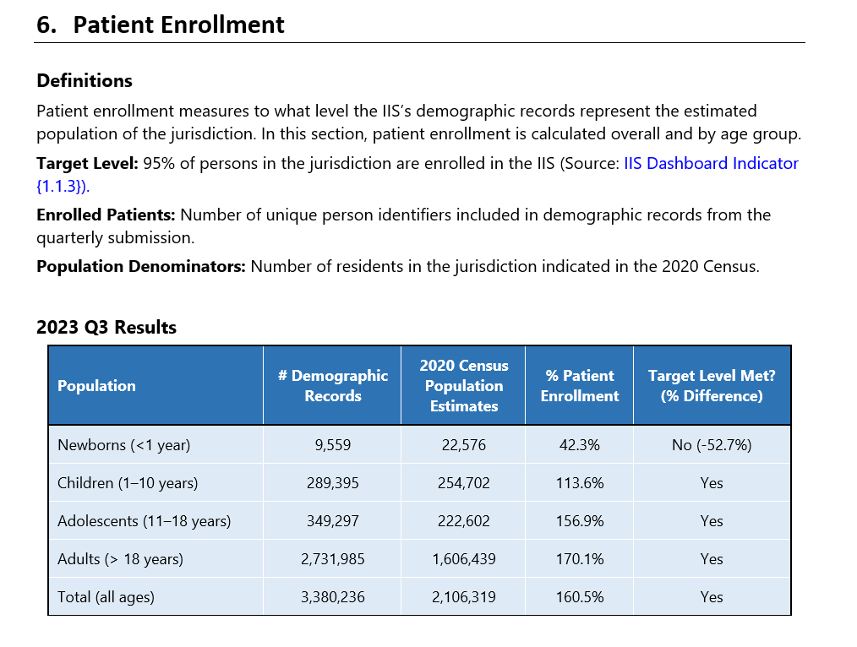
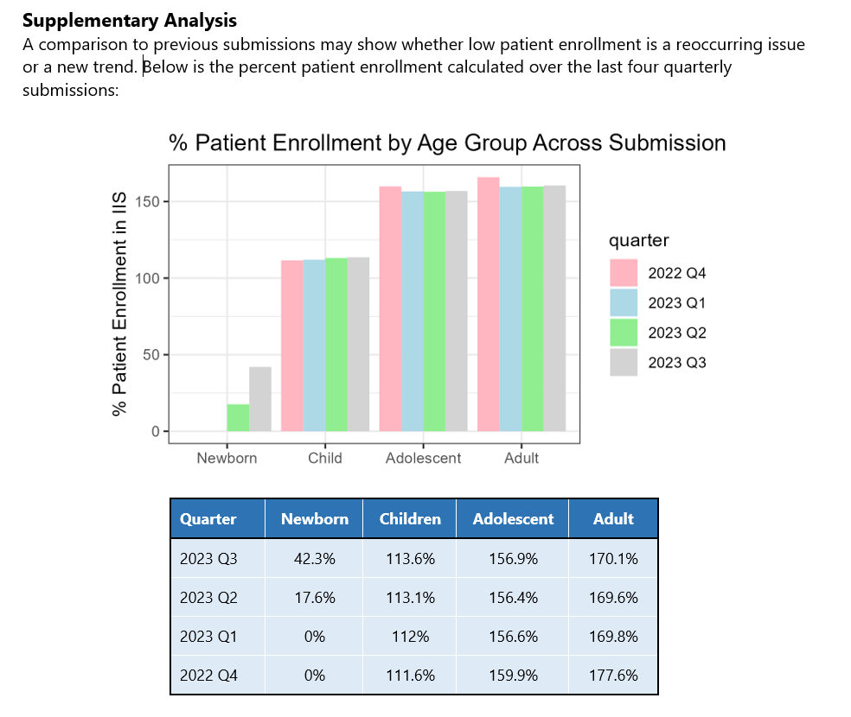
Routine Vaccination Data Quality Report
Evaluates routine vaccination data submissions against data quality goals and targets set by the IIS Data Quality Blueprint Indicators and AIRA completeness recommendations.
Includes sections describing:
Provider participation
Patient enrollment
Data element completeness
Data element validity
Trends across age groups and over time
19

Slide 20
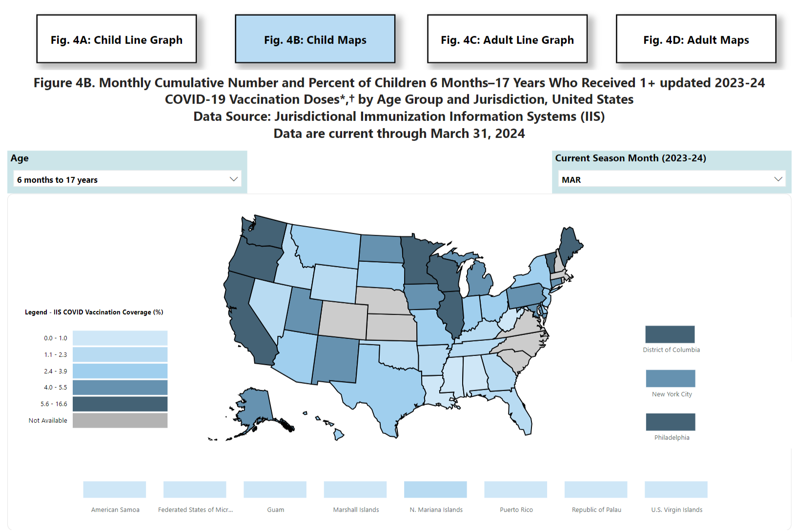
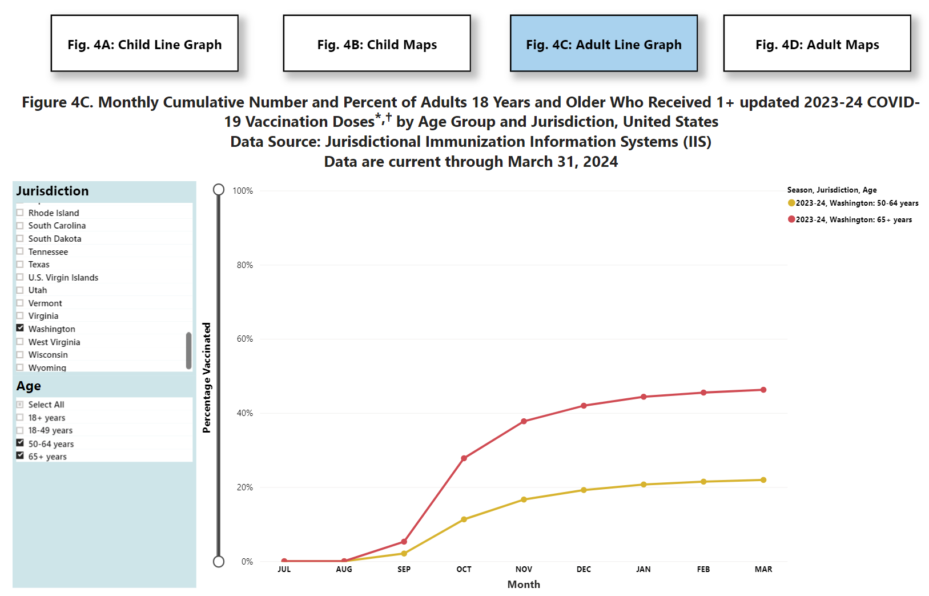
CDC Use of IIS Data
Vaccine Administration and Coverage by Jurisdiction (IIS), United States
Vaccine Administration and Coverage by Jurisdiction (IIS), United States | CDC
Vaccine Administration and Coverage by Jurisdiction (IIS), United States | CDC

Slide 21
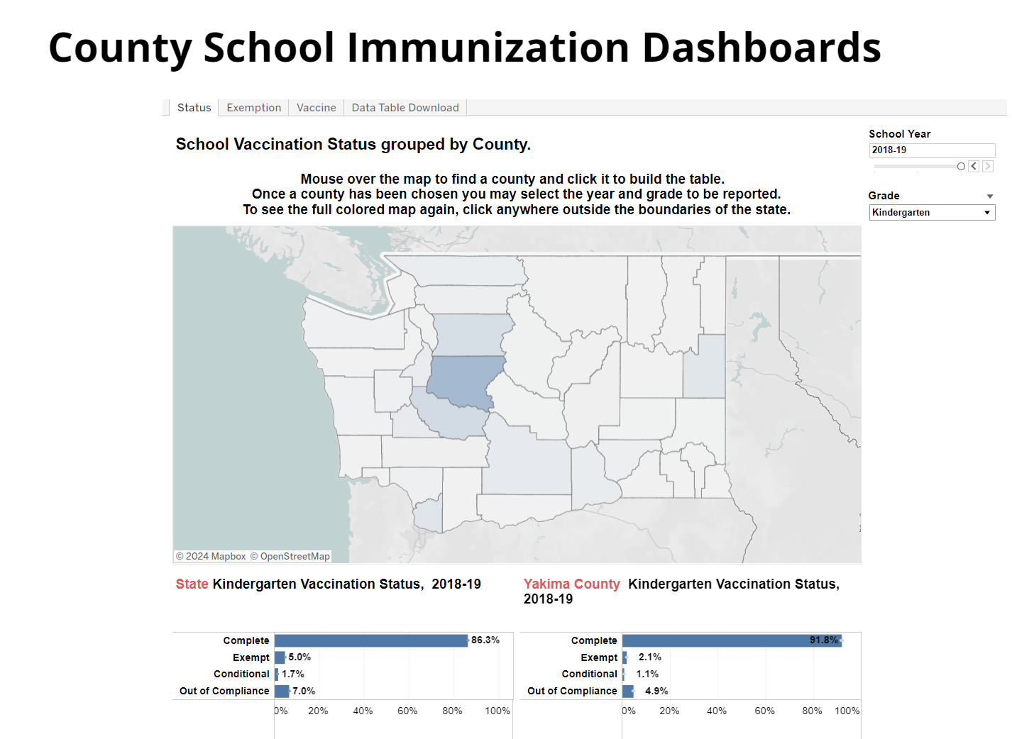
Jurisdiction Use of IIS Data
County School Immunization Dashboards | Washington State Department of Health

Slide 22
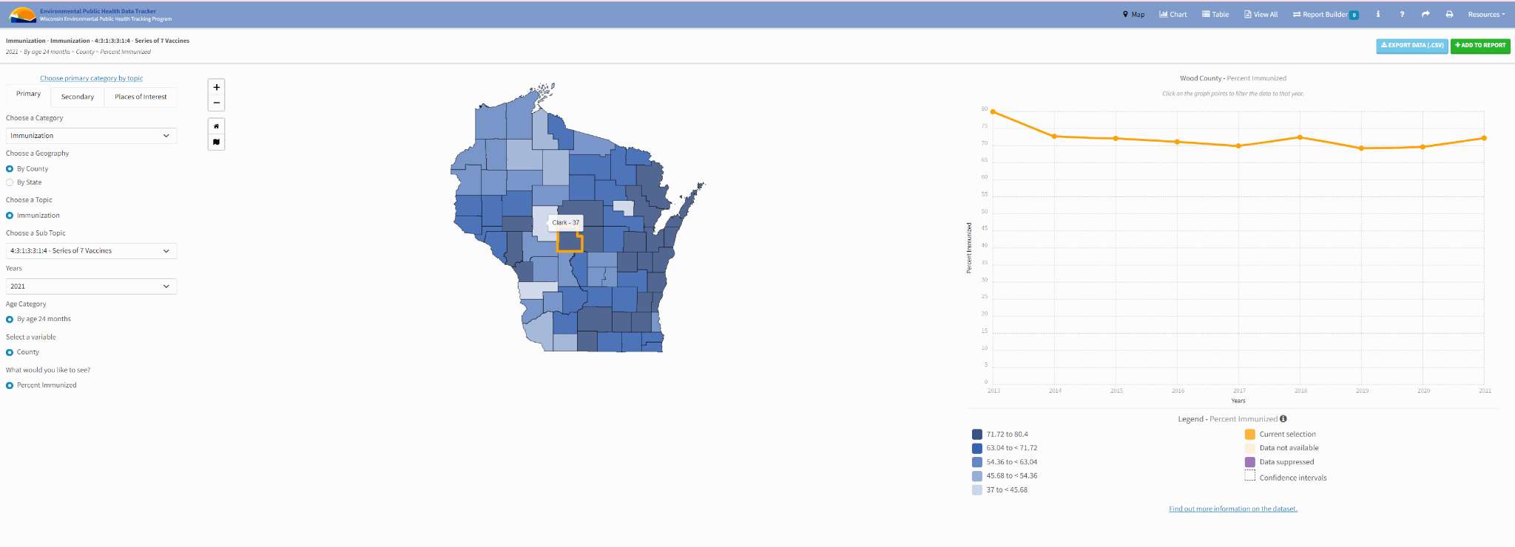
Jurisdiction Use of IIS Data
Wisconsin EPH Tracker

Slide 23

Activity: Small Group Discussion
Discuss the questions below with the people at your table, and designate one person to report out for your group.
What data use challenges are you facing now?
How can you work to overcome them?
After 10 minutes, each group will report out and everyone will engage in a large group discussion.

Slide 24

Questions/Comments/Discussion?

Slide 25
Data Use Key Resources
CDC Core Data Elements for IIS Functional Standards v4.1 - list of CDC-endorsed data elements
CDC IIS HL7 Version 2.5.1 Implementation Guide (IG) and Addendum - guide for EHR vendors, immunization providers, and other partners to implement standards-based data exchange with an IIS
AIRA Onboarding Guidance and Shared Services - supports awardee jurisdictions with onboarding providers to their local IIS
AIRA Aggregate Analysis Reporting Tool (AART) - an application developed to visualize and compile results and information on community-driven measures and tests related to IIS Functional Standards

