Slide 1
Communication
Building Support of Your IIS
Marcey Propp
June 4, 2024
Presenter name/date
Notes:
For the last session of our day, I would like to invite Marcey Propp on stage.
Marcey Propp is a Sr. Project Manager, and a PHII faculty member from HLN Consulting
Marcey Propp has engaged with public and private health systems and not-for-profit organizations for the past 20+ years, assisting them in developing strategic health information technology plans for improving productivity and efficiency. Over the past several years, as a Sr. Project Manager, Marcey has been collaborating with the CDC, AIRA and PHII to provide technical assistance to jurisdictions across the country to help support successful IIS platform transitions and project management activities throughout the project lifecycle. Marcey has been a faculty with the IIS Leadership workshop since 2017.
Let’s hear what Marcey has to say about “Communications”..

Slide 2
Learning Objectives
Understand the critical role of communication in building support of the IIS
Learn the building blocks in developing a robust communication plan
Identify key internal and external partners for IIS communication
Draft communication plan strategies and key messages tailored to sample partners or groups
Notes:
Marcey…[thread] as heard in Amy’s module, communication is key to creating/achieving the vision and who is responsible (staffing) for communication
communication — without an “S” — is used to describe the exchange and interpretation of messages and the meanings behind them, specifically how different entities convey information to one another. Communications — with an “S” — is generally more focused on how these messages are delivered.

Slide 3
Communication Defined
Communication is engaging internal and external partners to build and sustain effective use of the IIS and its data.
2021 IIS Core Competency Model
Communication builds credibility and trust in the program, IIS and its data!
Notes:
Marcey
This was highlighted during pandemic and continues to be a critical role of an IIS leader

Slide 4




Purpose of a Communication Plan
To identify key partners/groups, messages, timelines, and communication channels for the dissemination of essential information regarding your IIS
Notes:
Marcey
<NOTE to Presenter>: there is an icon for each bolded phrase- animations are set up to have one appear each time you click.>
I tend to refer to these various components (partners, messages, channels, timeline) as building blocks of a Comms Plan

Slide 5

Frequently Asked Questions
When should we communicate...how soon/often?
Why should we communicate?
What should we communicate?
How should we communicate?
To whom should we communicate?
A Communication Plan addresses all these questions…
and more!
Notes:
Marcey
A communications plan allows you to address these questions in a proactive rather than a reactive manner.
One jurisdiction recently mentioned that building the communications plan enabled her to begin drafting the training plan – to apply change management disciplines in both communications and training to their diverse audiences.
Another jurisdiction suggested “going back to basics” in drafting a comms plan as their law had changed due to the pandemic requiring reporting to the IIS for all vaccinations (adults and children)

Slide 6
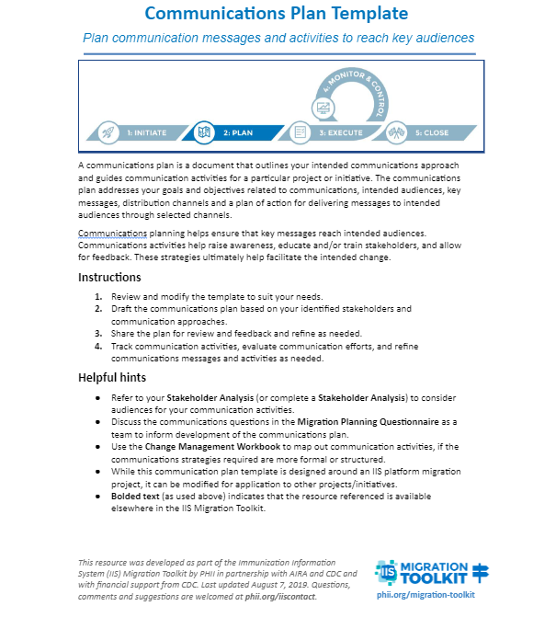
Communication Plan Sections
Objectives and Goals
Partners and Groups
Strategies and Key Messages
Communication Vehicles
Planning and Tracking
Change Management
Notes:
Marcey
The Communication Plan is organized into sections that enables the user to build on the information and planning detailed in the previous section and develop a comprehensive and cohesive plan. Answers the when, why, what, how and to whom questions

Slide 7
1. Communication Plan: Objectives and Goals
The purpose/timeframe of the plan should be developed for:
Short-term (3-6 months)
Intermediate-term (6-12 months)
Long-term (12-18 months)
Notes:
Marcey
Depending on what needs to be communicated will determine the purpose and timeframe:
EX: If you want to communicate an upcoming (imminent) enhancement versus a transition to a new platform that might warrant communications over the next 18-24 months

Slide 8

2. Communication Plan: Partners and Groups
Begin to formulate the who to communicate with
Identify who might have:
Influence,
Vital interest in,
Engage with, and/or
Impacted by changes in your IIS
Notes:
Marcey
Partner Identification from a change management perspective:
who may be impacted by enhancements/changes
each group may have specific communication needs and key strategies required to meet their specific needs
We have developed several tools to identify various audiences by group/category - Change Management Workbook and Stakeholder Analysis

Slide 9
Partner Analysis Workbook
Sample partners:
Birthing hospitals
Childcare providers
EHR vendors
Healthcare providers (pediatric/adult immunization providers, pharmacies, non-immunizing providers, etc.)
Local health departments
National partners (CDC, AIRA, etc.)
School nurses
State agency, programs (vital records, DSS, WIC, DOE, surveillance programs, state IT, etc.)
State leadership
Tools to identify who to communicate with
by…
Group/organization
Role
Degree of interest, influence, and impact
Notes:
Marcey
Mention many tools available (Change Management Workbook) to identify the audience…use the Partner Analysis Worksheet as a tool to identify the groups by category, group and key strategies to meet the specific needs of each unique group.
Tips: All the tools within the Toolkit are available for your use and can be adapted/modified to fit your needs!
Examples of potential partners/organizations and communication strategies listed on the slide AND provided within the Communication Plan Template for reference

Slide 10
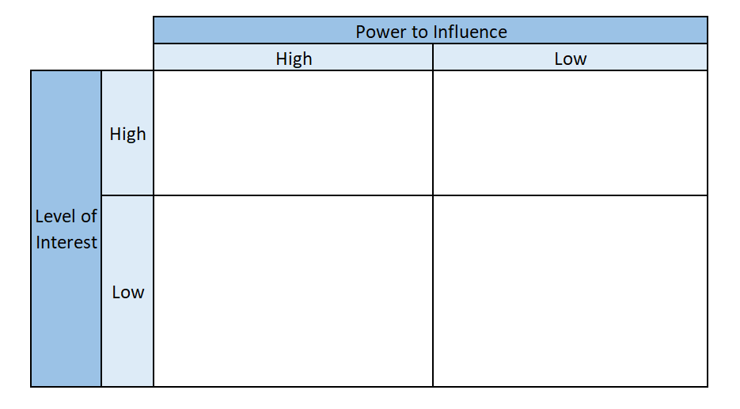
Partner Analysis Matrix
Notes:
Marcey
Another tool in the workbook: Partner Analysis Matrix
This allows you to place key partners on a 2x2 table based on their power to influence, and their level of interest in your IIS. This can be used to identify sponsors, leaders, strategies and potential message communicators e.g., identifying a champion nurse/provider
The goal is to get as many partners as possible into that upper left quadrant - where those that have high power to influence have high levels of interest as well.
Power to influence - from the partner’s perspective and not the power of the program to influence the partner

Slide 11

Activity: Partner Analysis Matrix
As a table, identify 2-3 key partners and indicate within the matrix their:
Level of interest
Power to influence
Notes:
Marcey
Spend 5 mins thinking of key partners on your own
Discuss with your table partners (5 mins)
Have one person from the table share with the larger group (questions on next slide - 5 mins) to create a common Partner Analysis Matrix (flipchart)
Page 30 in your workbook

Slide 12
Activity: Large Group Sharing
Based on your small group discussions:
Who might be strong advocates of your IIS (high/high)?
What relationships might be strengthened through communication?
Notes:
Marcey
Share with the larger group, table by table and plot onto the common flipchart matrix

Slide 13
3. Communication Plan: Communication Strategies
Based on the partners’/group’s level of interest, awareness, influence and/or impact
Does the communication need to…
Raise awareness?
Educate/train?
Seek input?
Update/status?
Notes:
Marcey
Sample partners and strategies are provided in the Communications Plan template, but others may come to mind as well in thinking through the strategies.
Communication strategies include: Raising awareness, educate/train, seek input, status update

Slide 14
3. Communication Plan: Key Messages
Consider from each partner’s/group’s perspective…
Value of the IIS
Highlight the value in the messages
Answer the question: “what is in it for me!”
Collect feedback from some groups to modify/refine messages
Notes:
Marcey
It should be noted that the messages are not final and will continue to be modified as feedback is received from key partner groups.
Messages should be customized based on audience - to speak directly to their needs/concerns
Helpful to have a set of core messages that are repeated to all partners and more tailored messages for specific audiences.

Slide 15
3. Communication Plan: Key Messages (cont’d)
Content…
What level of messaging is best for different audiences?
How might messaging differ in various phases of a project?
What questions are people going to want/need answers to?
Identify and celebrate milestones!
Sample Messages
Core messages
New/improved functionality
Customer support
Electronic exchange
Streamlined/automated processes
Notes:
Marcey
Messages will be unique to each specific partner/group.
Within the CP template, several message categories and examples within each are provided:
core, functionality, customer support, electronic exchange
You can then select from the ones within the template or draft your own
Example: Communication targeting pediatric clinicians, for example, should have a different emphasis/core message than outreach intended for immunization program staff.
EX: Save time and resources in meeting the immunization reporting requirements by establishing an interface for electronic reporting.
No more printing, copying, faxing, mailing and playing phone tag! Enroll now at _______ (provider)
The functions you rely on are still here...plus a whole lot more! (staff)
Helpful to have a set of core messages that are repeated to all partners and more tailored messages for specific audiences.
Messages will be unique to each phase of the project and to the specific partner/group.
current state vs. future state
what is the impact of the change, i.e. WIIFM
progress updates

Slide 16
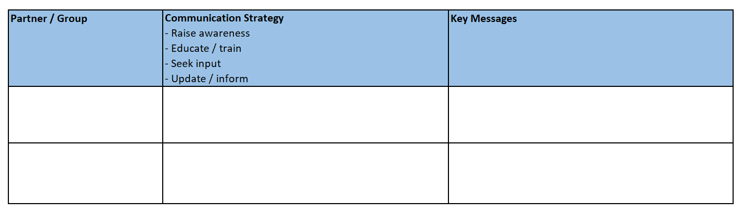
Activity: Strategies and Key Messages
Consider one of the partners listed in the previous activity and determine:
Strategy(ies) needed to communicate with this partner
Key messages tailored to their use/need of the IIS
Notes:
Marcey: Taking Amy’s slide #24 further (for action)
As a table, determine which partner to consider from your matrix (activity #1);
determine which strategy may be important in communicating with this partner (5 mins)
Identify key messages to communicate to this partner (5 mins)
Have one person from the table readout to the group (5 mins)
Messages:
Core messages
New/improved functionality
Customer support
Electronic exchange
Streamlined/automated processes

Slide 17
4. Communication Plan:
Communication Channels/Vehicles
Sample Channels/Vehicles
Email/fax
Fact sheet
IIS message board
Meeting
Conference
Newsletter
Online training
Onsite training
Social media
Video
Webinar
Determine how and by whom key messages will be delivered…
Packaging the messages
Delivery method
Frequency
Sender
Notes:
Marcey
Packaging - all at once or in manageable chunks?
Sample delivery methods (vehicles/channels)
● Email/fax
● Fact sheet
● IIS message board
● Meeting
● Conference
● Newsletter
● Online training
● Onsite training
● Social media
● Video
● Webinar
Recent technologies may provide other options available to DOH (e.g., social media channels)
When feasible, existing forums, such as, association meetings or channels (e.g., newsletters, website alerts, etc.) should be leveraged
Sender - depends on the audience - sometimes best to have messages communicated by leadership or someone within the partner group e.g., school nurse, pediatrician, etc.

Slide 18
Attributes of a Successful Communicator
Open and honest
Able to listen
Able to describe ‘WIIFM’
Personable
Chooses the appropriate communication channel
Passionate
Credible/trusted
Able to deliver a clear message
Knowledgeable about the change
Provide consistent and timely messages
Notes:
Marcey

Slide 19
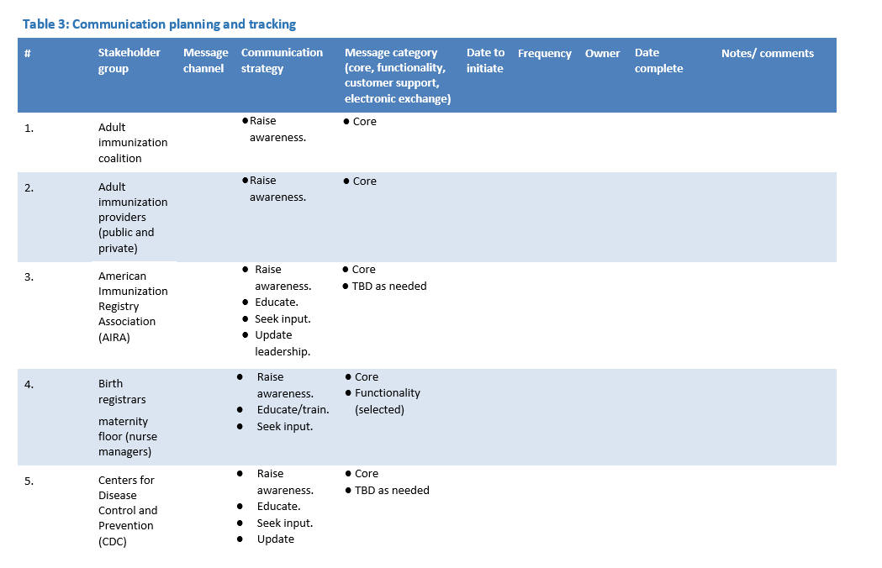
5. Communication Plan: Planning and Tracking
Prepare and present the plan…
Who is the audience
Who is the sender
What are the key messages
When will it be delivered
Where will it occur
How will the messages be sent
Notes:
Marcey
The messenger may change with the message - IIS Manager, Program Manager, advocates

Slide 20
6. Communication Plan: Change Management
Awareness
What is the nature of the change?
Why the change is needed?
What are the risks of not changing?
Allows for interaction with those who are directly affected
Formalizes feedback mechanisms
Reinforcement…celebrates successes
Awareness
Desire
Knowledge
Ability
Reinforcement
Prosci’s ADKAR Model
Notes:
Marcey
Always comes back to the overarching concept of CM!
CM = assisting people through change is critical - and a communications plan is one method to guide people through the change
Making them aware of the change and providing reinforcement to celebrate the successes along the way…we should never forget to communicate (acknowledge) the successes!!
We will speak more about change management during the workshop (Day 2)

Slide 21
Your Role in Communication Planning
Advocate for the Immunization Program and IIS – locally and nationally
Build credibility and trust in the Program, IIS and its data
Ensure partner needs are represented and considered
Promote clear and transparent discussions of IIS issues and updates
Provide guidance, direction and support for the future and direction of IIS
Be an effective consistent communicator to diverse audiences!
Notes:
Marcey - will enable IIS to gain a seat at the DMI table and have a voice in key decisions
As Amy noted in her module ‘Role of an IIS Leader’, you are an advocate of your IZ program and IIS, which means you need to engage and communicate with partners (external and internal) to hear what is going well, issues/concerns, and what could be improved!
BUT you do not have to take on all aspects of communication planning/communication yourself…you can allocate someone who may have an interest, can manage some of the building blocks within the plan or even put it all together in the Comms Plan template!!

Slide 22

Questions/Comments/Discussion?

Slide 23
Communication Resources
Tools and resources that can be used to inform and complement your Communications Plan are available in the IIS Operations Toolkit, including:
Communications Plan Template - instructions and samples to complete a comprehensive communication plan
Partner Analysis Workbook
Partner Analysis Worksheet - to identify various partners to communicate with
Partner Analysis Matrix - a 2x2 matrix to determine the level of interest and influence a partner may have
Change Management Workbook - to map out/complete communication activities
Notes:
Marcey
The Communications Plan template includes several tools and samples that can be modified or adapted as needed for your use to effectively communicate updates, enhancements or the status of your IIS
All tools available within the PHII Toolkit

