Slide 1
Change Management, Project Management, and the Systems Development Life Cycle
The Convergence of People and Process to Successfully Deliver Technology
Marcey Propp
June 5, 2024
Presenter name/date

Slide 2
Learning Objectives
Understand how change management differs from project management
Recognize how they complement each other and why they are crucial to a successful systems transition/IT project
Utilize the PHII project management framework and tools as foundational resources in managing program systems initiatives
Notes:
While you may not need to design and manage the development of your IIS or enhancements, this module is intended to provide an introduction to SDLC and enable you to become a bit more familiar and comfortable with the competencies, phases and tools needed to effectively deploy or maintain an information system.
Change management - staff want to understand what is going on in the midst of all changes - will likely stay in role if aware/informed

Slide 3


Activity: Word Cloud
Identify new terminology/technology in this new era…
AI
TEFCA
Others?
Notes:
Use MentiMeter- word cloud to gather these…
So many new terms have entered our public health lexicon dealing with new technologies, data collection, reporting and visualization.
Any others that come to mind? What terms have you heard recently?
AI Analytics
Data Clearing House
Data Lake
Cloud Computing
Cloud Hosting
IZ Gateway
VAMS
Priority Groups
Tiberius
Data Modernization
Data Visualization
Dashboards
Others?

Slide 4
Information Systems Management
Application and administration of technologies to securely and effectively meet IIS program and user needs.
2021 IIS Core Competency Model
Notes:
As I like to say…let’s take a step back and define Information Systems Management
From an overarching perspective, Info Systems Mgmt is defined as the coalescence of technologies to securely and effectively meet IIS Program and user needs. It can be one application or a multitude of technologies that enable an organization to meet its objectives and goals.
From this definition, we can see the IIS as a public health information system that enables the IZ Program to meet its strategic objectives and user needs.
But I would argue that it is not a matter of simply deploying the technology and expecting it to work its magic…though we have all probably hoped at some point that this was the case?
Rather it is the artful combination of Change Management, Project Management and Systems Development Life Cycle methodologies that enable a successful implementation of an information system.

Slide 5



Successful Change
Systems Development Life Cycle
Project Management
Conceptual model used in information system design and development that defines the stages in bringing a project from inception to completion.
Application of methods and tools to achieve defined objectives within the available time, human, technical and budgetary resources.
Change Management
Application of methods/tools to engage and support partners through changes in policies, processes and/or technologies.
2021 PHII IIS Core Competency Model
Notes:
Animation on slide….
Marcey - CM focus on people
Change is not automatic or effortless…and new technologies can be a significant (and frightening) change for many people
There is a need to identify, prioritize and effect the changes needed, and equally important - to assist people through the change…as change is not always easy for everyone.
It takes the application of complementary disciplines, methodologies, tools and techniques - change management (go through defn), project management (go through defn) and SDLC (go through defn) - to implement new technology and bring about successful change
There is a challenge of bringing people and organizations to the point of understanding and adopting technology
The convergence of people (CM), process (PM) and technology (SDLC) were all required during the pandemic response. I saw these practices in play very successfully in jurisdictions across the country and others that struggled to find/apply the right balance in bringing, people, process and tech together in a positive and constructive way.

Slide 6
Project Managing the SDLC
Convergence of People, Process and Technology
Budget
Project Sponsorship
Staffing
Planning
Project Management
Change Management
Scope
Charter
Training
Risk Management
Communications
Change Control
Business Case
Documentation
Status
Maintenance
Reporting
Process Flows
Requirements
Testing
Implementation
Deployment
SDLC
Performance
Design
Capacity
Scalability
Notes:
Marcey

Slide 7
Activity: Change Readiness Assessment
Thinking about your organization, click on the QR code to answer some questions in Menti (Yes/No)
Discuss your responses with the larger group
Notes:
Candid responses will highlight those areas on an organizational level that may need to be addressed before initiating an IIS project.
The Change Readiness Self-Assessment tool is intended to assess an organization's (and your) attitude to change, and is not intended to be an evaluation of your staff, funding, technical or operational capability.
In keeping with the workshop schedule, we have not included all questions within the Prosci Change Readiness Assessment, but can make it available upon request.
Based on reasons in #2, we can highlight tools within the toolkit to assist in mitigating some of the obstacles/issues.
Menti Qs:
Most changes in my organization in the past have been implemented successfully
Leadership in my organization are visible and active change leaders and sponsors
My organization encourages and rewards staff who promote change and introduce new ideas
My management team is receptive to feedback and alternative ideas and encourages open communication

Slide 8
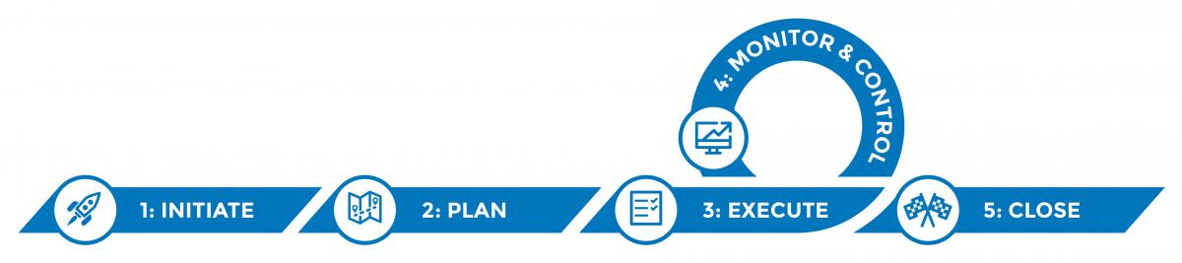
Project Management Framework
The five phases of the project management lifecycle:
Resource: https://phii.org/what-we-do/iis-hub/iis-operations/
Notes:
PM focuses on the cost, schedule and sufficient resource allocation to ensure performance and scope objectives are achieved throughout the project life cycle (go thru the 5):
Phase 1: Initiate - Define the project and obtain leadership support and authorization to proceed.
Phase 2: Plan - Determine critical aspects in managing the overall project scope and work.
Phase 3: Execute - Execute plan(s); complete quality deliverables to meet stated objectives and requirements.
Phase 4: Monitor & Control - Monitor the quality of deliverables, control project constraints and refine plan(s) as needed.
Phase 5: Close - Obtain sponsor’s approval to formally close the project and transition into maintenance and operations.
We have developed many tools that can be used by IIS leaders and/or a project manager to successfully complete one phase and move to the next of any IIS project.
Discuss RAID Log

Slide 9
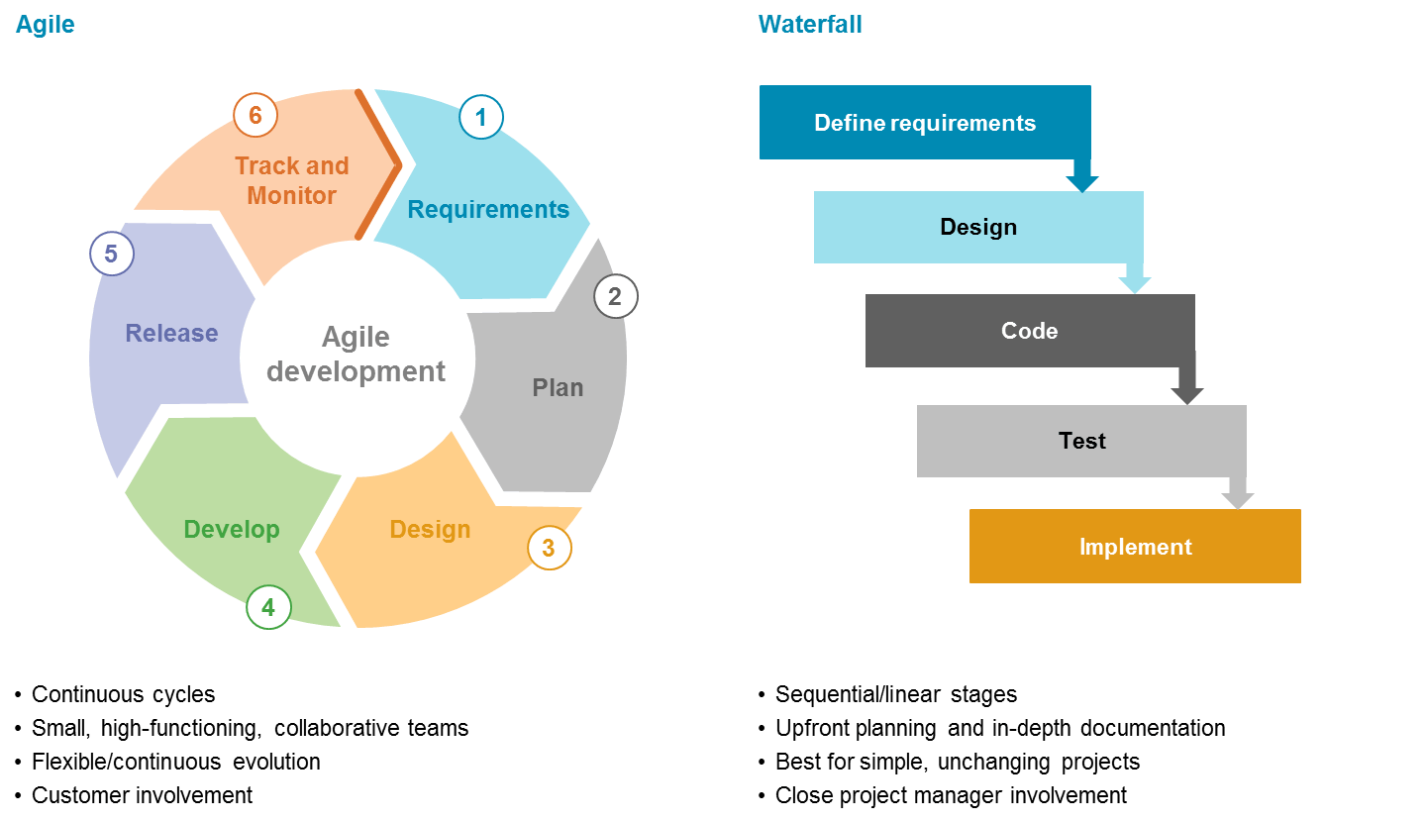
SDLC Delivery Approaches: Agile and Waterfall
Source: https://saigontechnology.com/blog/agile-vs-waterfall-in-software-development
Notes:
SDLC methodologies - Agile or waterfall system development
Both options include key aspects of system development - requirements, design, test and implementation, but Agile is more continuous and tends to engage users throughout the process rather than at certain points (reqs/testing).

Slide 10
Leveraging Agile for System Development
Resource: DMI Recommendations Document
An agile approach to system development, transition and maintenance can:
Help meet the demands of a rapidly changing, dynamic world
Enable thinking in terms of functions instead of systems to promote modularity and flexibility
Allow for a more flexible version to help deal with immediate, urgent needs
Provide additional functionality and choice in addressing emergent needs
Use modularity to be genuine and substitutable with components that are truly interoperable through application program interfaces (APIs)
Notes:
Cannot say one is better than another, but Agile also provides benefits which align to strategic initiatives such as DMI such as:
Enables thinking in terms of functions, instead of systems, to promote modularity and flexibility.
Provides a more flexible version to help deal with immediate, urgent needs.
Allows for additional functionality and choice in addressing emergent needs. Because as we all know, objectives, goals and priorities change
Uses modularity to be genuine and substitutable with components that are truly interoperable through application program interfaces (APIs).

Slide 11
IIS Functional Model
Visual representation of the baseline functions, capabilities and attributes of a standard IIS
  Identifies core functions that promote modularity and flexibility rather than promoting a single monolithic system
  Represents a core system that can be supplemented by ancillary applications
Developed as a tool to assess your IIS in terms of:
  Functionality
  Alignment with Functional Standards/IPOM
  Enhancements
Notes:
Talking points to introduce the FM on next slide
As an IIS leader, need to consider your primary Information System - the IIS!
The functional model has been validated by immunization programs, CDC, AIRA, IIS vendors and other organizations and should be considered an integral tool for baseline IIS functions, capabilities and attributes
The FM can be used to consider the DMI thinking of an IIS in terms of core functions instead of a monolithic system that promotes modularity and flexibility.
After all, an IIS is a core information system supplemented by ancillary applications/systems to address immediate or strategic needs.

Slide 12
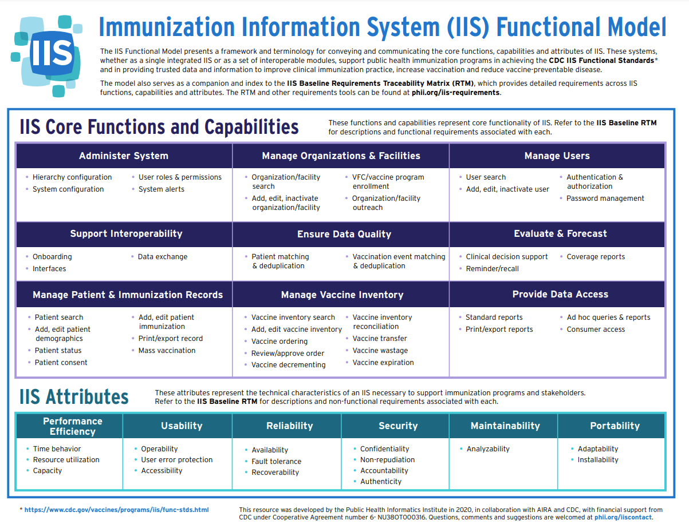
Notes:
Review format: Core functions, capabilities and attributes of an IIS

Slide 13
IIS Leader Considerations
Consider a balance between an IIS that meets your programmatic needs and one that allows for interoperability across modules, agencies and systems
Maintain awareness/understanding of emerging technologies, cognizant of the priority, need and cost to internal and external partners
Promote a culture of adaptation to present and evolving changes (e.g., DMI) to ensure strategic sustainability
Ensure you have the appropriate governance, staff and disciplines to successfully deploy and optimize new technologies
Align program efforts with other IT initiatives and Agency’s overall strategic roadmap
Notes:
SDLC, CM and PM disciplines provide planning and methods to affect/implement new systems
Promote a culture of adaptation to present and evolving changes to ensure strategic sustainability - key aspect that will be explored further in Budget and Sustainability module (Day 3)
"Build Strategic Sustainability" section of the DMI toolkit created by PHII. That has a lot of good considerations in it and can be a place to point this group to learn more. https://phii.org/module-7/build-strategic-sustainability-for-data-modernization-overview/
Governance in terms of who and how decisions are made in a timely manner

Slide 14
Activity: SWOT(lite) of Your IIS
In your team:
Identify 1-2 Strengths of your IIS
Identify 1-2 Opportunities for enhancement you would like to make in your IIS
Identify a spokesperson to read out your team’s responses to the broader group
IIS Strengths | IIS Weaknesses
IIS Opportunities | IIS Threats
Notes:
Initial discussion at your table (10 mins)
General discussion with the broader group (10 mins)
As IIS leaders, we should consider data modernization for the IIS…after all, many things have changed in the years since they were implemented and COVID shined a light on the need to fully optimize them as a public health information system - to collect, store and share vaccination data with federal and state agencies, other IIS and the public.

Slide 15
Role of an IIS Leader
Foster productive internal and external partnerships
Establish and promote an environment of continuous improvement
Provide mechanisms for collecting, sharing ideas and fostering innovation
Apply SDLC, project management and change management disciplines to deliver technologies that meet program and users’ needs
Delegate activities and tasks to leverage staff expertise and strengths in system deployments – don’t try to do everything yourself!
Notes:
May not be at the helm of SDLC, but aware and influence initiatives
As Amy noted in her Role of an IIS Leader, building partnerships within the health department is key.
Data mod is an enterprise wide initiative, making IIS an inherent part of data mod work. Getting to know those within the agency that are leading this effort and discussing how IIS can be involved and figuring out governance early is really important.

Slide 16

Questions/Comments/Discussion?

Slide 17
Change Management, Project Management Resources*
Change Management Tools - guidance on change management activities that assist internal staff and external partners through transition
Project Management Framework - guidance to initiate, plan, execute, monitor and control, and close an IIS project
IIS Functional Model - a framework and terminology for conveying and communicating the core functions, capabilities and attributes of an IIS
IIS Baseline Requirements Traceability Matrix (RTM) - draft baseline functional and non-functional requirements for an IIS to clarify minimum expectations for what IIS technology must do and how it must operate to support IIS Functional Standards and programmatic and immunization stakeholder needs
RAID Log - a centralized source of Risks (R), Actions (A), Issues (I) and Decisions (D) identified and tracked throughout a project and a convenient means of distributing it to project team members and stakeholders; reviews and edits to the RAID log contents are commonly facilitated by the project manager during weekly project team meetings
*Additional Change Management and Project Management tools can be found in the PHII IIS Operations Toolkit located at: https://phii.org/what-we-do/iis-hub/iis-operations/

