Slide 1
CDC and the IIS Community
Beth Cox
June 4, 2024
Presenter name/date

Slide 2
Learning Objectives
Understand what an Immunization Information System (IIS) is and the purpose of an IIS
Understand how the IIS supports the Immunization Program through 317/VFC CoAg activities
Learn how to use the following CDC tools to improve IIS data quality:
IIS Blueprint
IIS Dashboard
Routine Vaccination Submission Data Quality Report
PPRL Data Quality Report
IIS Functional Standards
Understand the Immunization Services Division (ISD) structure
Understand how ISD communicates and engages with jurisdictions
Notes:
Beth - [thread] From Amy’s module, will discuss the tools available to IIS leaders to meet CDC DQ/objectives

Slide 3
What is an IIS and its purpose?
Notes:
How CDC ‘sees’ the IIS

Slide 4
IIS Overview
Immunization information systems (IIS) are confidential, population-based, computerized databases that record all immunization doses administered by participating providers to persons residing within a given geopolitical area
At the point of clinical care, an IIS can provide consolidated immunization histories for use by a vaccination provider in determining appropriate client vaccinations
At the population level, an IIS provides aggregate data on vaccinations for use in surveillance and program operations, and in guiding public health action with the goals of improving vaccination rates and reducing vaccine-preventable disease
Notes:
CDC’s Definition

Slide 5
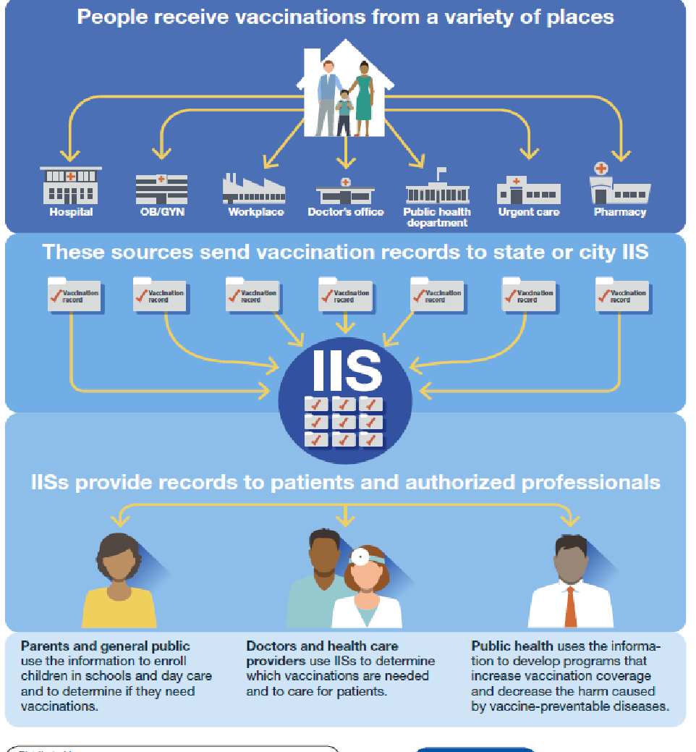
IIS Overview
IIS data enables public health to:
Identify populations at risk for vaccine-preventable diseases
Analyze vaccination coverage and work to address gaps
Respond to public health emergencies
Notes:
Discuss the different inputs noted on the visual.

Slide 6
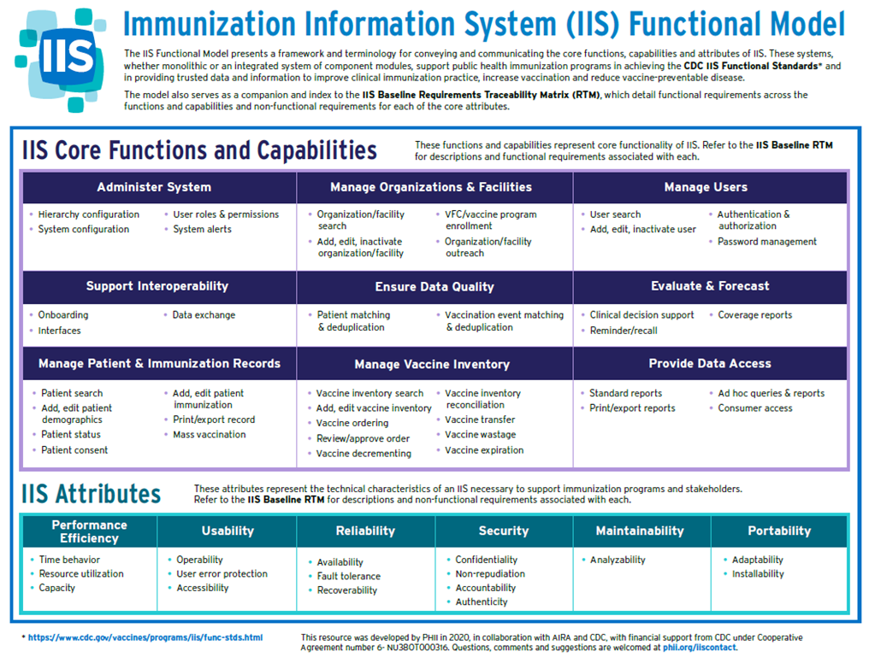
Notes:
Core functions, capabilities and attributes of an IIS

Slide 7
IIS Functions and Capabilities
What Does an IIS Do?
IIS Core Capabilities
Monitors new vaccine uptake
Tracks and evaluates trends in coverage levels
Monitors outbreaks and disease levels
Automatically calculates vaccinations needed
Consolidates immunization-related information
Generates vaccination reminder/recall notices
Connects providers to complete vaccination records
Monitors Vaccines for Children (VFC) vaccine use and provider compliance
Evaluating vaccine validity and forecasting next appropriate vaccination(s) due, specific to each patient
Supporting emergency preparedness and pandemic planning
Integrating with other electronic health information systems
Supporting vaccine management at the provider and immunization program levels

Slide 8




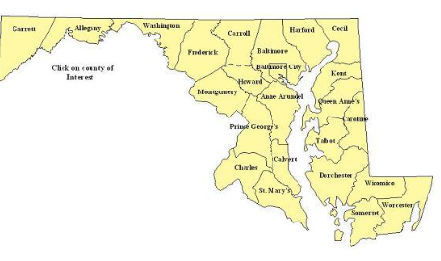
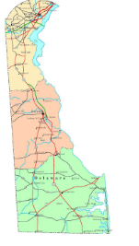
Primary IIS Data Sources
Vital statistics
Provider data via EHR
Data from other jurisdictions and federal entities via the IZ Gateway

Slide 9
What Has Changed in 10 Years?
Originally the goal was to get data into the IIS
Manual documentation shifted to Interoperability and data exchange
Visibility
Today, there is AIRA M&I that provides a focus of standards and how our community looks as a whole
IIS Dashboard summarizes the annual IISAR responses with met and unmet metrics
Today, the focus is more on quality data and providing functionality that supports the Immunization Program

Slide 10
IIS Focus in the Immunization VFC/317 Cooperative Agreement

Slide 11

Using the IIS to Support the Immunization Program through its Cooperative Agreement
IPOM Chapter B – Coverage
IPOM Chapter C – Vaccines for Children
IPOM Chapter D – IIS
IPOM Chapter F – Quality Improvement
IPOM Chapter G – Surveillance and Outbreak Response
IPOM Chapter I – Emergency Preparedness
IPOM Chapter L – Adult
Notes:
Depends on the Awardee. As my co-workers can attest to it jurisdictions also have IIS tied to Perinatal Hep B, Adolescent, School Coverage
IIS SMEs sent their awardees an IIS Functional Model and a corresponding IIS Baseline Requirements Traceability Matrix (RTM) developed in collaboration with CDC, AIRA, and jurisdictions. The RTM provides an extensive list of essential and optional functionality across a set of core IIS functions. We hope awardees will use this information to inform their jurisdiction’s COVID-19 Vaccination Supplemental Funding plans, which are due March 1, 2021. In addition to the technical system functionality enhancements in the RTM documents, awardees should consider the following additions to the plan:
Add IIS support staff at the state level, in local health departments, or to work across groups of providers to:
Onboard providers, including COVID-19 and pharmacy providers
Improve data quality and support analytics and reporting activities
Support help desk activities
Train internal staff and providers either onboarding or already using the IIS
Develop marketing and training materials to increase IIS awareness and use within the jurisdiction
Develop IIS marketing materials targeted at submitting providers and other provider sites
Develop and/or enhance on-demand training materials (e.g., for responsibilities related to data quality)
Improve immunization program processes
Automate current manual IIS and program business processes
Procure a customer management system
Enhance the IIS provider enrollment system (e.g., with the ability to incorporate enhancements rapidly if needed in the future)
Contract with an organization to develop a strategic plan in areas such as change management, operating procedures documentation, position description development, business process improvement, and use of IIS data to support immunization program goals
Improve data exchange and access to immunization data
Adopt the Privacy Preserving Record Linkage (PPRL)
Onboard to the IZ Gateway
Implement a consumer access system
Develop and support dashboards to inform the public

Slide 12
Guidance | IPOM Chapter D
CDC’s Immunization Program Operations Manual (IPOM) Chapter D has requirements to drive IIS advancement towards strategic priorities in three areas.
Improve Data Quality
Improve demographic data completeness and accuracy Submit data to CDC monthly (flu) and quarterly (routine) Ensure appropriate IIS capabilities and staffing for data quality improvement, staffing, and reporting Develop public-facing dashboards Resolve duplicate and fragmented patient records
Advance IIS Capabilities
Onboard to Immunization (IZ) Gateway Implement PPRL
Adhere to IT Industry Best Practices
Evaluate IIS ability to modernize Apply governance and PM best practices Improve demographic data completeness and accuracy Develop the appropriate deliverables and artifacts from the applied governance and best practices
Notes:
Since you are relatively new in your role as Immunization Program Managers, you may or may not have seen previous years’ IPOM requirements. Chapter D includes most of the IIS requirements in the IPOM. Since the IIS supports all aspects of the immunization program, however, you will also find IIS requirements in other IPOM chapters.
This slide highlights the top level IIS strategies and some of the priority activities. Data Quality, Advance IIS Capabilities, Incorporate Technology Best Practices.
You can see that onboarding to the IZ Gateway and implementing PPRL are highlighted. These additions promote data exchange among IIS and with multi-jurisdictional vaccine providers and improving data quality by linking vaccination records administered by multiple providers.

Slide 13
Guidance | IPOM Chapter G
CDC’s Immunization Program Operations Manual (IPOM) Chapter G provides requirements to drive IIS advancement towards strategic priorities within three areas.
Assess vaccination coverage. Identify vulnerable populations. Prepare for and respond to outbreaks and other public health emergencies.
Enroll and onboard providers that may contribute to mass vaccination events and vaccinate front line workers Leverage the IIS for timely and accurate demographic and vaccine administration reporting Report all vaccinations to the CDC Implement and support systems to provide consumer access to immunization records Implement and support systems to facilitate data linkages
Notes:
Since you are relatively new in your role as Immunization Program Managers, you may or may not have seen previous years’ IPOM requirements. Chapter D includes most of the IIS requirements in the IPOM. Since the IIS supports all aspects of the immunization program, however, you will also find IIS requirements in other IPOM chapters.
This slide highlights the top level IIS strategies and some of the priority activities. Data Quality, Advance IIS Capabilities, Incorporate Technology Best Practices.
You can see that onboarding to the IZ Gateway and implementing PPRL are highlighted. These additions promote data exchange among IIS and with multi-jurisdictional vaccine providers and improving data quality by linking vaccination records administered by multiple providers.

Slide 14
Practical Uses of IIS to Support the Immunization Program
Coverage Assessment reports for jurisdiction and providers
VFC Program Support
Managing vaccine orders
Managing vaccine inventory
Ensuring appropriate storage unit temperatures
IQIP Support
Provider Coverage reports by age, vaccine, etc.

Slide 15
How Data is Used
Understand pockets of need, populations and geographic areas that are not being immunized
Publish public dashboards at the federal and jurisdictional level to better understand coverage rates
Providing immunization records to the jurisdictional public

Slide 16
CDC Reports and Tools

Slide 17
Immunization Information System Annual Report (IISAR)
An annual assessment is conducted of IIS activity among the 64 immunization program awardees that receive funding under section 317b of the Public Health Service Act
The IISAR is a self-administered web-based questionnaire completed by immunization program managers as part of their annual reporting requirement.
Awardees are asked to provide information about their IIS, such as:
The number of children aged less than 6 years with two or more vaccinations recorded in the IIS
Public and private provider site participation levels
Fulfillment of IIS functional standards
Other IIS-related programmatic functions
Notes:
Annual information submitted by each awardee is used to inform your Data Quality Report and helps use understand where to focus improvement efforts for better data use.
Often your vendor helps create some of the responses that you will then document into PAPA.

Slide 18
CDC Tools to Improve IIS and Data Quality
CDC Functional Standards v4.1
CDC Functional Standards Resource Guide
IIS Data Quality Blueprint
IIS Routine Vaccination Submission Data Quality Report*
PPRL Submission Data Quality Report
IIS Dashboard
Notes:
Note as we just discussed the IISAR that its data alone don't improve data quality. When combined with information about targets and other information, they can be used as valuable feedback to awardees about their data quality over time. If you decide to keep this item, you can say that we stopped sending it when the national public health emergency ended. Future data quality feedback reports will build on this report (e.g., with targets, tips for how to improve).

Slide 19
Functional Standards
The IIS Functional Standards describe the operations, data quality, and technology needed by IISs to support immunization programs, vaccination providers, and other immunization stakeholders
The IIS Functional Standards and Operational Guidance Statements (OGS) help assure that all IISs attain a level of uniformity and consistency in supporting common clinical, programmatic, and public health immunization goals for both public and private stakeholders

Slide 20
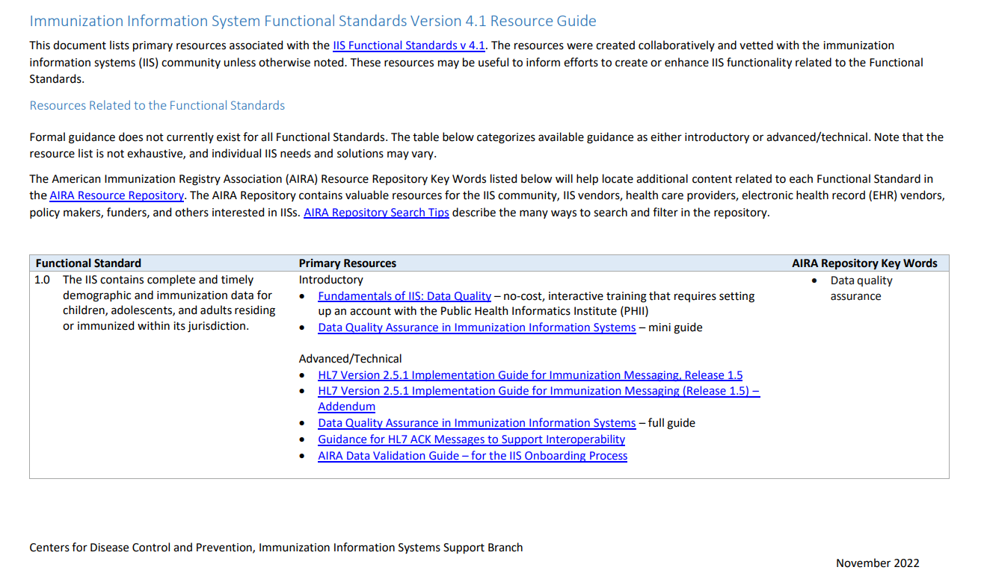
IIS Functional Standards Resource Guide

Slide 21
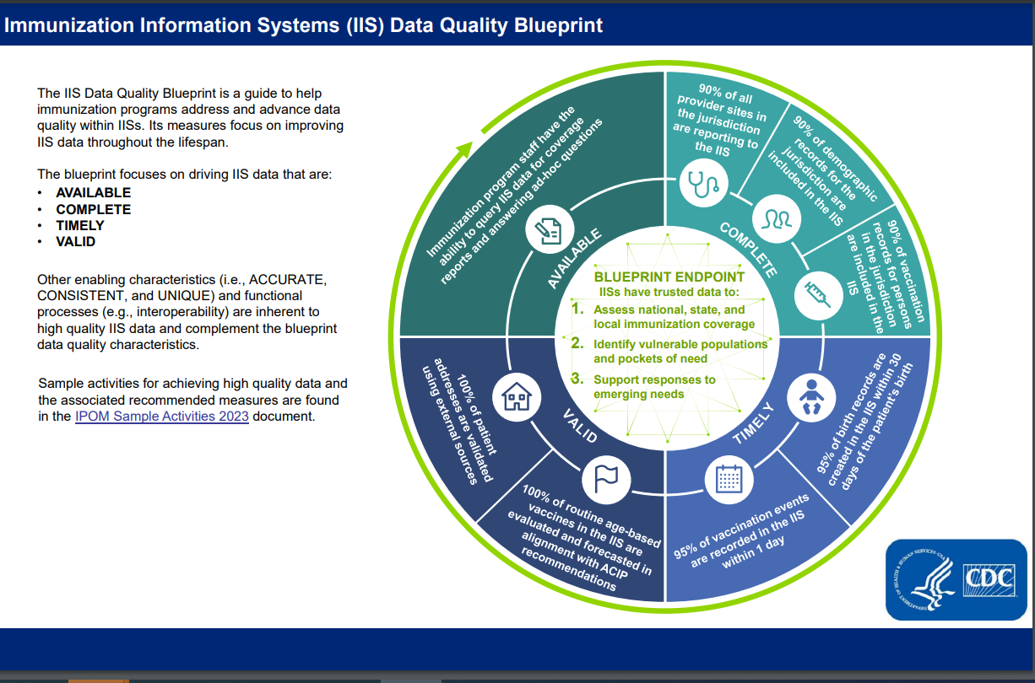
IIS Data Quality Blueprint
Notes:
You have the recently updated version.

Slide 22
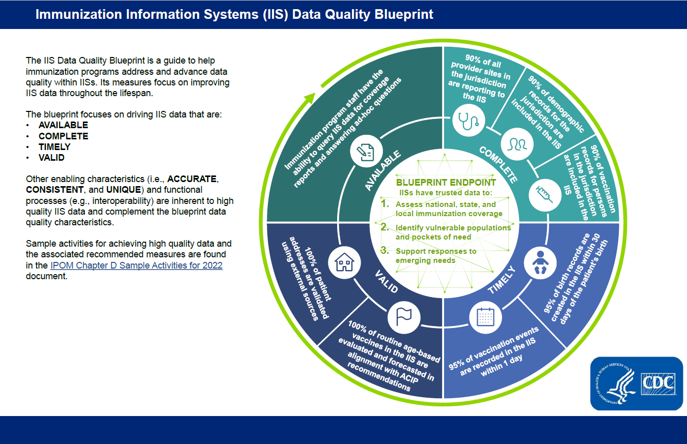
The Blueprint defines IDAB’s goals for IIS and guides awardee activities for data quality improvement
Blueprint Guiding Principles:
1
Focuses on improved IIS data quality, which will support improved immunization outcomes by supplying credible immunization data
2
Prioritizes a small set of meaningful, quantifiable IIS measures
3
Informs technical assistance approach to address shared challenges
4
Adapts to national, state, and local emerging priorities and needs

Slide 23
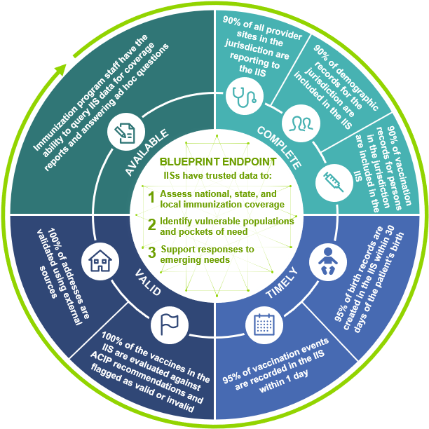
The Blueprint endpoint defines IDAB’s vision for improving IIS data quality
Endpoint:
IISs will be the trusted source for reliable immunization data
As the trusted source, IISs will produce data to support:
Immunization coverage assessments
Identification of pockets of need
Responses to emerging needs

Slide 24
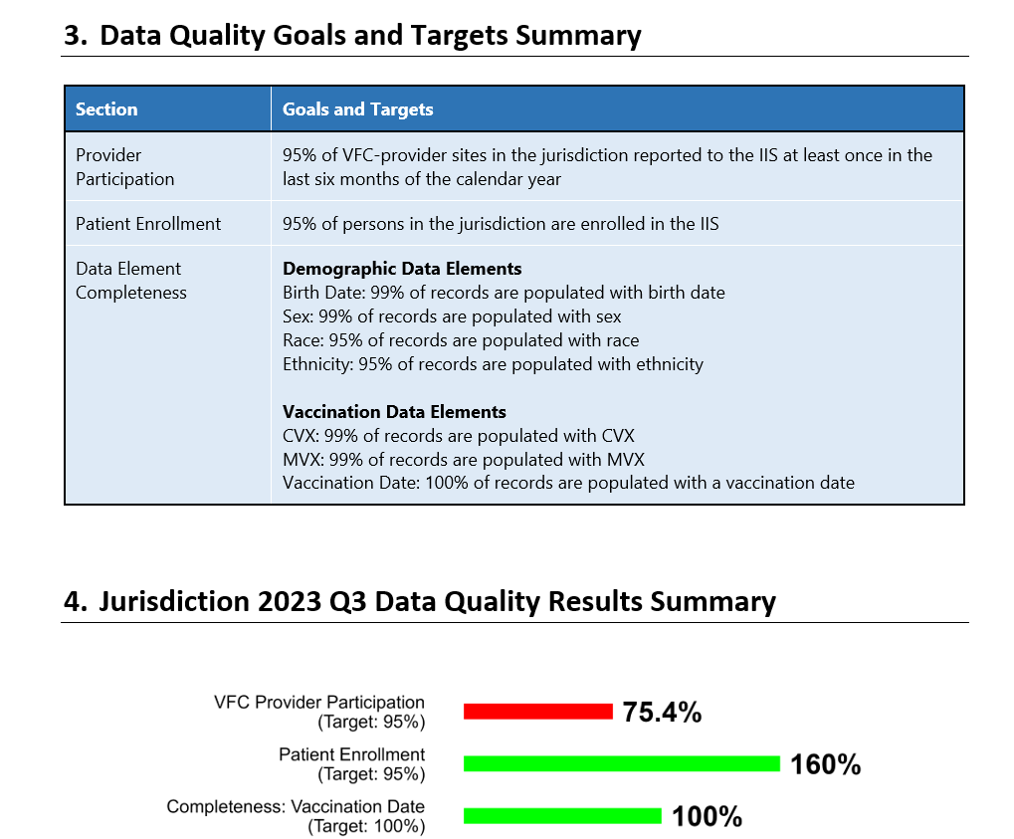
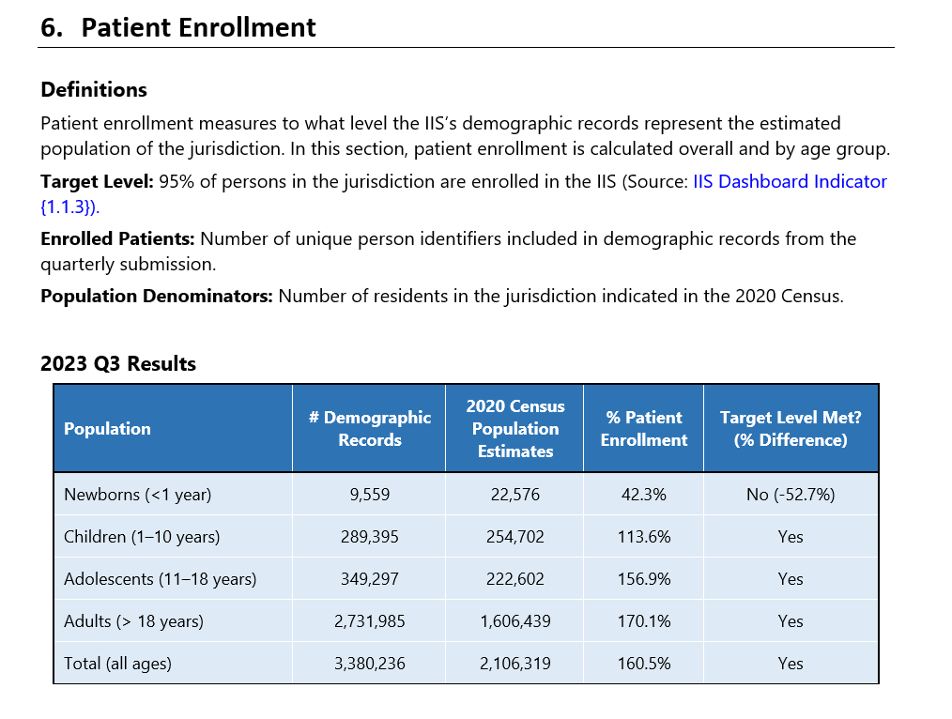
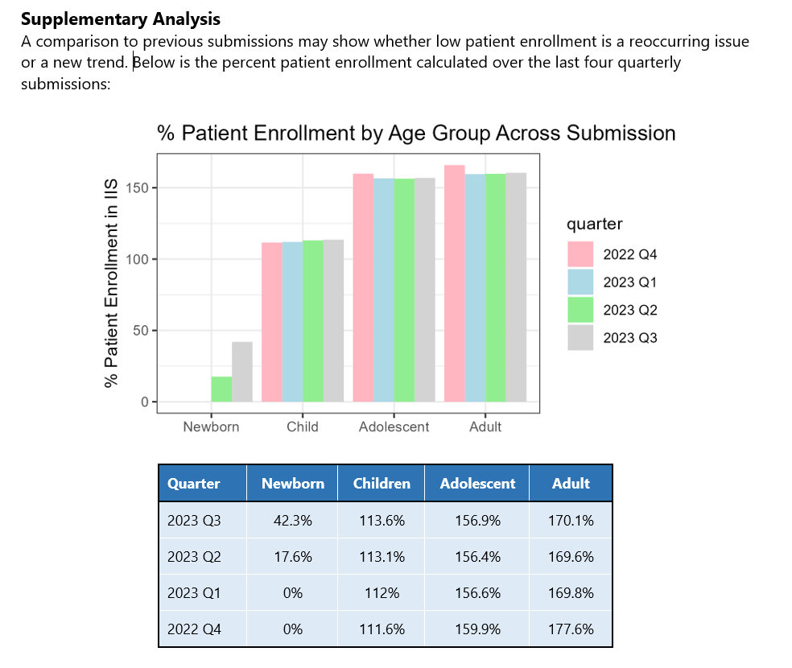
Routine Vaccination Data Quality Report
Evaluates routine vaccination data submissions against data quality goals and targets set by the IIS Data Quality Blueprint Indicators and AIRA completeness recommendations.
Includes sections describing:
Provider participation
Patient enrollment
Data element completeness
Data element validity
Trends across age groups and over time
24

Slide 25
PPRL Submission Data Quality Report
Provides insight on the following:
Summary – High level feedback and actions a jurisdiction can take to improve IIS data quality
Ensure that Record Counts Match – A checklist that is intended to help the jurisdiction, HealthVerity (the PPRL contractor), and CDC track the progress of your PPRL records from creation to delivery.
Check IIS Record Completeness – Provides a list of Patient IDs that did not have values for all fields required in the DUA Appendix F specification, and we could not determine a PPRL link ID for the associated patients
Check for Duplicate Patient IDs – Provides likely duplicate Patient IDs (i.e., the list of Patient IDs that have the same ENCRYPTED CDC Unique ID, which CDC generates and that is not the same as the PPRL ID)

Slide 26
IIS Dashboard
The IIS Dashboard is a tool intended for Immunization Program Managers and IIS Managers to:
Determine how well the IIS and vaccination data it contains meet data quality targets
Compare Annual IIS Annual Report (IISAR) responses over time
Determine progress for groups of indicators related to each of the seven data quality characteristics
Compare the jurisdiction’s IIS performance with other awardees’ IIS

Slide 27
IIS Dashboard (cont.)
Determine opportunities and formulate plans for improvement when drafting the jurisdiction's Immunization VFC/317 cooperative agreement work plan and budget
Take a comprehensive view of data quality, including the associated policies, IIS infrastructure, auxiliary projects, and measures

Slide 28
IIS Dashboard Data Sources
IISAR
Census CIA World Factbook
Behavioral Risk Factor Surveillance System (BRFSS)
NIS-Child, and NIS-Teen
VTrckS
AIRA Measurement and Improvement Results
Jurisdictional Policy Information
PEAR
Notes:
It includes three years of data.

Slide 29
Accessing the IIS Dashboard
Dashboard requirements include:
Microsoft Edge for Windows​
Adobe Reader 9 and higher​
Operating Systems: .NET Framework 4.0; Windows 10, 2000, Vista, XP, 7
Notes:
Get them to open the dashboard
Show them were the link can be found
-open the ISD SharePoint

Slide 30
Reviewing the IIS Dashboard
Targets, Met or Unmet
Reference the columns labeled Year: 2019, 2020, 2021, 2021 Target Achieved, and Target
Comparisons
Reference the % Awardees Meeting Target in 2021 column
Notes:
Show them a states progress report to familiarize them with the columns

Slide 31

Activity: IIS Dashboard
Review your IIS Dashboard printout
Identify which targets your jurisdiction are meeting/not meeting?
Are there strategies to maintain your targets/opportunities for improvement?
What discussions should you have and with whom to champion improvement e.g., immunization program manager, vendor, other?
Discuss strategies/opportunities with your “assigned” IIS SME
Large group discussion of key themes
Notes:
Need a activity page for each chapter so the awardee can write notes to answer the questions…. They will then share around the room they’re responses…
Time permitting, key themes discussed or input to growth plan/EOD discussion

Slide 32
Immunization Services Division (ISD) & Informatics and Data Analytics Branch (IDAB) Organizations

Slide 33
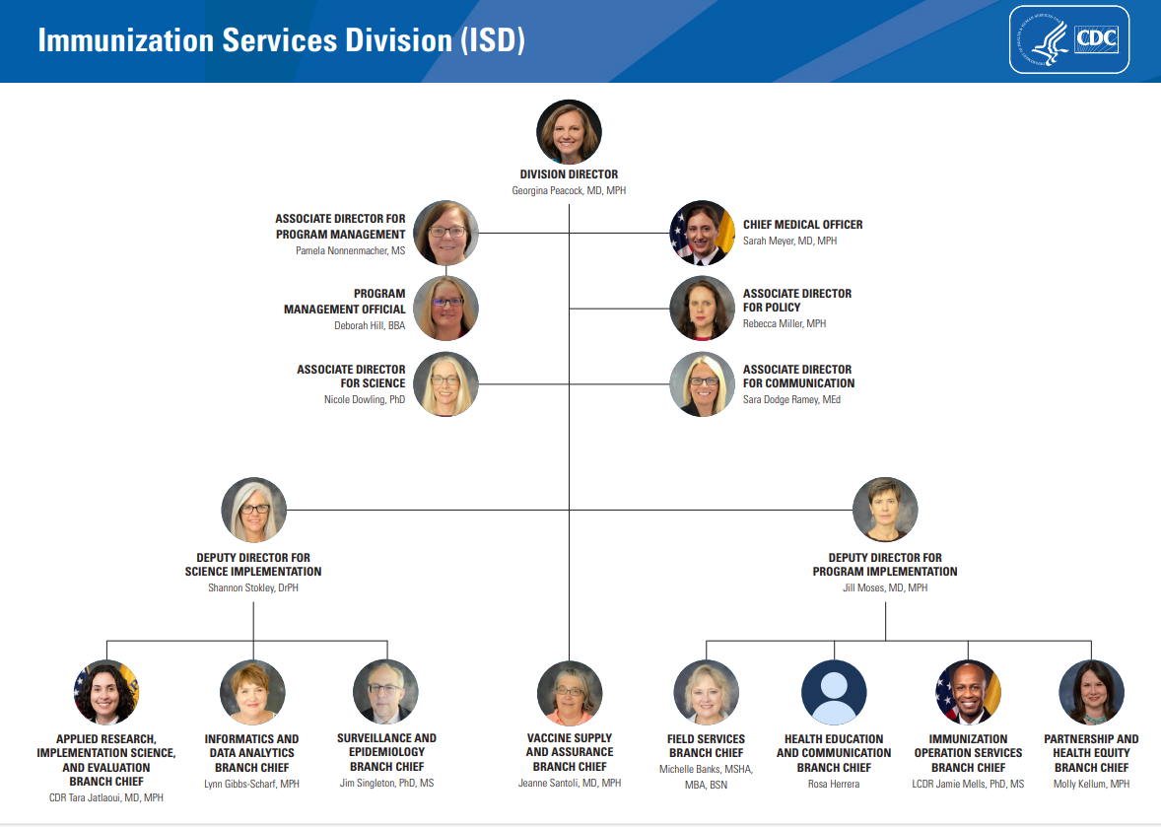
Notes:
What you can emphasize here is the adult program and the branches. IDAB works closely with our sister branches.

Slide 34
Informatics and Data Analytics Branch (IDAB) Org Chart
Branch Chief
Lynn Gibbs Scharf
As of April 2024
Deputy Branch Chief & Acquisition Project Management Team Lead
Kimberly Clark
Deputy Branch Chief for Program/Senior Scientist
LaTreace Harris
Vickie Garrett
Kesha Billingsley
Karla Harrison
Lee Kennedy
Virginia O’Garro
Strategic and Special Projects Team
Lead: Kafayat Adeniyi
Mandi Kellerman
Jennifer Junkins
Outreach and Assistance Team
Lead: Jan Hicks-Thomson
Outreach and Assistance Team
Lead: Beth Cox
Informatics and Standards Team
Lead: Stuart Myerburg
Evaluation and Applied Analytics Team
Lead: Kimberly Nguyen
Application Support Team
Lead: Susan Pierce-Richards
Michelle Ruslavage
Trenetria Steele
Natalie Johns
Jennifer Ratliff
Chantel Hartman
Marley Vazquez
Roua El Kalach
Janet Fath
David Lyalin
Fikru Mekonnen
Chrissy Miner
Abdulhakeem Olorukooba
Faisal Reza
Carla Stearle
Heba Athar
Ellen Boundy
Hannah Fast
Nkenge Jones Jack
Bhavini Murthy
Lauren Shaw
Ashley Treharne
Camila Rodriguez-Rojas
Melody Parker
Mark Winarsky
Shani Doss
The Informatics and Data Analytics Branch (IDAB), works to maximize protection against vaccine-preventable diseases by funding and supporting IIS across the country.

Slide 35
Awardee Organizational Reporting Structure
Does your organizational structure impact the information you receive from and your engagement with CDC ISD or IDAB?
Does your IIS reside within the Immunization Program? Does your IIS reside within a state IT chain of command? If so, does it impact your ability to develop and maintain your IIS to support your Immunization Program? Does your program have a Data Quality Team? Does this group report to program or up through IIS?
Does your IIS Subject Matter Expert (SME) communicate with the right individuals for your health department's structure?
Is your IT department involved in supporting your IIS? If so, how?
Do you have an outside technology partner? Do the right individuals from your jurisdiction engage with your technology partner?
How can you leverage your relationship with CDC to solve data quality challenges?
Notes:
Is your SME communicating with those that make decisions about IIS priorities and implement plans to achieve the priorities?
This is a discussion with and between the awardees.
Who are the right individuals for bullet two? What are their characteristics? Their roles?

Slide 36
CDC and Communications

Slide 37
CDC Awardee Communications
Weekly All-Awardee Message
Weekly IIS Information Brief
ISD All-Awardee SharePoint
IIS Documentation on the CDC Website
IIS All Awardee Forum Calls
Notes:
Beth [thread] Communication as you heard key aspect of an IIS leader’s role…
Question: How many of you receive the All-Awardee message, IIS Branch Brief? Communicate how to subscribe
Question: How many of you have access to the ISD SharePoint? Obtain information from those that don’t to assist in obtaining access.

Slide 38
Opportunities to Engage with CDC
Monthly calls with IIS SME
CDC-hosted All-Awardee calls and meetings
Awardee Site Visits
Program Area Reverse site visits
American Immunization Registry Association National (AIRA) Conference
American Immunization Managers Association (AIM)
National Immunization Conference
Working with Partners to provide additional Technical Assistance
Notes:
Many of these are opportunities to come as travel opens back up both at the jurisdiction and for CDC.

Slide 39

Questions/Comments/Discussion?

Slide 40
CDC Resources
IIS Functional Model - visual representation of the baseline functions, capabilities and attributes of a standard Immunization Information System (IIS)
IIS Data Quality Blueprint - guide to address and advance IIS data quality characteristics
IIS Functional Standards - describes operations, data quality and technology needed by IISs to support immunization programs and partners
IIS Functional Standards Resource Guide - guidance and best practices to assist in implementing the standards
IIS Dashboard - identifies jurisdiction-specific data quality strengths and challenges

