Slide 1
Immunization Information Systems
National Center for Immunization and Respiratory Disease
IIS Leadership Workshop
June 6, 2024
Lynn Gibbs Scharf, MPH
Chief, Informatics and Data Analytics Branch
1

Slide 2

Today, we will answer these questions:
What are CDC’s vision and priorities for IISs?
How does CDC support IISs?
2

Slide 3
What are CDC’s vision and priorities for IISs?
9

Slide 4

CDC’s Vision for IISs
IISs support the standardized capture and exchange of high-quality, individual-level immunization data for all doses of ACIP*-recommended vaccines.
These data are linked across jurisdictions, providers, and partners, and to other individual-level data sources to inform public health action.
* ACIP: Advisory Committee on Immunization Practices
10
Notes:
Tags: statement, vision, overview, left aligned text, right aligned image

Slide 5
Understanding Immunization Data for Public Health
IISs play a key role in the dissemination and tracking of vaccines across the U.S., provided critical data during the COVID-19 response and are reporting immunization data to CDC.
Populations at risk of vaccine-preventable disease
Areas of low vaccination coverage
Characteristics of populations with high/low coverage
IIS Data Provides Valuable Insights
Quality of data
(i.e., available, timely, complete, valid, accurate, consistent, unique)
Vaccination coverage at the jurisdiction and national level
7
Notes:
As you all know, we are in the process of establishing a national population based surveillance system leveraging IIS data. The purpose of this effort is to use IIS data to inform public health actions by defining vaccination coverage at the jurisdictional and national level, pinpointing areas of low vaccination coverage where additional intervention may be needed, identifying populations at increased risk of vaccine preventable diseases and the characteristics of those populations, and evaluating the quality of IIS data.
Note from JF:
A goal we communicated during the reverse site visit is for CDC to estimate vaccination coverage rates with high confidence and timeliness. High quality data from IISs increases the confidence. We are looking for ways improve our data collection and analysis efficiency/timeliness.
IISs support:
Rapid distribution of VFC, 317, and COVID Bridge vaccines across the U.S.
End-to-end tracking of vaccines from orders to inventory to shots in arms
Sharing of data with pharmacies, other jurisdictions and national partners
Submission of line-level Routine and aggregate Flu, COVID and RSV data to support public health decision-making
In recent years, IISs improved performance and implemented new functionality, such as mass vaccination tools, and enhanced infrastructure, like the increased use of cloud hosting and storage to continue to ensure public health has insight for decision making.

Slide 6
Strategic Priorities for IISs
Based on CDC’s data modernization effort to accelerate data into action and lessons from the COVID-19 response, IDAB supports these priorities for the IIS.
Technology Infrastructure |  | Data Quality |  | Data Exchange
Meet IIS Functional Standards to increase standardization of IIS functionality and data elements and support program and provider immunization processes. Test functionality to ensure standardization using AIRA's Measurement and Improvement Initiative. |  | Improve data quality through use of IIS Data Quality Blueprint to prioritize meaningful, quantifiable measures and IIS Data Quality Reports to identify actionable improvements. |  | Increase interoperability and data sharing between jurisdictions and providers via IZ Gateway. Use PPRL to allow cross-jurisdiction data matching.
11

Slide 7

Technology and Standards
Functional Standards and Operational Guidance Statements (OGS)
These describe the underlying operations, data quality, and technology needed by IISs to support immunization programs, vaccination providers, and other immunization stakeholders and their immunization-related goals. They help assure that IISs attain a level of consistency in support of common clinical, programmatic, and public health immunization goals
HL7 v2.5.1 Implementation Guide for Immunization Messaging, Release 1.5
Guidance to help IIS comply with national standards, best practices, and the latest Health Level Seven (HL7) conformance methodology.
Measure Your IISs Adherence to Standards with Measurement and Improvement Initiative
Measurement and Improvement (M&I) Initiative supports system testing to help guide individual IIS in aligning with identified standards
LINK: IIS Functional Standards
12

Slide 8


Data Quality:
Immunization Data Reporting at the National Level
Pre-COVID-19
COVID-19 Response
Present
DUAs and Data Reporting
Jurisdictions use IISs to manage the Vaccines for Children (VFC) program and understand their jurisdiction’s vaccine coverage. ​
13 jurisdictions signed Data Use Agreements (DUAs)
Routine data reported quarterly and flu data reported monthly
Data use was limited
Federally provided vaccine, provider agreements, and a COVID-19-specific DUA superseded state reporting and data sharing laws to allow reporting to CDC.
New DUA allows reporting of routine vaccination data across the lifespan.
54 jurisdictions with DUAs
Line-level routine data reported quarterly
Aggregate RSV, flu, COVID-19 data reported monthly
64 jurisdictions with DUAs
COVID-19 data reported daily, then weekly
Latest Data Reporting
April Aggregate Jurisdiction Data Submissions ​ submitted in May 2024 |  |  |  | Q1 2024 Routine Data Submission​ submitted in April 2024 ​
Flu Data​ | RSV Data​ | COVID-19 All Data​ | COVID-19 Bridge Data​ | Record Level Routine Data​
51 | 51 | 50 | 50 | 51 16 PPRL
8

Slide 9
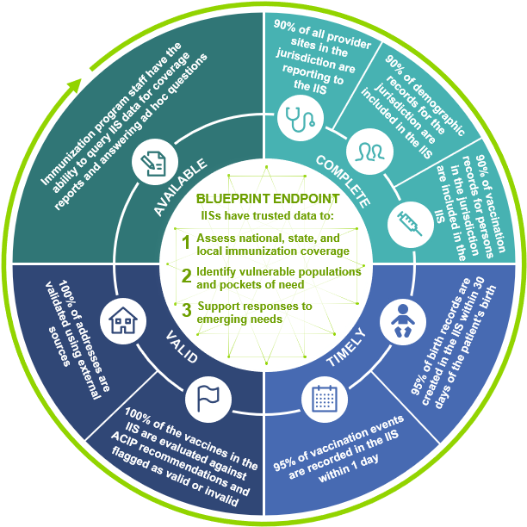
Data Quality: IIS Data Quality Blueprint
The blueprint guides awardee activities to improve data quality by prioritizing a small set of meaningful, quantifiable measures.
IIS Data Quality Endpoint
IISs will be the trusted source for reliable immunization data
IISs will produce data to support:
Immunization coverage assessments
Identification of pockets of need
Responses to emerging needs
7 Data Quality Characteristics
Available | Complete | Timely | Valid | Accurate | Consistent | Unique
13

Slide 10

Data Quality: Feedback and Reports
CDC aims to provide jurisdictions with timely feedback and technical assistance to support data quality improvements.
Types of Feedback
Validation Report
Provided when jurisdictions submit their quarterly data
Data quality monitoring and assistance
Provide jurisdictions with an assessment on the completeness and accuracy of IIS data along with targets and strategies to improve quality
Data quality in action
Q4 2023: 104 million demographic records submitted for PPRL. CDC could assign a PPRL link ID to 94% of the records.
Goal: increase this percentage over time by making process improvements and highlighting patient IDs with missing values in the PPRL DQ Feedback Report.
Routine Vaccination DQ Report
Offers analysis of data quality trends over time and within population groups
PPRL DQ Feedback Report
Identifies potential duplicates and patient IDs with missing required values
Provides tracking sheet to ensure CDC receives a PPRL link ID for every routine vaccination demographic record
14
Notes:
Since this section is about data collection and management, consider including a version of this slide. Points to make are:
1. CDC values privacy and security of IIS data; CDC and awardees share responsibility for maintaining the privacy of individuals whose vaccination data are recorded in IISs.
2. Aggregate reporters will… (say something about their process and that the specs will be available…)
3. CDC is collecting a lot of data and is looking for ways to improve the efficiency of the process including only processing data that change between quarters and ultimately only requiring jurisdictions to report data that changed between quarters. (This could be where we say that by processing only data that changed since the last quarter, CDC reduced processing time for three pilot jurisdictions by 80%.)
4. Submitting data via the IZ Gateway enables CDC to take advantage of capabilities of the DMI front door.
Taking an integrated approach, this slide could also include PPRL findings for 4Q2023: CDC implements PPRL to assign a unique ID for ever routine immunization demographic record. The 11 jurisdictions that submitted PPRL data for 4Q2023 submitted 103,823,978 demographic records and CDC could assign a PPRL link ID to 94% of the records. CDC hopes to increase that percentage over time by making process improvements and by highlighting patient IDs with missing values in the PPRL DQ feedback report.
1.95% of the routine immunization demographic records CDC received appear to be duplicates​. CDC provided jurisdictions with data quality feedback to investigate. Fun facts: In 1,198,990 cases, two patient IDs matched a single PPRL ID. There were instances where between 25 and 250 patient IDs matched a single PPRL ID. Prior to this slide, there could be a slide that summarizes CDC's strategy for providing data quality feedback. That strategy begins with recognition that IISs own the data and that they are responsible for maintaining high quality data in their IISs. CDC aims to provide timely feedback. Jurisdictions receive three types of feedback: 1) a validation report (I'm not sure if that is the right name and don't have a copy handy to check the specific focus -- ) when they submit quarterly data; 2) PPRL DQ feedback to identify potential duplicates, patient IDs with missing required values, and a tracking sheet to be sure that CDC receives a PPRL link ID for every routine vaccination demographic record; and 3) the routine vaccination data quality report that focuses on data completeness.
Assess your own data quality; have a data quality plan; implement the plan; use existing tools DAR, CDC DQ reports to prioritize data quality gaps for improvement

Slide 11
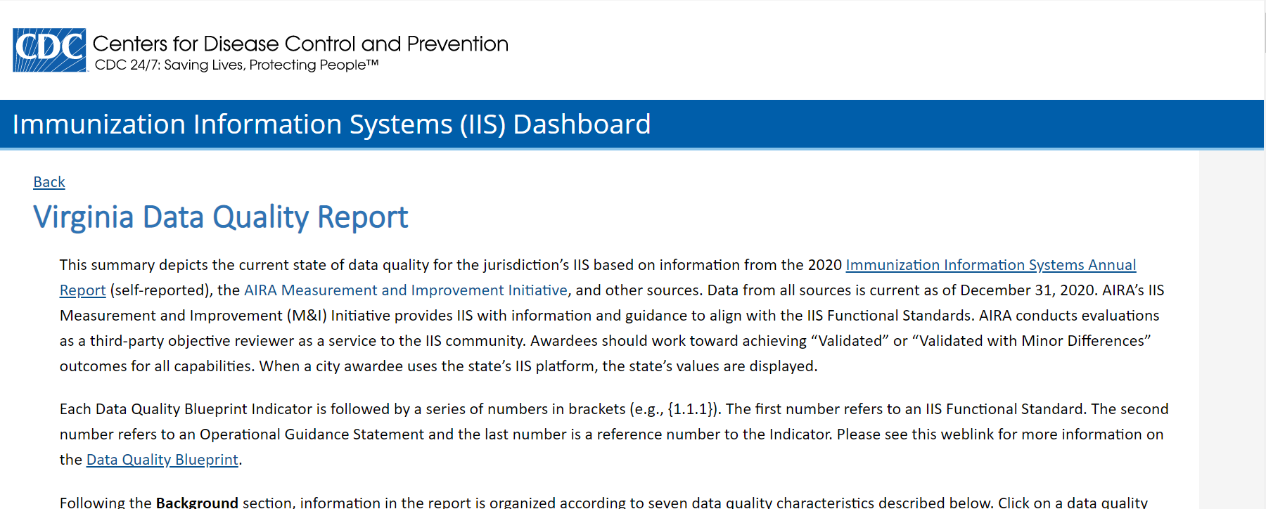
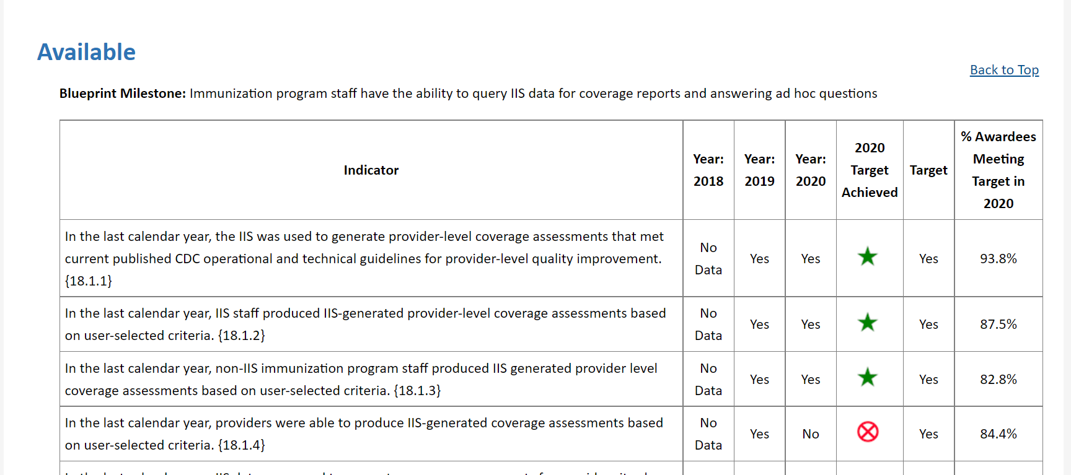
Data Quality: IIS Dashboard
The IIS Dashboard provides a comprehensive view of data quality, including the associated policies, IIS infrastructure, auxiliary projects, and measures
Dashboard content is available to help Program Managers and IIS Managers to:
Consider how their system and its data meet targets from the Data Quality Blueprint
Gauge progress over time
Compare the jurisdiction’s IIS performance with other jurisdictions
Determine opportunities and formulate plans for improvement
Dashboard Screen Shots
Link: The IIS Dashboard
15

Slide 12
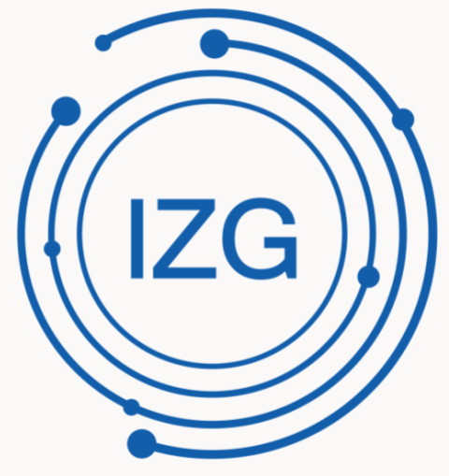


Data Exchange: The Immunization (IZ) Gateway
Jurisdiction IISs
The IZ Gateway is a policy framework and cloud-based message routing system that facilitates data exchange among IISs, vaccine providers, direct-to-consumer applications, and data submission to CDC.
Consumer Access Applications
Message routing technology enables uniform application of data quality assurance, messaging, and security industry standards and best practices for all participants.
Multijurisdictional Vaccine Providers
VAMS
Policy framework ensures compliance with each jurisdiction’s data sharing laws and policies.
CDC via
IZ Data Lake
17
Notes:
Tags: process, current, future, changes

Slide 13
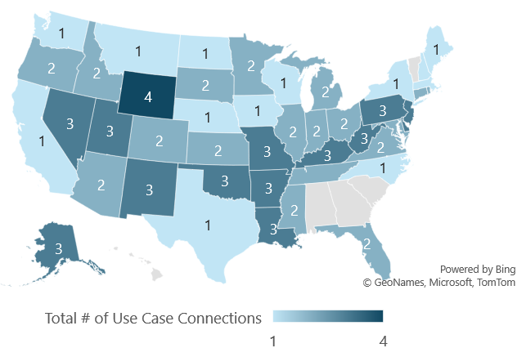
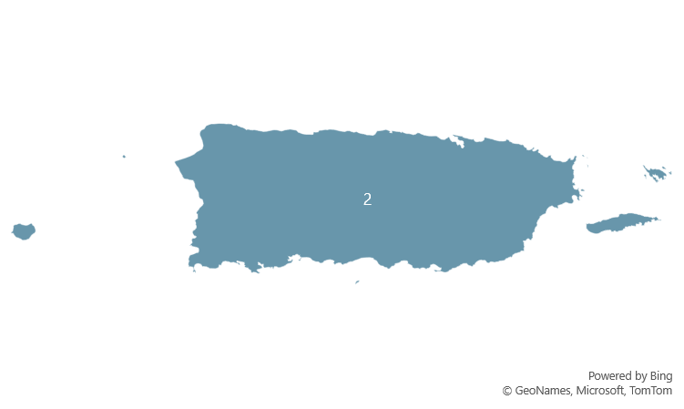
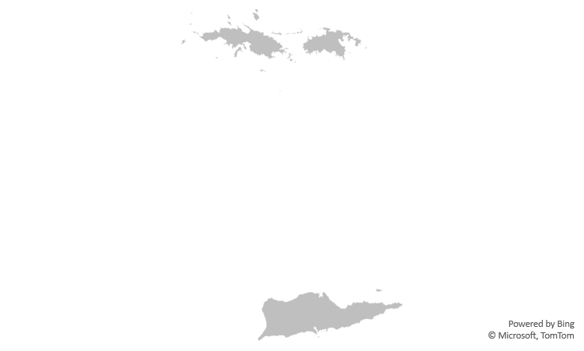
Data Exchange: IZ Gateway Data Exchange Metrics
IZ Gateway Exchange Metrics |  | Impact
Completed Baseline Onboarding | 63 Jurisdictions | These jurisdictions are prepared to implement other use cases
Participating in IIS-to-IIS Data Exchange | 36 jurisdictions with 205 active exchanges | 32 IIS have more complete records for citizens vaccinated outside their jurisdiction
IIS and Multijurisdictional Provider Data Exchange | 7 providers* with 4,220 facilities in 42 jurisdictions | 42 jurisdictions have data on citizens vaccinated at large, multijurisdictional provider organizations
Consumer Access System Exchange with IIS | 1 platform exchanging with 6 jurisdictions | 6 jurisdictions streamlined their citizens’ access to their consolidated vaccination records
IIS Data Exchange with CDC (data submission) | 20 jurisdictions submit routine vaccination data to DLP through DEX and NDLP storage container | CDC offers jurisdictions the option to automatically send their routine vaccination data to CDC rather than using a manual submission process
Jurisdictions Participating in the IZ Gateway
Onboarded, Not Pictured
Washington D.C.
Philadelphia
NYC
Chicago
San Antonio
Houston
*Multijurisdictional Providers: Veterans Administration (VA) VistA, VAMS, DocStation, AZOVA, VA Oracle Health, Fond du Lac, Department of Defense
Updated 06/4/24
18
Notes:
Presenter: Weekly Lead
Slide owner: Priti
Source: Salesforce, this slide deck and Master Slide Deck Visuals.xlsx (sharepoint.com)
Visuals from Desktop Version of Master Slide Deck Visuals.xlsx (sharepoint.com)
Updates for the week of 10/17
- IL/KY go live
--IL first IIS-IIS exchange bringing total jurisdictions to 26
Updates the week of 8/22/22
NJ/NYC go live
Updates the week of 8/8/22:
USVI baseline connection completed in PROD
Update the week of 7/5/22:
NJ/PHIL and NJ/CT go live adding four new connections
Consumer access – Idaho went live, now four jurisdictions participating in consumer access
Total jurisdictions up to 31, and 50% of jurisdictions with any use case
NYC, FL, AZ live with VHA
Updates for the week of 6/20/22:
No Updates
Updates for the week of 6/6/22:
NYC/ CT, CO/OK go live
Up to 30 jurisdictions participating in any use case (added NYC, CT, CO)
30/62 = 48%
Updates for the week of 5/23/22:
Updated, data quality check on total number of jurisdictions participating in any use case. Up from 22 to 29.
Updated map
Updated text formatting and color
Updates for the week of 5/16/22:
No new updates
Updates 5/9/22:
NJ/DE go live bringing total jurisdictions for IIS-IIS exchange to 22 and total connections to 121
Updates for the week of 5/3/22:
No new updates
Updates for 4/25/22:
DC/MD go live bringing total number of connections to 119
4/18/22: No Change
Updates for 4/11/22:
Removed KY/WV connection per clarification from Envision. They are done testing in test, but not in prod. Removed from total bringing it back down to 117.
Updates for 4/11/22:
OK/PHI new connection, bringing total to 119 connections
Updates for the week of 4/4/22:
No new updates
Updates for the week of 3/29/22:
No new updates
Updates for the week of 3/22/22:
No new updates
Updates for the week of 3/14/22:
No new updates
Updates for the week of 3/07/22:
Oregon completed baseline onboarding (3/2)
Updates for the week of 2/28/22:
No new updates
Updates for the week of 2/21/22
New IIS-IIS connection: Philly/NV. Upping total to 117 total connections.
Updates for the week of 2/14/22
Three new connections: KY/DE, NV/NM, KY/NM bringing total connections to 115 (3% completion)
Updates for the week of 2/7/22
OK/NM go live bringing the count to 111 total connections across 21 jurisdictions.
Illinois completed baseline onboarding bringing total onboarded to 55
Updates for 1/31/22:
No new updates
Updates for 1/24/22:
Arkansas/KY connection and DE/NV validated
KY/DE go live and validated bringing total number of active exchanges to 109
Updates for the week of January 10th:
KY/Arkansas and KY/NV went live in production 1/7/22 raising the total number of connections from 99 to 103 (2.8% now).
Wisconsin completed baseline onboarding. Oregon is very close, but not quite completed yet.
Updates for the week of January 3rd:
Data quality check updated total data exchange partnerships from 101 to 99.
Several connection validations came in from Envision jurisdictions.
Updates for the week of December 20th:
Added HI and USVI to denominator raising it to 62. Impacted most percentages.
Recalculated total data exchange partnerships using formula: x = n(n-1) or x = 62(62-1) or x = 3,782
Data exchange between 20 IIS (up from 18)
Added eight new connections (CT/NV, NV/CT, CT/DE, DE/CT, NV/OK, OK/NV, NV/AR, AR/NV)
Michigan completed baseline onboarding bringing PROD connections to 87% complete
Update week of 12/13:
# IIS participating in IIS-IIS exchange dropped from 19 to 18. MO is not moving forward with signing updated MOU and does not want to participate in IIS-IIS data exchange at this time.
# active IIS-IIS exchanges dropped from 94 to 93 (MO)
Updated number of facilities to 68 from >43
Update week of 12/6: No update. Delaware was not filled in
Update 11/29: No changes from 11/23
No updates 11/23 (or last update added 11/23...)
Unclear of number of VAMS facilities, but will have when they return the form
Visual: Master slide deck visuals, tab: use case (any)
Data sources: MAT slides/master tracker for IIS-IIS; Zoho “IIS-IZG Onboarding Checklist Full Report,” “Provider by Jurisdiction Report,” “Consumer Access Report

Slide 14
Data Exchange: Privacy Preserving Record Linkage
Privacy-Preserving Record Linkage (PPRL)
PPRL is a cutting-edge solution that allows jurisdictions to preserve and protect personally identifiable information and protected health information when sharing vaccine administration information to improve data quality.
PPRL Allows |  | PPRL Can
Jurisdictional data to stay within the jurisdiction Deduplication of records in the national datasets Linking of records from different data sources for the same individual Lookup of first dose information No private or personal information is shared with CDC. |  | Link records concerning a single individual from multiple reporting jurisdictions/systems Link records from multiple data domains* for a single individual * Data domains: vaccination, laboratory, disease surveillance, epidemiology, adverse event, and morbidity
16

Slide 15
Data Exchange: Local Implementation Guide Standardization and Digitization Project
Local implementation guides (IGs) are not standardized, which causes onboarding delays, IZ Gateway challenges, and data sharing issues. This project streamlines the local IG development process, increasing efficiency and effectiveness in healthcare data exchange.
August 2024
May 2024
Second Phase
Continue process for all local IGs
Standardize
Digitize
Pilot Phase
Finalize second local IG
Second Phase
Start entering two local IGs
October 2023
Pilot Phase
Start inputting local IG into IGAMT
Standardizing local IGs ensures each jurisdiction’s guide:
Follows national standards
Complies with the latest HL7 conformance methodology
Adheres to best practices
The National Institute of Standards and Technology's (NIST) HL7 Implementation Guide Authoring and Management Tool (IGAMT) is used to digitize each jurisdiction’s IG, making all IGs more accessible and usable (e.g., creating a jurisdiction-specific validation tool).
February 2024
Pilot Phase
Finalize local IG in IGAMT (NH)
Start entering next local IG
July 2024
Second Phase
Finalize two local IGs
TBD
Third Phase
Train jurisdictions to manage local IGs in IGAMT
19
Notes:
Another project that we are undertaking to improve standardization is the local implementation guide digitization project. When local implementation guides are not standardized it can cause delays in onboarding, increased difficulty in leveraging the IZ Gateway, and difficulty in sharing data between IIS. This project uses the National Institute of Standards and Technooogy HL7 implementation guide authoring and management tool (IGAMT) to digitize each jurisdiction’s implementation guide to make it more accessible and usable. Through this project we are also standardizing local guides to ensure each one follows national standards and complies with the latest HL7 conformance methodology.
New Hampshire is the first jurisdiction to participate, and their IG is almost complete. In February, the next jurisdiction will begin the process to standardize and digitize their IG.

Slide 16
How does CDC support the IISs?
20

Slide 17




CDC Supports the IISs
Providing funding and guidance to achieve priorities
Offering direct support to awardees through technical assistance, engagement, and communications
Engaging technical and national partners to strengthen the IIS community
21

Slide 18
Support: Engagement with the IIS Community
CDC regularly engages with awardees and technology partners to support IIS activities. CDC also supports awardees and technology partners by providing funds and direction to the American Immunization Registry Association (AIRA) and the Public Health Informatics Institute (PHII) for developing guidance, identifying best practices, and collaboratively solving problems.
CDC
CDC regular communicates and engages with stakeholders to provide relevant, timely information and guidance.
CDC Communication Resources
IIS Information Brief
SharePoint sites
Awardees
Technology Partners
Implement IISs and ensure capacity to advance prioritized IIS capabilities.
CDC Engagement
IIS-All Awardee Forum
Platform-based consortia sessions
Dedicated CDC SME
CDC- and partner-provided technical assistance
On behalf of awardees, implement IISs and ensure capacity to advance prioritized IIS capabilities.
CDC Engagement
Technology Partner call
Direct vendor contracts
AIRA
PHII
Technical assistance
Workgroups
Technical trainings and educational activities
Technical assistance
Workforce trainings and educational activities
Competencies model
23
Notes:
CDC provides resources to partners to support immunization programs and IIS. This includes funding to AIRA who provides direct technical assistance to jurisdictions for onboarding and data exchange between providers and IISs, manages the Measurement and Improvement Initiative, convenes workgroups to solve problems, and collaboratively defines best practices.
It also includes the Public Health Informatics Institute who
Develops and maintains the IIS competencies model and
develops role specific training curriculum
Collaborates with CDC and other partners to address IIS topics of national interest including facilitating the IIS Functional Standards updates, developing national IIS requirements, and convening a collaborative to assist jurisdictions with the adoption and implementation of a new IIS platform.
One way that we engage the community is through a variety of communication vehicles including the weekly IIS Information Brief, monthly IIS All awardee forum, IIT technology partner calls, and sharepoint sites.
CDC has engaged with IIS technology partner-based consortia as needed, such as the consortium-specific meetings held during the 2023 AIRA National Meeting. However, we have heard from jurisdictions that you want regular engagement with your consortium in order to develop uniform strategies to advance IIS, share successes and challenges, and collaboratively identify priorities.
We have assigned a point of contact for each consortium who will help facilitate ongoing engagement through quarterly meetings (or more frequent, if needed), cross-consortium sharing, and collaboration tools.
We also fund and engage regularly with IIS technology partners to advance prioritized capabilities.

Slide 19


Technology Providers and Partners
To support and sustain IISs, CDC funds technology partners to implement IISs and ensure capacity to advance prioritized IIS capabilities.
CDC also collaborates with technology partners, who are contracted by jurisdictions to support CDC’s vision and strategic priorities.
The three most commonly used IIS platforms are managed by Envision, STC Health, and Gainwell.
20
15
17
12
Arkansas
Colorado
Connecticut
Delaware
Kansas
Kentucky
Missouri
Nevada
New Hampshire
New Mexico
Oklahoma
Pennsylvania
Philadelphia
Pacific Islands (6)
South Carolina
Alaska
Arizona
District of Columbia
Georgia
Indiana
Louisiana
Mississippi
Montana
Ohio
Puerto Rico
South Dakota
Tennessee
Washington
West Virginia
Wyoming
California
Hawaii
Idaho
Iowa*
Maine
Maryland
Minnesota
Nebraska
New York State
North Carolina
Oregon
Texas/Houston/San Antonio
U.S. Virgin Islands
Virginia
Wisconsin
Alabama
Chicago/Illinois
Florida
Massachusetts
Michigan
New Jersey
New York City
North Dakota
Rhode Island
U.S. Virgin Islands
Utah
Vermont
Envision
STC Health
Gainwell/WIR
Awardee Developed
*Awardee is transitioning to a new IIS platform
As of 2024
6

Slide 20
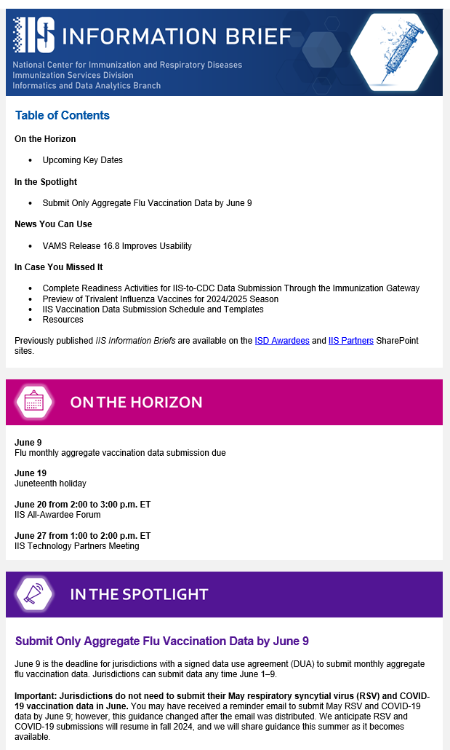
Support: IIS-Specific Communication Channels
Resource | Audiences | Notes
IIS Information Brief weekly email | Jurisdiction, Technology, and National Partners | Provides updates and announcements for the IIS community
IIS All-Awardee Forum monthly call | IIS Managers and Program Managers | Offers opportunity for in-depth look at priority activities and hear from jurisdictional partners
IIS Technology Partners Calls monthly call | Technology Vendors and Partners | Engage IIS technology partners/IIS vendors in discussion about priorities and key technical updates
SharePoint Site document repository | Jurisdiction, Technology, and National Partners | Allows CDC to manage and provide partners access to useful documents
22
Notes:
Resource
Format
Audiences
Notes
IIS Information Brief is Weekly email for Jurisdiction, Technology, and National Partners
That Provides updates and announcements for the IIS community
IIS All-Awardee Forum, Monthly call with IISS Managers, Program Managers, and Awardee IIS team members
Offers opportunity for in-depth look at priority activities and hear from jurisdictional partners
IIS Technology Partners Monthly call to engage IIS technology partners/IIS vendors in discussion about priorities and key technical updates
SharePoint Sites
Document Portal
Jurisdiction, Technology, and National Partners
Various SharePoint spaces allow CDC to manage and provide partners access to useful documents.
REQUEST – We want All Awardee Forums to be useful to you. Help us by suggesting topics for upcoming forums in the comments section.

Slide 21
Support: Informatics and Data Analytics Branch (IDAB)
IDAB works to maximize protection against vaccine-preventable diseases by funding and supporting IISs across the country.
Branch Chief
Lynn Gibbs Scharf
Deputy Branch Chief & Acquisition Project Management Team Lead
Kimberly Clark
Deputy Branch Chief for Program/Senior Scientist
LaTreace Harris
Vickie Garrett
Strategic and Special Projects Team
Lead: Kafayat Adeniyi-Inniss
Outreach and Assistance Team
Lead: Jan Hicks-Thomson
Outreach and Assistance Team
Lead: Beth Cox
Informatics and Standards Team
Lead: Stuart Myerburg
Evaluation and Applied Analytics Team
Lead: Kimberly Nguyen
Application Support Team
Lead: Susan Pierce-Richards
May 31, 2024
24

Slide 22
Support: Outreach and Assistance Team SMEs
IIS subject matter experts (SMEs) provide direct support to awardees. Beth Cox and Jan Hicks-Thomson lead the teams.
Beth Cox nhy7@cdc.gov 404-718-5698 All Interim Assignees | Jan Hicks-Thomson hbv8@cdc.gov 404-718-1555 All Interim Assignees | Michelle Ruslavage qbc5@cdc.gov 470-572-3714 | Natalie Johns nbk4@cdc.gov 210-485-8007 | Chantel Hartman xrv8@cdc.gov 770-488-4974 | Jennifer Ratliff jua7@cdc.gov 678-595-9771 | Marley Vazquez pyo2@cdc.gov 339-223-3287
Arkansas Delaware District of Columbia Houston Indiana Louisiana Michigan New Jersey New York Oklahoma Puerto Rico San Antonio Texas Virgin Islands Virginia West Virginia | Arizona California Iowa Kansas Minnesota Missouri Nebraska New Mexico Nevada Ohio Wisconsin | Connecticut Idaho (interim) Maine Massachusetts New Hampshire Oregon (interim) Pennsylvania Philadelphia Rhode Island Vermont Washington (interim) | American Samoa CNMI Guam Hawaii Marshal Islands Micronesia Palau | Alabama Florida Georgia Kentucky Mississippi North Carolina South Carolina Tennessee | Alaska Colorado Montana North Dakota South Dakota Utah Wyoming | Chicago Illinois Maryland New York City
25

Slide 23

Resources
General Resources
Explore Immunization Information Systems home page
Review the IIS Functional Standards
Review IIS Functional Standards Guidance
Enroll in PHII’s e-mail crash course for all things IIS
Subscribe to IIS Information Brief (e-mail IISInfo@cdc.gov)
IPOM Support Resources
Data Quality Report on the IIS Dashboard
IPOM Chapter D Sample Activities
PHII Staffing Tools and Resources
General Resources
Explore Immunization Information Systems home page
Review the Functional Standards
Enroll in PHII’s e-mail crash course for all things IIS
Subscribe to IIS Information Brief (email IISInfo@cdc.gov)
IPOM Support Resources
Letter to Awardees (February 2, 2022)
Data Quality Report on the IIS Dashboard
IPOM Chapter D Sample Activities for Budget Year 2022
30
Notes:
Highlight:
IIS Functional Standards Guidance
IPOM Chapter D Sample Activities for Budget Year 2022

Slide 24
Thank you! Questions?
31

