Slide 1

Building an Informatics-Savvy Health Department
Defining, assessing and strengthening our information capabilities
<your logo here>
Notes:
Notes to the facilitator:
Feel free to use your agency’s design template for these slides or add images from your agency to make the presentation more visual and engaging.
The speaking notes below and on the following slides are suggestions only, largely based on what seemed to work in health departments conducting similar events.
Depending upon the number of people participating, the size of your agency and how programs are involved, you would likely start with introductions. Be sure to introduce yourself and why you are facilitating.
This slide deck would presumably occur after opening remarks by a senior leader, who would lend legitimacy and support to the meeting.
Suggested speaking notes:
Welcome and thank you to everyone who made the effort to attend today.
It’s a rare opportunity for so many staff from across the health department to convene to discuss what is arguably the most important resources we have other than our staff: information.
Information is the life blood of all of our programs, the basis upon which we make our decisions, and the basis for our relationships with many of our community partners.

Slide 2
Overview of the day
Welcome, introductions and opening remarks
Introduction to building an informatics-savvy health department
<insert rest of the agenda>
Notes:
Suggested speaking notes
Here is a view of our agenda for today.
<Provide a high-level review of the day, not the details of the large and/or small group process or the self-assessment instrument itself.
<Include something about lunch plans>
We plan to end at _________.

Slide 3
What does it mean to be “informatics-savvy?”
And what exactly is informatics?
Notes:
Suggested speaking notes
But first, what does it mean to be “informatics-savvy?” What is informatics and why do we care about it? How is it relevant to us?
<You might ask participants if they have a definition of informatics that works for them.>

Slide 4
An applied science and discipline
Public health informatics is the science that supports effective use of information and information technology to improve population health outcomes.
Notes:
Suggested speaking notes
This definition comes from the Public Health informatics Institute and is meant to convey the applied and practical nature of informatics.
It is applied, it’s about effective use of both information and information technology, especially effective use of information. In fact, PHII says that informatics is most often more about sociology than technology.
And it’s ultimate purpose is improved population health outcomes.
So, like epidemiology, public health informatics supports effective decision making through useful and high quality information.

Slide 5
Defining Informatics-Savvy
Informatics-Savvy Health Department
Informatics vision and strategy
Skilled workforce
Well-design, effectively used systems
Notes:
Suggested speaking notes
If that is informatics, what is an “informatics-savvy health department?” How would we know one if we saw one and, most important, are we one?
PHII defines an informatics-savvy health department as having three core attributes:
A clear vision and strategy for how information and information technology are managed strategically, as critical resources.
A staff skilled in using information and information technology tools.
Information systems are thoughtfully designed to effectively and efficiently support the work of the staff.

Slide 6
Defining Informatics-Savvy
Informatics Vision & Governance
How the agency uses information and IT
Skilled Workforce
Strategies to improve informatics knowledge and skills
Well-designed & effectively used systems
Information systems effectively meet the information needs, workflows and practices of staff and programs
Organizational approach to interoperability
Effective relationship with community partners and IT
Policies to ensure confidentiality, security and data integration
Informatics unit with agency-wide responsibilities
Program managers with knowledge and skills in informatics principles, methods and tools
Interoperable systems
Sound project management principles guide IT projects
Notes:
Suggested speaking notes
The self-assessment questionnaire we are going to work through today is based on those three core attributes, each of which has 10-12 specific and measurable capabilities, which you will become familiar with shortly if you haven’t already reviewed them.

Slide 7
Why be informatics-savvy?
Effective use of information and information technology increasingly seen as critical for health departments
Pressing external drivers
  Meaningful Use, population health initiatives, demand for more current information
Pressing internal factors
  Shrinking budgets and workforces, challenges getting information out of systems for decision making, aging information systems, health department accreditation, central IT absorbing IT staff (and informatics knowledge)
Informatics now seen as a core science within public health to help meet these demands
Notes:
Note: You may want to change this slide to include specific factors and drivers for your health department.
Suggested speaking notes
Why is this important to us today?
HDs struggling to keep up with new information demands, both internal and external.
Informatics now widely seen as a core science within public health. Any staff person working with information or information technology needs at least some basic informatics knowledge and skill.
So how do we assess how informatics-savvy we are currently? And how do we identify what new skills, policies, strategies and technologies will help get us where we want to be?

Slide 8
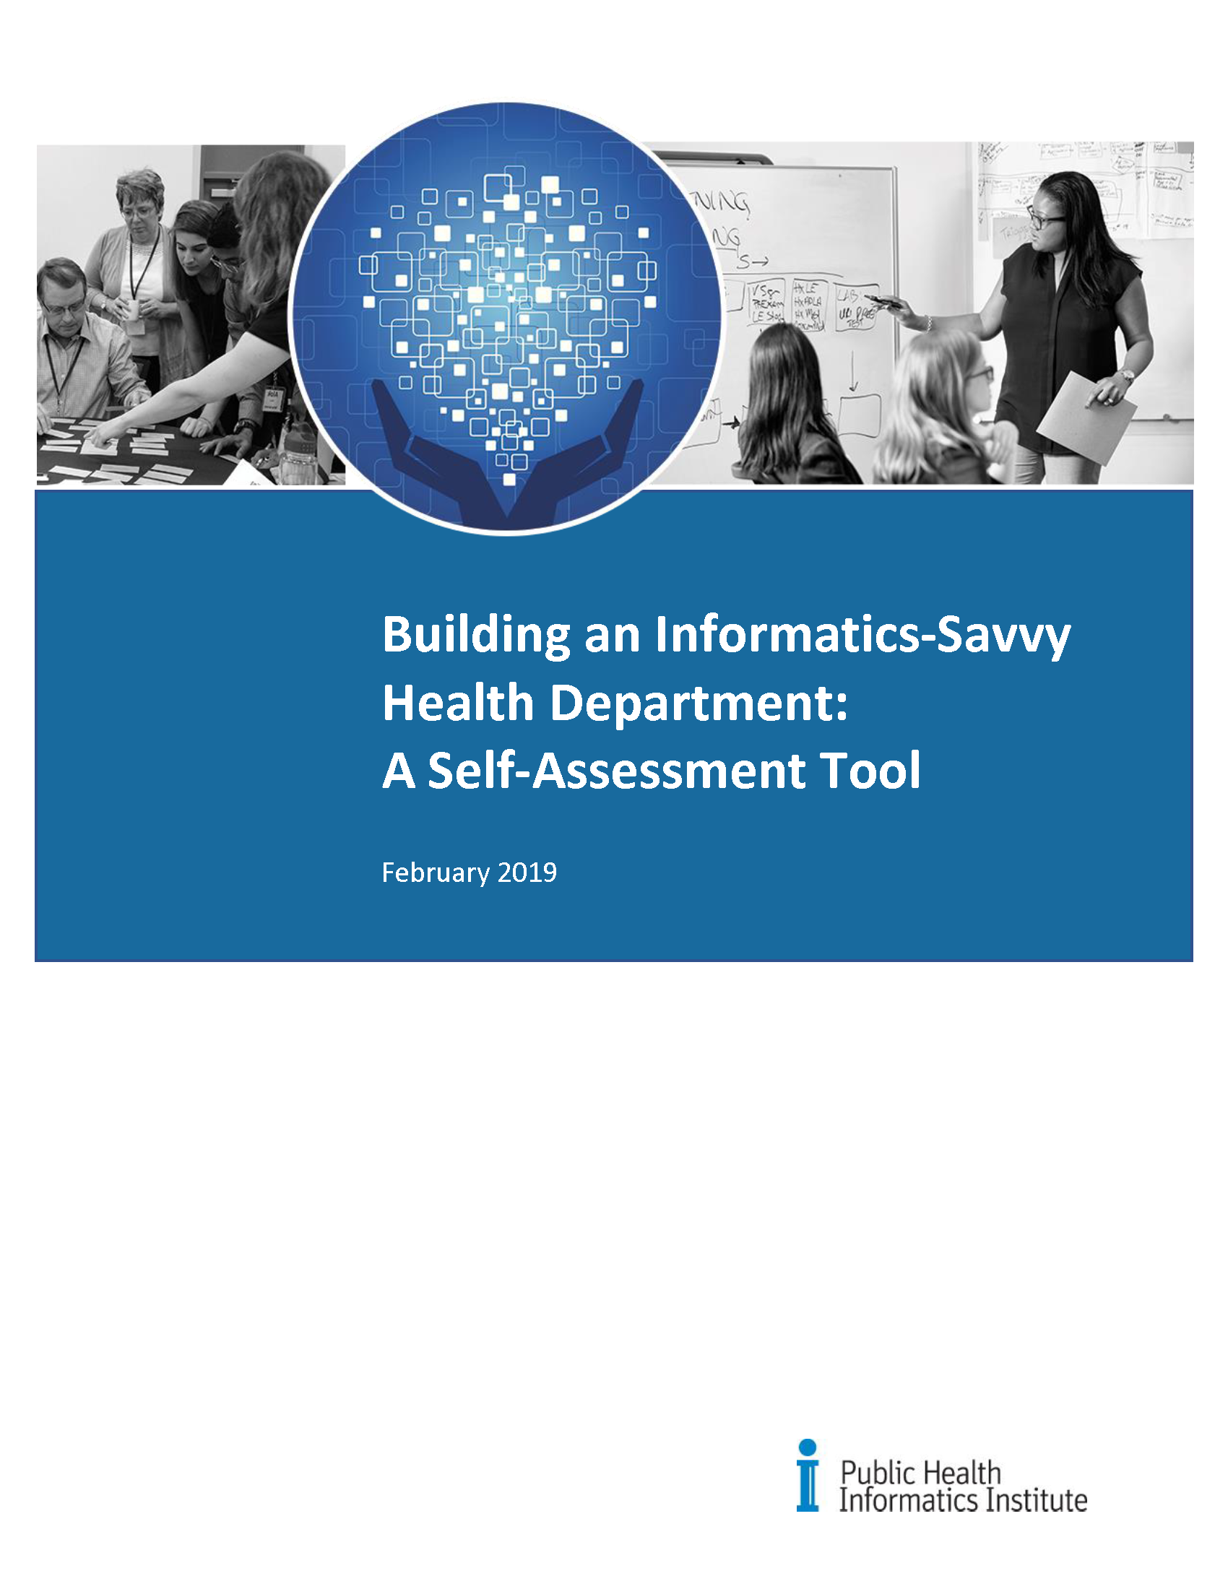
Notes:
We will begin with a self-assessment instrument developed by the Public Health Informatics Institute.
The instrument has been used by local, state and territorial health departments of all sizes since 2014, helping them to see where their strengths were, and where they needed to improve. In all cases, the fact that staff from across the entire health department came together to discuss information – something critical to each of their areas – was a huge step forward in thinking more strategically and in a more coordinated way about information and information technology
The instrument is based on the Capability Maturity Model which describes the progressive stages an organization advances through as it adopts a new process or practice.

Slide 9
CMM Response Categories
^{CMM Level Name} | ^{General Description}
^{0 - Absent} | No capability is evident; “starting from scratch.”
^{1 - Initial} | No organized, systematic efforts to build informatics capacity, only ad hoc efforts and isolated, individual heroics.
^{2 - Managed} | Some organized efforts begun or completed, but not systematically documented or institutionalized.
^{3 - Defined} | Systematic, ongoing efforts underway, but no overall method to measure progress or to ensure coordination.
^{4 - Measured} | Systematic, ongoing efforts underway to measure progress and ensure coordination.
^{5 - Optimized} | Systematic, ongoing efforts underway with quality improvement activities to align results with guiding vision, strategies and performance metrics.
Notes:
As you see when we get into the self-assessment, there are defined response categories for each of the questions. This makes it more objective and repeatable than using a simple Likert scale. It will make it easier for us to actually measure progress over time.
The Capability Maturity Model also works well for both non-technical and technical staff.
By the way, most organizations only score in the 1-3 range; it’s rare for organizations to score 4 or above. Since our information demands and needs are evolving so fast, we should not be worried that we are not as far along as we might like.

Slide 10
Lessons from other health departments
Staff coming together from across the agency to discuss information capabilities and challenges is a rare and valuable undertaking.
Staff/programs realize they have more challenges in common than expected.
Strategies for addressing challenges collaboratively or at the agency level have a more lasting impact.

Slide 11

Questions? Suggestions?

